Slide 1
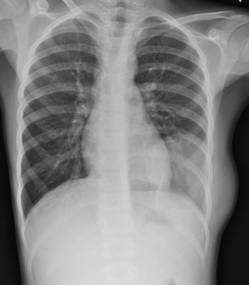
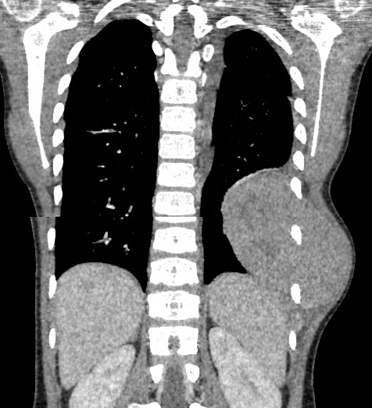
Lymphoma

Slide 2
What is Lymphoma
It is a cancer that affects the body lymphatic system.
It affects lymphocytes which are integral in immune system and help in fighting body diseases.
It starts with the white blood cells and can spread or metastasize with time in the bloodstream.
When infected by Lymphoma, lymphocytes change and grow out of control.

Slide 3
What is lymphoma (continued)
Lymphoma can be categorized into two main types:
1. Non-Hodgkin
2. Hodgkin
Non-Hodgkin Lymphoma (NHL) is divided into Low, Intermediate and high grades.
In children, NHL is considered high grade and the tumors can be histologically subdivided into Lymphoblastic, anaplastic large-cell, small noncleaved and diffuse large B-cell.
Lymphoblastic Lymphoma accounts for about 2% of lymphoma cases in all ages and 30% in children.

Slide 4
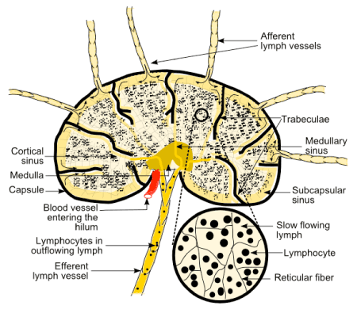
Anatomy & lymphoma
The lymphatic systems which are main targets for lymphoma are; Lymphatic vessels, Lymph nodes, ducts and organs containing hematopoietic elements of the body.
The lymph nodes are spread underneath the skin and mostly along main blood vessels. They are found in large amounts in areas like Underarms, abdomen, groin, pelvis and neck linked to Lymphatic vessels.

Slide 5
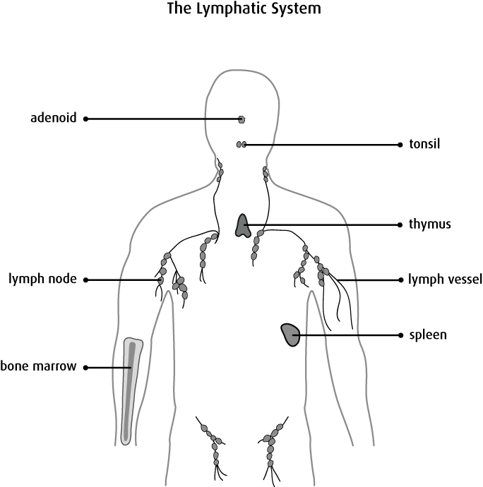
Anatomy and Lymphoma (continued)
Other organs with lymphatic tissue include:
Spleen - located on the left body size under the lower rib. Produces lymphocytes, acts as storage for healthy blood cells.
Bone marrow – bone’s inner region
Thymus gland – found near heart.
Tonsils – they are round shaped lymphatic tissues located at throat
Adenoids – found in post-nasal area.

Slide 6
Pathophysiology of lymphoma
Hodgkin lymphoma comes as a result of cell’s clonal transformation.
Genetic susceptibility issues related to environment, treatment history using radio therapy, chemotherapy and phenytoin play a role in causing lymphoma.
Patients may develop cell-mediated immunity defect in a way that it would contribute to bacterial, fungal, viral, as well as protozoan infections in its advanced stages.

Slide 7
Signs and symptoms
For Non-Hodgkin lymphomas:
Enlarged lymph nodes are rubbery and later coalesce into masses.
The nodes are usually not painful unlike tender nodes that are associated with viral infections.
Some patients enlarged mediastinal and retroperitoneal nodes produce symptoms such as;
Compression of external biliary tree (Jaundice)
Hydronephrosis
Vomiting and obstipation
Interference with lymph drainage

Slide 8
Signs and symptoms (continued)
For Hodgkin lymphoma;
Patients present painless cervical or axillary adenopathy although pain may occur after taking alcohol beverages.
Symptoms may include fever, night sweats and loss of appetite leading to unintentional weight loss.
Tumor compression can cause symptoms such as;
Lymphatic obstruction in pelvis or groin
Infiltration of lung parenchyma
Bile duct obstruction

Slide 9
Lymphoma diagnosis process
Enlarged nodes are biopsied. No imaging is required with palpable nodes.
A blood test to detect presence of lymphoma involves sample of lymph tissue. The surgeon can use needle to take the sample.
The sample should be reviewed by a pathologist with expertise in lymphoma diagnosis.
The histologic criteria involves destroying the lymph node, invading the capsule and nearing fat using neoplastic cells.
Immuno-phenotyping should find out the cells’ origin to help identify the subtype of lymphoma for easy prognosis and management.
A combined FDG/CT scan of chest, pelvis and abdomen is done to provide accurate location of lesions and their size. Bone marrow biopsy may not be needed for staging large cell NHL if a PET scan has been done.

Slide 10
Lymphoma treatment
Lymphoma can be treated through different modes in consideration to the stage of disease.
Men should be advised and offered an opportunity for sperm banking before treatment while ladies given choice to preserve fertility by their oncologists and fertility specialists.
Treatment can be done through;
Immunotherapy with anti-CD20 monoclonal antibody
Surgery
Chemotherapy
Hematopoietic cell transplantation
Radiation therapy

Slide 11
Lymphoma Prognosis
Prognosis varies according to the type and stage of lymphoma as well as patients factors.
The IPI considers 5 factors;
Age
Elevated LDH
Stage III or IV disease
Poor performance
1 extra-nodal site
Outcome may be worse with increase in factors. Patients with highest risk have 50% 5 years chance of survival while those with less risk factors have high cure rate.

Slide 12
References
Cheson, B. D., Pfistner, B., Juweid, M. E., Gascoyne, R. D., Specht, L., Horning, S. J., ... & Rosen, S. T. (2007). Revised response criteria for malignant lymphoma. Journal of clinical oncology, 25(5), 579-586.
Turtle, C. J., Hanafi, L. A., Berger, C., Hudecek, M., Pender, B., Robinson, E., ... & Soma, L. (2016). Immunotherapy of non-Hodgkin’s lymphoma with a defined ratio of CD8+ and CD4+ CD19-specific chimeric antigen receptor–modified T cells. Science translational medicine, 8(355), 355ra116-355ra116.
Papageorgiou, A., Ziogas, D. C., Mavragani, C. P., Zintzaras, E., Tzioufas, A. G., Moutsopoulos, H. M., & Voulgarelis, M. (2015). Predicting the outcome of Sjogren’s syndrome-associated non-Hodgkin’s lymphoma patients. PLoS One, 10(2), e0116189.

