Slide 1
Organizational Environment and Cultures

Slide 2
Learning Outcomes
Discuss how changing environments affect organizations
Describe the four components of the general environment
Explain the five components of the specific environment
Describe the process that companies use to make sense of their changing environments
Explain how organizational cultures are created and how they can help companies be successful

Slide 3
Changing Environments
LO 1
External environment: All events outside a company that can influence or affect it
Environmental change: Rate at which a company’s general and specific environments change
  Stable environment: Rate of change is slow
  Dynamic environment: Rate of change is fast

Slide 4
Punctuated Equilibrium Theory
LO 1
Companies go through long periods of stability during which incremental changes occur
  This is followed by short periods of dynamic, fundamental change, and then a new equilibrium

Slide 5
Environmental Complexity
LO 1
Number and intensity of external factors in the environment that affect organizations
  Simple environment: Includes few factors
    Example - Diary industry
  Complex environment: Includes many factors
    Example - Personal computer (PC) business

Slide 6
Resource Scarcity and Uncertainty
LO 1
Resource scarcity
  Abundance or shortage of critical organizational resources in an external environment
Uncertainty
  Extent to which managers can predict which external changes and trends will affect their businesses

Slide 7
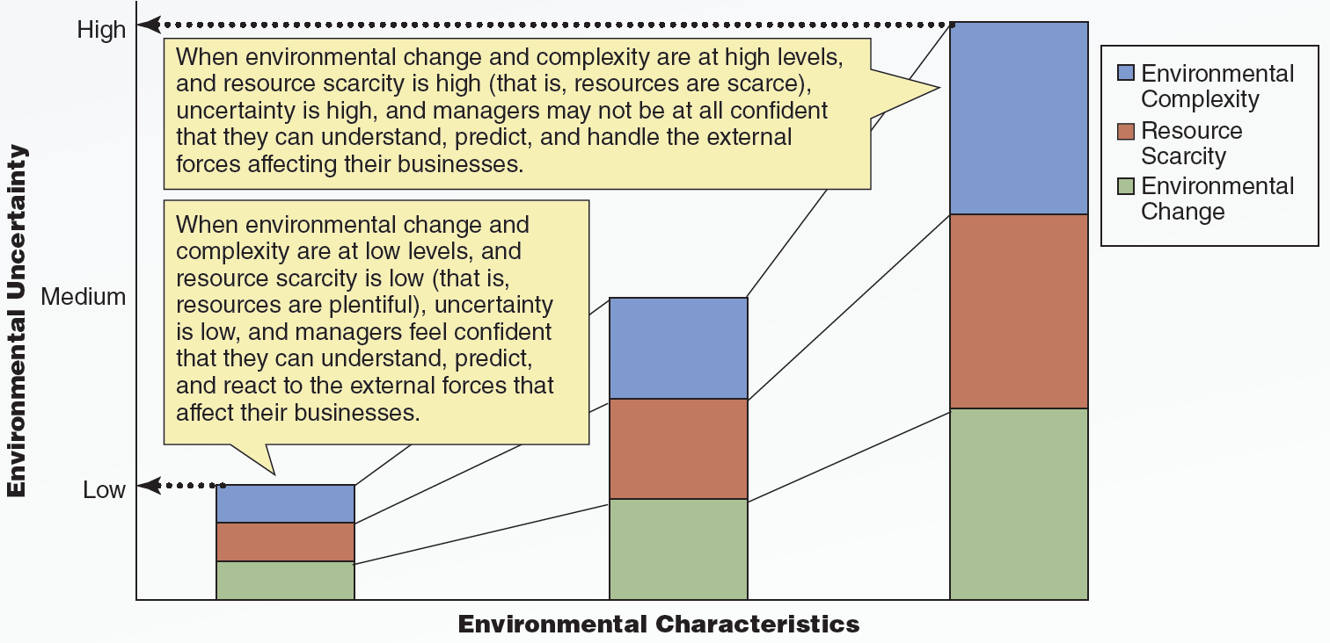
3.1 Environmental Change, Environmental Complexity, and Resource Scarcity
LO 1
Notes:
This illustration represents the relationship between environmental change, environmental complexity, and resource scarcity. It contains an x-axis and a y-axis. The x-axis is labeled environmental characteristics and the y-axis is labeled environmental uncertainty. There are three markings on the y-axis. From the bottom to the top, these read low, medium, and high.
There are three boxes stacked one above the other. The first box represents environmental complexity, the second box represents resource scarcity, and the third box represents environmental change. There are three sets of such boxes, and these sets have been positioned in an increasing order of their size on the x-axis.
A dotted arrow arises from the edge of the first set of boxes and points at the term low on the y-axis. A speech bubble appears above this and contains content that reads when environmental change and complexity are at low levels, and resource scarcity is low, that is resources are plentiful, uncertainty is low, and managers feel confident that they can understand, predict, and react to the external forces that affect their businesses.
A dotted arrow arises from the edge of the third set of boxes and points at the term high on the y-axis. A speech bubble appears beside this set and contains content that reads when environmental change and complexity are at high levels, and resource scarcity is high, that is resources are scarce, uncertainty is high, and managers may not be at all confident that they can understand, predict, and handle the external forces affecting their businesses.

Slide 8
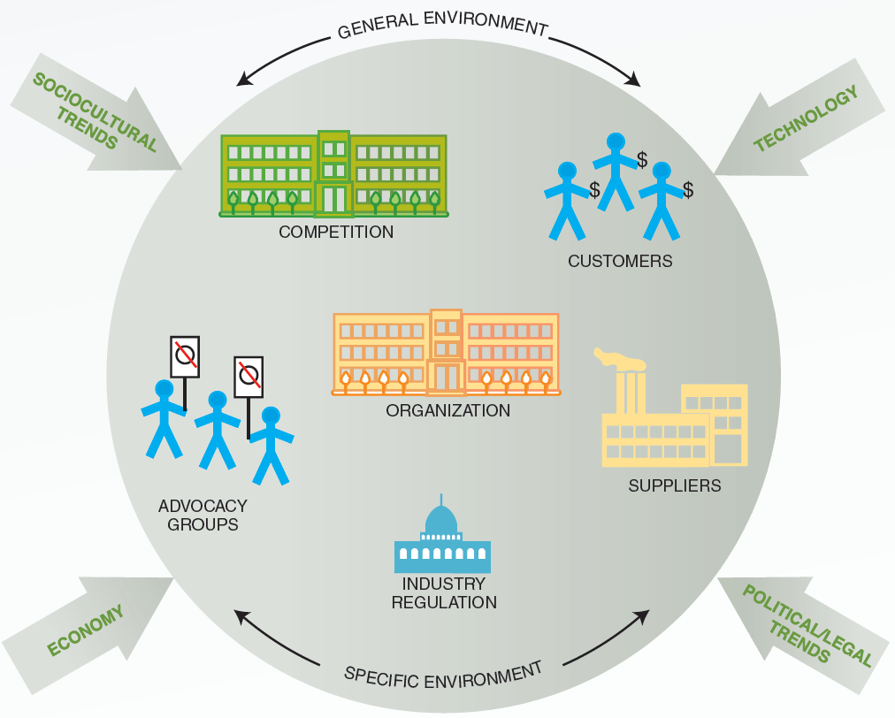
3.2 General and Specific Environments
LO 2

Slide 9
Economy
LO 2
Growing economy provides a favorable environment for business growth
  Consumers have more money to spend
Influences basic business decisions
  Managers scan the economic environment by using economic statistics and business confidence indices
    Show managers’ level of confidence about future business growth

Slide 10
Technology
LO 2
Knowledge, tools, and techniques used to transform inputs into outputs
Technological changes help companies:
  Provide better products
  Produce products more efficiently
Must be used effectively to improve products or decrease costs

Slide 11
Sociocultural Trends
LO 2
Demographic characteristics, general behavior, attitudes, and beliefs of people in a society
  Changes in demographic characteristics affect how companies staff their businesses
  Changes in behavior, attitudes, and beliefs affect the demand for a business’s products and services

Slide 12
Political/Legal Component
LO 2
Business behavior is governed and regulated by:
  Legislation
  Regulations
  Court decisions
Managers must be aware of the laws, regulations, and potential lawsuits that could affect their business

Slide 13
Components of the Specific Environment
LO 3
Customers
  Purchase products and services
Competitors
  Firms in the same industry that sell similar products or services
Suppliers
  Companies that provide material, human, financial, and informational resources to other companies

Slide 14
Components of the Specific Environment (continued)
LO 3
Industry regulation
  Regulations and rules that govern the practices and procedures of specific industries, businesses, and professions
Advocacy groups
  Concerned citizens who band together to try to influence the business practices of specific industries, businesses, and professions

Slide 15
Making Sense of Changing Environments
LO 4
Environmental scanning
  Searching the environment for important events or issues that might affect an organization
Interpreting environmental events
  Viewed as either threats or opportunities
Deciding how to act on threats and opportunities
  Use of cognitive maps to summarize perceived relationships

Slide 16
Internal Environment
LO 5
Events and trends inside an organization that affect management, employees, and organizational culture
  Organizational culture: Values, beliefs, and attitudes shared by organizational members

Slide 17
Creation and Maintenance of Organizational Cultures
LO 5
Company founders create organizations in their images and imprint them with their beliefs, attitudes, and values
Organizational stories: Help make sense of organizational events
  Emphasize culturally consistent assumptions, decisions, and actions
Organizational heroes: People admired for their qualities and achievements within the organization

Slide 18
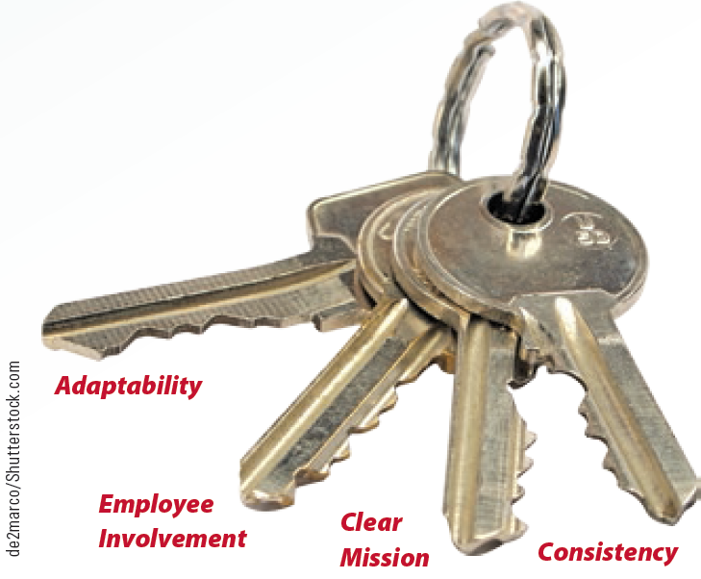
3.4 Keys to an Organizational Culture That Fosters Success
LO 5

Slide 19
Changing Organizational Cultures
LO 5
Behavioral addition
  Having managers and employees perform new behaviors that are central to and symbolic of the desired organizational culture
Behavioral substitution
  Having managers and employees perform new behaviors central to the new organizational culture in place of behaviors that were central to the old culture

Slide 20
Changing Organizational Cultures (continued)
LO 5
Changing visible artifacts
  Visible signs of an organization’s culture
    Include office design and layout, company dress code, and company benefits and perks
Employee selection
  Selecting those who have values and beliefs consistent with the desired culture

Slide 21
Key Terms
External environments
Environmental change
Stable environment
Dynamic environment
Punctuated equilibrium theory
Environmental complexity
Simple environment
Complex environment
Resource scarcity
Uncertainty
General environment
Specific environment
Business confidence indices
Technology
Competitors
Competitive analysis
Suppliers
Supplier dependence

Slide 22
Key Terms (continued)
Buyer dependence
Opportunistic behavior
Relationship behavior
Industry regulation
Advocacy groups
Public communications
Media advocacy
Product boycott
Environmental scanning
Cognitive maps
Internal environment
Organizational culture
Organizational stories
Organizational heroes
Company mission
Consistent organizational culture
Behavioral addition
Behavioral substitution
Visible artifacts

Slide 23
Summary
Changing environments affect a firm’s decisions and performance
  General environment consists of the economy, technological, sociocultural, and political/legal trends
  Specific environment comprises customer, competitor, supplier, industry regulation, and advocacy groups
Adaptability, involvement, clear mission, and consistency influence successful cultures

