Slide 1
Ethics and Social Responsibility

Slide 2
Learning Outcomes
Identify common kinds of workplace deviance
Describe the U.S. Sentencing Commission Guidelines for Organizations, and explain how they both encourage ethical behavior and punish unethical behavior by businesses
Describe what influences ethical decision making
Explain what practical steps managers can take to improve ethical decision making

Slide 3
Learning Outcomes (continued)
Explain to whom organizations are socially responsible
Explain for what organizations are socially responsible
Explain how organizations can respond to societal demands for social responsibility
Explain whether social responsibility hurts or helps an organization’s economic performance

Slide 4
Ethics, Ethical Behavior, and Workplace Deviance
LO 1
Ethics
  Set of moral principles or values that defines right and wrong for a person or group
Ethical behavior
  Behavior that follows accepted principles of right and wrong
Workplace deviance
  Unethical behavior that violates organizational norms about right and wrong

Slide 5
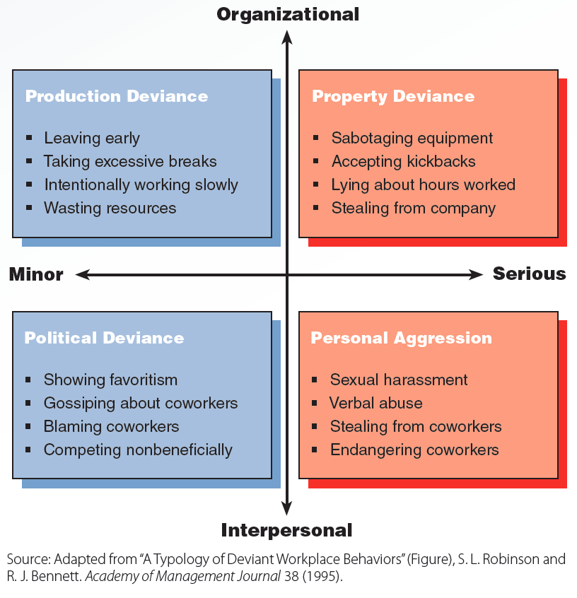
4.1 Types of Workplace Deviance
LO 1

Slide 6
U.S. Sentencing Commission Guidelines for Organizations
LO 2
Prosecute and punish firms even if management is unaware of the unethical behavior
Cover offenses defined by federal laws
Encourage companies to take proactive steps that will discourage white-collar crime
Give companies an incentive to cooperate and disclose illegal activities to federal authorities

Slide 7
Determining the Punishment
LO 2
Step 1 - Computation of base fine by determining the level of offense
  Varies depending on kind of crime, loss incurred, and amount of planning that went into the crime
Step 2 - Judicial determination of a culpability score
Step 3 - Determination of total fine
  Multiplying the base fine by the culpability score

Slide 8
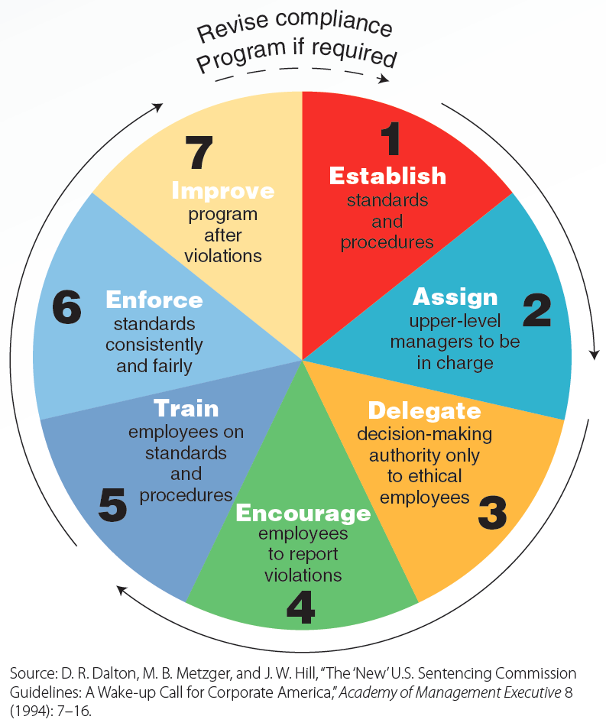
4.3 Compliance Program Steps from the U.S. Sentencing Commission Guidelines for Organizations
LO 2

Slide 9
Influences on Ethical Decision Making
LO 3
Ethical intensity of the decision
Moral development
Principles of ethical decision making

Slide 10
Ethical Intensity
LO 3
Degree of concern people have about an ethical issue
Factors that contribute to ethical intensity:
  Magnitude of consequences
  Social consensus
  Probability of effect
  Temporal immediacy
  Proximity of effect
  Concentration of effect

Slide 11
Factors That Contribute to Ethical Intensity
LO 3
Magnitude of consequences
  Total harm or benefit derived from an ethical decision
Social consensus
  Agreement on whether behavior is bad or good
Probability of effect
  Chance that something will happen that results in harm to others

Slide 12
Factors That Contribute to Ethical Intensity (continued)
LO 3
Temporal immediacy
  Time between an act and the consequences the act produces
Proximity of effect
  Social, psychological, cultural, or physical distance between a decision maker and those affected by his/her decisions
Concentration of effect
  Total harm or benefit that an act produces on the average person

Slide 13
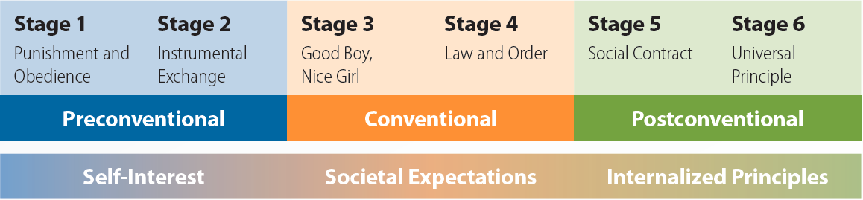
4.5 Kohlberg’s Stages of Moral Development
LO 3

Slide 14
Principles of Ethical Decision Making
LO 3
Long-term self-interest
Religious injunctions
Government requirements
Individual rights
Personal virtue
Distributive justice
Utilitarian benefits

Slide 15
Practical Steps to Ethical Decision Making
LO 4
Selecting and hiring ethical employees
  Use of overt integrity tests or personality-based integrity tests
Establishing a specific code of ethics
Training employees to make ethical decisions
  Developing employee awareness
  Achieving credibility with employees
  Teaching a practical model of ethical decision making

Slide 16
Practical Steps to Ethical Decision Making (continued)
LO 4
Creating an ethical climate by:
  Ensuring managers act ethically
  Ensuring top management is active and committed to the ethics program
  Developing a reporting system that encourages whistle-blowers
  Fairly and consistently punishing those who violate the code of ethics

Slide 17
Social Responsibility of Organizations
LO 5
Shareholder model
  Organization’s overriding goal should be profit maximization for the benefit of shareholders
Stakeholder model
  Management’s most important responsibility, long-term survival, is achieved by satisfying the interests of multiple corporate stakeholders

Slide 18
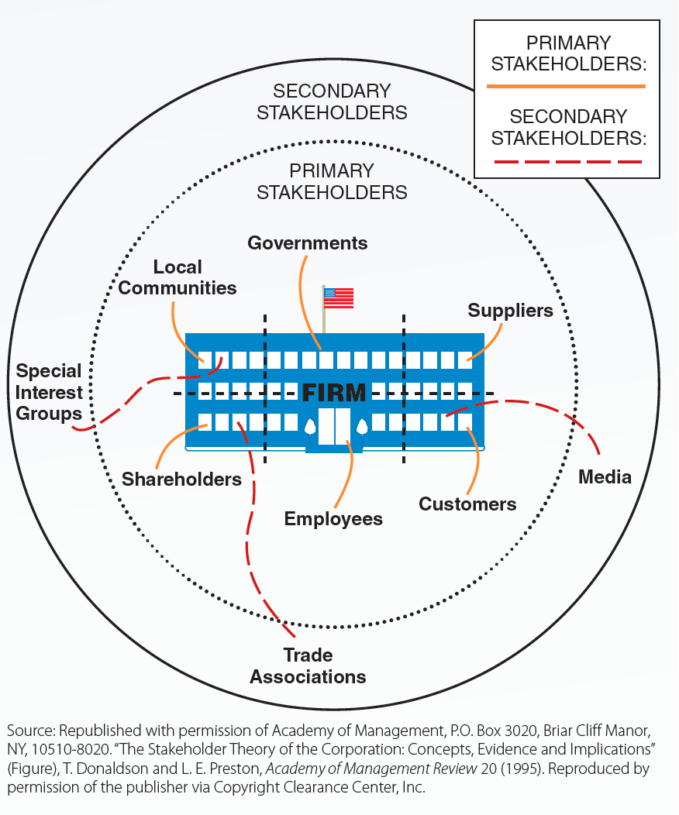
4.7 Stakeholder Model of Corporate Social Responsibility
LO 5

Slide 19
Social Responsibility toward Stakeholders
LO 6
Economic responsibility
  To make a profit by producing a valued product or service
Legal responsibility
  To obey society’s laws and regulations
Ethical responsibility
  To abide by accepted principles of right and wrong when conducting business
Discretionary responsibilities
  Social roles that a company fulfils beyond its economic, legal, and ethical responsibilities

Slide 20
Social Responsiveness Strategies
LO 7
Reactive strategy
  Company does less than society expects
Defensive strategy
  Company admits responsibility for a problem but does the least required to meet societal expectations
Accommodative strategy
  Company accepts responsibility for a problem and does all that society expects to solve that problem
Proactive strategy
  Company anticipates a problem before it occurs and does more than society expects

Slide 21
Social Responsibility and Economic Performance
LO 8
No trade-off between being socially responsible and economic performance
Relationship becomes stronger when a company has a strong reputation for social responsibility
No guarantee that socially responsible companies will be profitable

Slide 22
Key Terms
Ethics
Ethical behavior
Workplace deviance
Production deviance
Property deviance
Employee shrinkage
Political deviance
Personal aggression
Ethical intensity
Magnitude of consequences
Social consensus
Probability of effect
Temporal immediacy
Proximity of effect
Concentration of effect
Preconventional level of moral development
Conventional level of moral development
Postconventional level of moral development
Principle of long-term self-interest
Principle of religious injunctions
Principle of government requirements
Principle of individual rights

Slide 23
Key Terms (continued)
Principle of personal virtue
Principle of distributive justice
Principle of utilitarian benefits
Overt integrity test
Personality-based integrity test
Whistle-blowing
Social responsibility
Shareholder model
Stakeholder model
Stakeholders
Primary stakeholders
Secondary stakeholders
Economic responsibility
Legal responsibility
Ethical responsibility
Discretionary responsibilities
Social responsiveness
Reactive strategy
Defensive strategy
Accommodative strategy
Proactive strategy

Slide 24
Summary
Workplace deviance includes production, property, political, and personal aggression
U.S. Sentencing Commission Guidelines for Organizations
  Provide firms with incentives to cooperate with and disclose illegal activities to federal officials
Social responsibilities of a firm
  Economic, legal, ethical, and discretionary

