Slide 1
Innovation and Change

Slide 2
Learning Outcomes
Explain why innovation matters to companies
Discuss the different methods that managers can use to effectively manage innovation in their organizations
Discuss why not changing can lead to organizational decline
Discuss the different methods that managers can use to better manage change as it occurs

Slide 3
Why Innovation Matters
LO 1
Organizational innovation: Successful implementation of creative ideas in organizations
Technology cycle: Begins with the birth of a new technology
  Ends when the technology reaches its limits and is replaced by a newer and better technology

Slide 4
S-Curve Pattern of Innovation
LO 1
Characterized by slow initial progress, followed by rapid progress, and then slow progress again
  Slow progress results when a technology matures and reaches its limits
Slope of the curve
  Steep slope - Little effort increases performance
  Flat slope - Further developmental efforts lead to small increases in performance

Slide 5
Innovation Streams
LO 1
Patterns of innovation over time that can create sustainable competitive advantage
Phases
  Technological discontinuity: Unique combination of existing technologies creates a significant breakthrough in performance
  Discontinuous change: Characterized by design competition and technological substitution

Slide 6
Innovation Streams (continued)
LO 1
  Dominant design: New technological design/process that becomes the accepted market standard
    Indicates winners and losers
    Signals shift from experimentation and competition to incremental change

Slide 7
Managing Innovation
LO 2
Build a creative work environment
Use experiential approach to manage innovation during discontinuous change
Use compression approach to manage innovation during incremental change

Slide 8
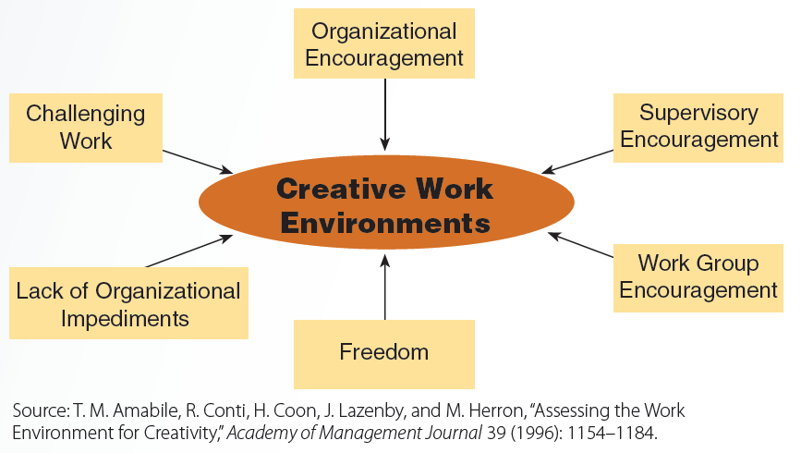
7.3 Components of Creative Work Environments
LO 2

Slide 9
Experiential Approach
LO 2
Assumes innovation occurs within a highly uncertain environment
Uses intuition, flexible options, and hands-on experience
  Help reduce uncertainty and accelerate learning and understanding
Aspects
  Design iterations, testing, milestones, multifunctional teams, and powerful leaders

Slide 10
Methods to Effectively Manage Innovation
LO 2
Design iteration
  Cycle of repetition in which a company tests a prototype of a new product, improves on that design, and then builds and tests the improved prototype
Testing
  Systematic comparison of different product designs or design iterations
Milestones
  Formal project review points used to assess progress and performance

Slide 11
Methods to Effectively Manage Innovation (continued)
LO 2
Multifunctional teams
  Work teams composed of people from different departments
  Accelerate learning by integrating technical, marketing, and manufacturing activities
Powerful leaders
  Provide the vision, discipline, and motivation to keep the innovation process focused, on time, and on target

Slide 12
Compression Approach
LO 2
Assumes that incremental innovation can be planned using a series of steps
  Compressing the steps can speed innovation
Aspects
  Planning
  Supplier involvement
  Shortening the time of individual steps
  Overlapping steps
  Multifunctional teams

Slide 13
Organizational Decline
LO 3
Occurs when companies fail to anticipate, recognize, neutralize, or adapt to internal or external pressures
Stages
  Blinded
  Inaction
  Faulty action
  Crisis
  Dissolution

Slide 14
Types of Forces and Resistance to Change
LO 4
Types of forces
  Change forces: Produce differences in the form, quality, or condition of a firm over time
  Resistance forces: Support the existing conditions in organizations
Resistance to change
  Results from self-interest, misunderstanding and distrust, and a general intolerance for change

Slide 15
Managing Organizational Change
LO 4
Unfreezing
  Getting the people affected by change to believe that change is needed
Change intervention
  Getting workers and managers to change their behaviors and work practices
Refreezing
  Supporting and reinforcing new changes so that they stick

Slide 16
Managing Resistance to Change
LO 4
Education
Communication
Participation
Negotiation
Top-management support
Coercion

Slide 17
Errors in Leading Change
LO 4
Unfreezing phase
Change phase
Refreezing phase
  Not establishing a great sense of urgency
  Not creating a powerful enough coalition
  Lack of a vision
  Undercommunicating the vision by a factor of ten
  Not removing obstacles to the new vision
  Not systematically planning for and creating short-term wins
  Declaring victory too soon
  Not anchoring changes in the corporation’s culture

Slide 18
Change Tools and Techniques
LO 4
Results-driven change
  Created quickly by focusing on the measurement and improvement of results
General Electric workout
  Three-day meeting in which managers and employees generate and act on solutions to specific business problems
Organizational development
  Philosophy and collection of planned change interventions
  Designed to improve an organization’s long-term health and performance

Slide 19
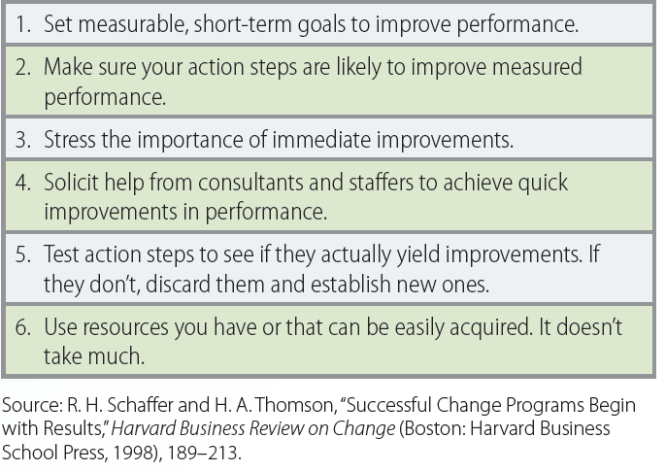
7.4 How to Create a Results-Driven Change Program

Slide 20
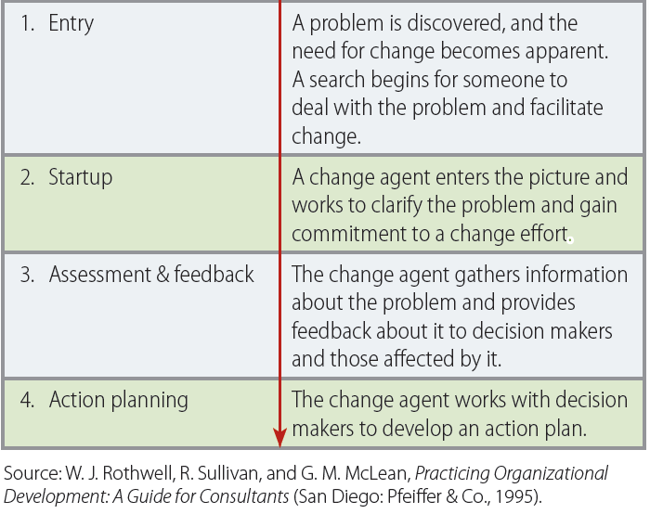
7.5 General Steps for Organizational Development Interventions

Slide 21
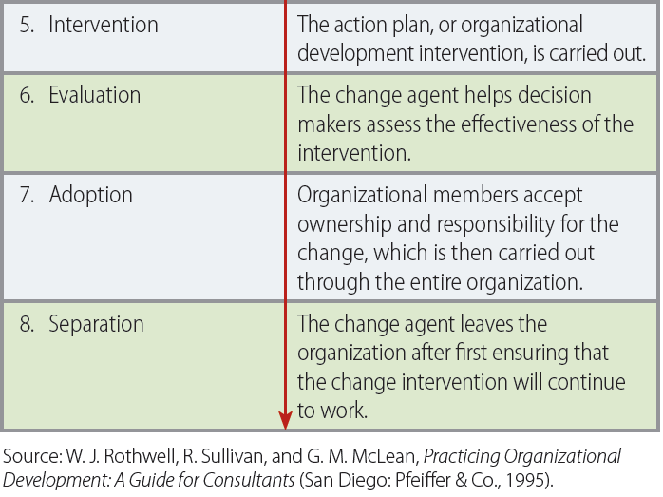
7.5 General Steps for Organizational Development Interventions (continued)

Slide 22
Key Terms
Organizational innovation
Technology cycle
S-curve pattern of innovation
Innovation streams
Technological discontinuity
Discontinuous change
Technological substitution
Design competition
Dominant design
Technological lockout
Incremental change
Creative work environments
Flow
Experiential approach to innovation
Design iteration

Slide 23
Key Terms (continued)
Product prototype
Testing
Milestones
Multifunctional teams
Compression approach to innovation
Generational change
Organizational decline
Change forces
Resistance forces
Resistance to change
Unfreezing
Change intervention
Refreezing
Coercion
Results-driven change
General Electric workout
Organizational development
Change agent

Slide 24
Summary
Organizational innovation refers to the successful implementation of creative ideas
Innovation can be managed by first managing its sources
Organizational decline occurs when firms fail to recognize the need for change
Change is a function of:
  Forces that promote change
  Opposing forces that slow or resist change
Notes:
managing innovation is to manage the sources of innovation,

