Slide 1
Chapter 8
Copyright ©2017 Cengage Learning. All Rights Reserved. May not be scanned, copied or duplicated, or posted to a publicly accessible website, in whole or in part.

Slide 2
Learning Outcomes
Discuss the impact of global business and the trade rules and agreements that govern it
Explain why companies choose to standardize or adapt their business procedures
Explain the different ways that companies can organize to do business globally

Slide 3
Learning Outcomes (continued)
Explain how to find a favorable business climate
Discuss the importance of identifying and adapting to cultural differences
Explain how to successfully prepare workers for international assignments

Slide 4
Global Business
LO 1
Buying and selling of goods and services by people from different countries
Impacts
  Multinational corporation: Owns businesses in two or more countries
  Direct foreign investment: Company builds a new business or buys an existing business in a foreign country

Slide 5
Trade Barriers
LO 1
Government-imposed regulations that increase the cost and restrict the number of imported goods
Types
  Tariff: Direct tax on imported goods
  Nontariff barriers: Nontax methods of increasing the cost or reducing the volume of imported goods

Slide 6
Types of Nontariff Barriers
LO 1
Quota
  Limit on the number or volume of imported products
Voluntary export restraints
  Voluntarily imposed limits on the number or volume of products exported to a particular country
Government import standard
  Established to protect the health and safety of citizens but is used to restrict import

Slide 7
Types of Nontariff Barriers (continued)
LO 1
Subsidies
  Government loans, grants, and tax deferments given to domestic companies to protect them from foreign competition
Customs classification
  Assigned to imported products by government officials that affects the size of the tariff and the imposition of import quotas

Slide 8
Trade Agreements
LO1
General Agreement on Tariffs and Trade (GATT)
  Worldwide trade agreement that:
    Reduced and eliminated tariffs
    Limited government subsidies
    Established protections for intellectual property

Slide 9
Trade Agreements (continued)
LO 1
World Trade Organization (WTO)
  Deals with global rules of trade between nations
  Ensures that trade flows as smoothly, predictably, and freely as possible
Regional trading zones
  Areas in which tariff and nontariff barriers on trade between countries are reduced or eliminated

Slide 10
Regional Trading Zones
LO 1
Trading zones | Agreements
Africa | African Free Trade Zone Agreement (AFTZ) Tripartite Free Trade Area (TFTA)
Asia | Association of Southeast Asian Nations (ASEAN) Asia-Pacific Economic Cooperation (APEC) Trans-Pacific Partnership (TPP)
Central America | Dominican Republic-Central America Free Trade Agreement (CAFTA-DR)
Europe | The Maastricht Treaty
North America | North American Free Trade Agreement (NAFTA)
South America | Union of South American Nations (USAN)

Slide 11
Global Consistency
LO 2
Multinational company conducts business in different countries using the same rules, guidelines, policies, and procedures
Valued because it simplifies decisions
Involves risk of using management procedures poorly suited to particular countries

Slide 12
Local Adaptation
LO 2
Modifying rules, guidelines, policies, and procedures
  To adapt to differences in foreign customers, governments, and regulatory agencies
Involves the risk of losing the cost effectiveness and productivity

Slide 13
Forms of Global Business
LO 3
Exporting: Selling domestically produced products to customers in foreign countries
Cooperative contract: Foreign business owner pays a company a fee for the right to conduct that business in his or her country
  Licensing: Domestic company receives royalty payments
    For allowing another company to produce the licensor’s product, sell its service, or use its brand name in a specified foreign market

Slide 14
Forms of Global Business (continued 1)
LO 3
  Franchise: Collection of networked firms in which the manufacturer licenses the entire business to another person or organization
Strategic alliances: Companies combine key resources, costs, risks, technology, and people
  Joint venture: Two existing companies collaborate to form a third, independent company

Slide 15
Forms of Global Business (continued 2)
LO 3
Wholly owned affiliates
  Foreign offices, facilities, and manufacturing plants that are 100 percent owned by the parent company
Global new ventures
  New companies that are founded with an active global strategy and have sales, employees, and financing in different countries

Slide 16
Finding the Best Business Climate
LO 4
Having access to a growing market
Choosing an office/manufacturing location
Identifying and minimizing the political risk to the company

Slide 17
Factors That Determine the Growth Potential of Global Markets
LO 4
Purchasing power: Relative cost of a standard set of goods and services in different countries
Degree of global competition - Determined by the number and quality of companies that already compete in a foreign market

Slide 18
Criteria for Choosing an Office Location
LO 4
Qualitative factors
Quantitative factors
  Work force quality
  Company strategy
  Kind of facility being built
  Tariff and nontariff barriers
  Exchange rates
  Transportation and labor costs

Slide 19
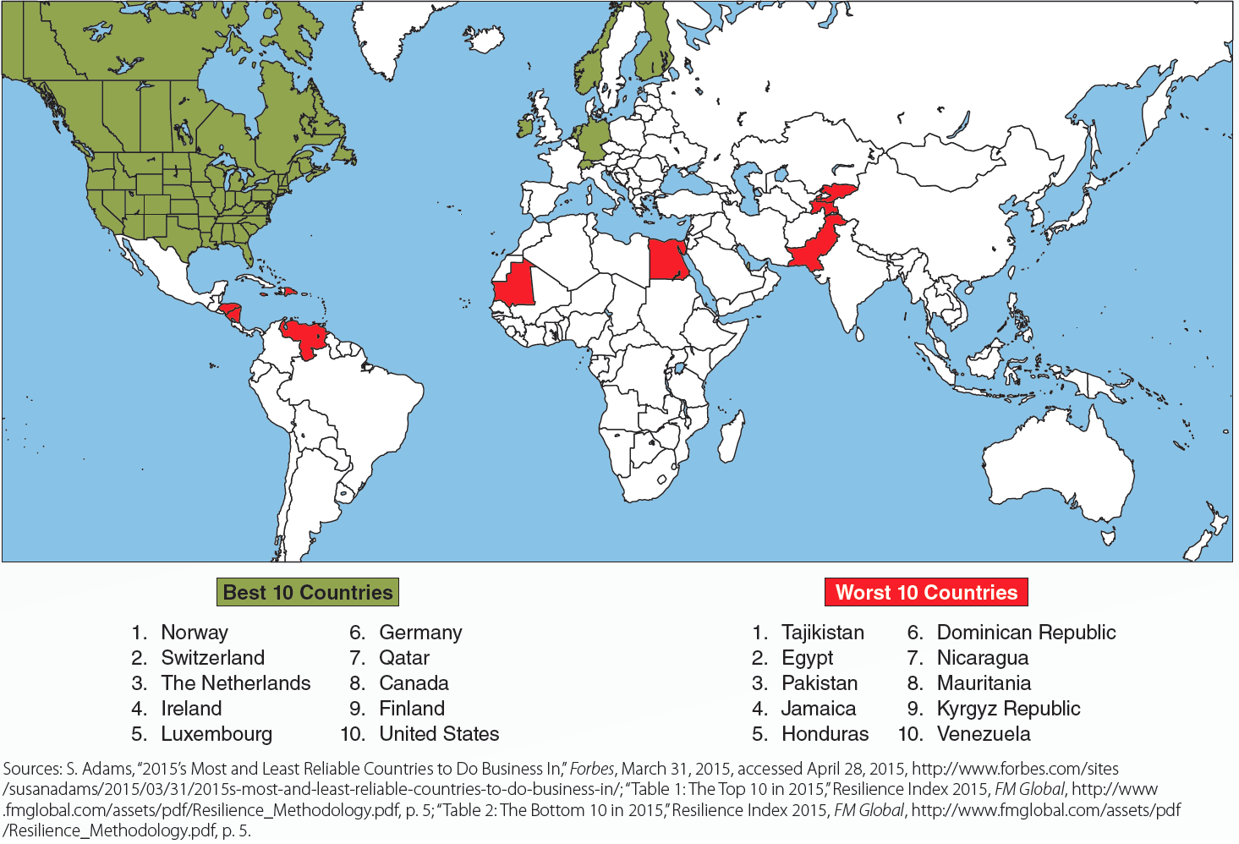
8.6 World’s Best Countries for Business
LO 4

Slide 20
Types of Political Risk
LO 4
Political uncertainty
  Risk of major changes in political regimes that can result from war, revolution, death of political leaders, social unrest, or other influential events
Policy uncertainty
  Risk associated with changes in laws and government policies that directly affect the way foreign companies conduct business

Slide 21
Strategies to Minimize Political Risk
LO 4
Avoidance strategy
  Divesting or selling the business
  Postponing investment until the risk shrinks
Control strategy
  Lobbying foreign governments or international trade agencies to change laws, regulations, or trade barriers
Cooperation
  Using joint ventures and collaborative contracts

Slide 22
Becoming Aware of Cultural Differences
LO 5
National culture
  Set of shared values and beliefs that affects the perceptions, decisions, and behavior of the people from a particular country
Consistent cultural dimensions across countries
  Power distance, individualism, masculinity, uncertainty avoidance, short-term/long-term orientation, and indulgence versus restraint

Slide 23
Factors That Increase the Chances for a Successful International Assignment
LO 6
Language and cross-cultural training
  Help expatriates make faster adjustments to foreign cultures and perform better on their international assignments
    Documentary training - Focuses on identifying specific critical differences between cultures
    Cultural simulations - Trainees practice adapting to cultural differences
    Field simulation - Trainees are placed in an ethnic neighborhood for three to four hours to talk to residents about cultural differences

Slide 24
Factors That Increase the Chances for a Successful International Assignment (continued)
LO 6
Consideration of spouse, family, and dual-career issues
  Adaptability screening - Used to assess how well managers and their families are likely to adjust to foreign cultures
  Intercultural training - Helping families prepare for the cultural differences they will encounter

Slide 25
Key Terms
Global business
Multinational corporation
Direct foreign investment
Trade barriers
Protectionism
Tariff
Nontariff barriers
Quota
Voluntary export restraints
Government import standard
Subsidies
Customs classification
General Agreement on Tariffs and Trade (GATT)
World Trade Organization (WTO)

Slide 26
Key Terms (continued 1)
Regional trading zones
Maastricht Treaty of Europe
North American Free Trade Agreement (NAFTA)
Dominican Republic- Central America Free Trade Agreement (CAFTA-DR)
Union of South American Nations (UNASUR)
Association of Southeast Asian Nations (ASEAN)
Asia-Pacific Economic Cooperation (APEC)
Trans-Pacific Partnership (TPP)

Slide 27
Key Terms (continued 2)
Tripartite Free Trade Agreement (TFTA)
Global consistency
Local adaptation
Exporting
Cooperative contract
Licensing
Franchise
Strategic alliance
Joint venture
Wholly owned affiliates
Global new ventures
Purchasing power
Political uncertainty
Policy uncertainty
National culture
Expatriate

Slide 28
Summary
Global business presents its own set of challenges for managers
Business has to strike a balance between global consistency and local adaptation
Firm must determine how to organize itself for successful entry into foreign markets
Firms try to find regions with promising business climates while going global
Meaningful differences must be recognized when dealing with culture

