Slide 1
Managing Teams

Slide 2
Learning Outcomes
Explain the good and bad of using teams
Recognize and understand the different kinds of teams
Understand the general characteristics of work teams
Explain how to enhance work team effectiveness

Slide 3
Work Teams
LO 1
Small number of people with complementary skills who are mutually accountable for:
  Pursuing a common purpose
  Achieving performance goals
  Improving interdependent work processes
Help firms respond to specific problems and challenges

Slide 4
Advantages of Teams
LO 1
Increase customer satisfaction
Improve product and service quality
Increase speed and efficiency in product development
Increase job satisfaction
  Cross-training: Members are trained to do all or most of the jobs done by other team members
Share the benefits of group decision making

Slide 5
Disadvantages of Teams
LO 1
Initial high turnover
Social loafing
  Team members withhold their efforts and fail to perform their share of the work
Disadvantages of group decision making
  Groupthink - Members feel the pressure not to disagree with each other
  Minority domination - One or two people dominate team discussions

Slide 6
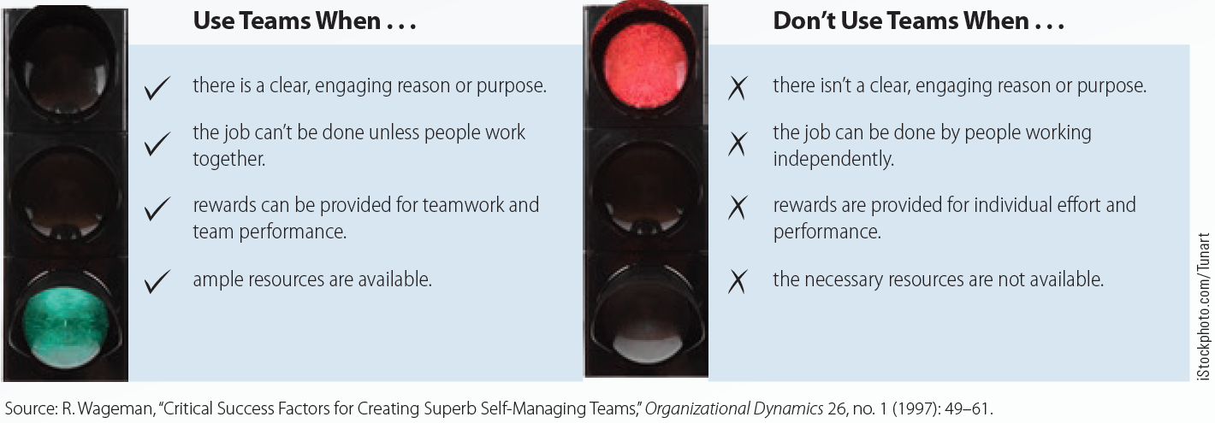
10.1 When to Use and When Not to Use Teams
LO 1

Slide 7
Classification of Teams According to Autonomy
LO 2
Traditional work groups
  Composed of two or more people who work together to achieve a shared goal
Employee involvement teams
  Provide advice to management about specific issues
Semi-autonomous work groups
  Have the authority to make decisions and solve problems related to major tasks of producing a product

Slide 8
Classification of Teams According to Autonomy (continued)
LO 2
Self-managing teams
  Manage and control crucial tasks of producing a product or service
Self-designing teams
  Control team design, work tasks, and team membership

Slide 9
Special Kinds of Teams
LO 2
Cross-functional teams
  Composed of employees from different functional areas of the organization
Virtual teams
  Composed of geographically and/or organizationally dispersed coworkers who use telecommunication and information technology to accomplish an organizational task
Project teams
  Created to complete one-time projects within a limited time

Slide 10
Work Team Characteristics
LO 3
Norms
Cohesiveness
Size
Conflict

Slide 11
Team Norms
LO 3
Informally agreed-on standards that regulate team behavior to enable effective functioning
Associated with positive and negative outcomes
Developed around quality and timeliness of job performance, absenteeism, safety, and honest expression of ideas and opinions

Slide 12
Team Cohesiveness
LO 3
Extent to which members are attracted to a team and motivated to remain in it
Promoted by:
  Ensuring that all team members are present at team activities and meetings
  Providing opportunities for task interdependence
  Engaging in nonwork activities

Slide 13
Team Size
LO 3
Should be small enough for members to get to know each other
  Provide each member with the opportunity to contribute
Significantly impacts the value of a company
Greater team size:
  Poses the risk of minority domination
  Increases incidences of social loafing

Slide 14
Team Conflict
LO 3
Arises from disagreement over team goals
Types of conflict
  Cognitive (c-type) - Focuses on problem-related differences of opinion
  Affective (a-type) - Emotional reactions that occur due to personal disagreements
Reduced by using cognitive conflict to address work problems in a manner that minimizes occurrences of affective conflict

Slide 15
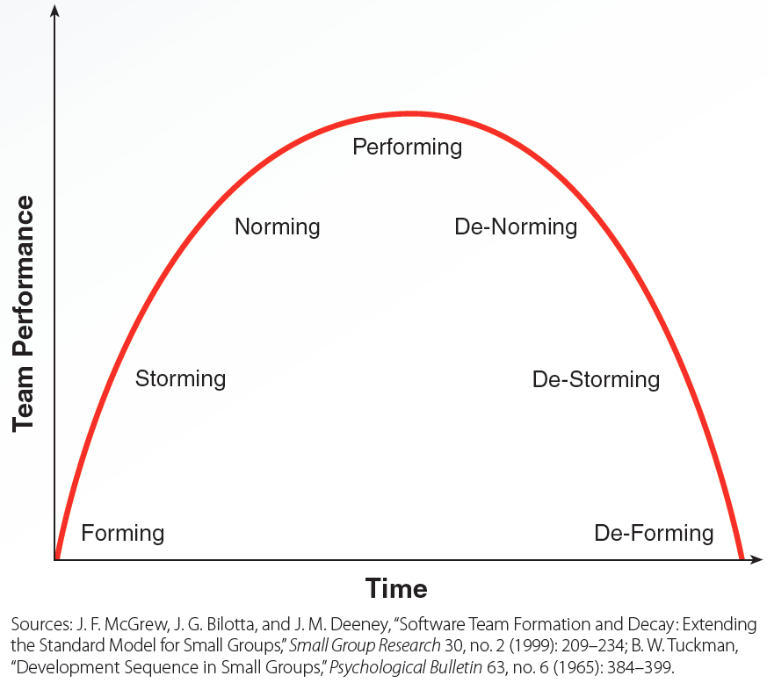
10.4 Stages of Team Development
LO 3

Slide 16
Enhancing Work Team Effectiveness
LO 4
Setting team goals and priorities
Selecting people for teamwork
Team training
Recognition and compensation

Slide 17
Setting Team Goals and Priorities
LO 4
Setting stretch goals
  Extremely ambitious goals that employees don’t know how to reach
  Can be effective if teams:
    Have high degree of autonomy
    Are empowered with control of resources
    Have structural accommodation and bureaucratic immunity

Slide 18
Factors to Consider during Selection
LO 4
Individualism-collectivism
  Degree to which a person believes that people need to be self-sufficient and loyalty to one’s self is important than loyalty to team or company
Team level
  Average level of ability, experience, personality, or other factors on a team
Team diversity
  Variances in ability, experience, personality, or other factors on a team

Slide 19
Areas of Team Training
LO 4
Interpersonal skills
  Enable people to have effective working relationships with others
Decision-making and problem-solving skills
Conflict resolution skills
Technical training

Slide 20
Types of Employee Compensation
LO 4
Skill-based pay: Employees are paid for learning additional skills or knowledge
Gainsharing: Companies share the financial value of performance gains with their workers
Nonfinancial rewards
  Most effective when teams or team-based interventions are first introduced

Slide 21
Key Terms
Work team
Cross-training
Social loafing
Traditional work group
Employee involvement team
Semi-autonomous group
Self-managing teams
Self-designing teams
Cross-functional team
Virtual team
Project team
Norms
Cohesiveness
Forming
Storming
Norming
Performing
De-norming
De-storming

Slide 22
Key Terms (continued)
De-forming
Structural accommodation
Bureaucratic immunity
Individualism-collectivism
Team level
Team diversity
Interpersonal skills
Skill-based pay
Gainsharing

Slide 23
Summary
Work teams consist of a small number of people with complementary skills
  Characteristics include team norms, cohesiveness, size, and conflict
  Differ primarily based on autonomy
  Effectiveness can be enhanced by setting priorities/goals and appropriate team selection, training, and compensation

