Slide 1
Chapter 11
Copyright ©2017 Cengage Learning. All Rights Reserved. May not be scanned, copied or duplicated, or posted to a publicly accessible website, in whole or in part.

Slide 2
Learning Outcomes
Explain how different employment laws affect human resource practice
Explain how companies use recruiting to find qualified job applicants
Describe the selection techniques and procedures that companies use when deciding which applicants should receive job offers

Slide 3
Learning Outcomes (continued)
Describe how to determine training needs, and select the appropriate training methods
Discuss how to use performance appraisal to give meaningful performance feedback
Describe basic compensation strategies, and discuss the four kinds of employee separations

Slide 4
Human Resource Management (HRM)
LO 1
Process of finding, developing, and keeping the right people to form a qualified workforce

Slide 5
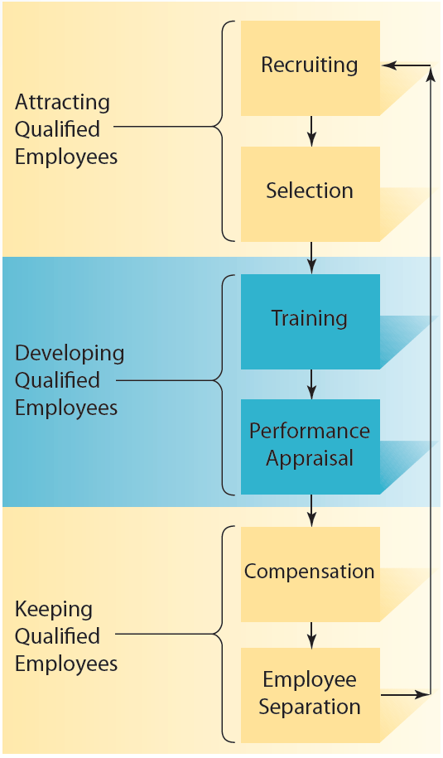
11.1 The Human Resource Management Process

Slide 6
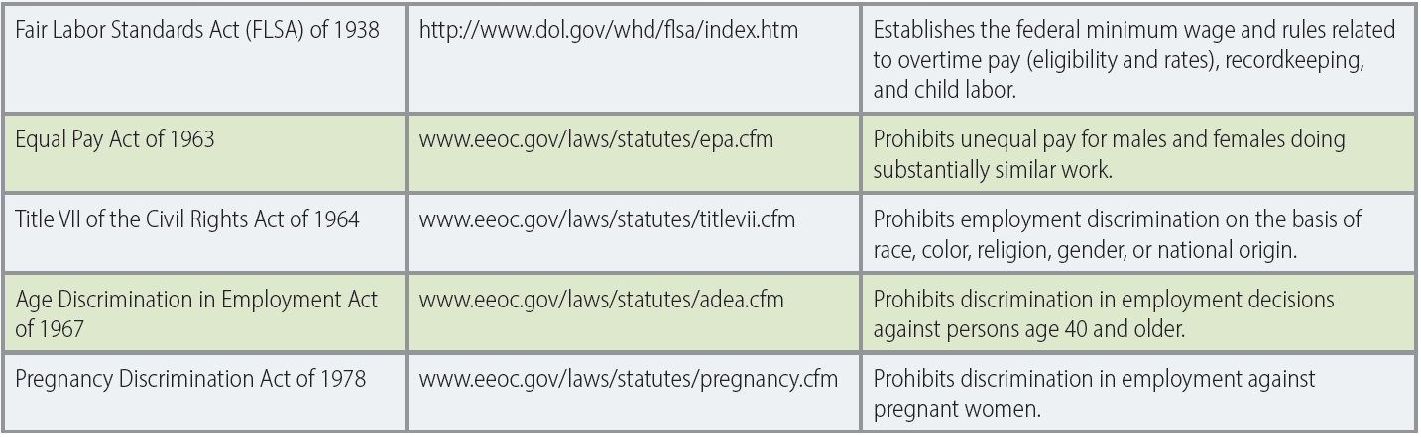
11.2 Summary of Major Federal Employment Laws
LO 1

Slide 7
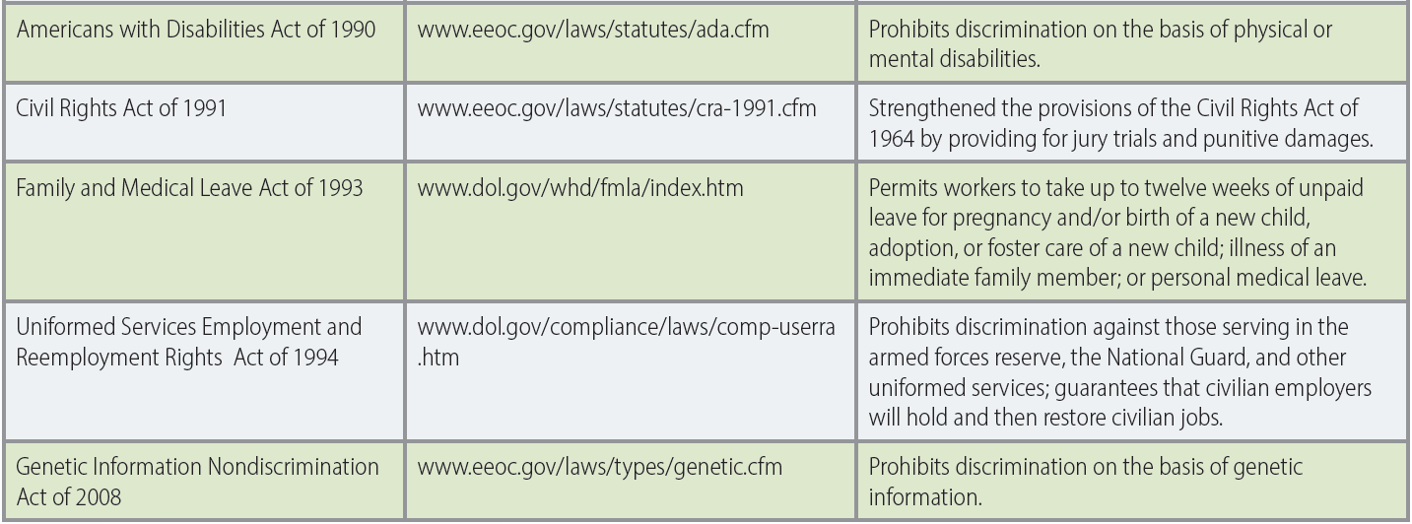
11.2 Summary of Major Federal Employment Laws (continued)
LO 1

Slide 8
Other Federal Employment Laws
LO 1
Labor laws
  Regulate the interaction between management and labor unions that represent groups of employees
Occupational Safety and Health Administration (OSHA)
  Sets safety and health standards for employers and conducts inspections to determine whether those standards are being met

Slide 9
Disparate Treatment
LO 1
Occurs when people are purposely not given the same hiring, promotion, or membership opportunities
  Because of their race, color, sex, age, ethnic group, national origin, or religious beliefs

Slide 10
Adverse Impact
LO 1
Occurs when members of a particular race, sex, or ethnic group are unintentionally harmed or disadvantaged
  Because they are hired, promoted, or trained at substantially lower rates than others
Four-fifths (80 percent) rule: Used to determine if there has been a case of adverse impact
  Violation of this rule occurs when the impact ratio is less than 80%, or four-fifths

Slide 11
Sexual Harassment
LO 1
Form of discrimination in which a conduct of sexual nature occurs while performing one’s job
Types
  Quid pro quo: Employment outcomes or keeping one’s job depends on whether an individual submits to sexual harassment
  Hostile work environment: Unwelcome and demeaning sexually related behavior creates an intimidating and offensive work environment

Slide 12
Recruiting
LO 2
Process of developing a pool of qualified job applicants
Job analysis: Purposeful, systematic process for collecting information on the important work-related aspects of a job
  Job description: Written description of the basic tasks, duties, and responsibilities required of an employee holding a particular job
  Job specification: Written summary of the qualifications needed to successfully perform a particular job

Slide 13
Internal and External Recruiting
LO 2
Internal recruiting
  Process of developing a pool of qualified job applicants from people who work in the company
  Job posting - Advertising job openings within the company to existing employees
External recruiting
  Process of developing a pool of qualified job applicants from outside the company
  Advertising, employee referrals, walk-ins, outside organizations, employment services, special events, Internet job sites, and social media

Slide 14
Selection and Validation
LO 3
Selection: Process of gathering information about job applicants to decide who should be offered a job
Validation: Process of determining how well a selection test or procedure predicts future job performance
  Test is said to be more valid when the prediction of future job performance is better or more accurate

Slide 15
Selection Procedures
LO 3
Procedures | Description
Application forms and résumés | Organizations collect applicant's information in their own format for entry into a human resource information system (HRIS)
Employment references | Sources such as previous employers or co-workers who can provide job-related information about job candidates
Background checks | Procedures used to verify the truthfulness and accuracy of information that applicants provide about themselves and to uncover negative, job-related background information not provided by applicants
Interviews | Unstructured: Interviewers are free to ask the applicants anything they want Structured: All applicants are asked the same set of standardized questions

Slide 16
Selection Procedures (continued)
LO 3
Selection tests | Description
Specific ability or aptitude tests | Measure the extent to which applicants possess the particular kind of ability needed to do a job well
Cognitive ability tests | Measure the extent to which applicants have abilities in perceptual speed, verbal comprehension, numerical aptitude, general reasoning, and spatial aptitude
Biographical data (biodata) | Extensive surveys that ask applicants questions about their personal backgrounds and life experiences
Personality tests | Measure the extent to which applicants possess different kinds of job-related personality dimensions
Work sample tests | Require applicants to perform tasks that are actually done on the job
Assessment centers | Series of managerial simulations used to determine applicants’ capability for managerial work

Slide 17
Training
LO 4
Needs assessment: Process of identifying and prioritizing the learning needs of employees
Criteria to select appropriate training methods
  Number of people to be trained
  Cost and objectives of the training
Ways to evaluate training
  Reactions, learning, behavior, and results

Slide 18
Training Methods
LO 4
Films and videos
Lectures
Planned readings
Case studies
Coaching and mentoring
Group discussions
On-the-job training
Role-playing
Simulations and games
Vestibule training
Computer-based learning

Slide 19
Performance Appraisal
LO 5
Process of assessing how well employees are doing their jobs
Purposes
  Making administrative decisions
  Providing feedback for employee development
  Evaluating human resource programs
  Documenting performance ratings and decisions

Slide 20
Ways to Improve Performance Appraisal Measures
LO 5
Objective performance measures
  Involve easily and directly counted or quantified measures
Subjective performance measures
  Require someone to judge or assess a worker’s performance
Behavior observation scales (BOSs)
  Indicate the frequency with which workers perform specific behaviors that are representative of the job dimensions
Rater training
  Provides training on how to avoid rating errors and increase rating accuracy

Slide 21
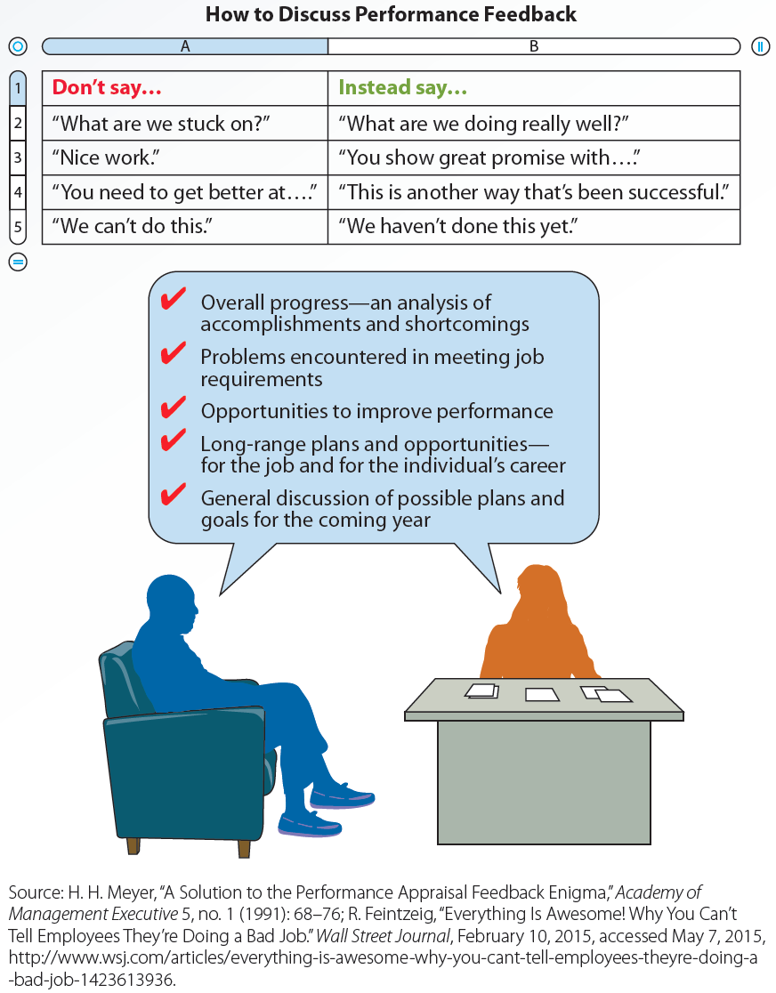
11.10 How and What to Discuss in a Performance Appraisal Feedback Session

Slide 22
Compensation
LO 6
Financial and nonfinancial rewards that organizations give employees in exchange for their work
Job evaluation: Process that determines the worth of each job in a company
  Evaluates the market value of the knowledge, skills, and requirements needed to perform the job

Slide 23
Compensation Decisions
LO 6
Pay-level
  Decisions about whether to pay workers at a level that is below, above, or at current market wages
Pay-variability
  Decisions concerning the extent to which employees’ pay varies with individual and organizational performance
Pay-structure
  Decisions concerning the extent to which people in the company receive very different levels of pay

Slide 24
Employee Separation
LO 6
Voluntary or involuntary loss of an employee
Termination should be for a good reason
  Wrongful discharge: Legal doctrine that requires employers to have a job-related reason to terminate employees
Downsizing: Planned elimination of jobs in a company

Slide 25
Employee Separation (continued 1)
LO 6
Retirement
  Early retirement incentive programs (ERIPs)
    Programs that offer financial benefits to employees to encourage them to retire early
  Phased retirement
    Employees transition to retirement by working reduced hours over a period of time before completely retiring

Slide 26
Employee Separation (continued 2)
LO 6
Employee turnover: Loss of employees who voluntarily choose to leave the company
  Functional turnover: Loss of poor-performing employees
  Dysfunctional turnover: Loss of high-performing employees

Slide 27
Key Terms
Human resource management (HRM)
Bona fide occupational qualification (BFOQ)
Disparate treatment
Adverse impact
Four-fifths (or 80%) rule
Sexual harassment
Quid pro quo sexual harassment
Hostile work environment
Recruiting
Job analysis
Job description
Job specifications
Internal recruiting
External recruiting
Selection
Validation

Slide 28
Key Terms (continued 1)
Human resource information system (HRIS)
Employment references
Background checks
Specific ability tests (aptitude tests)
Cognitive ability tests
Biographical data (biodata)
Personality test
Work sample tests
Assessment centers
Interview
Unstructured interviews
Structured interviews
Training
Needs assessment
Performance appraisal
Objective performance measures
Subjective performance measures

Slide 29
Key Terms (continued 2)
Behavior observation scales (BOSs)
Rater training
360-degree feedback
Compensation
Employee separation
Job evaluation
Piecework
Commission
Profit sharing
Employee stock ownership plan (ESOP)
Stock options
Wrongful discharge
Downsizing
Outplacement services
Early retirement incentive programs (ERIPs)
Phased retirement
Employee turnover
Functional turnover
Dysfunctional turnover

Slide 30
Summary
Several federal laws govern human resource management decisions
Recruiting is the process of developing a pool of qualified job applicants
Selection process determines which applicants have the best chance of performing well on the job
Training provides opportunities for employees to improve their performance

Slide 31
Summary (continued)
Performance appraisal is the process of assessing how well employees are doing their jobs
Compensation includes financial and nonfinancial rewards that organizations give employees in exchange for their work

