Slide 1
Chapter 12
Copyright ©2017 Cengage Learning. All Rights Reserved. May not be scanned, copied or duplicated, or posted to a publicly accessible website, in whole or in part.

Slide 2
Learning Outcomes
Describe diversity and explain why it matters
Understand the special challenges that the dimensions of surface-level diversity pose for managers
Explain how the dimensions of deep-level diversity affect individual behavior and interactions in the workplace
Explain the basic principles and practices that can be used to manage diversity

Slide 3
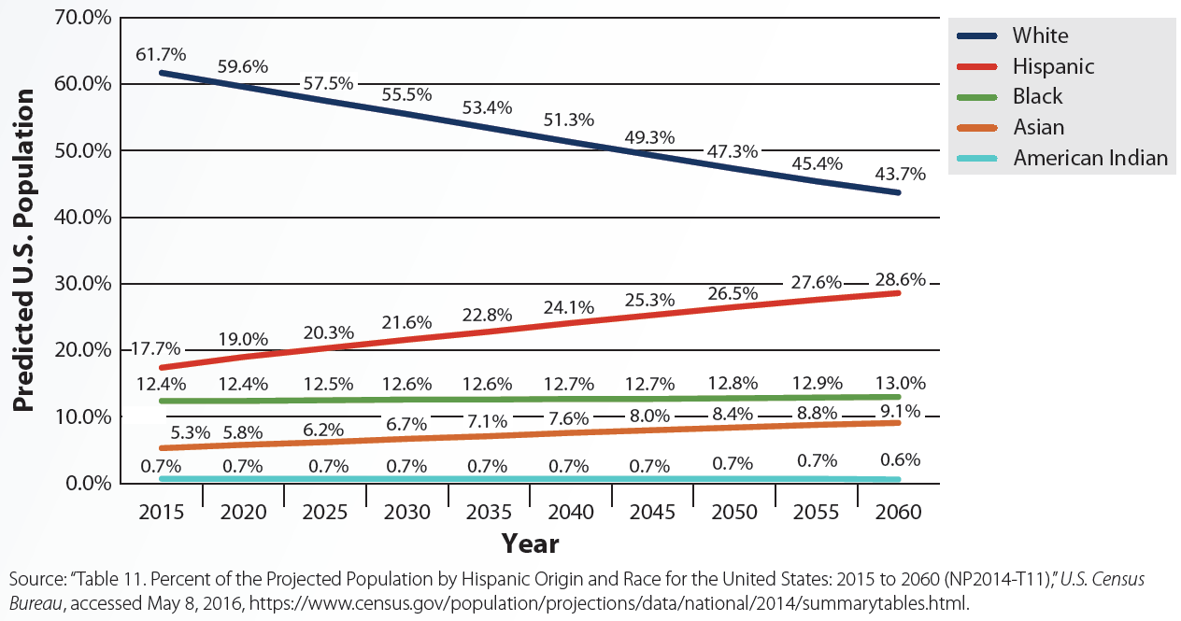
12.1 Percent of the Projected Population by Race and Hispanic Origin for the United States: 2015–2016
LO 1

Slide 4
Diversity
LO 1
Variety of demographic, cultural, and personal differences among an organization's employees and customers
Not an affirmative action
  Affirmative action: Purposeful steps taken by an organization to create employment opportunities for minorities and women
Purpose - Create a positive work environment where no one is advantaged or disadvantaged

Slide 5
Diversity (continued)
LO 1
Makes good business sense
  Helping with cost savings by reducing turnover, decreasing absenteeism, and avoiding discrimination lawsuits
  Attracting and retaining talented workers
  Driving business growth
  Helping companies grow through higher-quality problem solving

Slide 6
Surface-Level Diversity
LO 2
Differences that are observable, typically unchangeable, and easy to measure
  Age, sex, race/ethnicity, and physical disabilities
Initial impressions and categorizations of coworkers, bosses, customers, or job applicants are formed
  Lead to decisions or behaviors that discriminate

Slide 7
Dimensions of Surface-Level Diversity
LO 2
Discrimination | Description | Ways to reduce discrimination
Age | Treating people differently because of their age | Recognizing that age discrimination is much more pervasive than expected Monitoring the extent to which older workers receive training Ensuring that younger and older workers interact with each other
Sex | Treating people differently because of their sex | Mentoring or pairing promising female executives with senior executives from whom they can seek advice and support Ensuring that male-dominated social activities do not unintentionally exclude women

Slide 8
Dimensions of Surface-Level Diversity (continued)
LO 2
Discrimination | Description | Ways to reduce discrimination
Racial and ethnic | Treating people differently because of their race or ethnicity | Comparing the hiring rates of whites with the hiring rates for racial and ethnic applicants Surveying employees to compare white and nonwhite employees' job satisfaction Considering employing a private firm to test the hiring system Eliminating unclear selection and promotion criteria
Disability | Treating people differently because of their mental or physical disabilities | Committing to reasonable workplace accommodations Providing workers with assistive technology Actively recruiting qualified workers with disabilities

Slide 9
Deep-Level Diversity
LO 3
Differences communicated through verbal and nonverbal behaviors and learned only through extended interaction with others
  Personality, attitudes, beliefs, and values
Can lead to less prejudice, discrimination, and conflict in the workplace, thus resulting in better social integration

Slide 10
Big Five Personality Dimensions
LO 3
Extraversion: Degree to which someone is active, assertive, gregarious, sociable, talkative, and energized by others
Emotional stability: Degree to which someone is not angry, depressed, anxious, emotional, insecure, and excitable
Agreeableness: Degree to which someone is cooperative, polite, flexible, forgiving, good-natured, tolerant, and trusting

Slide 11
Big Five Personality Dimensions (continued)
LO 3
Conscientiousness: Degree to which someone is organized, hardworking, responsible, persevering, and achievement oriented
Openness to experience: Degree to which someone is curious, broad-minded, and open to new ideas, things, and experiences

Slide 12
Diversity Paradigms
LO 4
Paradigms | Description | Advantages | Disadvantages
Discrimination and fairness | Equal opportunity, fair treatment, recruitment of minorities, and strict compliance with the equal employment opportunity laws | Fairer treatment of employees and increase in demographic diversity | Focus of diversity remains on the surface-level diversity dimensions of sex, race, and ethnicity
Access and legitimacy | Acceptance and celebration of differences to ensure that the diversity within the company matches the diversity found among primary stakeholders | Clear business reason for diversity is established | Focus is only on the surface-level diversity dimensions of sex, race, and ethnicity

Slide 13
Diversity Paradigms (continued)
LO 4
Paradigms | Description | Advantages
Learning and effectiveness | Integration of deep-level diversity differences, such as personality, attitudes, beliefs, and values, into the actual work of the organization | Common ground is valued Distinction is made between individual and group differences Conflict, backlash, and divisiveness associated with diversity programs are less likely to be encountered Different talents and perspectives are brought together

Slide 14
Organizational Plurality
LO 4
Work environment where:
  All members are empowered to contribute in a way that maximizes the benefits to the organization, customers, and themselves
  Individuality of each member is respected by not segmenting or polarizing people on the basis of their membership in a particular group
Consistent with learning and effectiveness paradigm

Slide 15
Diversity Principles
LO 4
Carefully and faithfully following and enforcing federal and state laws regarding equal opportunity employment
Treating group differences as important but not special
Finding the common ground

Slide 16
Diversity Principles (continued)
LO 4
Tailoring opportunities to individuals, not groups
Maintaining high standards
Soliciting negative as well as positive feedback
Setting high but realistic goals

Slide 17
Diversity Training and Practices
LO 4
Skills-based diversity training: Teaches employees the practical skills they need for managing a diverse workforce
  Flexibility and adaptability
  Negotiation and problem solving
  Conflict resolution

Slide 18
Diversity Training and Practices (continued)
LO 4
Awareness training: Designed to:
  Raise employees’ awareness of diversity issues
  Challenge underlying assumptions or stereotypes employees may have about others

Slide 19
Diversity Audits
LO 4
Formal assessments that:
  Measure employee and management attitudes
  Investigate the extent to which people are advantaged or disadvantaged with respect to hiring and promotions
  Review companies' diversity-related policies and procedures

Slide 20
Diversity Pairing
LO 4
Mentoring program in which people of different cultural backgrounds, sexes, or races/ethnicities are paired together
  To get to know about each other
  To change stereotypical beliefs and attitudes

Slide 21
Key Terms
Diversity
Affirmative action
Surface-level diversity
Deep-level diversity
Social integration
Age discrimination
Sex discrimination
Glass ceiling
Racial and ethnic discrimination
Disability
Disability discrimination
Disposition
Personality
Extraversion
Emotional stability
Agreeableness

Slide 22
Key Terms (continued)
Conscientiousness
Openness to experience
Organizational plurality
Skills-based diversity training
Awareness training
Diversity audits
Diversity pairing

Slide 23
Summary
Trends show that workforce of the near future will be increasingly Hispanic, Asian American, and female
Surface-level diversity consists of differences that are immediately observable
Deep-level diversity includes differences that are learned only through extended interaction
Diversity paradigms are general approaches or strategies for managing diversity

