Slide 1
Motivation

Slide 2
Learning Outcomes
Explain the basics of motivation
Use equity theory to explain how employees’ perceptions of fairness affect motivation
Use expectancy theory to describe how workers’ expectations about rewards, effort, and the link between rewards and performance influence motivation

Slide 3
Learning Outcomes (continued)
Explain how reinforcement theory works and how it can be used to motivate
Describe the components of goal-setting theory and how managers can use them to motivate workers
Discuss how the entire motivation model can be used to motivate workers

Slide 4
Motivation and Job Performance
LO 1
Motivation
  Set of forces that initiates, directs, and makes people persist in their efforts to accomplish a goal
Job performance
  How well an individual performs the job requirements
  Determined by motivation, ability, and situational constraints

Slide 5
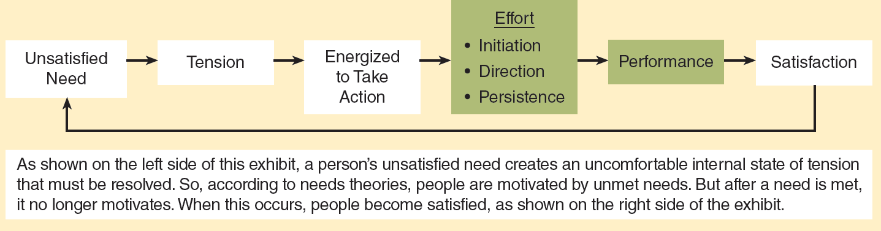
13.2 Basic Model of Work Motivation and Performance
LO 1

Slide 6
Needs
LO 1
Physical or psychological requirements that must be met to ensure survival and well-being
Types
  Lower-order needs - Concerned with safety and physiological and existence requirements
  Higher-order needs - Concerned with relationships, challenges and accomplishments, and influence

Slide 7
Kinds of Rewards
LO 1
Extrinsic reward
  Tangible reward that is visible to others and is given to employees contingent on the performance of specific tasks or behaviors
Intrinsic reward
  Natural reward associated with performing a task or activity for its own sake

Slide 8
Motivating with the Basics
LO 1
Enquiring about people’s needs
Satisfying lower-order needs first
Expecting people’s needs to change
Creating opportunities for employees to satisfy higher-order needs when:
  Needs change
  Lower-order needs are satisfied

Slide 9
Equity Theory
LO 2
States that people will be motivated when they perceive that they are being treated fairly
Components
  Inputs: Contributions made to the firm
  Outcomes: Rewards received for contributions
  Referents: Others with whom people compare themselves to ascertain if they have been treated fairly

Slide 10
Equity Theory (continued)
LO 2
Outcome/input (O/I) ratio
  Employee’s perception of how the rewards received from an organization compare with the employee’s contributions to that organization
Forms of inequity
  Underreward: Referent’s O/I ratio is better than that of the employee
  Overreward: Referent’s O/I ratio is worse than that of the employee

Slide 11
Reaction to Perceived Inequity
LO 2
Equity is restored by:
  Reducing inputs
  Increasing outcomes
  Rationalizing inputs or outcomes
  Changing the referent
  Leaving

Slide 12
Motivating with Equity Theory
LO 2
Enquiring about the needs of employees
Reducing employees’ inputs
Ensuring that decision-making processes are fair
  Distributive justice: Perceived degree to which outcomes and rewards are fairly distributed
  Procedural justice: Perceived fairness of the procedures used to make reward allocation decisions

Slide 13
Expectancy Theory
LO 3
People will be motivated to the extent to which they believe that:
  Their efforts will lead to good performance
  Good performance will be rewarded
  They will be offered attractive rewards
Components
  Valence
  Expectancy
  Instrumentality

Slide 14
Motivating with Expectancy Theory
LO 3
Systematically gathering information to find out what employees want from their jobs
Taking specific steps to link rewards to individual performance in a clear and understandable manner
Empowering employees to make decisions

Slide 15
Reinforcement Theory
LO 4
States that:
  Behavior is a function of its consequences
  Behaviors followed by positive consequences will occur more frequently
  Behaviors followed by negative consequences, or not followed by positive consequences, will occur less frequently
Reinforcement: Process of changing behavior by changing the consequences that follow behavior

Slide 16
Components of the Reinforcement Theory
LO 4
Positive reinforcement
  Strengthens behavior by following behaviors with desirable consequences
Negative reinforcement
  Strengthens behavior by withholding an unpleasant consequence when a specific behavior is performed
Punishment
  Weakens behavior by following behaviors with undesirable consequences
Extinction
  Weakens behavior by not allowing positive consequences to follow a previously reinforced behavior

Slide 17
Categories of Reinforcement Schedules
LO 4
Continuous reinforcement schedule
  Requires consequences to be administered following every instance of a behavior
Intermittent reinforcement schedule
  Requires consequences to be delivered after a specified or average time has elapsed or after a specified or average number of behaviors has occurred

Slide 18
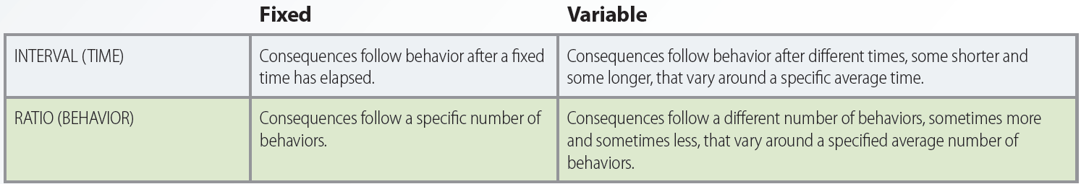
13.7 Intermittent Reinforcement Schedules
LO 4

Slide 19
Motivating with Reinforcement Theory
LO 4
Identify
Measure
Analyze
Intervene
Evaluate

Slide 20
Goal-Setting Theory
LO 5
People will be motivated to the extent to which they:
  Accept specific, challenging goals
  Receive feedback that indicates their progress toward goal achievement
Components
  Goal specificity, goal difficulty, goal acceptance, and performance feedback

Slide 21
Motivating with Goal-Setting Theory
LO 5
Assigning specific, challenging goals
Ensuring that workers truly accept organizational goals
Providing frequent and specific performance-related feedback

Slide 22
Key Terms
Motivation
Needs
Extrinsic reward
Intrinsic reward
Equity theory
Inputs
Outcomes
Referents
Outcome/input (O/I) ratio
Underreward
Overreward
Distributive justice
Procedural justice
Expectancy theory
Valence
Expectancy
Instrumentality
Reinforcement theory
Reinforcement
Reinforcement contingencies
Schedule of reinforcement
Positive reinforcement

Slide 23
Key Terms (continued)
Negative reinforcement
Punishment
Extinction
Continuous reinforcement schedule
Intermittent reinforcement schedule
Fixed interval reinforcement schedule
Variable interval reinforcement schedule
Fixed ratio reinforcement schedule
Variable ratio reinforcement schedule
Goal
Goal-setting theory
Goal specificity
Goal difficulty
Goal acceptance
Performance feedback

Slide 24
Summary
Equity theory - People are motivated when they perceive fair treatment
Expectancy theory - People are motivated when efforts lead to good performance
Reinforcement theory - Behavior is a function of its consequences
Goal-setting theory - People are motivated when they accept specific, challenging goals and receive feedback

