Slide 1
Chapter 14 - Leadership

Slide 2
Learning Outcomes
Explain what leadership is
Describe who leaders are and what effective leaders do
Explain Fiedler’s contingency theory
Describe how path-goal theory works
Explain the normative decision theory
Explain how visionary leadership (that is, charismatic or transformational) helps leaders achieve strategic leadership

Slide 3
Leaders versus Managers
LO 1
Leaders
Focus on vision, mission, goals, and objectives
Encourage creativity and risk taking
Managers
Focus on productivity and efficiency
Preservers of status quo
Have a long-term perspective
Have a short-term perspective
Concerned with ends
Concerned with means

Slide 4
Leadership Traits: Trait Theory
LO 2
Effective leaders possess similar set of traits or characteristics
  Traits: Relatively stable characteristics
Leaders differ from nonleaders in the following traits:
  Drive and the desire to lead
  Honesty/integrity
  Self-confidence
  Emotional stability
  Cognitive ability and knowledge of the business

Slide 5
Leadership Behaviors
LO 2
Initiating structure: Degree to which a leader structures the roles of followers
  Involves setting goals, giving directions, setting deadlines, and assigning tasks
  Affects subordinates’ job performance
Consideration: Extent to which a leader is friendly, approachable, and supportive and shows concern for employees
  Affects subordinates’ job satisfaction

Slide 6
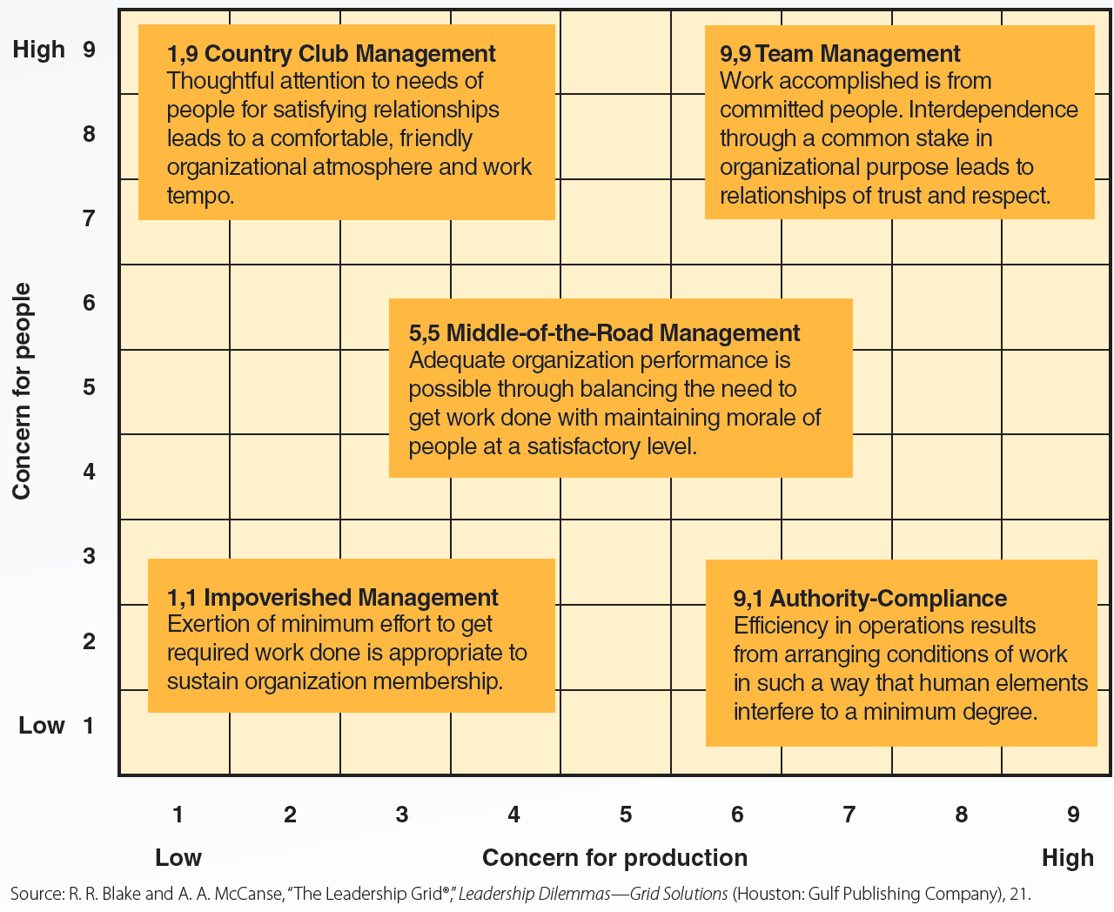
14.1 Blake/Mouton Leadership Grid
LO 2

Slide 7
Fiedler’s Contingency Theory
LO 3
Performance can be maximized by matching leaders to the situations that best fit their leadership style
Assumptions
  Leaders are effective when their work groups perform well
  Leaders are unable to change their leadership styles
  Situational favorableness depends on the degree to which the situation permits the leader to influence the behavior of group members

Slide 8
Fiedler’s Contingency Theory (continued)
LO 3
Least Preferred Coworker (LPC)
  Questionnaire used to measure leadership style
    Score above 64 - Relationship-oriented style
    Score below 54 - Task-oriented style
    Score between 58 and 63 - Flexible style
Factors that determine situational favorableness
  Leader-member relations
  Task structure
  Position power

Slide 9
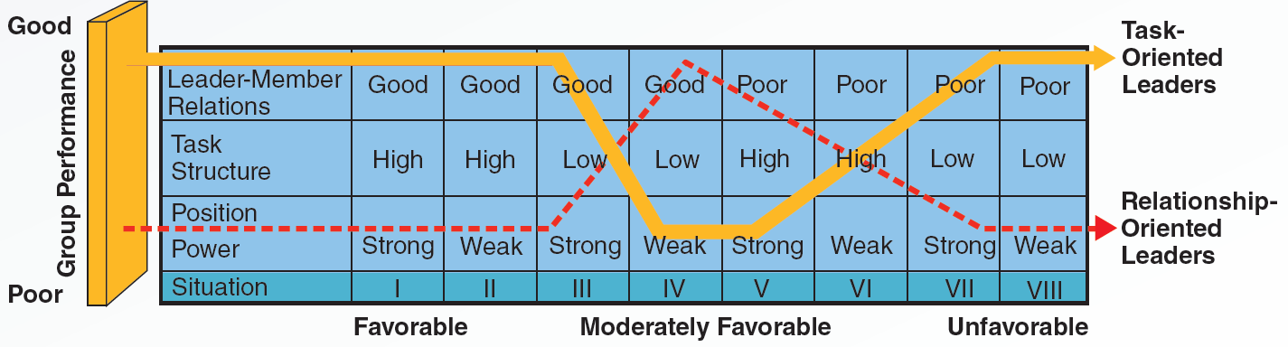
14.3 Matching Leadership Styles to Situations
LO 3

Slide 10
Path-Goal Theory
LO 4
Leaders can increase subordinate satisfaction and performance by:
  Clarifying and clearing the paths to goals
  Increasing the number and kinds of rewards available for goal attainment
Conditions for path clarification, path clearing, and rewards
  Leader behavior must be a source of immediate or future satisfaction for followers
  Leader behavior must offer something unique and valuable to followers

Slide 11
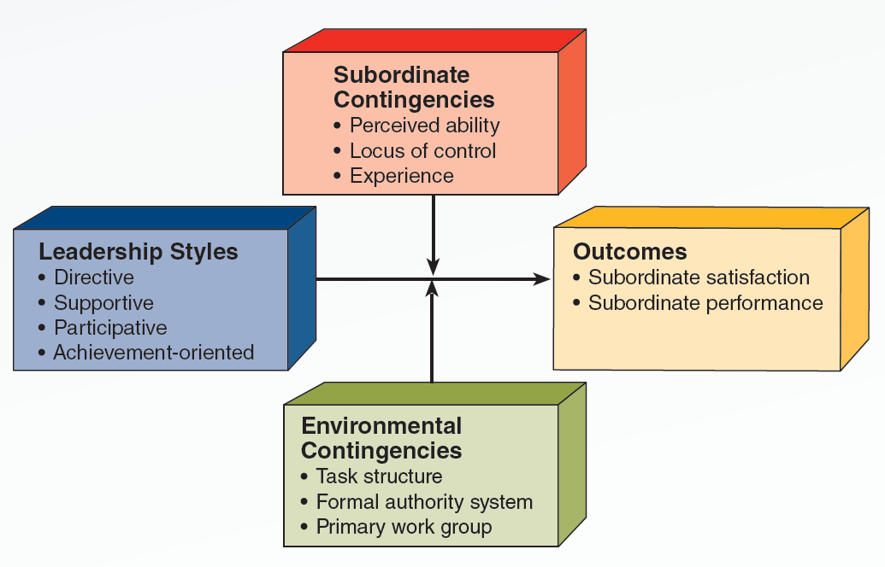
14.4 Path-Goal Theory
LO 4

Slide 12
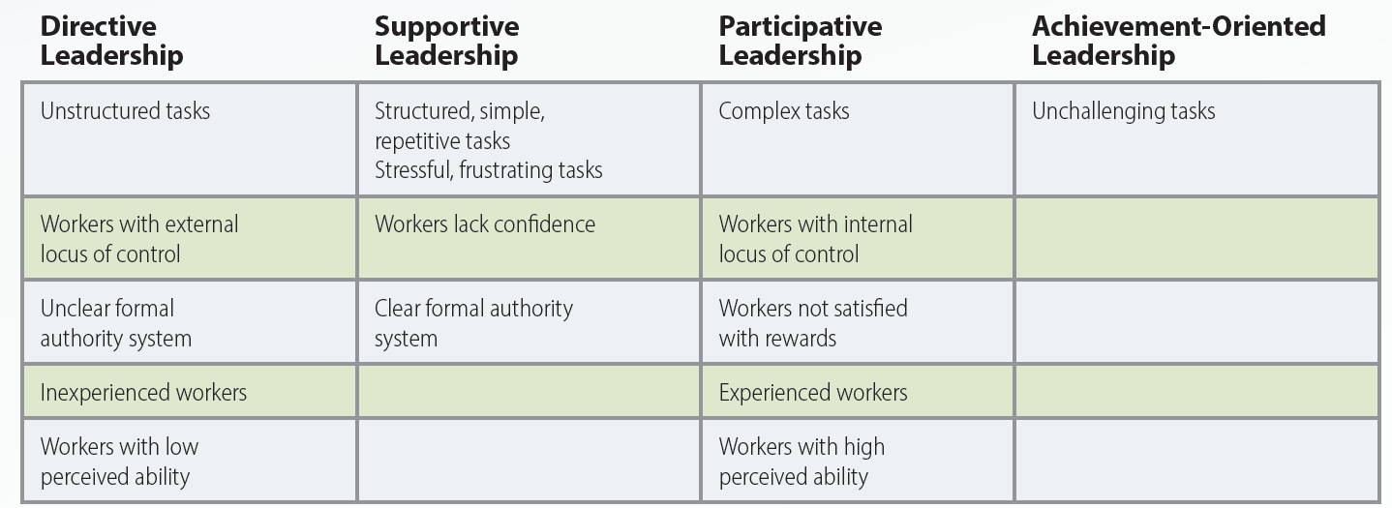
14.5 Path-Goal Theory: When to Use Directive, Supportive, Participative, or Achievement-Oriented Leadership
LO 4

Slide 13
Normative Decision Theory
LO 5
Helps leaders determine an appropriate amount of employee participation when making decisions
  Decision styles
    Autocratic (AI or AII), consultative (CI or CII), and group (GII) decisions
  Right degree of employee participation improves:
    Quality of decisions
    Extent to which employees accept and are committed to decisions

Slide 14
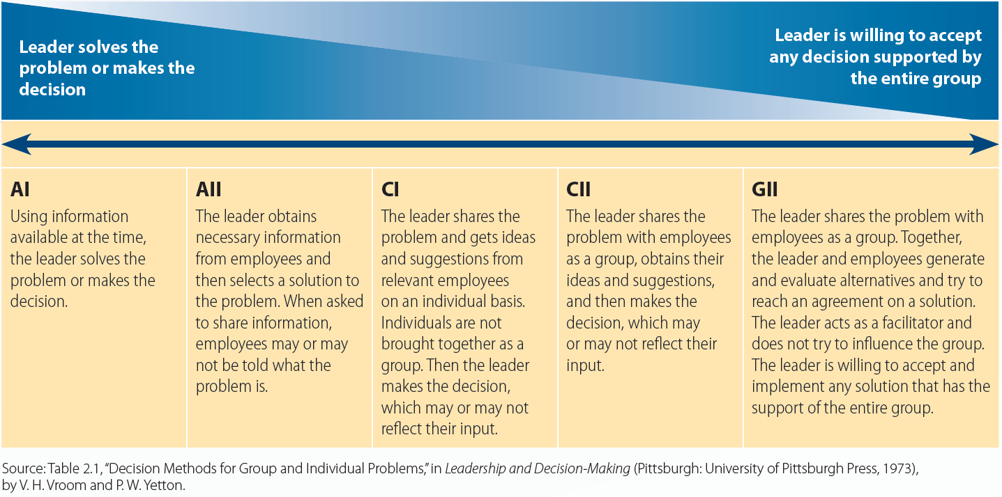
14.6 Normative Theory, Decision Styles, and Levels of Employee Participation
LO 5

Slide 15
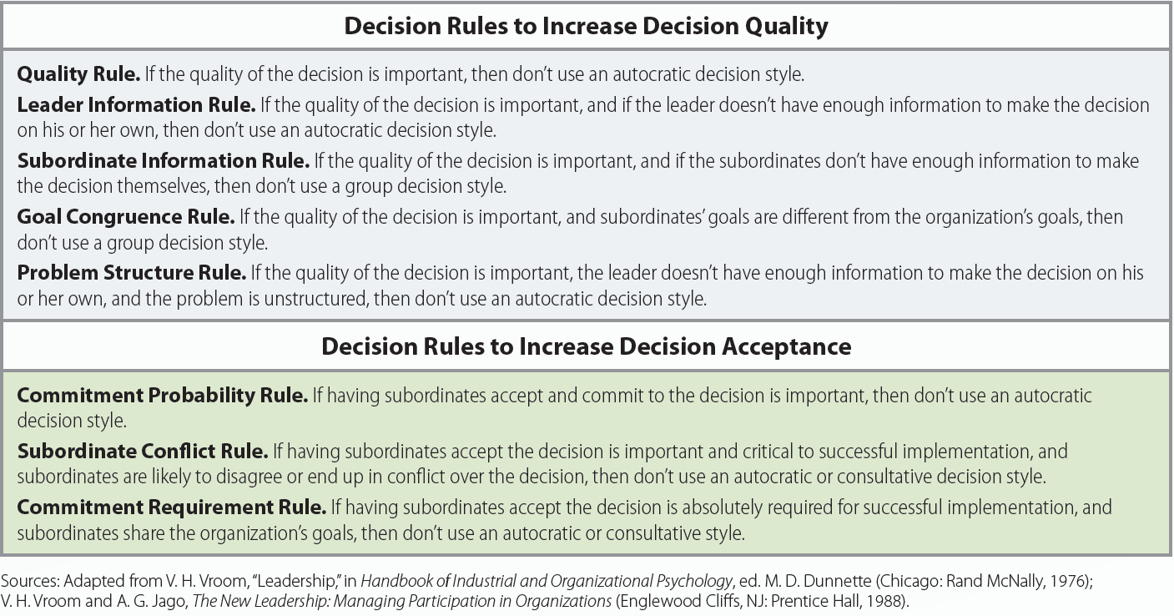
14.7 Normative Theory Decision Rules
LO 5

Slide 16
Visionary Leadership
LO 6
Creates a positive image of the future that:
  Motivates organizational members
  Provides direction for future planning and goal setting
Types
  Charismatic leadership
  Transformational leadership

Slide 17
Types of Charismatic Leadership
LO 6
Ethical charismatics
Charismatic leaders who:
Unethical charismatics
Charismatic leaders who:
Provide developmental opportunities for followers and recognize others’ contributions
Are open to positive and negative feedback
Have moral standards that emphasize the larger interests of the organization or society
Control and manipulate followers
Do what is best for themselves
Have moral standards that put their interests before everyone else’s

Slide 18
Transformational Leadership
LO 6
Generates awareness and acceptance of a group’s purpose and mission
Gets employees to see beyond their own needs and self interests
Components
  Charismatic leadership or idealized influence
  Inspirational motivation
  Intellectual stimulation
  Individualized consideration

Slide 19
Transactional Leadership
LO 6
Based on exchange process
  Followers are rewarded for good performance and punished for poor performance
Relies heavily on discipline or threats to bring performance up to standards

Slide 20
Key Terms
Leadership
Trait theory
Traits
Initiating structure
Consideration
Leadership style
Contingency theory
Situational favorableness
Leader-member relations
Task structure
Position power
Path-goal theory
Directive leadership
Supportive leadership
Participative leadership
Achievement-oriented leadership
Normative decision theory

Slide 21
Key Terms (continued)
Strategic leadership
Visionary leadership
Charismatic leadership
Ethical charismatics
Unethical charismatics
Transformational leadership
Transactional leadership

Slide 22
Summary
Leadership is the process of influencing others to achieve organizational goals
  Traits of a leader include desire to lead and honesty/integrity
  Situational approaches to leadership include Fiedler’s contingency theory, path-goal theory, and normative decision theory
  Types of visionary leadership - Charismatic and transformational

