Slide 2
Learning Outcomes
Explain the role that perception plays in communication and communication problems
Describe the communication process and the various kinds of communication in organizations
Explain how managers can manage effective one-on-one communication
Describe how managers can manage effective organization-wide communication

Slide 3
Communication
LO 1
Process of transmitting information from one person or place to another
Basic management process cannot be performed without effective communication
  Planning
  Organizing
  Leading
  Controlling

Slide 4
Perception
LO 1
Process by which individuals attend to, organize, interpret, and retain information from their environments
People experience stimuli through their perceptual filters
  Perceptual filters: Personality-, psychology-, or experience-based differences that influence people to ignore or pay attention to particular stimuli

Slide 5
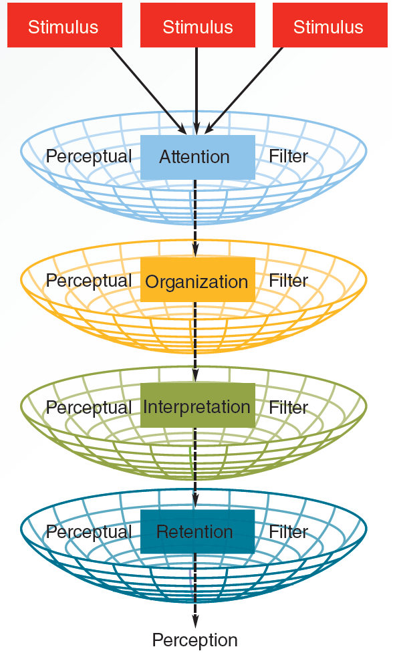
15.1 Basic Perception Process
LO 1

Slide 6
Perception Problems
LO 1
Selective perception
  Tendency to notice and accept objects and information consistent with one’s values, beliefs, and expectations, while ignoring or screening inconsistent information
Closure
  Tendency to fill in gaps of missing information by assuming that what one does not know is consistent with what one already knows

Slide 7
Attribution Theory
LO 1
People have a basic need to understand and explain the causes of other people's behaviour
Internal and external attributions are used to explain people's behavior

Slide 8
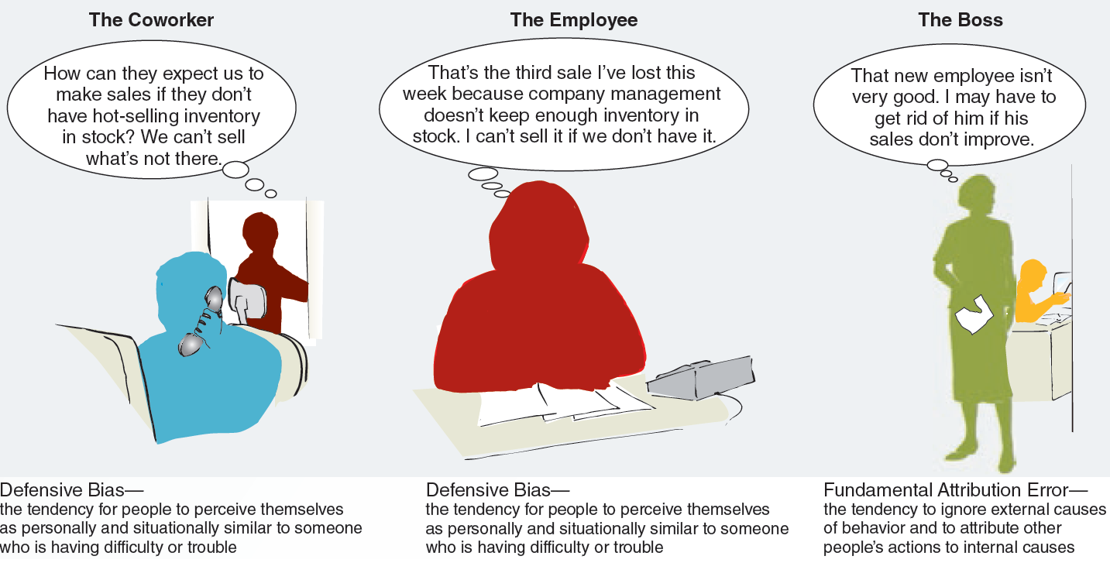
15.2 Defensive Bias and Fundamental Attribution Error
LO 1

Slide 9
Self-Serving Bias
LO 1
Tendency to overestimate one’s value by attributing successes to oneself and failures to others or the environment
Makes it difficult for managers to talk to employees about performance problems

Slide 10
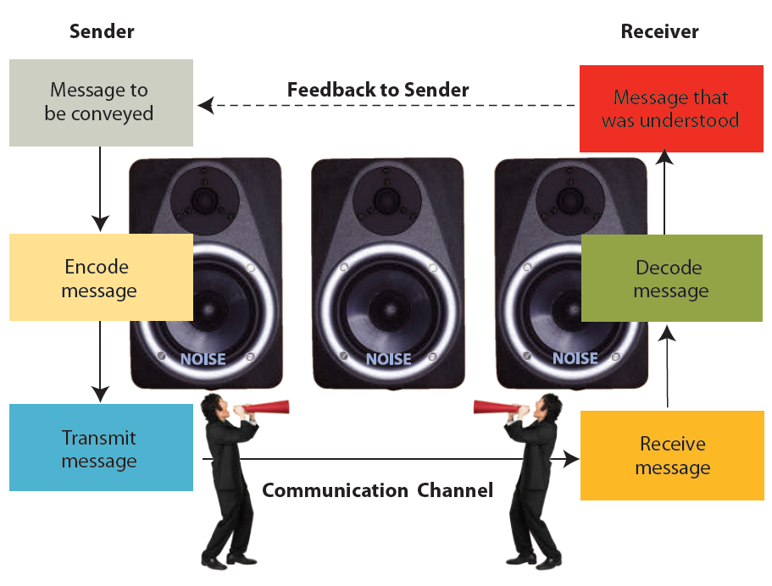
15.3 Interpersonal Communication Process
LO 2

Slide 11
Noise and Jargon
LO 2
Noise
  Anything that interferes with the transmission of the intended message
Jargon
  Vocabulary particular to a profession or group that interferes with communication in the workplace

Slide 12
Formal Communication Channel
LO 2
System of official channels that carry organizationally approved messages and information
  Downward communication: Flows from higher to lower levels in an organization
  Upward communication: Flows from lower to higher levels in an organization
  Horizontal communication: Flows among managers and workers who are at the same organizational level

Slide 13
Informal Communication Channel
Transmission of messages from employee to employee outside of formal communication channels
Called grapevine

Slide 14
Informal Communication Channel
Transmission of messages from employee to employee outside of formal communication channels
Called grapevine

Slide 15
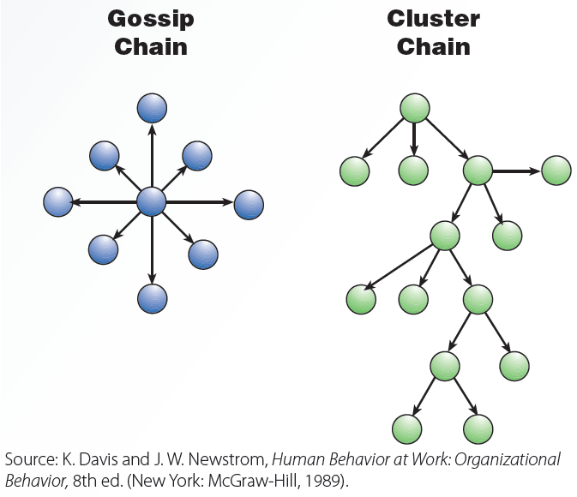
15.4 Grapevine Communication Networks

Slide 16
One-on-One Communication
LO 2
Coaching: Communicating with someone for the direct purpose of improving the person’s on-the-job performance
Counseling: Communicating with someone about non-job-related issues that may be affecting the person’s performance
  Employee Assistance Program (EAP)

Slide 17
Nonverbal Communication
LO 2
Any communication that does not involve words
Kinds
  Kinesics: Movements of the body and face
  Paralanguage: Pitch, rate, tone, volume, and speaking pattern of one's voice

Slide 18
Managing One-on-One Communication
LO 3
Choosing the right communication medium
Being a good listener
Giving effective feedback

Slide 19
Choosing the Right Communication Medium
LO 3
Communication medium: Method used to deliver a message
  Oral communication - Allows to receive and assess the nonverbal communication that accompanies spoken messages
  Written communication - Well suited for delivering straightforward messages and information

Slide 20
Active and Empathetic Listening
LO 3
Active listening
  Assuming half the responsibility for successful communication
    By actively giving the speaker nonjudgmental feedback that shows one has accurately heard what he or she said
Empathetic listening
  Understanding the speaker’s perspective and personal frame of reference
  Giving feedback that conveys that understanding to the speaker

Slide 21
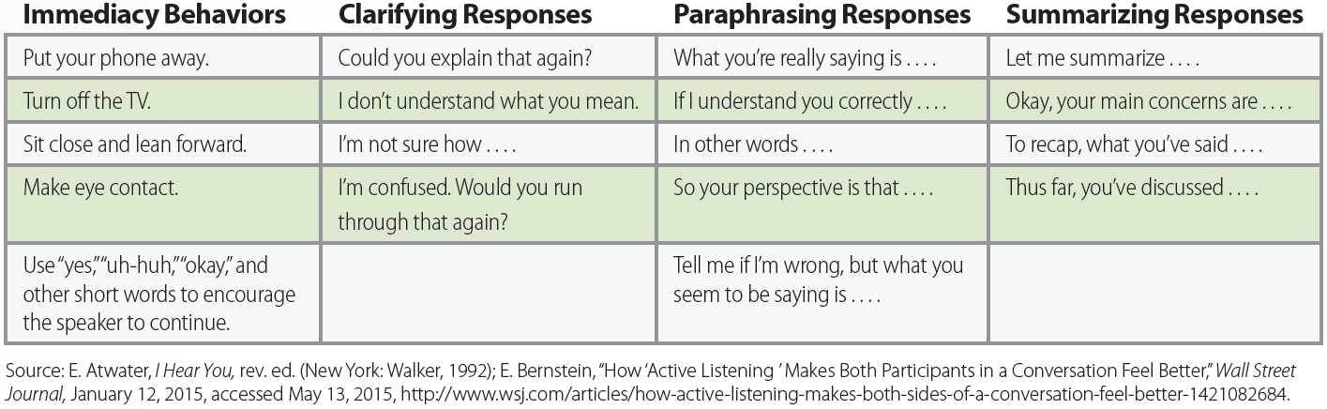
15.5 Immediacy Behaviors, and Paraphrasing and Summarizing Responses for Active Listeners
LO 3

Slide 22
Giving Feedback
LO 3
Destructive feedback
  Disapproves without any intention of being helpful and causes a negative or defensive reaction in the recipient
Constructive feedback
  Intended to be helpful, corrective, and/or encouraging
  Must be immediate, focused on specific behaviors, and problem-oriented

Slide 23
Managing Organization-Wide Communication
LO 4
Improving transmission by getting the message out
Improving reception by finding ways to hear what others feel and think

Slide 24
Improving Transmission: Electronic Communication
LO 4
Email
Collaborative discussion sites
  Online discussion forums: Using web- or software-based discussion tools to allow employees to communicate easily
Televised/videotaped speeches and meetings
Broadcast voice mail

Slide 25
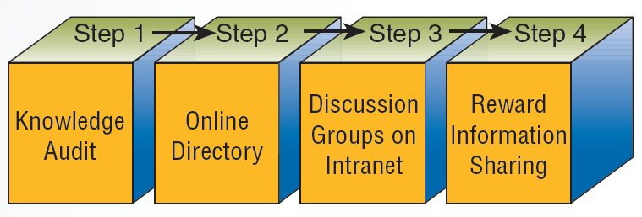
15.6 Establishing Collaborative Discussion Sites
LO 4

Slide 26
Organizational Silence
LO 4
Withholding information about organizational problems or issues
Occurs when employees believe that telling management about problems would not make a difference
Ways to overcome organizational silence
  Company hotlines: Phone numbers that anyone in the company can call anonymously to leave information for upper management

Slide 27
Improving Reception: Hearing What Others Feel and Think
LO 4
  Survey feedback: Information that is collected by surveys from organizational members
    Compiled, disseminated, and used to develop action plans for improvement
  Frequent informal meetings and surprise visits
  Blog: Personal website that provides personal opinions or recommendations, news summaries, and reader comments

Slide 28
Key Terms
Communication
Perception
Perceptual filters
Selective perception
Closure
Attribution theory
Defensive bias
Fundamental attribution error
Self-serving bias
Encoding
Decoding
Feedback to sender
Noise
Jargon
Formal communication channel
Downward communication
Upward communication

Slide 29
Key Terms (continued 1)
Horizontal communication
Informal communication channel (grapevine)
Coaching
Counseling
Nonverbal communication
Kinesics
Paralanguage
Communication medium
Hearing
Listening
Active listening
Empathetic listening
Destructive feedback
Constructive feedback
Online discussion forums

Slide 30
Key Terms (continued 2)
Televised/videotaped speeches and meetings
Organizational silence
Company hotlines
Survey feedback
Blog

Slide 31
Summary
Perception is a key part of communication
Communication can be formal, informal, coaching/counseling, and nonverbal
Managing one-on-one communication and organization-wide communication are primary tasks in improving communication

