Slide 1
Control

Slide 2
Learning Outcomes
Describe the basic control process
Discuss the various methods that managers can use to maintain control
Describe the behaviors, processes, and outcomes that today’s managers are choosing to control in their organizations

Slide 3
Control versus Standards
LO 1
Control
  Regulatory process of establishing standards to achieve organizational goals, comparing actual performance against standards, and taking corrective action when necessary
Standards
  Basis of comparison for measuring the extent to which various kinds of organizational performance are satisfactory or unsatisfactory

Slide 4
Setting Standards
LO 1
Standards are determined by:
  Listening to customer feedback
  Observing competitors
  Benchmarking
Also involves:
  Identifying the company against which to benchmark set the standards
  Collecting data to determine performance standards of other companies

Slide 5
Comparison to Standards and Corrective Action
LO 1
Comparison to standards
  Quality of comparison depends on the organization’s measurement and information systems
Corrective action
  Involves identifying performance deviations, analyzing those deviations, and developing and implementing programs to correct them

Slide 6
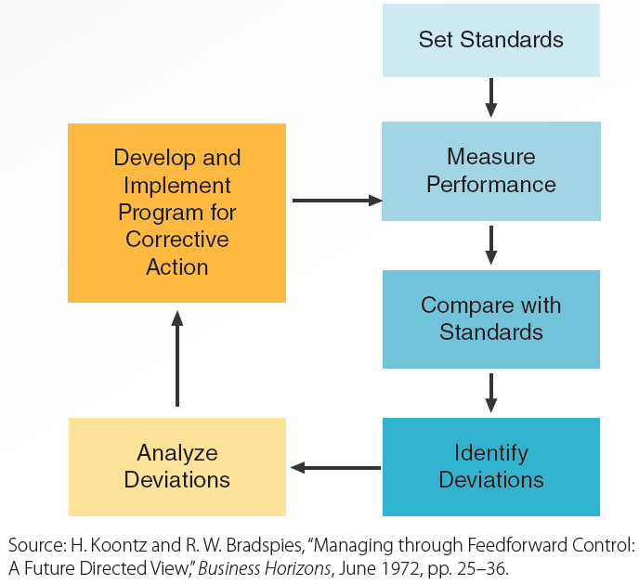
16.1 Cybernetic Control Process
LO 1

Slide 7
Basic Control Methods
LO 1
Feedback control
  Gathering information about performance deficiencies after they occur and using the same to correct or prevent performance deficiencies
Concurrent control
  Gathering information about performance deficiencies as they occur, thereby eliminating the delay between performance and feedback
Feedforward control
  Monitoring performance inputs to minimize performance deficiencies before they occur

Slide 8
Maintaining Control
LO 1
Control loss: Occurs when behavior and work procedures do not conform to standards
To determine if control is worthwhile, managers must carefully assess:
  Regulation costs: Associated with implementing or maintaining control
  Cybernetic feasibility: Extent to which it is possible to implement each step in the control process

Slide 9
Control Methods
LO 2
Bureaucratic control
Objective control
Normative control
Concertive control
Self-control

Slide 10
Bureaucratic Control
LO 2
Use of hierarchical authority to influence employee behavior
  Involves rewarding or punishing employees for compliance or noncompliance with organizational rules, policies, and procedures
Characteristics
  Greater emphasis on following rules
  Higher resistance to change and slower response to competitors and customers

Slide 11
Objective Control
LO 2
Use of observable measures of worker behavior or outputs to assess performance and influence behavior
Types
  Behavior control: Regulation of behaviors and actions that workers perform on the job
  Output control: Regulation of workers’ results via rewards and incentives

Slide 12
Normative Control
LO 2
Regulation of workers’ behavior and decisions through widely shared organizational values and beliefs
Created in two ways
  Hiring based on attitudes and values
  Learning about what should and shouldn't be done by observing and listening to stories recited by experienced personnel

Slide 13
Concertive Control
LO 2
Regulation of workers’ behavior and decisions through work group values and beliefs
Arises when firms assign work groups complete autonomy and responsibility for task completion
Leads to more stress to conform to expectations

Slide 14
Self-Control or Self-Management
LO 2
Managers and workers control their own behavior by:
  Setting their own goals
  Monitoring their own progress
  Rewarding themselves for goal achievement
Leaders and managers:
  Provide clear boundaries to guide and control one’s behavior
  Teach skills needed to maximize and monitor one’s effectiveness

Slide 15
Balanced Scorecard
LO 3
Measurement of organizational performance in four areas
  Finances
  Customers
  Internal operations
  Innovation and learning

Slide 16
Balanced Scorecard - Advantages
LO 3
Forces managers to set specific goals and measure performance
Minimizes the chances of suboptimization
  Improved performance in one part of a firm at the expense of decreased performance in another part

Slide 17
Controlling Finances
LO 3
Cash flow analysis
Balance sheets
Income statements
Financial ratios
Budgets
Economic value added (EVA)

Slide 18
Controlling Customer Defections
LO 3
Customer defections: Performance assessment in which companies:
  Identify which customers are likely to leave
  Measure the rate at which customers are leaving
Advantages
  Impact of improved retention on profits
  Higher likelihood of receiving honest feedback
  Ability to determine who will leave and prevent that from happening

Slide 19
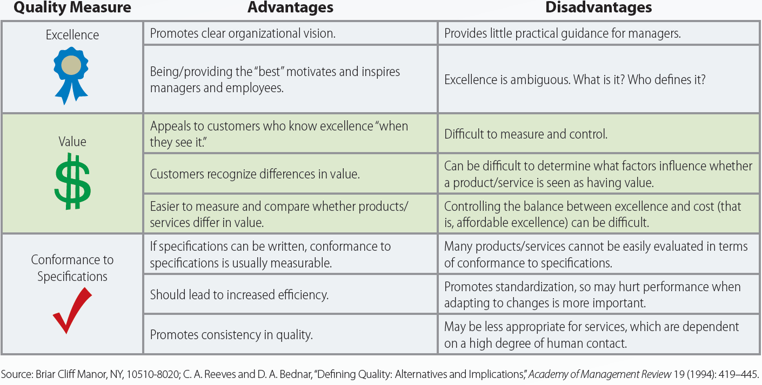
16.5 Advantages and Disadvantages of Different Measures of Quality
LO 3

Slide 20
Innovation and Learning Perspective
LO 3
Involves:
  Continuous improvement in ongoing services and products
  Relearning and redesigning creation processes
  Maximizing sustainability, whose levels include:
    Waste prevention and reduction
    Recycle and reuse
    Waste treatment
    Waste disposal

Slide 21
Key Terms
Control
Standards
Benchmarking
Cybernetic
Feedback control
Concurrent control
Feedforward control
Control loss
Regulation costs
Cybernetic feasibility
Bureaucratic control
Objective control
Behavior control
Output control
Normative control
Concertive control
Self-control (self-management)
Balanced scorecard

Slide 22
Key Terms (continued)
Suboptimization
Cash flow analysis
Balance sheets
Income statements
Financial ratios
Budgets
Zero-based budgeting
Economic value added (EVA)
Customer defections
Value

Slide 23
Summary
Control
  Regulatory process of establishing standards to achieve goals, comparing actual performance against the standards, and taking corrective action
  Achieved by self-control and bureaucratic, objective, normative, and concertive control
  Measured by using the balanced scorecard

