Slide 1
Chapter 17 – Managing Information

Slide 2
Learning Outcomes
Explain the strategic importance of information
Describe the characteristics of useful information (that is, its value and costs)
Explain the basics of capturing, processing, and protecting information
Describe how companies can access and share information and knowledge

Slide 3
Moore’s Law
LO 1
Prediction that about every two years, computer processing power would double and its cost would drop by 50 percent

Slide 4
Raw Data and Information
LO 1
Raw data: Facts and figures
Information: Useful data that can influence people’s choices and behavior
  Has strategic importance for organizations as it can be used to:
    Obtain first-mover advantage
    Sustain competitive advantage once it is created

Slide 5
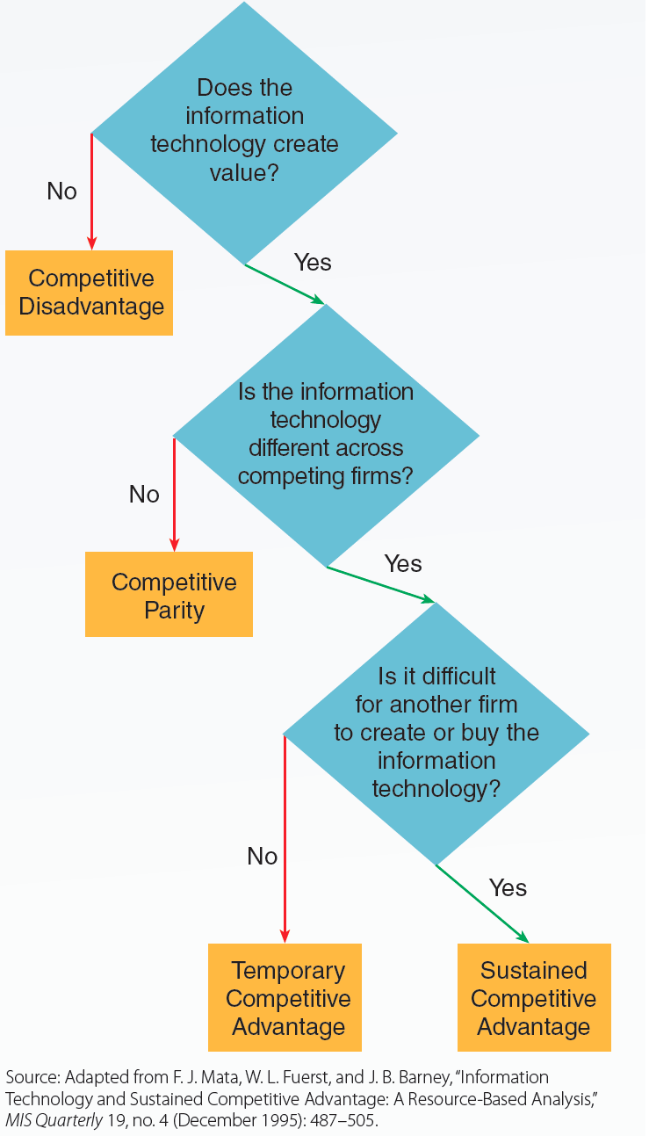
17.2 Using Information Technology to Sustain a Competitive Advantage
LO 1

Slide 6
Characteristics of Useful Information
LO 2
Accurate
Complete
Relevant
Timely

Slide 7
Costs of Useful Information
LO 2
Acquisition cost
Processing cost
Storage cost
Communication cost
Retrieval cost

Slide 8
Methods of Capturing Information
LO 3
Manual capture
  Slow, costly, labor-intensive, and inaccurate process
  Entails recording and entering data by hand into a data storage device
Electronic capture
  Involves using electronic storage devices to capture and record data electronically
    Electronic storage devices include bar codes, radio frequency identification (RFID) tags, and electronic scanners

Slide 9
Processing Information
LO 3
Transforming raw data into meaningful information
Data warehouse: Stores huge amounts of data prepared for data mining analysis by being cleaned of errors and redundancy
  Data mining: Discovering unknown patterns and relationships in large amounts of data

Slide 10
Types of Data Mining
LO 3
Supervised
  Data mining software is used to look and test for specific patterns and relationships in a data set
Unsupervised
  Data mining software is used to uncover all patterns and relationships in a data set
  Helps identify:
    Association or affinity patterns: Two or more database elements tend to occur together in a significant way

Slide 11
Types of Data Mining (continued)
LO 3
    Sequence patterns: Two or more database elements occur together in a significant pattern and one of the elements precedes the other
    Predictive patterns: Help identify database elements that are different
    Data clusters: Three or more database elements occur together in a significant way

Slide 12
Protecting Information
LO 3
Process of ensuring that data are reliably and consistently retrievable in a usable format for authorized users but no one else
Critical steps in granting access to authorized users
  Authentication
    Two-factor authentication: Based on what users know (a password) and what they have in possession (secure ID card or key)
  Authorization

Slide 13
Protecting Information (continued)
LO 3
Precautions
  Firewalls
  Data encryption
  Virtual private networks (VPNs)
  Secure sockets layer (SSL) encryption
  Hiring white hat hackers

Slide 14
Security Threats to Data and Data Networks
LO 3
Denial of service
Web server attacks and corporate network attacks
Password cracking software and unauthorized access to PCs
Viruses, worms, Trojan horses, and rootkits
Malware, spyware, adware, malicious scripts, and applets

Slide 15
Security Threats to Data and Data Networks (continued)
LO 3
Email snooping
Keystroke monitoring
Phishing
Spam
Cookies

Slide 16
Technologies That Aid Internal Access and Sharing
LO 4
Executive information system (EIS)
  Uses internal and external data sources
  Provides information required to monitor and analyze organizational performance
Intranets: Private company networks
  Allow employees to easily access, share, and publish information using Internet software
Corporate portals: Hybrid of executive information systems and intranets

Slide 17
Technologies That Aid External Access and Sharing
LO 4
Electronic data interchange (EDI)
  Allows two companies to convert their purchase and ordering information to a standardized format
  Enables direct electronic transmission of information between company systems
Extranets
  Allow companies to exchange information and conduct transactions with outsiders

Slide 18
Technologies That Aid External Access and Sharing (continued)
LO 4
Web services
  Use standardized protocols to describe data that can be processed by different computer systems in companies
Internet
  Allows companies to electronically automate transactions with customers

Slide 19
Technologies That Help Capture and Share Knowledge and Expertise
LO 4
Decision support system (DSS)
  Helps managers understand specific kinds of problems and potential solutions
  Acquires and analyzes information with sophisticated models and tools
Expert systems
  Contain specialized knowledge and decision rules used by experts and experienced decision makers
    Helps nonexperts to draw on this knowledge to make decisions

Slide 20
Key Terms
Moore’s law
Raw data
Information
First-mover advantage
Acquisition cost
Processing cost
Storage cost
Retrieval cost
Communication cost
Bar code
Radio frequency identification (RFID) tags
Electronic scanner
Optical character recognition
Processing information
Data mining
Data warehouse
Supervised data mining
Unsupervised data mining

Slide 21
Key Terms (continued 1)
Association or affinity patterns
Sequence patterns
Predictive patterns
Data clusters
Protecting information
Authentication
Authorization
Two-factor authentication
Firewall
Virus
Data encryption
Virtual private network (VPN)
Secure sockets layer (SSL) encryption
Executive information system (EIS)
Intranets
Corporate portal

Slide 22
Key Terms (continued 2)
Electronic data interchange (EDI)
Web services
Extranets
Knowledge
Decision support system (DSS)
Expert system

Slide 23
Summary
Information can be used to obtain first-mover advantage and sustain competitive advantage
Useful information is accurate, complete, relevant, and timely
Significant costs can be associated with useful information
Companies use information technology to capture, process, protect, access, and share information

