Slide 1
Micro
ECON
Chapter 10
Monopolistic Competition and Oligopoly

Slide 2
I) Monopolistic Competition
Characteristics:
  Many producers
  Products are slightly different (differentiated products)
    A firm that raises prices loses some customers to rivals
  Low barriers to entry (easy entry)
  Firms advertise and promote their products

Slide 3
Monopolistic Competition (continued 1)
Product differentiation
  Physical differences
    Differences in appearance and quality
  Location
    Spatial differentiation - the number and variety of locations where a product is available
  Services
    Quality and range of accompanying services
  Product image
    Promotion and advertising to create and maintain brand loyalty
  Examples of monopolistic competitive markets?

Slide 4
Short-Run Profit Maximization or Loss Minimization
Demand curve, D
  Some control over price makes firms price makers
    Downward-sloping demand curve
  Marginal revenue, MR
    Lies below the demand curve
    Slopes downward
  Average total cost, ATC
  Average variable cost, AVC
  Marginal cost, MC

Slide 5
Short-Run Profit Maximization or Loss Minimization (continued)
q that maximizes profit is
  Output q where profit is the biggest
  Or q where MR = MC
  Or q where MR > MC before MR < MC.
If price exceeds ATC: P > ATC
  Firms earn economic profit
If P = ATC, firm breaks even (make zero economic profit)
Price is lower than ATC: P < ATC
  Firms incur economic loss
  Firms should continue to produce in the short run if P > AVC
  Firms should shut down in the short run if P < AVC

Slide 6
Short-Run Profit Maximization
_______________________________________________
Price q TC TR MR MC Profit
($) (000s) ($) ($) ($) ($) ($)
_______________________________________________
10 0 2
9 1 6
8 2 13
7 3 21
6 4 30
_______________________________________________________
a. Complete the above table.
b. What is the level of production q that maximizes profit for the monopolist competitive firm?

Slide 7
Short-Run Profit Maximization (continued 1)
_________________________________________________
Price q TC TR MR MC Profit
($) (000s) ($) ($) ($) ($) ($)
_________________________________________________
10 0 2 0 - - -2
9 1 6 9 9 4 3
8 2 13 16 7 7 3
7 3 21 21 5 8 0
6 4 30 24 3 9 -6
__________________________________________________________
a. Complete the table.
b. What is the level of production q that maximizes profit for the firm?
The monopolistic competitive firm could either produce output level of q = 1,000 units or q = 2,000 units because that’s where profit is the biggest at $3.

Slide 8
Short-Run Losses and the Shutdown Decision (continued 1)
Price q FC VC TR TC MR MC AVC Profit
90 0 40 0
80 1 40 75
70 2 40 140
60 3 40 210
50 4 40 285
___________________________________________________________________
a. Complete the above table.
b. What is the level of production q that maximizes profit or minimizes loss for the monopolist?

Slide 9
Short-Run Losses and the Shutdown Decision (continued 1)
Price q FC VC TR TC MR MC AVC Profit
90 0 40 0 0 40 - - - -40
80 1 40 75 80 115 80 75 75 -35
70 2 40 140 140 180 60 65 70 -40
60 3 40 210 180 250 40 70 70 -70
50 4 40 285 200 325 20 75 71.25 -125
___________________________________________________________________
a. Complete the table.
b. What is the level of production q that maximizes profit or minimizes loss for the monopolist?
The monopolist is losing money, so she should pick q that minimizes economic loss. She produces output level of q = 1 unit because that’s where economic loss is at minimum. Or because that’s q before MR < MC
c. Should the monopolist shut down in the short run?
Shut down in the short run if P < AVC.
At q = 1, P = $80 > AVC = $75: The firm should not shut down in the short run.
Or At q = 1, TR = $80 > VC = $75: The firm should not shut down in the short run.

Slide 10
Monopolistic competition in the Long Run
Short-run economic profit
  Causes new firms to enter the market
    Draws customers away from the existing firms
    Reduce demand facing the existing firms
    Profit continue to fall until it disappear in the long run
    Firms make zero economic profit in the long run

Slide 11
Zero Economic Profit in the Long Run (continued)
Short-run economic loss
  Causes some firms to exit the market
    Their customers switch to the remaining firms
    Remaining firms experience an increase in demand
    Loss decreases until it is erased in the long run
    Firms make zero economic profit in the long run

Slide 12
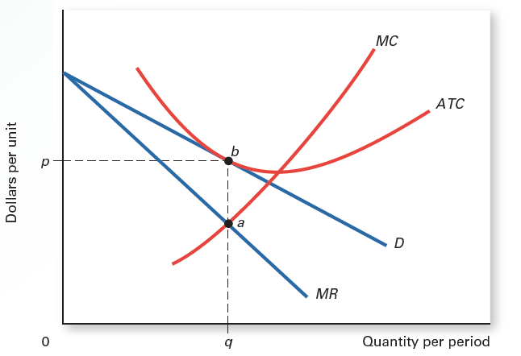
2 Long-Run Equilibrium in Monopolistic Competition
In monopolistic competition, if existing firms earn economic profit in the short run, new firms will enter the industry in the long run. This entry reduces the demand facing each firm. In the long run, each firm’s demand curve shifts leftward until marginal revenue equals marginal cost (point a) and the demand curve is tangent to the average total cost curve (point b). Economic profit is zero at output q. With zero economic profit, no more firms will enter, so the industry is in long-run equilibrium. The same long-run adjustment occurs if firms suffer a short-run loss. In the long run, firms leave until the remaining firms earn just a normal profit.

Slide 13
Monopolistic Competition and Perfect Competition Compared
Similarities
  In both Monopolistic competition and perfect competition
    There is a large number of firms
    Easy entry into and exit from the market
    Firms make zero economic profit in the long run
    The demand curve is tangent to the average total cost curve in the long run

Slide 14
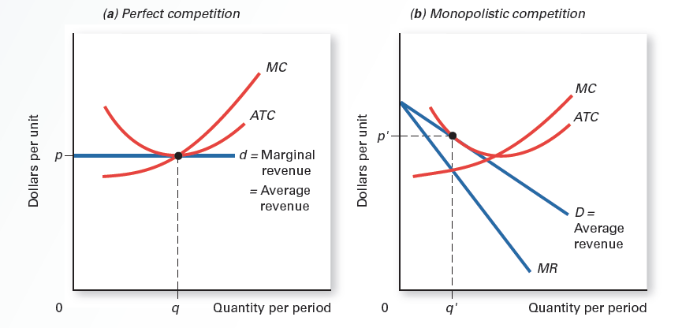
3 Perfect Competition Versus Monopolistic Competition in Long-Run Equilibrium
Cost curves are assumed to be the same in each panel. The perfectly competitive firm in panel (a) faces a demand curve that is horizontal at market price p. Long-run equilibrium occurs at output q, where the demand curve is tangent to the average total cost curve at its lowest point. The monopolistically competitive firm in panel (b) is in long-run equilibrium at output q’, where the demand curve is tangent to the average total cost curve. Because the demand curve slopes downward in panel (b), the tangency does not occur at the minimum point of average total cost. Thus, the monopolistically competitive firm produces less output and charges a higher price than a perfectly competitive firm with the same cost curves. Neither firm earns economic profit in the long run. Each earns normal profit (zero economic profit).

Slide 15
Monopolistic Competition and Perfect Competition Compared (continued)
Differences
  In Perfect competition
    Firm’s demand curve is a horizontal line
    P = MR
    Allocative Efficiency in the long run
      P = MC
    Productive Efficiency in the long run
      Firms produce at minimum average cost
    Consumers enjoy surplus
      Firms charge price P = min ATC = MC of production

Slide 16
Monopolistic Competition and Perfect Competition Compared (continued)
Differences
  In monopolistic competition, firms:
    Face a downward-sloping demand curve
    MR < P
    No allocative efficiency in the long run
      P > MC
    Produce less and charge more (P > MC) than firms in perfect competition in the long run
      Smaller consumer surplus
    Spend more on ads to differentiate their products
    No productive efficiency in the long run
      Do not produce at minimum average cost

Slide 17
Monopolistic Competition and Perfect Competition Compared (continued 1)
Excess capacity (Not Covered)

Slide 18
II. Oligopoly
  Few firms - A handful of firms
  Product can be similar or differentiated
  Barriers to entry
  Firms’ behaviors are interdependent – Interdependence among firms
    Firms react to each other’s decision about price, advertising, and product differentiation
    Each firm considers the effect of its own action on competitors’ behavior
    The outcome of a firm’s decision about price, advertising, and product differentiation depends on the reaction or response of its competitors

Slide 19
Varieties of Oligopoly
Undifferentiated oligopoly
  Product is similar: Firms sell a commodity that does not differ across suppliers, such as oil or steel
  The more similar the products, the greater the interdependence among firms
Differentiated oligopoly
  Product is differentiated: Firms sell products that differ across suppliers, such as automobiles or breakfast cereal
  Product differentiation
    Physical appearance and quality
    Sales location
    Services offered with a product
    Image of a product in the consumer’s mind

Slide 20
Sources of Oligopoly
Oligopoly created by barriers to entry such as
  Economies of scale
  Legal restrictions
  Brand names
  Control over an essential resource
  High cost of entry
    Start-up costs and advertising costs
  Crowding out the competition
    Firms try to block new entry by offering a variety of the same product.
      Few cereal makers offer more than a dozen types of cereal each.

Slide 21
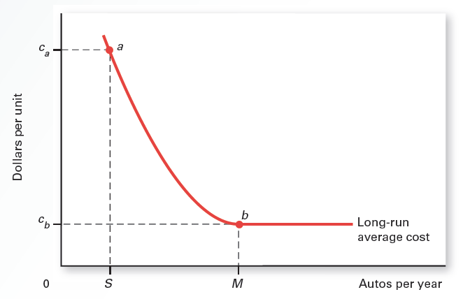
4 Economies of Scale as a Barrier to Entry
At point b, an existing firm can produce M or more automobiles at an average cost of c_{b}. A new entrant able to sell only S automobiles per year would incur a much higher average cost of c_{a} at point a. If automobile prices are below c_{a}, a new entrant would suffer a loss. In this case, economies of scale serve as a barrier to entry, insulating firms that have achieved minimum efficient scale from new competitors.

Slide 22
Three Models of (Approaches to) Oligopoly
Due to interdependence among firms, firms can either choose
  Cooperation or
  Fierce competition
Models of Oligopoly
  Collusion and Cartels
  Price leadership
  Game theory

Slide 23
Collusion and Cartels
Collusion and cartels are illegal in the U.S.
Collusion
  Agreement among firms to increase economic profit by:
      Dividing the market
      Fixing the price
Cartel
  A group of firms that agree to coordinate their production and pricing decisions to reap economic profit.

Slide 24
Collusion and Cartels (continued)
Cartels maximize profit by allocating output among cartel members so that the MC of the final unit produced by each firm is the same
Challenges of maintaining a cartel
  Differences in average cost
  Many firms in the cartel
  Low barriers to entry
  Cheating on the cartel agreement
  Technological change which can introduce new and cheap sources of supply

Slide 25
Price Leadership
  Informal or tacit collusion among firm
  No price competition
    Firms charge similar prices for their products
Price leader:
  Sets the price for the industry
  Initiates price changes
  Is followed by other firms (Price followers)
Obstacles
  U.S. antitrust laws
  Product differentiation: create brand name to charge higher price
  No guarantee others will follow

Slide 26
Game Theory
  Not Covered

Slide 27
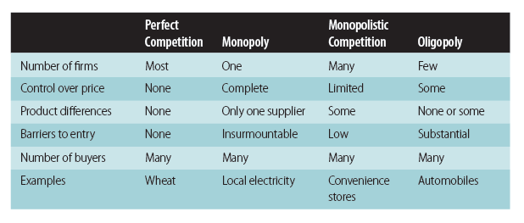
9 Comparison of Market Structures

Slide 28
Summary
Monopolistic competitor faces a downward-sloping demand curve and earns zero economic profit in the long run
Oligopoly can be traced to some form of barrier to entry, such as economies of scale, legal restrictions, etc.
Analyzing oligopoly behavior is difficult because oligopolists are interdependent
Perfect competition, monopoly, monopolistic competition, and oligopoly differ in terms of the number of firms, control over prices, product differences, etc.

