Slide 1
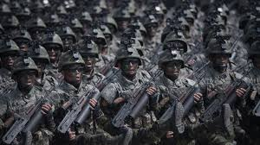
MILITARIZATION OF NORTH EAST ASIA
Student’s name
Institution affiliation
Professor
Course
Date

Slide 2
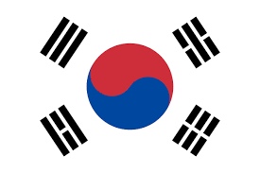
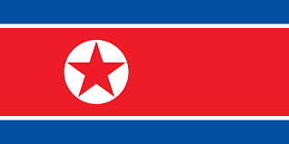


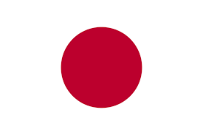
COUNTRIES INVLOVED

Slide 3
TENSIONS CIRCLE IN ASIA
Japan sees china as threat.
North Korea’s threat to Japan.
America’s threat to China.
North Korea’s threat to America.
America’s friendliness to Japan.
China’s friendliness to North Korea

Slide 4
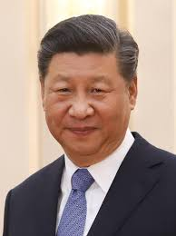
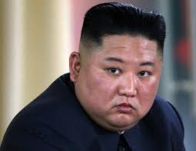
LEADER’S QUOTES
"We have an intent to successfully defend, consolidate and develop the China-Korea relations together with Korean comrades and propel the long-lasting and stable development of the socialist cause of the two countries” Xi Jinping- Chinese President
“We will continue to strengthen the war deterrent, the righteous self-defense means, so as to contain and control all the dangerous attempts and intimidatory acts by the hostile forces, including their sustained and aggravating nuclear threat,”- Kim Jong Un

Slide 5
CAUSES OF NORTH KOREA FAILURES
International sanctions
Manipulative external environments
Floods
Typhoons

Slide 6
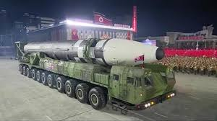
WEAPONS PARADED
MiG-29 fighters
Anti-tank guided missiles
Air defense radar
“Prototype” main battle tank
KN23, KN24, and KN25 missiles
Intercontinental-range ballistic missile (ICBM) missile

Slide 7
JAPAN: EFFECTS OR ARTICLE 9 CHANGE
Expansion of Japan’s forces
Change in weapon’s use standards.
Change in ability to use force.
Change in diplomatic relations tactics.
Eliminate constitution control.
Alter civil-military relations.

Slide 8
CAUSES OF JAPANESE TENSION
Testing of short and long range missiles by North Korea.
North Korea testing submarine missile launches in Japan.
North Korea kidnapping of Japanese citizens.
North Korea's aggressiveness in response.
Tension between American and North Korea.

Slide 9
MILITARIZATION OUTCOMES
Civil unrest.
Hostile diplomatic relations.
Hostile economic environment.
Political misunderstandings.
Wastage of country financial resources.
Derailment of development agendas.
Development into poor governance structures.
Threat to regional stability.

Slide 10
Final questions
Will demilitarization of North Korea ease tension in Northeast Asia?
If America is removed from the negotiation picture, will tension reduce in the region?
Can japan militarization strategy be pacified if its tension with South Korea is reduces?

Slide 11
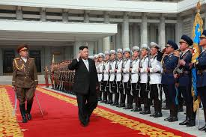
PROPOSED SOLUTIONS
Enhance cooperation.
Better policy coordination.
Mutual demilitarization.
Coordination of military spheres.
Changes to their strategic visions and goals.

