Slide 1
Al Moammar Information Systems Co.
Name
Institution of Affiliation

Slide 2
Al Moammar Information Systems Co
Al Moammar Information systems (MIS) is a Saudi company established in 1979 to empower local business with IT solutions.
The company has grown exponentially over the years, especially due to the popularity of technological applications.
MIS is now one of the most reliable and well-known companies in the sector of, software, hardware, and systems in Saudi Arabia.

Slide 3
Reasons for Selection of MIS
The reason for choosing the MIS firm is that the demand for systems and software is getting higher every day as seen in the pandemic era when almost everyone is studying or working online.
Another reason owes to the stock price of MIS; while last year it was in the range of 30s, it is now soaring at 150s and this is significant rise.

Slide 4
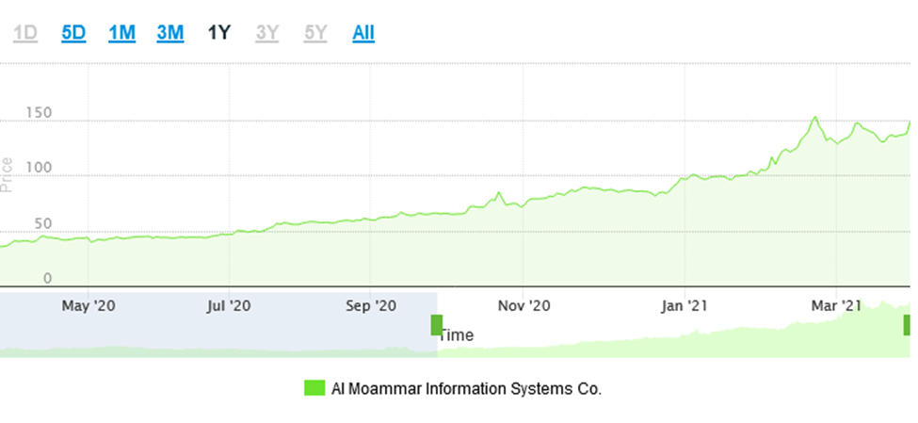
Notes:
Last year stock price for MIS

Slide 5
Reasons for Selection of MIS Cont...
The main reason for the significant price change is because of the demand on the systems from the companies.
Firms are procuring systems from MIS to enable their employees to work remotely during COVID-19.
Besides, MIS is participating in big projects such as establishing a digital bank in Saudi Arabia.
They also signed a contract with ministry of health on 2020/11/18 and maintain the digital infrastructure of 72 hospitals in the Eastern and northern region.

Slide 6
References
MIS, 2021
Tadawul, 2021

