Slide 1
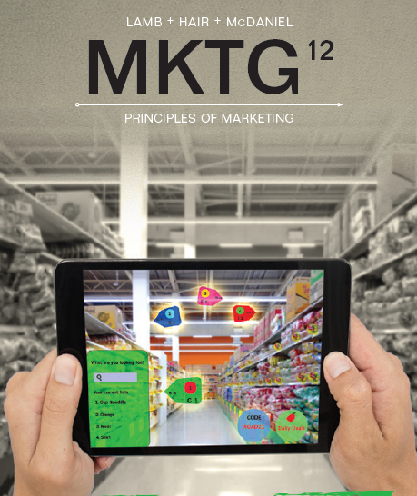

MKTG
Principles Of Marketing
Twelfth Edition
Chapter 8
Segmenting and Targeting Markets
© 2019 Cengage. All rights reserved.

Slide 2
Learning Outcomes
(slide 1 of 2)
8-1 Describe the characteristics of markets and market segments
8-2 Explain the importance of market segmentation
8-3 Discuss the criteria for successful market segmentation
8-4 Describe the bases commonly used to segment consumer markets
8-5 Describe the bases for segmenting business markets

Slide 3
Learning Outcomes
(slide 2 of 2)
8-6 List the steps involved in segmenting markets
8-7 Discuss alternative strategies for selecting target markets
8-8 Explain how CRM can be used as a targeting tool
8-9 Explain how and why firms implement positioning strategies and how product differentiation plays
a role

Slide 4
Markets and Market Segments
Market: people or organizations with needs or wants and the ability and willingness to buy
Market segment: a subgroup of people or organizations sharing one or more characteristics that cause them to have similar product needs
Market segmentation: the process of dividing a market into meaningful, relatively similar, and identifiable segments or groups
Notes:
The term market means different things to different people.
Familiar markets such as supermarket, stock market, labor market, fish market, and flea market share several characteristics.
A market is composed of people or organizations who:
Have wants and needs that can be satisfied by particular product categories.
Have the ability to buy the products they seek.
Are willing to exchange their resources, usually money or credit, for desired products.
A market segment is a subgroup of people or organizations sharing one or more characteristics that cause them to have similar product needs
The purpose of market segmentation is to enable the marketer to tailor marketing mixes to meet the needs of one or more specific segments.

Slide 5
Importance of Market Segmentation
Plays a key role in the marketing strategy of successful organizations
Powerful marketing tool
Helps marketers define customer needs and wants precisely
Helps decision makers define objectives and allocate resources more accurately
Notes:
Until the 1960s, market segmentation was not used extensively.
Example: Before 1960, the Coca-Cola Company produced only one beverage and aimed it at the entire soft drink market. Today, over a dozen different products are offered by the company to different market segments based on diverse customer preferences.
Plays a key role in the marketing strategy of successful organizations
Powerful marketing tool
Helps marketers define customer needs and wants precisely
Helps decision makers define objectives and allocate resources more accurately
Performance can be better evaluated when objectives are more precise
Discussion/Team Activity
Name different fashion retailers and identify their market segmentation strategies.

Slide 6
Discussion Point
Market Segmentation
Look at some of the Coca-Cola Company’s product lines:
  Coca-Cola
  Coke Zero Sugar
  DaSani
  Powerade
  Gold Peak Tea
  Honest tea
  Sprite
  Smart water
How do these product lines fit the needs
of different market segments?
Notes:
Answers will vary.
Consider similar product lines (DaSani/Smartwater, Coca-Cola/Coke Zero Sugar/Sprite, Honest tea/Gold Peak tea). How do the target markets differ for those similar product lines?

Slide 7
Criteria for Successful Segmentation
Marketers segment markets for three reasons:
  To identify groups of customers with similar needs and analyze the characteristics and buying behavior of these groups
  Segmentation provides marketers with information to help them design marketing mixes specifically for one or more segments
  Segmentation is consistent with the marketing concept of satisfying customer wants and needs while meeting the organization’s objectives
A market segment must meet four criteria:
  Substantiality
  Identifiability and measurability
  Accessibility
  Responsiveness
Notes:
Markets are segmented for three reasons:
Segmentation enables the identification of groups of customers with similar needs and the analysis of the buying behavior of these groups.
Segmentation provides information to design marketing mixes to match the characteristics of the segment.
Segmentation helps marketers satisfy customer wants and needs while meeting the organization’s objectives.
A market segment must meet four criteria:
Substantiality: Segment must be large enough to warrant developing and maintaining a special marketing mix.
Identifiability and measurability: Segment must be identifiable and its size measurable
Accessibility: Marketing mix must be reachable to members of targeted segments.
Responsiveness: Segment need not be treated separately unless it respond differently to a marketing mix

Slide 8
Bases for Segmenting Consumer Markets
Segmentation bases (variables): characteristics of individuals, groups, or organizations
  Geography
  Demographics
  Psychographics
  Benefits sought
  Usage rate
Notes:
Segmentation bases (variables): characteristics of individuals, groups, or organizations
An inappropriate segmentation strategy could lead to lost sales and missed profit opportunities
Markets can be segmented using a single variable or several
Geography
Demographics
Psychographics
Benefits sought
Usage rate

Slide 9
Geographic Segmentation
Geographic segmentation: segmenting markets by region of a country or the world, market size, market density, or climate
Notes:
Geographic segmentation: segmenting markets by region of a country or the world, market size, market density, or climate
Market density is the number of people within a unit of land
Geographic segmentation is useful for companies needing to find ways to grow
Ex. Target opening smaller stores in urban locations. Smaller, quick-tip shopping, and services tailored to customers living in large cities.
Discussion/Team Activity
Discuss the marketing of regional brands/products in various areas of the country.

Slide 10
Demographic Segmentation
Demographic segmentation: segmenting markets by age, gender, income, ethic background, and family life cycle
Notes:
Demographic segmentation: segmenting markets by age, gender, income, ethic background, and family life cycle
Demographic information is widely available and often related to consumers' buying and consuming behavior.

Slide 11
Age Segmentation
Segments markets by age into the following cohorts:
  Generation Z
  Millennials
  Generation X
  Baby Boomers
  War generation
  Great Depression generation
Notes:
Companies choose to segment by age because the needs of Baby Boomers are different from those of Generation Z

Slide 12
Gender and Income Segmentation
Gender segmentation
  Uses different strategies for men and women
  Many marketers are going after the less-traditional market
Income segmentation
  Income level influences consumers’ wants and determines their buying power
  Retailers can appeal to low-income or high-income categories, or both
Notes:
Women make 85 percent of consumer goods purchases annually.
Women tend to view money and wealth differently than men do.
They don’t seek to accumulate money but see it as a way to care for their families, improve their lives, and find security.
Marketers of products such as clothing and cosmetics still segment markets by gender.
Many of these marketers are going after the less-traditional male market.
Income influences consumers’ wants and determines their buying power

Slide 13
Ethnic Segmentation
Some companies make products geared toward specific ethnic groups
  To meet the needs and wants of expanding populations
Largest ethnic groups in the United States:
  Hispanic Americans
  African Americans
  Asian Americans
Notes:
In the past, ethnic groups in the United States were expected to conform to a homogenized, Anglo-centric ideal. Increasing numbers of ethnic minorities and increased buying power have changed this.
Some companies make products geared toward specific ethnic groups
To meet the needs and wants of expanding populations
Largest ethnic groups in the United States:
Hispanic Americans
African Americans
Asian Americans

Slide 14
Family Life Cycle Segmentation
Family life cycle (FLC): a series of stages determined by a combination of age, marital status, and the presence or absence of children
Consumption patterns among people of the same age and gender differ because they are in different stages of the family life cycle
The horizontal flow shows the traditional FLC
Notes:
Family life cycle (FLC): a series of stages determined by a combination of age, marital status, and the presence or absence of children
Consumption patterns among people of the same age and gender differ because they are in different stages of the family life cycle

Slide 15
Bases for Psychographic Segmentation
Psychographic segmentation: segmenting markets on the basis of personality, motives, lifestyles, and geodemographics
  Personality
  Motives
  Lifestyles
  Geodemographics
Geodemographic segmentation: segmenting potential customers into neighborhood lifestyle categories
Notes:
Psychographic segmentation: segmenting markets on the basis of personality, motives, lifestyles, and geodemographics
Personality reflects a person’s traits, attitudes, and habits.
Example: People buy clothes that they feel represent their personalities and give others an idea of who they are.
Motives: Marketers might appeal to emotional, rational, or status-related motives, among others.
Example: Carmakers might appeal to customers with status-related motives, whereas makers of baby product might appeal to emotional motives.
Lifestyle segmentation divides people into groups according to the way they spend their time, the importance of the things around them, their beliefs, and socioeconomic characteristics such as income and education.
Geodemographic segmentation: It is segmenting potential customers into neighborhood lifestyle categories.
It helps marketers develop marketing programs tailored to prospective buyers who live in small geographic regions, such as neighborhoods, or who have very specific lifestyle and demographic characteristics.
It combines geographic, demographic, and lifestyle segmentation.

Slide 16
Discussion Point
Geodemographic Segmentation
Visit the following website:
  www.mybestsegments.com
Search for the zip code(s) around the area of your college or university
What geodemographic segments are identified?
What are the traits of the segments identified?
How might marketers reach them?
Notes:
Answers will vary.
(Alternatively, you can visit esri’s tapestry segmentation website at: www.esri.com/en-us/arcgis/products/tapestry-segmentation/zip-lookup)
Click on one of the geodemographic segments identified for further information
What are the traits of that segment? How might marketers best reach them?
What local retailers/restaurants cater to these segments? How?

Slide 17
Benefit and Usage-Rate Segmentation
Benefit segmentation: the process of grouping customers into market segments according to the benefits they seek from the product
Usage-rate segmentation: dividing a market by the amount of product bought or consumed
80/20 principle: a principle holding that 20 percent of all customers generate 80 percent of the demand
Notes:
Most types of market segmentation are based on the assumption that the selected variable(s) and customers’ needs are related.
Benefit segmentation groups potential customers on the basis of their needs or wants only.
Segmenting by usage rate enables marketers to focus efforts on heavy users or to develop multiple marketing mixes aimed at different segments.
The focus of marketing is often on the heavy-user segment, based on the 80/20 principle.
Frequency/loyalty programs aim to develop customers into heavy users
Discussion/Team Activity
What programs do companies use to develop customers into heavy users? The list should include airlines' frequent flyer programs and in-store coupon dispensing.

Slide 18
Bases for Segmenting Business Markets
The business market consists of four broad segments: producers, resellers, government, and institutions.
Further market segmentation offers just as many benefits to business marketers as it does to consumer product marketers.
Notes:
The business market consists of four segments: producers, resellers, government, and institutions.
Further market segmentation offers just as many benefits to business marketers as it does to consumer product marketers.

Slide 19
Company Characteristics
Geographic location
Type of company
Company size
Product use
Volume of purchase (heavy, moderate, light) is a commonly used basis for business segmentation
Notes:
Geographic location is helpful because some buyers buy from local suppliers
Segmenting by customer type allows business marketers to tailor their marketing mixes to the unique needs of particular types of organizations or industries.
Volume of purchase (heavy, moderate, light) is a commonly used basis for business segmentation.
The ways in which customers use a product may influence the amount they buy, their buying criteria, and their selection of vendors.

Slide 20
Buying Processes
Satisficers: business customers who place an order with the first familiar supplier to satisfy product and delivery requirements
Optimizers: business customers who consider numerous suppliers, both familiar and unfamiliar, solicit bids, and study all proposals carefully before selecting one
Notes:
Many business marketers find it helpful to segment customers and prospective customers on the basis of how they buy.
Two purchasing profiles that have been identified are:
Satisficers: business customers who place an order with the first familiar supplier to satisfy product and delivery requirements
Optimizers: business customers who consider numerous suppliers, both familiar and unfamiliar, solicit bids, and study all proposals carefully before selecting one

Slide 21
Steps in Segmenting a Market
The purpose of market segmentation is to identify marketing opportunities
Select a market or product category for study
Choose a basis or bases for segmentation
Select segmentation descriptors
Profile and analyze segments
Select markets
Design, implement, and maintain appropriate marketing mixes
Notes:
The purpose of market segmentation is to identify marketing opportunities
Select a market or product category for study
Define the overall market or product category to be studied
Choose a basis or bases for segmentation
Requires managerial insight, creativity, and market knowledge
Select segmentation descriptors
Descriptors identify the specific segmentation variables to use
Profile and analyze segments
Profile should include segment size, expected growth, purchase frequency, current brand usage, brand loyalty, and long-term sales and profit potential
Select markets
A natural outcome of the segmentation process. Directly influences and determines the marketing mix
Design, implement, and maintain appropriate marketing mixes
Product, place (distribution), promotion, and pricing strategies

Slide 22
Strategies for Selecting Target Markets
Target market: a group of people or organizations for which an organization designs, implements, and maintains a marketing mix intended to meet the needs of that group, resulting in mutually satisfying exchanges
Strategies for selection:
  Undifferentiated targeting
  Concentrated targeting
  Multi segment targeting
Notes:
Market segmentation is the first step in determining whom to approach about buying a product. The next task is to choose one or more target markets.
Target market: a group of people or organizations for which an organization designs, implements, and maintains a marketing mix intended to meet the needs of that group, resulting in mutually satisfying exchanges
Because most markets will include customers with different lifestyles, backgrounds, and income levels, it is unlikely that a single marketing mix will attract all segments of the market.

Slide 23
Target Marketing Strategies
Undifferentiated targeting strategy: a marketing approach that views the market as one big market with no individual segments and thus uses a single marketing mix
Concentrated targeting strategy: a strategy used to select one segment of a market for targeting marketing efforts
  Niche: one segment of a market
Multisegment targeting strategy: a strategy that chooses two or more well-defined market segments and develops a distinct marketing mix for each
  Cannibalization: a situation that occurs when sales of a new product cut into sales of a firm’s existing products
Notes:
Undifferentiated targeting strategy
Essentially a mass-market philosophy—viewing the market as one big market and using one marketing mix
The first firm in an industry sometimes uses this strategy.
With no competition, the firm may not need to tailor marketing mixes to the preferences of market segments.
Too often, it emerges by default rather than by design, reflecting a failure to consider the advantages of a segmented approach.
The result is often sterile, unimaginative product offerings that have little appeal to anyone.
Concentrated targeting strategy
A firm selects a niche for targeting its marketing efforts.
Because the firm is appealing to a single segment, it can concentrate on understanding the needs, motives, and satisfactions of that segment’s members and on developing and maintaining a highly specialized marketing mix.
Multisegment Targeting Strategy
A firm that chooses to serve two or more well-defined market segments and develops a distinct marketing mix for each
Example: P&G offers 18 different laundry detergents, each targeting a different segment of the market.
A risk of multisegment targeting is cannibalization: a situation that occurs when sales of a new product cut into sales of a firm’s existing products

Slide 24
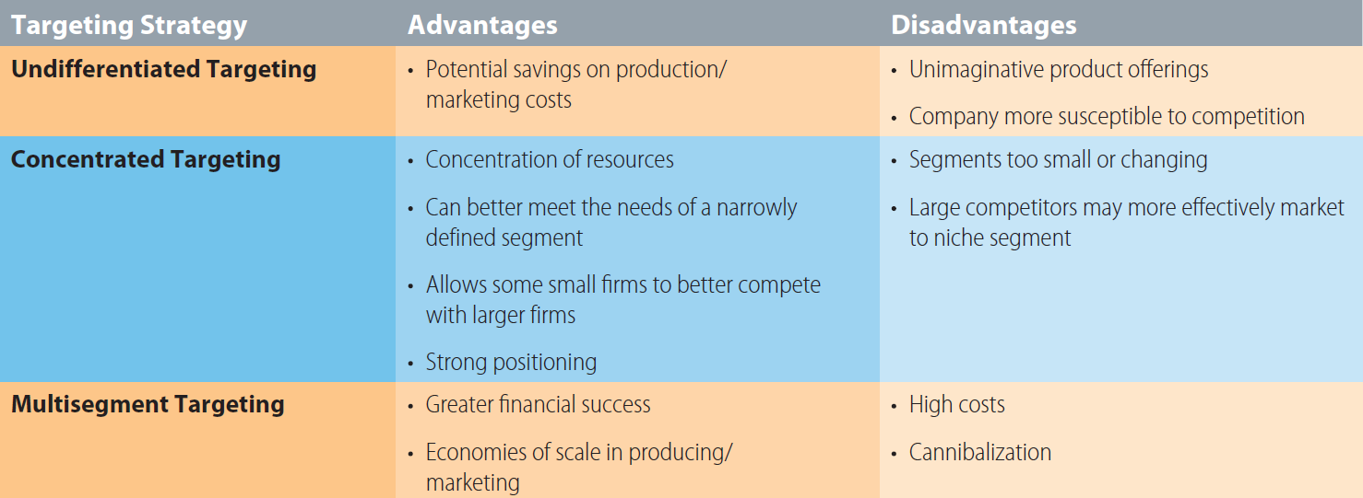
Exhibit 8.2 Advantages and Disadvantages of Target Marketing Strategies

Slide 25
CRM as a Targeting Tool
(slide 1 of 2)
Companies that successfully implement CRM tend to customize the goods and services offered to their customers
  Based on data generated through interactions between carefully defined groups of customers and the company
Can allow marketers to target customers with extremely relevant offerings
Notes:
Companies that successfully implement CRM tend to customize the goods and services offered to their customers
Based on data generated through interactions between carefully defined groups of customers and the company
Can allow marketers to target customers with extremely relevant offerings

Slide 26
CRM as a Targeting Tool
(slide 2 of 2)
Trends leading to the continuing growth of CRM:
  Personalization
  Time savings
  Loyalty
  Technology
Notes:
Trends leading to the continuing growth of CRM:
Personalization: One-size-fits-all marketing is no longer relevant.
Time savings: Direct and personal marketing efforts will continue to grow to meet the needs of consumers who no longer have the time to spend shopping and making purchase decisions.
Loyalty: Consumers will be loyal only to those companies and brands that have earned their loyalty and reinforced it at every purchase occasion.
Technology: Mass-media approaches will decline in importance as advances in market research and database technology allow marketers to collect detailed information on their customers.

Slide 27
Positioning
Positioning: developing a specific marketing mix to influence potential customers’ overall perception of a brand, product line, or organization in general
  Position: the place a product, brand, or group of products occupies in consumers’ minds relative to competing offerings
Product differentiation: a positioning strategy that some firms use to distinguish their products from those of competitors
Notes:
Positioning: developing a specific marketing mix to influence potential customers’ overall perception of a brand, product line, or organization in general
Position is the place a product, brand, or group of products occupies in consumers’ minds relative to competing offerings.
Positioning assumes that consumers compare products on the basis of important features.
Product differentiation is the positioning strategy used by firms to distinguish their products from those of competitors
Effective positioning requires:
Assessing the positions occupied by competing products.
Determining the important dimensions underlying these positions.
Choosing a position in the market where the marketing efforts will have the greatest impact.

Slide 28
Perceptual Mapping
Perceptual mapping: a means of displaying or graphing the location of products, brands, or groups of products in customers’ minds
Notes:
Perceptual mapping: a means of displaying or graphing the location of products, brands, or groups of products in customers’ minds

Slide 29
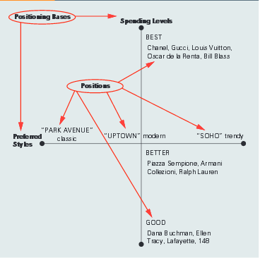
Exhibit 8.3: Perceptual Map and Positioning Strategy for
Saks Department Stores

Slide 30
Discussion Point
Perceptual Map
Create a perceptual map for fast food restaurants
Notes:
Answers will vary
Have students choose the labels for the dimensions. Examples might be: healthy/not healthy, low price/high price, limited variety/wide variety
Where are there opportunities for a new restaurant?

Slide 31
Positioning Bases
(slide 1 of 2)
Attribute: A product is associated with an attribute, product feature, or customer benefit
Price and quality: This positioning base may stress high price as a signal of quality or emphasize low price as an indication of value
Use or application: Stressing uses or applications can be an effective means of positioning a product with buyers
Product user: This positioning base focuses on a personality or type of user
Notes:
Attribute: Association of a product with an attribute, product feature, or customer benefit
Price and quality: High price as a signal of quality or low price as an indicator of value
Use or application: Stresses on uses or applications
Product user: Focuses on a personality or type of user

Slide 32
Positioning Bases
(slide 2 of 2)
Product class: The objective here is to position the product as being associated with a particular category
of products
Competitor: Positioning against competitors is part of any positioning strategy
Emotion: Positioning using emotion focuses on how the product makes customers feel
Notes:
Product class: Positioning a product as being associated with a particular category
Competitor: Positioning against competitors is part of any positioning strategy.
Emotion: Focuses on how the product makes customers feel

Slide 33
Repositioning
Repositioning: changing consumers’ perceptions of a brand in relation to competing brands
Notes:
Repositioning: changing consumers’ perceptions of a brand in relation to competing brands
Sometimes products or companies are repositioned in order to sustain growth in slow markets or to correct positioning mistakes

Slide 34
Key Terms
(slide 1 of 3)
Market
Market segment
Market segmentation
Segmentation bases (variables)
Geographic segmentation
Demographic segmentation
Family life cycle (FLC)
Psychographic segmentation
Geodemographic segmentation

Slide 35
Key Terms
(slide 2 of 3)
Benefit segmentation
Usage-rate segmentation
80/20 principle
Satisficers
Optimizers
Target market
Undifferentiated targeting strategy
Concentrated targeting strategy
Niche

Slide 36
Key Terms
(slide 3 of 3)
Multi segment targeting strategy
Cannibalization
Positioning
Position
Product differentiation
Perceptual mapping
Repositioning

