Slide 1
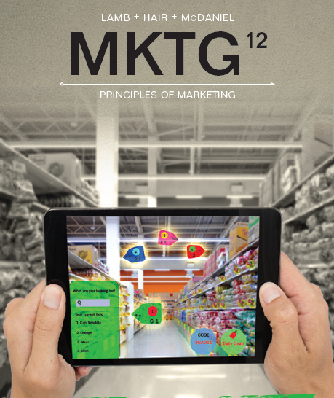

MKTG
Principles Of Marketing
Twelfth Edition
Chapter 16
Advertising, Public Relations, and
Sales Promotion
© 2019 Cengage. All rights reserved.

Slide 2
Learning Outcomes
16-1 Discuss the effects of advertising on market share and consumers
16-2 Identify the major types of advertising
16-3 Discuss the creative decisions in developing an advertising campaign
16-4 Describe media evaluation and selection techniques
16-5 Discuss the role of public relations in the promotional mix
16-6 Define and state the objectives of sales promotion and the tools used to achieve them

Slide 3
The Effects of Advertising
Popular form of promotion, especially for consumer packaged goods and services
Advertising is seen as an international endeavor
Promotional spending is divided into:
  Measured media: network and cable TV, newspapers, magazines, radio, outdoor, and the Internet
  Unmeasured media: direct marketing, promotions, co-op, coupons, catalogs, product placement, and event marketing
Notes:
Popular form of promotion, especially for consumer packaged goods and services
Advertising is seen as an international endeavor
Promotional spending is divided into:
Measured media: network and cable TV, newspapers, magazines, radio, outdoor, and the Internet
Unmeasured media: direct marketing, promotions, co-op, coupons, catalogs, product placement, and event marketing

Slide 4
Advertising and Market Share
Advertising is utilized for maintaining brand awareness and market share
New brands with small market shares spend more on advertising and sales promotion because of the following two reasons:
  Advertising response function: a phenomenon in which spending for advertising and sales promotion increases sales or market share to certain level but then produces diminishing returns
  Requirement of a minimum level of exposure to measurably affect purchase habits
Notes:
Advertising is utilized for maintaining brand awareness and market share
New brands with small market shares spend more on advertising and sales promotion because of the following two reasons:
Advertising response function: a phenomenon in which spending for advertising and sales promotion increases sales or market share to certain level but then produces diminishing returns
Requirement of a minimum level of exposure to measurably affect purchase habits

Slide 5
The Effects of Advertising on Consumers
Advertising affects peoples’ daily lives, informing them about products and services and influencing their attitudes, beliefs, and, ultimately, their purchases
Helps change a consumer’s negative attitude toward a product into a positive one
Reinforces positive attitudes toward brands
Can affect the way a consumer ranks a brand’s attributes
Notes:
Advertising affects peoples’ daily lives, informing them about products and services and influencing their attitudes, beliefs, and, ultimately, their purchases
Helps change a consumer’s negative attitude toward a product into a positive one
Reinforces positive attitudes toward brands
Can affect the way a consumer ranks a brand’s attributes

Slide 6
Discussion Point
Advertising
Discuss advertisements that are memorable. What makes them stand out?
Notes:
Answers will vary

Slide 7
Institutional Advertising
Institutional advertising: a form of advertising designed to enhance a company’s image rather than promote a particular product
  Advocacy advertising: a form of advertising in which an organization expresses its views on controversial issues or responds to media attacks
Notes:
Institutional advertising is designed to establish, change, or promote the corporation’s identity as a whole.
Institutional advertising: a form of advertising designed to enhance a company’s image rather than promote a particular product
A form of institutional advertising is advocacy advertising and is typically used to safeguard against negative consumer attitudes and to enhance the company’s credibility among consumers who already favor its position.
Advocacy advertising: a form of advertising in which an organization expresses its views on controversial issues or responds to media attacks
Discussion/Team Activity
Discuss examples of institutional advertising and the industries that frequently use this form.

Slide 8
Product Advertising
(slide 1 of 2)
Product advertising: a form of advertising that touts the benefits of a specific good or service
  Pioneering advertising: a form of advertising designed to stimulate primary demand for a new product or product category
    Used in the introductory stage of the product life cycle
    Offers consumers’ in-depth information about the benefits of the product class
Notes:
Product advertising: a form of advertising that touts the benefits of a specific good or service
Pioneering advertising: a form of advertising designed to stimulate primary demand for a new product or product category
Used in the introductory stage of the product life cycle
Offers consumers’ in-depth information about the benefits of the product class

Slide 9
Product Advertising
(slide 2 of 2)
  Competitive advertising: a form of advertising designed to influence demand for a specific brand
    Used when product enters its growth phase
    Goal—Influence demand for a specific brand
  Comparative advertising: a form of advertising that compares two or more specifically named or shown competing brands on one or more specific attributes
    Used when products experience slow growth or when competition in the market is strong
Notes:
Competitive advertising: a form of advertising designed to influence demand for a specific brand
Used when product enters its growth phase
Goal—Influence demand for a specific brand
Comparative advertising: a form of advertising that compares two or more specifically named or shown competing brands on one or more specific attributes
Used when products experience slow growth or when competition in the market is strong
Before the 1970s, comparative advertising was allowed only if the competing brand was veiled and unidentified.

Slide 10
Creative Decisions in Advertising
Advertising campaign: a series of related advertisements focusing on a common theme, slogan, and set of advertising appeals
Advertising objective: a specific communication task that a campaign should accomplish for a specified target audience during a specified period
DAGMAR approach helps set objectives that defines:
  Target audience
  Desired percentage change in some specified measure
  of effectiveness
  Time frame for the change
Notes:
Advertising campaign: a series of related advertisements focusing on a common theme, slogan, and set of advertising appeals
Advertising objective: a specific communication task that a campaign should accomplish for a specified target audience during a specified period
DAGMAR approach (defining advertising goals for measured advertising results) helps set objectives that defines:
Target audience
Desired percentage change in some specified measure
of effectiveness
Time frame for the change

Slide 11
Identifying Products Benefits
Sell the benefits of a product, not its attributes
  An attribute is simply a feature of the product
  A benefit is what consumers will receive or achieve by using the product, such as convenience or ease of use
Notes:
Sell the benefits of a product, not its attributes
An attribute is simply a feature of the product
A benefit is what consumers will receive or achieve by using the product, such as convenience or ease of use

Slide 12
Developing and Evaluating
Advertising Appeals
Advertising appeal: a reason for a person to buy a product
  It must make a positive impression and be desirable to the target market
  It must be exclusive or unique
Unique selling proposition: a desirable, exclusive, and believable advertising appeal selected as the theme for
a campaign
  Often becomes part of the campaign’s slogan
Notes:
Advertising appeal: a reason for a person to buy a product
It must make a positive impression and be desirable to the target market
It must be exclusive or unique
Unique selling proposition: a desirable, exclusive, and believable advertising appeal selected as the theme for
a campaign
Often becomes part of the campaign’s slogan

Slide 13
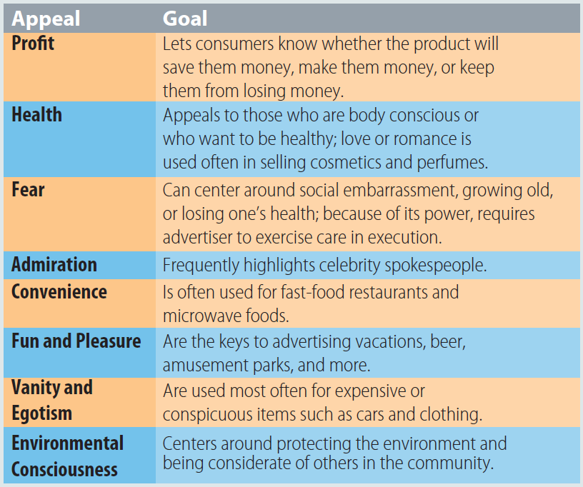
Exhibit 16.1: Common Advertising Appeals

Slide 14
Discussion Point
Advertising Appeal
Consider the following:
  Allstate’s Mayhem commercials
  Pampers diapers
  Ring doorbell system
  Universal Studios theme parks
  Lincoln commercials with Matthew McConaughey
  What type of appeal(s) do these companies or
  products use in their advertising?
Notes:
Answers
Humor and fear
Emotional
Safety and convenience
Fun and pleasure
Admiration

Slide 15
Executing the Message
The style in which information is portrayed
The AIDA plan is a good blueprint for executing an advertising message
The style in which the message is executed is one of the most creative elements of an advertisement
Injecting humor into an advertisement is a popular and effective executional style
Notes:
The style in which information is portrayed
The AIDA plan is a good blueprint for executing an advertising message
The style in which the message is executed is one of the most creative elements of an advertisement
Injecting humor into an advertisement is a popular and effective executional style

Slide 16
Post-Campaign Evaluation
Many advertising campaigns aim to create an image for the good instead of asking for action, so their real effect
is unknown
Before a campaign is released, pretests are used to determine the best advertising appeal, layout, and media vehicle
Testing ad effectiveness can be done before and/or after the campaign
Notes:
Before a campaign is released, pretests are used to determine the best advertising appeal, layout, and media vehicle.
Testing ad effectiveness can be done before and/or after the campaign.
Post-campaign evaluation can be the most demanding task facing advertisers.

Slide 17
Media Decisions in Advertising
Medium: the channel used to convey a message to a target market
  Selection of the medium is determined by promotional objectives and the appeal and executional style of the advertising
Media planning: the series of decisions advertisers make regarding the selection and use of media, allowing the marketer to optimally and cost-effectively communicate the message to the target audience
Notes:
Medium: the channel used to convey a message to a target market
Selection of the medium is determined by promotional objectives and the appeal and executional style of the advertising
Media planning: the series of decisions advertisers make regarding the selection and use of media, allowing the marketer to optimally and cost-effectively communicate the message to the target audience

Slide 18
Media Types
(slide 1 of 3)
Six major advertising media:
  Newspapers
    Cooperative advertising: an arrangement in which the manufacturer and the retailer split the costs of advertising the manufacturer’s brand
  Magazines
  Radio
  Television
    Infomercial: a 30-minute or longer advertisement that looks more like a television talk show than a sales pitch
Notes:
Six major advertising media:
Newspapers
Advantages: geographic flexibility and timeliness
Disadvantages: Not good for reaching a narrow market, distractions from competing ads and news stories
Cooperative advertising: an arrangement in which the manufacturer and the retailer split the costs of advertising the manufacturer’s brand
Magazines
Cost per contact is high
Radio
Advantages: selectivity and audience segmentation, a large out-of-home audience, low unit and production costs, timeliness, and geographic flexibility
Television
Advertising time can be expensive
Infomercial: a 30-minute or longer advertisement that looks more like a television talk show than a sales pitch
Concern about the rise in popularity of digital video recorders (DVRs)

Slide 19
Media Types
(slide 2 of 3)
  The Internet
    Advergaming: placing advertising messages in web-based, mobile, console, or handheld video games to advertise or promote a product, service, organization,
    or issue
  Outdoor media
  Alternative media
Notes:
The Internet
Advergaming: placing advertising messages in web-based, mobile, console, or handheld video games to advertise or promote a product, service, organization,
or issue
Outdoor media
Flexible, low-cost medium
Billboards, skywriting, giant inflatables, mini billboards in malls, signs in sports arenas, etc.
Reaches a broad and diverse market
Alternative media
Shopping carts, computer screen savers, interactive kiosks, ads before movies at the cinema, etc.

Slide 20
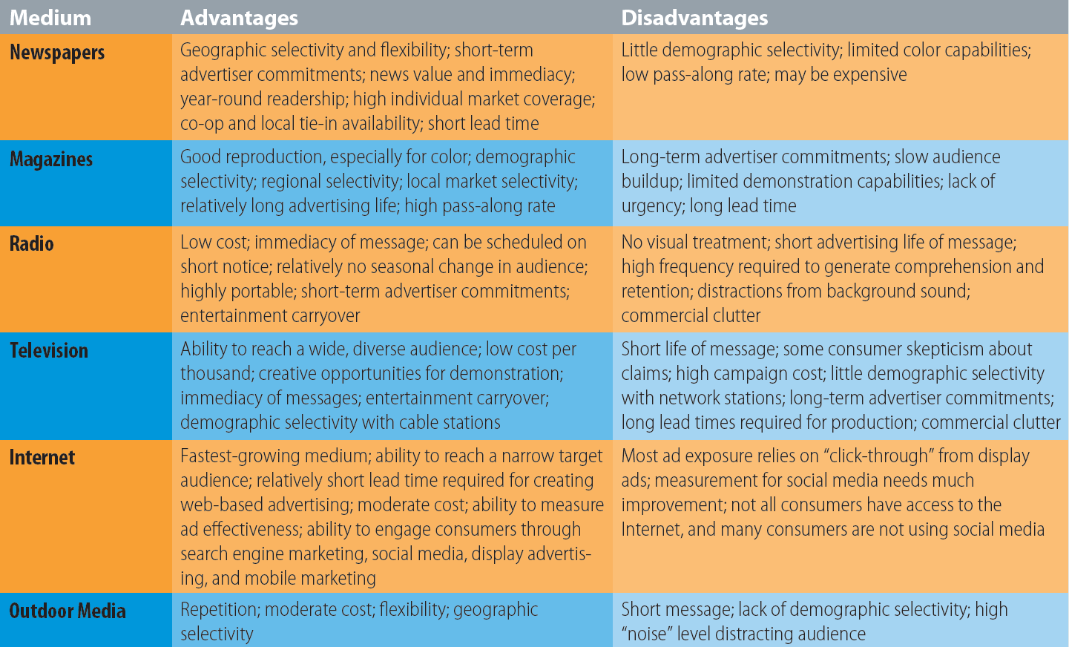
Exhibit 16.3: Advantages and Disadvantages of Major Advertising Media

Slide 21
Media Selection Considerations
(slide 1 of 2)
Media mix: the combination of media to be used for a promotional campaign
  Cost per contact (cost per thousand or CPM): the cost of reaching one member of the target market
  Cost per click: the cost associated with a consumer clicking on a display or banner ad
  Reach: the number of target customers who are exposed to commercial at least once during a specific period, usually four weeks
  Frequency: the number of times an individual is exposed to a given message during a specific period
Notes:
Media mix: the combination of media to be used for a promotional campaign
Based on several factors:
Cost per contact (cost per thousand or CPM): the cost of reaching one member of the target market
Marketers can compare the cost of different media vehicles
Cost per click: the cost associated with a consumer clicking on a display or banner ad
Pay for only “engaged” consumers
Reach: the number of target customers who are exposed to commercial at least once during a specific period, usually four weeks
Frequency: the number of times an individual is exposed to a given message during a specific period

Slide 22
Media Selection Considerations
(slide 2 of 2)
  Audience selectivity: the ability to reach a precisely defined market
  Flexibility: ability to change advertisement quickly
  Noise level: the level of distraction experienced by the target audience in a medium
  Life span: messages can either quickly fade or persist as tangible copy to be carefully studied
  Media fragmentation: resulting from proliferation of media
Notes:
Audience selectivity: the ability to reach a precisely defined market
General newspapers and network tv appeal to a wide cross section of the population, others appeal to specific groups
Flexibility: ability to change advertisement quickly
Magazines are less flexible due to long lead time than radio and Internet advertising
Noise level: the level of distraction experienced by the target audience in a medium
Newspapers and magazines have a high noise level, direct mail has a low noise level
Life span: messages can either quickly fade or persist as tangible copy to be carefully studied
Radio commercials are short, but can be repeated
Media fragmentation: resulting from proliferation of media
Marketers must pay as much attention to where they place their advertising as to how often the ad is repeated

Slide 23
Media Scheduling
Media schedule: designation of the media, the specific publications or programs, and the insertion dates of advertising
  Continuous media schedule: a media scheduling strategy in which advertising is run steadily throughout the advertising period; used for products in the later stages of the product life cycle
  Flighted media schedule: a media scheduling strategy in which ads are run heavily every other month or every two weeks to achieve a greater impact with an increased frequency and reach at those times
  Pulsing media schedule: a media scheduling strategy in which that uses continuous scheduling throughout the year coupled with a flighted schedule during the best sales periods
  Seasonal media schedule: a media scheduling strategy that runs advertising only during times of the year when the product is likely to be used
Notes:
After choosing the media for the campaign, advertisers must schedule the ads.
A media schedule designates the medium or media to be used, the specific vehicles, and the insertion dates of the advertising.
Continuous media schedule: a media scheduling strategy in which advertising is run steadily throughout the advertising period; used for products in the later stages of the product life cycle
Examples include Ivory soap and Charmin toilet tissue.
Flighted media schedule: a media scheduling strategy in which ads are run heavily every other month or every two weeks to achieve a greater impact with an increased frequency and reach at those times
Examples include movie ads on Wednesday and Thursday nights.
Pulsing media schedule: a media scheduling strategy in which that uses continuous scheduling throughout the year coupled with a flighted schedule during the best sales periods
Examples include Thanksgiving, Christmas, and back-to-school sales.
Seasonal media schedule: a media scheduling strategy that runs advertising only during times of the year when the product is likely to be used
Examples include cold medication and sunscreen lotion.
Recency planning is the theory of scheduling television advertising for frequently purchased products, such as Coca-Cola and Tide detergent.
Its main premise is to influence the brand choice of people who are ready to buy.

Slide 24
Public Relations
Public relations: the element in the promotional mix that evaluates public attitudes, identifies issues that may elicit public concern, and executes programs to gain public understanding and acceptance
  Public relations campaigns fit into overall marketing plans and focus on targeted audiences
Publicity: the effort to capture media attention, often initiated through press releases that further a corporation’s public relations plans
Notes:
Public relations: the element in the promotional mix that evaluates public attitudes, identifies issues that may elicit public concern, and executes programs to gain public understanding and acceptance
Public relations campaigns fit into overall marketing plans and focus on targeted audiences
Publicity: the effort to capture media attention, often initiated through press releases that further a corporation’s public relations plans

Slide 25
Major Public Relations Tools
(slide 1 of 2)
New-product publicity helps advertisers about their new product by prompting free news or positive words
Product placement: a public relations strategy that involves getting a product, service, or company name to appear in a movie, television show, radio program, magazine, newspaper, video game, video or audio clip, book, or commercial for another product; on the Internet; or at special events
Consumer education
Notes:
New-product publicity helps advertisers about their new product by prompting free news or positive words
Product placement: a public relations strategy that involves getting a product, service, or company name to appear in a movie, television show, radio program, magazine, newspaper, video game, video or audio clip, book, or commercial for another product; on the Internet; or at special events
Global product placement expenditures total about $10.5 billion annually
Consumer education
Example: Financial planning firms may sponsor free seminars on money management, retirement planning, and investing

Slide 26
Major Public Relations Tools
(slide 2 of 2)
Sponsorship: a public relations strategy in which a company spends money to support an issue, cause, or event that is consistent with corporate objectives, such as improving brand awareness or enhancing corporate image
Experiential marketing
Company websites
Notes:
Sponsorship: a public relations strategy in which a company spends money to support an issue, cause, or event that is consistent with corporate objectives, such as improving brand awareness or enhancing corporate image
Biggest category of sponsorship is sports
Companies can sponsor issues like education, health care, and social programs
Experiential marketing—involves engaging with consumers in a way that enables them to feel the brand
Company websites—used to:
introduce new products
provide information to the media
include social media news releases
promote existing products
obtain consumer feedback
communicate legislative and regulatory information

Slide 27
Managing Unfavorable Publicity
Crisis management: a coordinated effort to handle all the effects of unfavorable publicity or another unexpected unfavorable event
Notes:
Crisis management: a coordinated effort to handle all the effects of unfavorable publicity or another unexpected unfavorable event

Slide 28
Sales Promotion
Sales promotion: marketing communication activities other than advertising, personal selling, and public relations, in which a short-term incentive motivates consumers or members of the distribution channel to purchase a good or service immediately, either by lowering the price or by adding value
  Goal is to give the consumer an incentive to make an immediate purchase
Trade sales promotion: promotion activities directed to members of the marketing channel, such as wholesalers and retailers
Consumer sales promotion: promotion activities targeted to the ultimate consumer market
Notes:
In addition to advertising, public relations, and personal selling, sales promotion is utilized to increase the effectiveness of other promotional efforts.
Sales promotion: marketing communication activities other than advertising, personal selling, and public relations, in which a short-term incentive motivates consumers or members of the distribution channel to purchase a good or service immediately, either by lowering the price or by adding value
Goal is to give the consumer an incentive to make an immediate purchase
Sales promotion usually has more effect on behavior than on attitudes.
While advertising offers a reason to buy, sales promotion offers an incentive to buy. Both are important, but sales promotion is usually cheaper and easier to measure.
Trade sales promotion: promotion activities directed to members of the marketing channel, such as wholesalers and retailers
Consumer sales promotion: promotion activities targeted to the ultimate consumer market

Slide 29
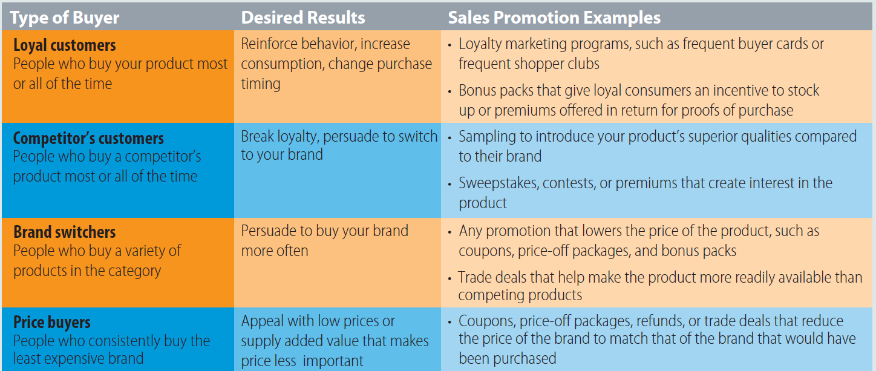
Exhibit 16.4: Types of Consumers and Sales Promotion Goals

Slide 30
Tools for Trade Sales Promotion
Tools for trade sale promotion:
  Trade allowance: a price reduction offered by manufacturers to intermediaries such as wholesalers and retailers
  Push money: money offered to channel intermediaries to encourage them to “push” products—that is, to encourage other members of the channel to sell the products
  Training
  Free merchandise
  Store demonstrations
  Business meetings, conventions, and trade shows
Notes:
Tools for trade sale promotion:
Trade allowance: a price reduction offered by manufacturers to intermediaries such as wholesalers and retailers
Given in exchange for doing something specific like allocating space for a new product
Push money: money offered to channel intermediaries to encourage them to “push” products—that is, to encourage other members of the channel to sell the products
Push money is often directed toward a retailer’s salespeople
Training
If the product is complex, a manufacturer will train an intermediary’s personnel
Free merchandise
May be used as payment for trade allowances
Store demonstrations
Food manufacturers often send representatives to grocery stores and supermarkets to let customers sample a product
Business meetings, conventions, and trade shows
Manufacturers, distributors, and other vendors can display their goods or describe their services to potential customers
Companies can identify new prospects, serve current customers, introduce new products, enhance corporate image, test the market response to new products, enhance corporate morale, and gather competitive information

Slide 31
Benefits of Trade Promotions
Help manufacturers gain new distributors
Obtain wholesaler and retailer support for consumer sales promotions
Build or reduce dealer inventories
Improve trade relations
Notes:
Help manufacturers gain new distributors
Obtain wholesaler and retailer support for consumer sales promotions
Build or reduce dealer inventories
Improve trade relations

Slide 32
Tools for Consumer Sales Promotion
(slide 1 of 2)
Tools for consumer sales promotion:
  Coupon: a certificate that entitles consumers to an immediate price reduction when the product is purchased
  Rebate: a cash refund given for the purchase of a product during a specific period
  Premium: an extra item offered to the consumer, usually in exchange for some proof of purchase of the promoted product
  Loyalty marketing program: a promotional program designed to build long-term, mutually beneficial relationships between a company and its key customers
    Frequent buyer program: a loyalty program in which loyal consumers are rewarded for making multiple purchases of a particular good or service
Notes:
The tools selected for sales promotion must suit the objectives to ensure success of the overall promotion plan.
Coupon: a certificate that entitles consumers to an immediate price reduction when the product is purchased
Coupons encourage product trial and repurchase and are likely to increase the amount of a product purchased.
Freestanding inserts (FSIs) are used to distribute 80 percent of coupons.
In-store coupons are more likely to influence buying decisions.
Rebate: a cash refund given for the purchase of a product during a specific period
Rebates must be mailed in along with a proof of purchase. Rebates offer price cuts to consumers directly and are more easily controlled. Further, customer databases can be built because of the information forms required for rebates.
Manufacturers prefer rebate because of the following reasons:
It allows manufacturers to offer price cuts to consumer directly.
Manufacturers have more control over rebate promotions.
It can be used to build customer database.
Most consumers never bother to redeem it.
Loyalty marketing program: a promotional program designed to build long-term, mutually beneficial relationships between a company and its key customers
Frequent buyer program: a loyalty program in which loyal consumers are rewarded for making multiple purchases of a particular good or service
Through loyalty programs, shoppers receive discounts, alerts on new products, and other types of enticing offers.
Retailers are able to build customer databases that help them understand consumer preferences

Slide 33
Tools for Consumer Sales Promotion
(slide 1 of 2)
  Contests and Sweepstakes
  Sampling: a promotional program that allows the consumer the opportunity to try a product or service
  for free
  Point-of-purchase (POP) display: a promotional display set up at the retailer’s location to build traffic, advertise the product, or induce impulse buying
Notes:
Contests and Sweepstakes
Contests: promotions in which participants use some skill or ability to compete for prizes
Sweepstakes: depends on chance and participation is free
Draw interest and publicity, but generally are not effective tools for generating long-term sales
Sampling: a promotional program that allows the consumer the opportunity to try a product or service for free
May be in-store, mailed to the customer, delivered door-to-door, or packaged with another product
Point-of-purchase (POP) display: a promotional display set up at the retailer’s location to build traffic, advertise the product, or induce impulse buying
Include signs attached to store shelves, shelf extenders, ads on grocery carts and bags, end-aisle and floor-stand displays, television monitors at supermarket checkout counters, in-store audio messages, and audiovisual displays
Discussion/Team Activity
Identify several companies that offer these programs. Discuss the benefits offered by some of the more popular loyalty marketing and frequent buyer programs.
Discussion/Team Activity
Discuss some of the occasions that you have had the opportunity to participate in product sampling. How did this influence your decision to purchase the sampled product?
What methods are most effective in reaching college students?

Slide 34
Discussion Point
Sales Promotion Tools
Identify companies that have utilized these popular sales promotion tools.
Notes:
Answers will vary
Examples include fast food services, cosmetic companies, banks, rental cars, magazines, computer manufacturers, and cell phones

Slide 35
Trends in Sales Promotion
Increased use of the Internet
Sales promotions online have proved both effective and cost-efficient
Marketers have discovered that online coupon distribution is another way to promote products
Major goal of retailers is to add potential customers to databases and expand marketing touch points
Utilization of sales promotions on social media and at the point of purchase
Notes:
Social media-, email-, and website-based promotions have expanded dramatically in recent years.
Sales promotions online generate response rates three to five times higher than off-line promotions.
Online versions of loyalty programs are gaining popularity, and the most successful are those run by hotel and airline companies.

Slide 36
Key Terms
(slide 1 of 4)
Advertising response function
Institutional advertising
Product advertising
Advocacy advertising
Pioneering advertising
Competitive advertising
Comparative advertising
Advertising campaign
Advertising objective
Advertising appeal
Unique selling proposition

Slide 37
Key Terms
(slide 2 of 4)
Medium
Media planning
Cooperative advertising
Infomercial
Advergaming
Media mix
Cost per contact (cost per thousand or CPM)
Cost per click
Reach
Frequency
Audience selectivity

Slide 38
Key Terms
(slide 3 of 4)
Media schedule
Continuous media schedule
Flighted media schedule
Pulsing media schedule
Seasonal media schedule
Public relations
Publicity
Product placement
Sponsorship
Crisis management
Sales promotion

Slide 39
Key Terms
(slide 4 of 4)
Trade sales promotion
Consumer sales promotion
Trade allowance
Push money
Coupon
Rebate
Premium
Loyalty marketing program
Frequent buyer program
Sampling
Point of purchase (P-O-P) display

