Slide 1
Multi-Drugs Resistant Organisms (MDROs)

Slide 2
Learning Outcomes
Describe MDROs
Review development of MDRO resistance
Establish the Risk Factors
Review the implications of MDROs
Discuss the courses of Resistance
Discuss the prevention and control measures

Slide 3
Introduction
Multidrug resistant organisms (MDROs) are organisms, primarily bacteria, that have developed resistance to antibiotics treatment.
The antibiotics can no longer cure the infections by these bacteria.
Antibiotics are vital in the health industry as they serve to fight bacterial infections.
Bacteria that have become resistant to more than one antibiotic are the ones labeled MDROs and they are mostly found in health facilities and other long-term care homes.
Notes:
The antibiotics can no longer cure the infections by these bacteria. Antibiotics are vital in the health industry as they serve to fight bacterial infections. Bacteria that have become resistant to more than one antibiotic are the ones labeled MDROs and they are mostly found in health facilities and other long-term care homes. Antibiotics resistance has been happening for decades with the first documented resistance being that of penicillin by Staphylococcus aureus in the 1940s

Slide 4
Common Multidrug Resistant Organisms
The common MDROs are usually bacteria, which include:
  Methicillin-resistant Staphylococcus aureus (MRSA)
  Vancomycin-resistant enterococci (VRE)
  Penicillin-resistant Streptococcus pneumoniae ( PRSP)
  Extended-spectrum beta-lactamases bacteria
  Multi-drug resistant Tuberculosis (MDR)
Notes:
The MDROs have increasingly become a threat to the global health; In the U.S alone at least two million people suffer from bacterial infections that are resistant to antibiotics. Of the two million infections, more than 23000 people die as a direct consequence of the MRDOs infections

Slide 5
Implications of MDROs
The implications of multi-drug resistant organism include the following:
  strain to the health costs
  lengthened periods of antibiotic therapy
  longer stays in hospitals
  frequent medical follow-ups
  use antibiotics that are expensive

Slide 6
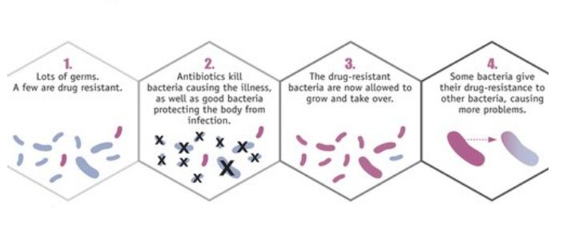
Cause of MDROs
Multi-drug resistant organisms develop when an individual takes antibiotics unnecessarily or longer than the recommended period.
The organisms can colonize or infect an individual
Image from CDC
Notes:
Initially, only a few of the infectious organisms survive an antibiotics treatment and as the antibiotics are used more often the bacteria undergo structural and physiological changes that make them to eventually become resistant while they maintain their virulence.
In colonization, the MDROs are present in a person but no actual illness occurs. He act as the carrier spreading the germs to other people. In infection, the bacterial invasion results in illnesses while the germs can also be transmitted to other people.

Slide 7
Mechanisms of Resistance
Multi-drug resistance in bacteria occurs through accumulation of resistance plasmids, transposons, or mutation of genes
The following biochemical mechanisms facilitate the development of antibiotics resistance.
    Modification of the Target Protein through Mutations
    Enzymatic Inactivation Antibiotics
    Genes Importation from Other Species for Less Susceptible Target Molecules
    Bypassing of the Target
    Blocking Drug Access to Targets
Notes:
The nucleic acids in one of the three genetic material code for resistance to a specific drug agent or by the action of multidrug efflux pumps that deactivate more than one antibiotic type.

Slide 8
Mechanisms of Resistance Cont…
Modification of the Target Protein through Mutations
For drugs that target specific bacterial proteins, the organism develops resistance by undergoing genetic modifications that make the target proteins less susceptible.
These mutations result in modification of single or limited sequences of amino acids in the target protein, often in the region of a known putative drug binding site.
Notes:
For example, fluoroquinolone resistance occurs by mutational modification in the target enzyme, DNA topoisomerases. Streptomycin resistant organisms undergo mutations in one of the ribosomal proteins that is the target for streptomycin (Nikaido, 2009). There is also a resistance to macrolides and lincosamide resulting from the methylation of adenine at position 2058 of the 50S rRNA.

Slide 9
Mechanisms of Resistance Cont…
II. Enzymatic Inactivation Antibiotic
It is a common mode of bacterial resistance for antibiotics of natural origin such as aminoglycosides which are inactivated by enzymatic adenylation, phosphorylation, or acetylation and β-lactam drugs which are inactivated by β-lactamase hydrolysis through the periplasm.
The genes that code for this mode of resistance can easily be transferred to other bacterial cells as plasmids.
Notes:
Aminoglycosides are inactivated by modifications that reduce the net positive charges on these polycationic antibiotics.
There are now many dozens of aminoglycoside-modifying enzymes known; for example, AAC (3)-II designates an aminoglycoside acetyltransferase acting on position 3 of the substrate and belonging to the second phylogenic grouping among these enzymes.
Bacteria often develop resistance to β-lactam antibiotics by synthesizing a β-lactamase, an enzyme that attacks the β-lactam ring

Slide 10
Mechanisms of Resistance Cont…
    III. Genes Importation from Other Species for Less Susceptible Target Molecules
Some MDROs such as Streptococcus pneumoniae undergo natural transformation that may entail importing foreign DNA that code for proteins that are less susceptible to the antibiotics.
Methicillin resistant Staphylococcus aureus (MRSA) contains a protein binding protein known as PBP-2A, which apparently came from another organism and whose expression is activated by Methicillin and other β-lactam drugs.
Notes:
Sequencing of the genes coding for the targets of penicillin, DD-transpeptidase or penicillin-binding proteins (PBPs), revealed that penicillin resistance among Streptococcus pneumoniae was due to the production of mosaic proteins, parts of which came from other organisms.
S. aureus is not naturally transformable, and it is unclear how this horizontal transfer of a large DNA segment occurred

Slide 11
    IV. Bypassing of the Target
    Some antibiotics, such as Vancomycin act on bacteria by binding to substrates, disaccharidepentapeptide, that is the precursor for peptidoglycan formation.
  Evaluation of the resistance mechanism has shown that the tail of the pentapeptide, D-Ala-, where Vancomycin binds is substituted by an ester structure, D-lactic acid in the resistant strain.
Notes:
Vancomycin resistance is now prevalent among enterococci, normal inhabitants of our intestinal tract. Because enterococci are naturally resistant to β-lactams, aminoglycosides, macrolides, and tetracycline, these vancomycin-resistant strains of enterococci become prevalent in a hospital environment, colonize the patients, and cause infections that are difficult to treat.

Slide 12
Mechanisms of Resistance Cont…
    V. Blocking Drug Access to Targets
    Antibiotics’ access to the internal environments of some MDROs is reduced through an active efflux mechanism.
    There are three mechanisms of access denial, which include local inhibition of drug access, antibiotics-specific efflux pump, non specific inhibition access.
Notes:
In local inhibition access, Tet proteins, produced by a plasmid in gram positive bacteria, bind to ribosomes thereby changing its conformation and preventing their association with tetracyclines. In drug-specific efflux pump, Tet A proteins in gram-negative bacteria catalyzes an electromotive force-dependent outward driving out tetracyclines. In non-specific inhibition access, mutations within the porin coding sequences reduce the permeation rates of β-lactam compounds without affecting that of smaller nutritional elements.

Slide 13
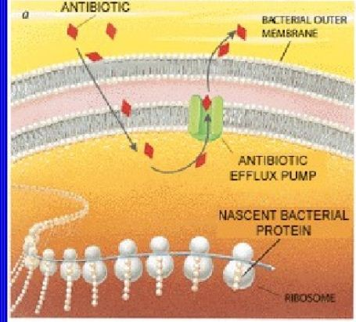
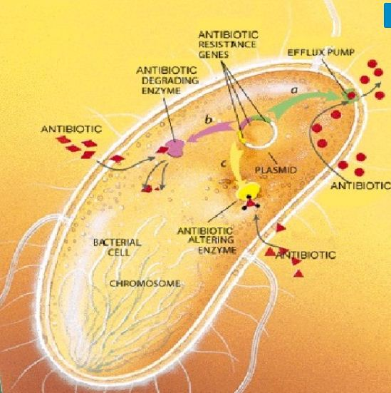
Mechanisms of Resistance Cont…
Notes:
Efflux mechanisms, both drug-specific and multidrug, are important determinants of intrinsic and/or acquired resistance to these antimicrobials in important human pathogens. Multidrug efflux mechanisms are generally chromosome-encoded, with their expression typically resultant from mutations in regulatory genes, while drug-specific efflux mechanisms are encoded by mobile genetic elements whose acquisition is sufficient for resistance.

Slide 14
Risk Factors for MDROs Infections
While the multi-drug resistant organisms can infect anyone, they colonize in some individuals but cause infections in others.
There are risk factors that predispose a person to these germs, which include consumption of antibiotics in foods, old age, a weakened immune system due to the use of immunosuppressants, increased use of invasive medical devices, and previous exposure to a MDROs.
Notes:
Settings that Promote Drug Resistance include Day-care centers, Long term care facilities, Homeless shelters, and Jails.
Location contributing to Drug Resistance include Intensive care units, Oncology units, Dialysis units, Rehab units, Transplant units, and Burn units.

Slide 15
Risk Factors for MDROs Infections Cont…
Chronic illnesses such as type 2 diabetes, chronic renal infection, peripheral vascular disease, and dermatitis also predispose a patient to MDROs infections.
Invasive procedures such as dialysis and urinary catheterization also expose people to these organisms as they colonize the inaccessible parts of a medical device that cannot be cleaned.
The organisms are associated with healthcare facilities and long or repeated contacts with hospital settings expose people to the bacteria.
Notes:
Healthy people can be colonized with these germs and even develop infections with an MDRO. Most people, including children, are at low risk of developing an infection.
One exception is MRSA, which is a type of MDRO that often causes infection in healthy adults and children. MRSA is common in the community.

Slide 16
Types of Infections Caused by MDROs
MDROs infect almost all body parts including
    the bloodstream
    skin
    wounds
    urinary tract
    lungs
    skin

Slide 17
Treatment for MRDOs
The infections are difficult to treat and are unresponsive to most of the common antibiotics.
Only few specific antibiotics eradicate the MDROs; the doctor ha to diagnose the specific MDRO in a patient and then chose the most efficient antibiotic to counteract it.
Use of the wrong antibiotics slows the recovery process and the infection becomes harder to cure.
Notes:
MDRO colonization does not usually need treatment. But people are advised to avoid spreading MDRO to others. Depending on the type of MDRO a person has, he or she may undergo a process called decolonization. Your healthcare provider will let you know more about this treatment if needed.
MDRO infections can be hard to treat. This is because they don’t respond to many common antibiotics. But some antibiotics remain effective against MDRO's and are routinely prescribed. Your healthcare provider will test for the type of MDRO causing the illness and choose the best antibiotic.

Slide 18
Prevention and Control Measures
Health providers are urged to only prescribe antibiotics when necessary.
The Centers for Disease Control and Prevention (CDC) advices people to use antibiotics as recommended by the doctor.
The most effective way to control the spread of MDROs is to wash hands with soap and water for no less than 20 seconds.
In the event that one visits a healthcare setting, one ought to wash hands on entering and before leaving the facility (SA Health). Gloves are also recommended if one expect to be exposed to body fluids of patients.
Notes:
Regular changing and washing of bed sheets is recommended, especially if they are soiled. The patients’ environment should be regular cleaned with a disinfectant while the doctor should be notified of the existing MDRO infections in patients.

Slide 19
Prevention and Control Measures Cont…
The safety measures that have been aligned by hospitals to curtail MDROs infection and spread include the following:
  Regular monitoring of the care facilities and their environments and educating the caregivers on the ways to prevent spread.
  Identification of high risk patients and appropriate placement into private rooms.
  Use of protective clothing such as gloves and gowns for caregivers and visitors while dealing with MDRO patients.
  Vaccinations against the organisms such as Streptococcus pneumoniae, which causes pneumonia.
Notes:
Prevention of antimicrobial resistance depends on appropriate clinical practices that should be incorporated into all routine patient care.
All types of MRO are managed with transmission-based precautions that are tailored to the route of transmission for the particular organism under consideration. A risk-based approach should always be taken in deciding the level of precautions, and whether or not a patient needs to be isolated.

Slide 20
Recap of High points
Multi-drug resistant organisms have been a menace in the current healthcare. The organisms cause latent to severe life threatening illnesses that may make people to lose body parts or perish at the extremes.
The drugs resistance develops through diverse mechanisms depending on the drug of exposure. Infections by these organisms are hard to treat and require specific, costly antibiotics.
Prevention and control measures are the only effective methods with individuals advised to habitualize washing of hands with disinfectants, vaccination, patient’s isolation, and regular cleaning of hospital facilities, among others.

Slide 21
References
Multidrug-resistant organisms (MRO). SA Health. Retrieved from https://www.sahealth.sa.gov.au/wps/wcm/connect/public+content/sa+health+internet/clinical+resources/clinical+topics/healthcare+associated+infections/multidrug-resistant+organisms+mro. Feb 23, 2019.
Nikaido, H. (2009). Multidrug resistance in bacteria. Annual review of biochemistry, 78, 119-146. Doi: 10.1146/annurev.biochem.78.082907.145923
Thind, S. (2017). Multidrug Resistant Organisms (MDROs): Growing, Spreading, and Killing. Medscape. 1-30

