Slide 1
MUSEUM EXHIBIT DIRECTIONS
Student Name:
Presented to:
Institutional Affiliation:
Date:
Venue:

Slide 2
Introduction
Germany is a country in central-western Europe.
It is made up of 16 state devolutions.
Area coverage is 357,386 square kilometers (Ribeiro, 2010).
It is largely temperate seasoned.
The presentation is my study.

Slide 3

Museum Exhibit
Language – our country’s official language is German.
It is spoken by over 90 percent of the people living in the country. As a matter of fact, I grew communicating in Germany until I learnt English in school.
Other indigenous languages include Danish, Turkish, and Romania etc.
Immigrants and neighborhood are major contributors of the foreign languages in the country.
The computer keyboard layout known as QWERTY is attributed to the German and Austria languages (Looper, 2018).

Slide 4
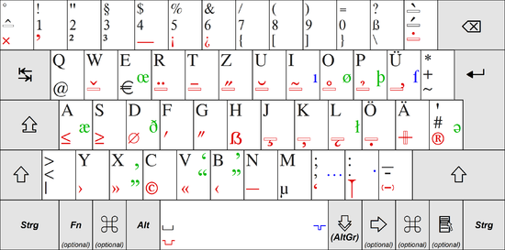
Language insights

Slide 5

Oktoberfest
Oktoberfest – this is a culture event that we conduct during important days.
As a matter of fact, it is branded the world’s favorite German fest.
We conduct it in Munich for 16 days. During this festival, people take their favorite foods and drinks (Looper, 2018). Most importantly, the occasion attracts over 16 million visitors annually.
The first Oktoberfest was carried out in October 12, 1810 during prince Ludwig’s wedding to princess Therese of Saxony-Hildburghausen (Zimmermann, 2018).
The royals had invited locals. The events were carried out for over 5 days on the fields that we call today Theserienwiese after the bride.

Slide 6
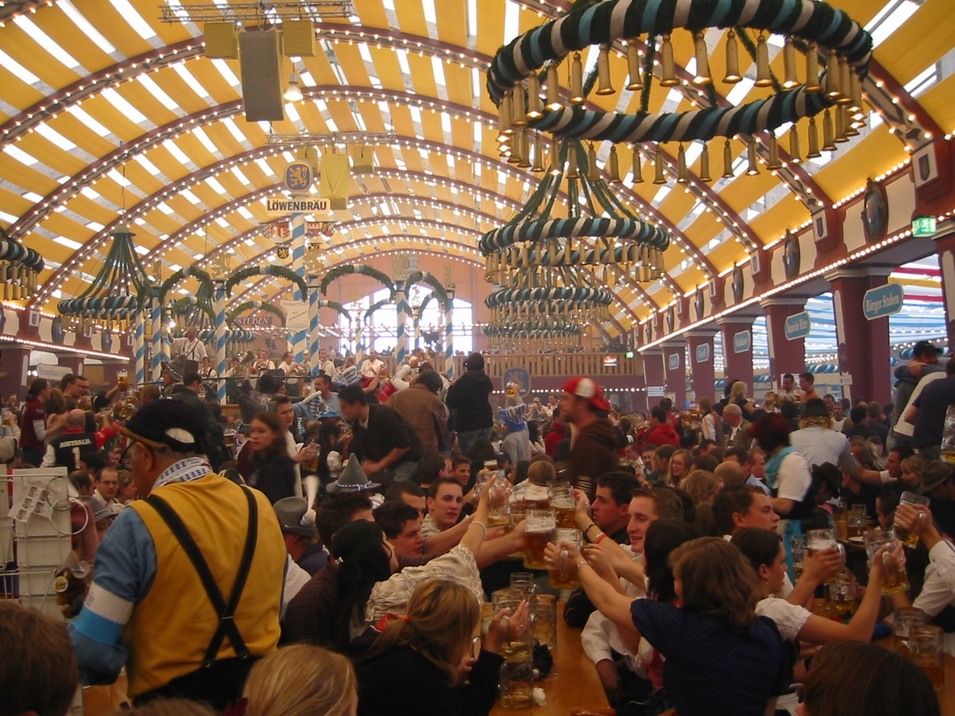
Oktoberfest

Slide 7
Religion
Religion – Germans are strong believers with a 65 to 70 percent of the population being Christians (Zimmermann, 2018).
Catholics are the biggest in number followed by Muslims.
There is also a good number that does not associate itself with any domination. 4 weeks before Christmas, we celebrate the Advent – a love-filled period that is traditionally associated with Christmas markets.
The first Germany Christmas market dates back in 1393, but today they evenly distributed across the country

Slide 8
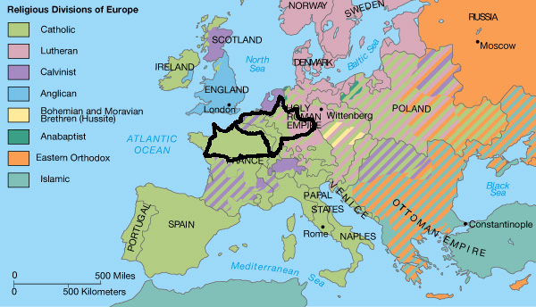
Religion

Slide 9
Germany Beer
Beer – Our country is traditionally known as the originator of a variety of beer products, examples including pilsner, Alt and weizenbbier (Looper, 2018).
This beers were brewed from barley, hops and water – the primary raw materials (the Purity Law). Yeast was an important factor during the brewing.
Barley and wheat were the grown crops in the country.
They were ready materials for the beer brewing
This explains why Germany beer is believed to be the best

Slide 10
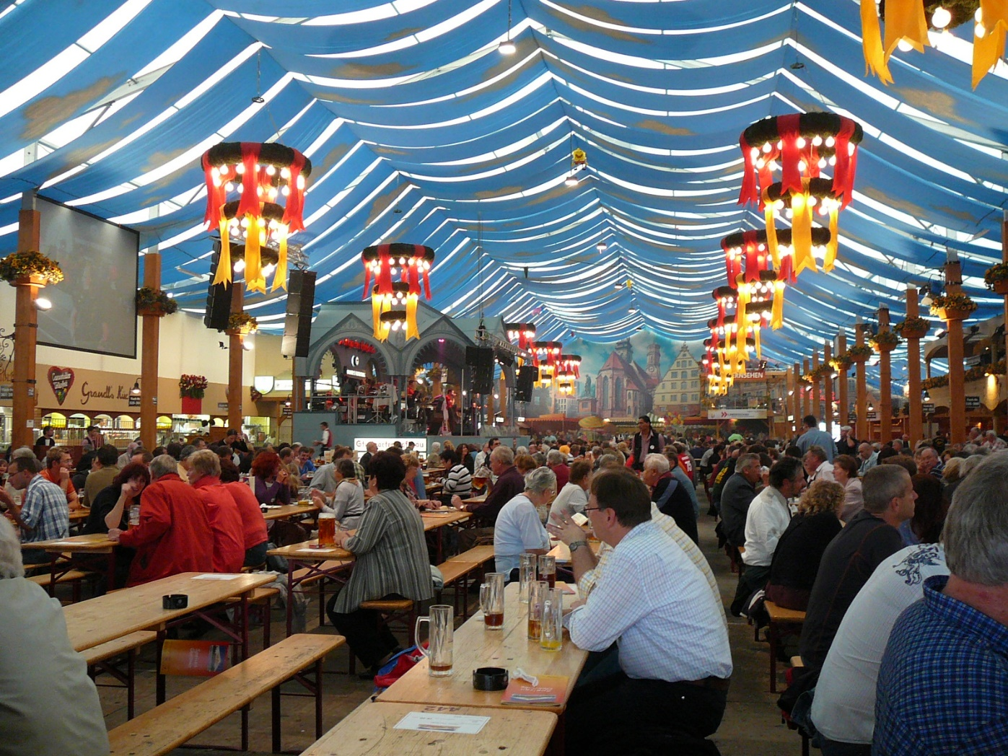
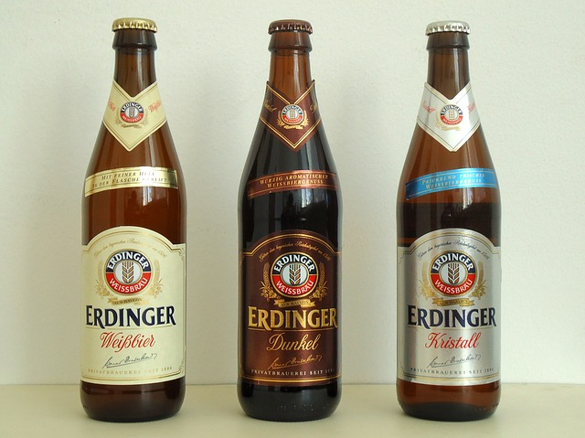
German Beer

Slide 11

Art
Art – we proud ourselves of the tremendous impact that some of our heroes and heroines made to classic music. Popular composers like Johann S. Bach, Ludwig V. Beethoven, Wolfgang A. Mozart, Gustav Mahler, and Richard Wagner left a legacy that we still appreciate today, not as Germans only but from a global perspective.
Still on art, we have representations of architecture that are famous and exhibited in iconic buildings like the cathedrals, public buildings and castles. A famous Germany art that you have heard of is the Brandenburg Gate, which symbolizes Berlin’s unity (Zimmermann, 2018).

Slide 12
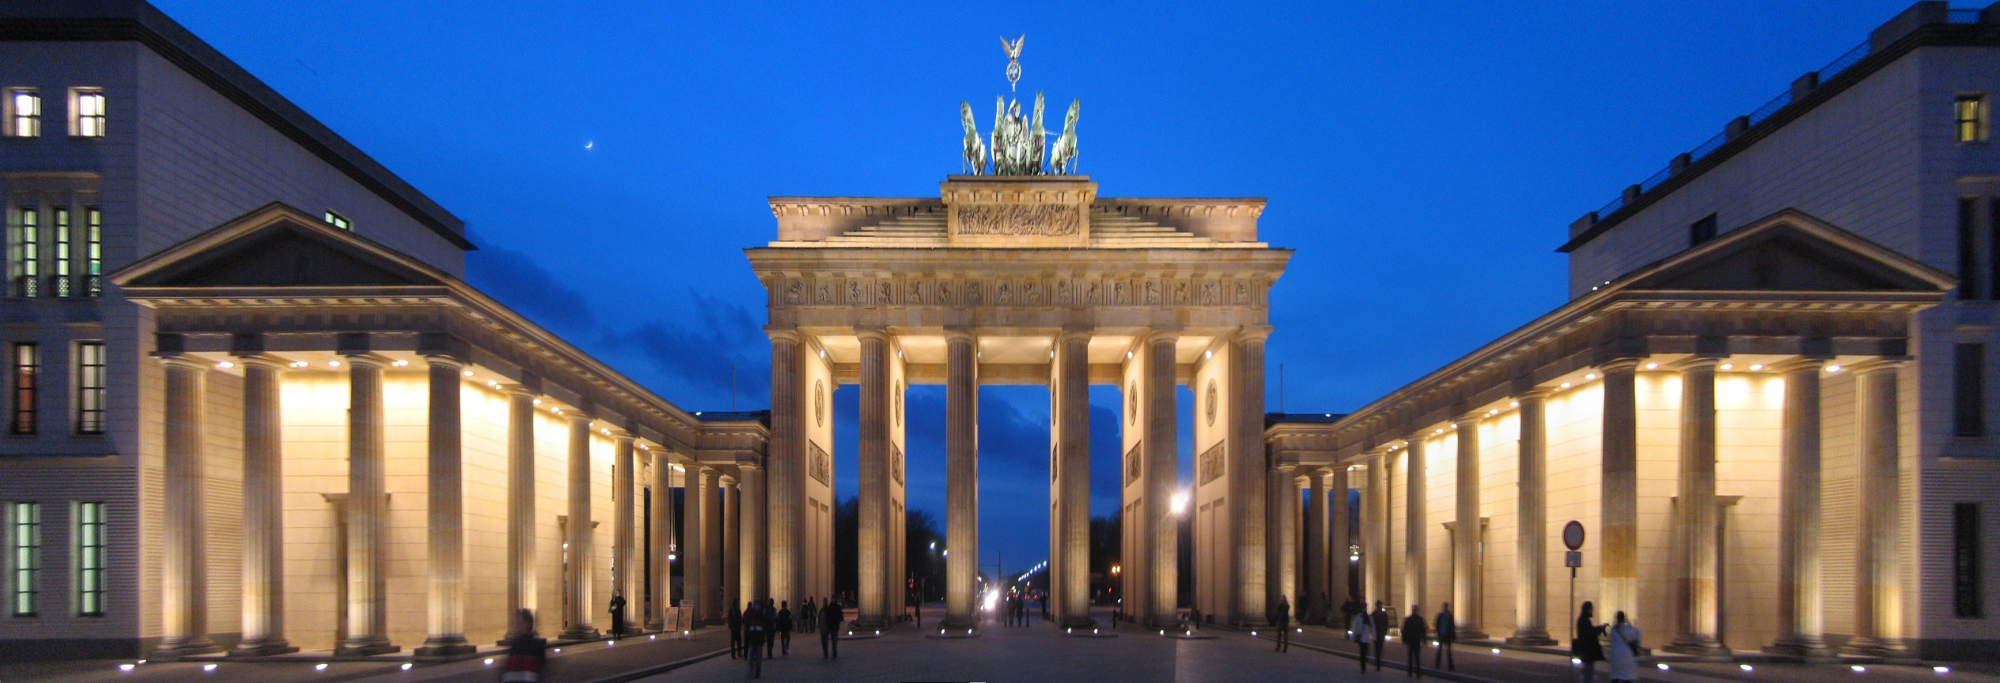
Brandenburg Gate

Slide 13

German’s quality of life
German’s quality of life – Munich is celebrated as one of the world top cities.
In 2010, Monocle Magazine named it as the most livable city in the world.
A higher percentage of our population lives in the city, even I.
Being close to Alps, we find it so attractive to live here.
Besides that, the beautiful scenery and architecture is always fascinating. Just to mention, Baroque and Rococo facilities, great infrastructure and the greatest beer culture on the planet.

Slide 14
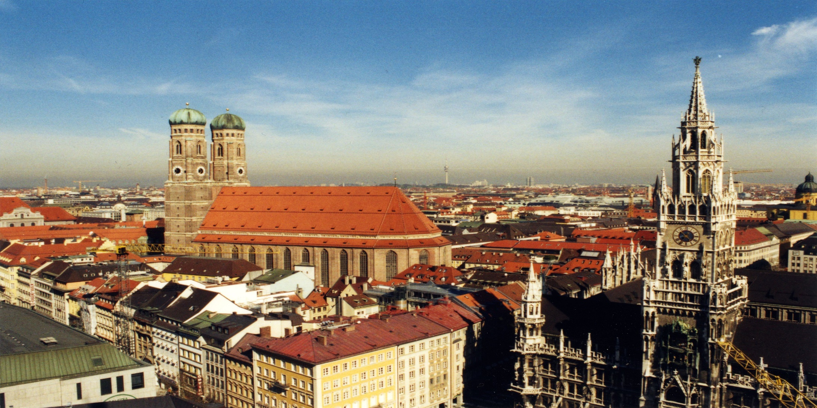
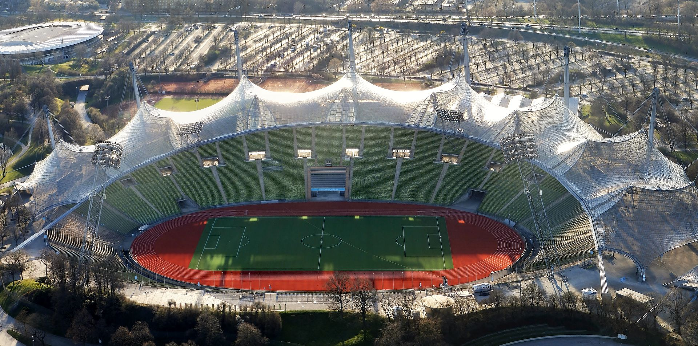
Munich

Slide 15
Traditional clothing
Traditional clothing – Lederhosen are leather trousers that were worn by their men.
They are usually knee-length that it was traditionally known that they belonged to working class men.
The women wear an attire known as the dirndi.
It is a ruffled apron dress that has a blouse and a skirt.
The Oktoberfest is an avenue where these attires are well represented.
The dirndi was worn as a uniform for house girls during the 19th century, mostly in Bavaria and Austria.

Slide 16
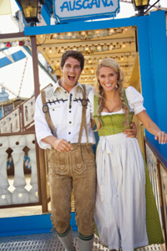
Germany Attire

Slide 17
Geographic areas
Geographic areas – Berlin is one stunning place that everybody desires to visit. I can tell by the number of visits I encompass.
It’s our country’s capital.
It serves as an attraction site.
It contains historical perception of the Second World War (Looper, 2018). Today, it is a unification centre that holds different ethnicities. It is endowed with historic cultures. It serves as an attraction site to the country.

Slide 18
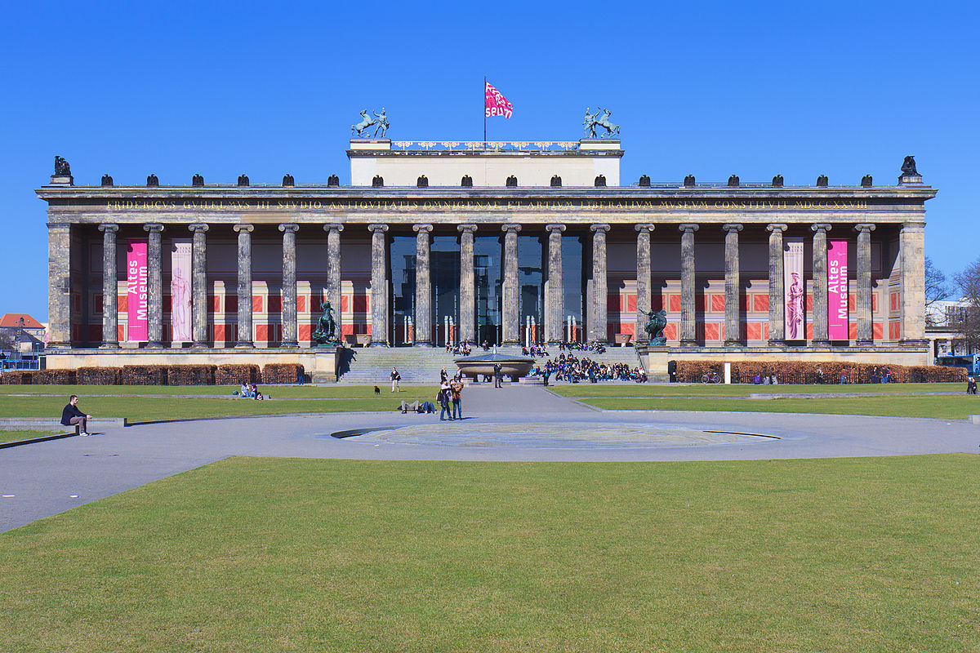
Berlin

Slide 19
Viktualienmark
Viktualienmark or the “victuals market” – this is a famous market in our city centre. (shown in the next slide)
Any imaginable vegies that you cannot find, meat, fish, and spices, then get to this place.
This market place has also quick foods that one can eat fast. T
his market emerged in 1807 after King Maximilian witnessed the congestion in the food market in the city (Zimmermann, 2018).
Sooner or later, the market was extended a few meters S.E. to the square between Heiliggeist-Kirche and Frauenstraße.

Slide 20
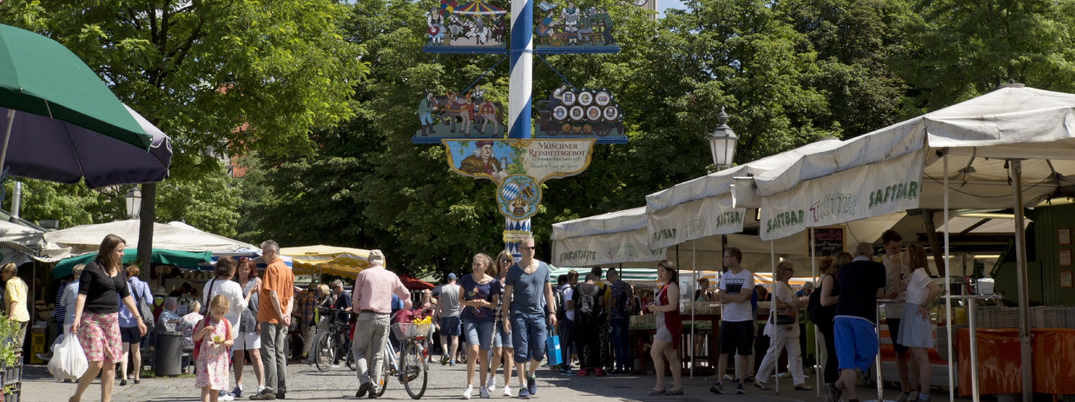

Slide 21
References
Looper, Lance. “How German Traditions Work.” Howstuffworks. https://people.howstuffworks.com/culture-traditions/national-traditions/german-tradition2.htm (Accessed October, 4 2018).
Ribeiro, W. C. (2010). Geografia política e gestão internacional dos recursos naturais. Estudos avançados, 24(68), 69-80.
Zimmermann, Kim A. “German Culture: Facts, Customs and Traditions.” LifeScience. https://www.livescience.com/44007-german-culture.html (Accessed October, 4 2018).

Slide 22

THANK YOU!

