Slide 1
Motor Vehicle Accidents among the Youths
Name:
Course:
Professor:
Date:

Slide 2
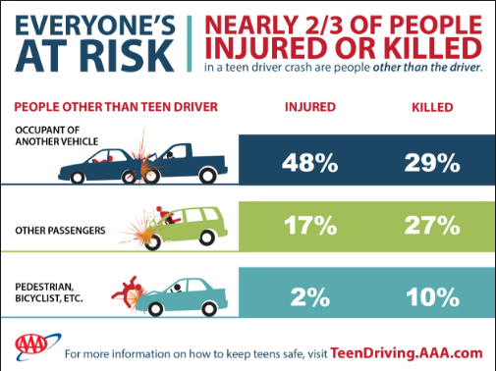
Introduction
Teen driving count for two thirds of the people injured or dead due to vehicle accidents. It is not necessarily the teens behind the when but also other road users e.g. passengers. In 2013, more than 370,000 teens got injured due to MVA related incidences and another 2, 927 died due to MVA (Preventing Teen Motor Crashes, 6).

Slide 3

Motor vehicle Accidents

Slide 4
Specific health concerns of teenagers
Motor vehicle accidents are a leading causes of death among teenagers in the United States of America. In the period of 2012, more than 1800 teenagers of the age 15-21 died in road accidents. Unintentional injury and behaviors that contribute to injury of teenagers affect the teenager’s health. Their psychology is also affected once they are involved in accidents and they survive (Gruber and Jonathan, 12).

Slide 5
Risk Factors for teenagers
Inexperience
Teenage passengers
Distraction while driving, including from using cell phones and texting
Driving at excessive speeds, close following, and other risky driving
Drinking and driving. While drinking and driving is not very high among novices, it causes a disproportionate number of fatal crashes. In the later teen years and young adulthood, drinking and driving increases greatly.
Driving at night
Being male. Teenage boys, especially ones with male passengers, are involved in more car crashes than teenage girls. However, the number of females involved in car crashes is increasing.
Social norms. Risky driving among teenage drivers is higher among teens who report that their friends drive in a risky manner ((Gadsden, et. al., 3).

Slide 6
Levels of prevention/control (Primary, Secondary, Tertiary)
Primary prevention: removal of circumstances causing injury - eg, traffic speed reduction, fitting stair gates for young children, reducing alcohol consumption (Bonnie, et. al., 5).
Secondary prevention: reduces severity of injury should an accident occur - eg, use child safety car seats, bicycle helmets, smoke alarms (Bonnie, et. al., 5).
Tertiary prevention: optimal treatment and rehabilitation following injuries - eg, effective first aid, appropriate hospital care (Bonnie, et. al., 5).

Slide 7
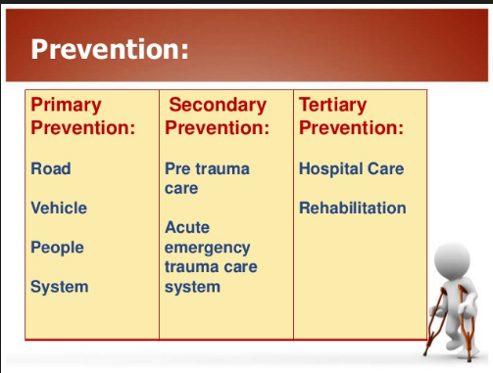
Levels of prevention/control (Primary, Secondary, Tertiary)

Slide 8
Works Cited
Bonnie, Richard J, and Mary E. O'Connell. Reducing Underage Drinking: A Collective Responsibility. Washington, DC: National Academies Press, 2015. Print.
Gadsden, Vivian L, Morgan A. Ford, and Heather Breiner. Parenting Matters: Supporting Parents of Children Ages 0-8. Washington, DC: the National Academies Press, 2016. Internet resource.
Gruber, Jonathan. Risky Behavior Among Youths: An Economic Analysis. Chicago: University of Chicago Press, 2016. Internet resource.
Preventing Teen Motor Crashes: Contributions from the Behavioral and Social Sciences : Workshop Report. Washington, D.C: National Academies Press, 2017. Internet resource.

