Slide 1
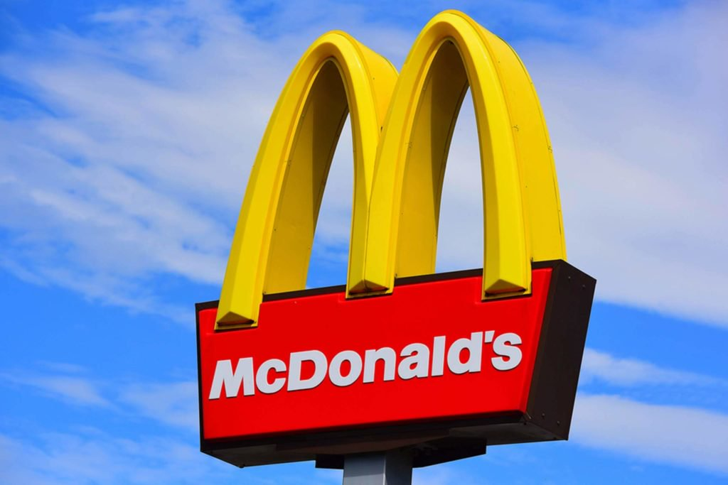
Legal Issues
McDonalds Unethical Marketing

Slide 2

Reasoning for Selection of MacDonald’s Corp.
I have chosen MacDonald’s Corp. because it operates in many countries governed by different laws
The Corp. has also being involved in legal issues in Quebec
Notes:
MacDonald’s Corp. has been involved in a legal issue in Quebec.

Slide 3
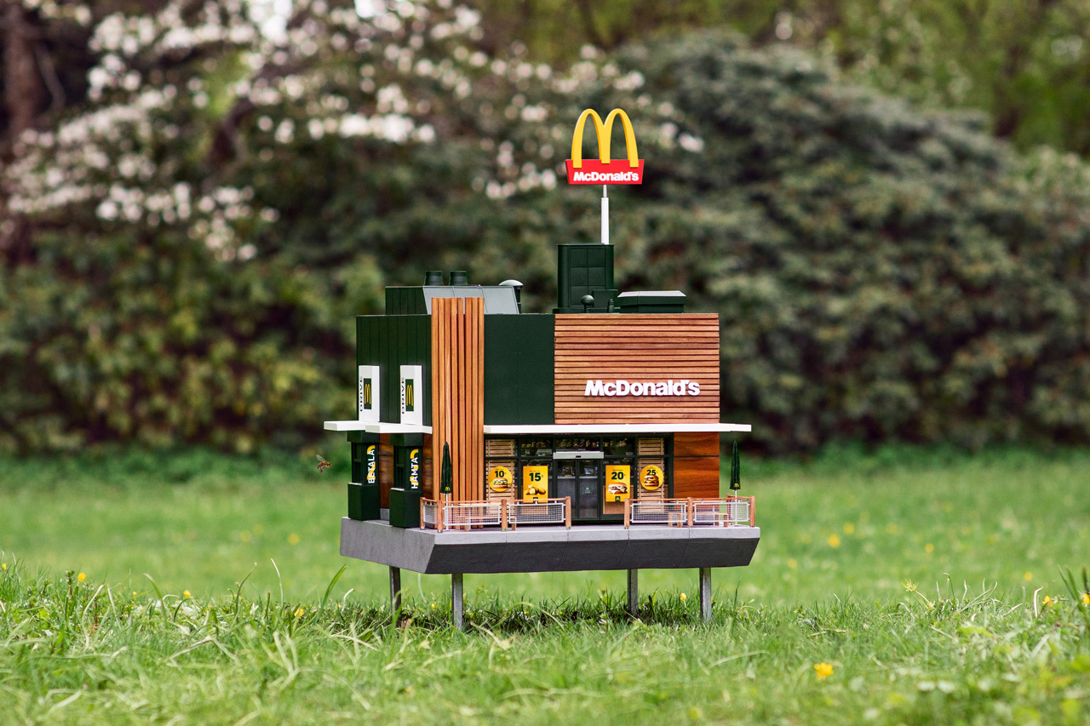
Cont…,
MacDonald’s Corp. deals with fast foods
MacDonald's corp. is currently running more than 30,000 restaurants in the six continents
MacDonald’s shareholders are; customers, partners, shareholders and employees
MacDonald's Corp. has to maintain professionalism and ethical conducts with its significant shareholders
The Corp. has been involved in legal issue that made it to break Quebec's law
Notes:
MacDonald Corp. is a company that deals with fast food and operates in six continents with more than 30,000 restaurants running. The Corp. has to ensure that professionalism and ethical conducts are adhered to so that it can avoid going against governing laws in the different regions where it operates.

Slide 4
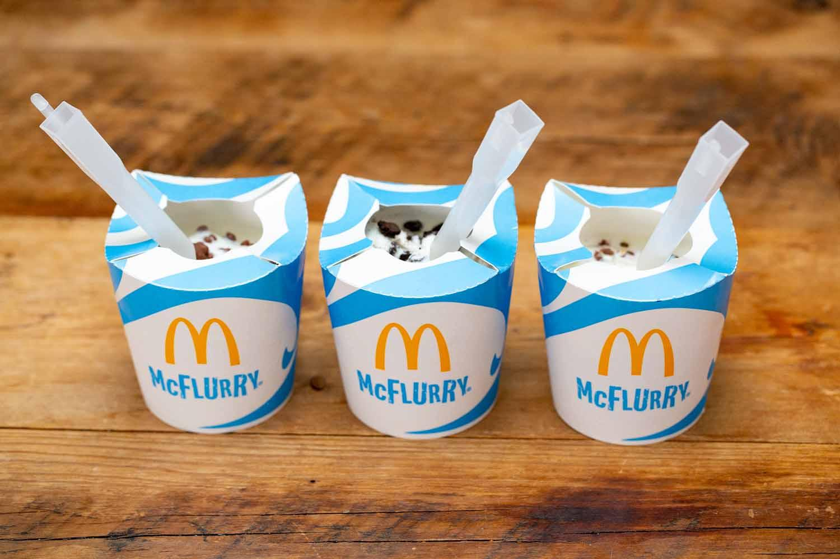
Cont…,
MacDonald’s Corp. was being sued by a dad of three
MacDonald’s Corp. had wrongfully advertised the Happy Meals to kids
It had run ad that was against the law of Quebec that opposes advertising of items to kids aged below 13
He sought to stop MacDonald’s Corp. from advertising toys and glad dinners to kids growing
The ad involved the dispatch of kid’s motion pictures which were inciting for continued consumption
Notes:
MacDonald’s Corp. is being sued for having gone against Quebec’s law guiding advertising of kid’s meals.

Slide 5
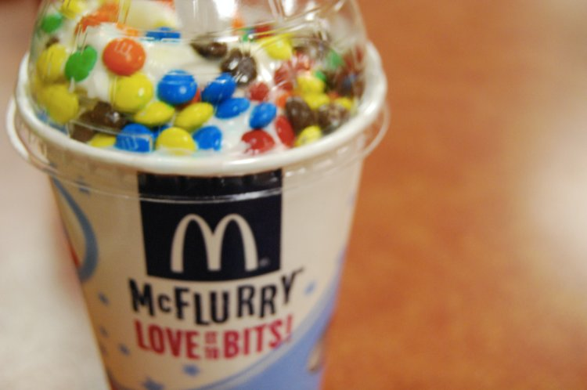
Cont…,
MacDonald’s Corp. appreciates the support that they have got from the Quebecers and their families
Such advertising as the one being run by the company has been prohibited in Quebec
The case presented in court does not fall in any of the above protected case
Notes:
There has been a related case presented in the past but this does not fall within the cases that were being presented in the 1970s.

Slide 6
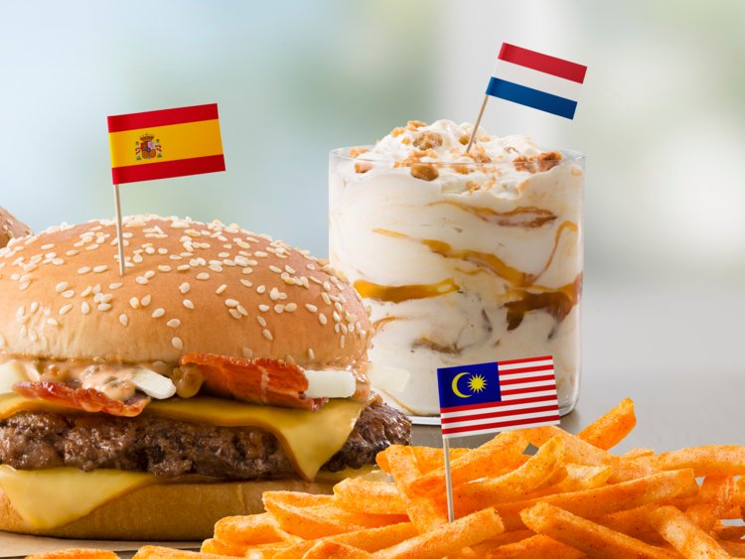
References
Green, S. (2015). McDonald's. Bellwether Media.
Olšanová, K. (2013). FOOD MARKETING TO CHILDREN-REVIEW OF THE ISSUE FOR FURTHER EXPLORATION. Central European Business Review, 2(3).

