Slide 1
A Marketing Plan On Farmers Dairy skim milk
Group / Topic of Presentation Date
Market Plan on Farmers Dairy skim milk _ _ ____
Name of Group Members: Student ID
_____________________________________________ _________________ ___
__________________________________________ ___________________ _
____________________________________________ __________________ __
_____________________________________________ ________________ ____
_____________________________________________ __________ _______ ___

Slide 2
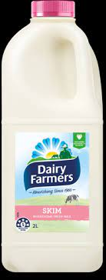
Introduction
The selected product being marketed is Farmers Dairy skim milk.
Skim milk is also commonly known as fat-free milk
It is milk from which cream has been removed
It contains approximately 0.5 grams of fat per serving
It contains no added ingredients besides flavors and preservatives
Notes:
The product that the group chose to market is Farmers Dairy skim milk. Skim milk is also referred to as fat-free or low-fat milk among consumers. Skim milk is produced by removing cream from milk. After manufacturing, skim milk retains at least 0.5 grams of fat so that it can still have nutritional value on the consumers' bodies. It is also important to note that skim milk contains no added ingredients apart from flavors and preservatives.

Slide 3
Market Overview
There has been a global increase in the Farmers Dairy skim milk market from 2018 -2021
The growth is due to:
Increased health concerns among consumers
Increased variety of Farmers Dairy skim milk flavors
Notes:
The global market overview for the Farmers Dairy skim milk is very positive. There has been an increased consumption and demand for their skim milk globally. This can be attributed to the fact that skim milk has fewer calories than whole milk, and consumers are shifting towards healthier options regarding milk consumption. The other factor contributing to increased demand for Farmers Dairy skim milk is the existence of a wide variety of flavors to choose from, thus meeting the desires and tastes of different consumers in the market.

Slide 4
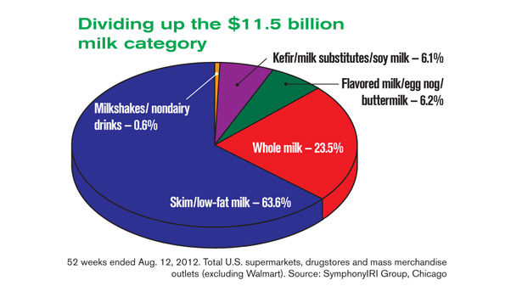
Segmentation
The Farmers Dairy skim milk market has been segmented into;
Type
Form
Channel of distribution
Packaging
Notes:
The marketing for Farmers Dairy skim market has been categorized into packaging, form, regions, channel of distribution, and skim milk type. With regard to packaging, there are different options, including; canned skim milk, bottled skim milk, instant powder bag skim milk, among others. The market according to type has been segmented as follows; white skim powder, green skim powder, black skim powder, among others. Concerning the form, the skim milk market has been segmented into powder and leaf. Distribution channels have segmented the market into convenience stores, supermarkets, and food services.

Slide 5
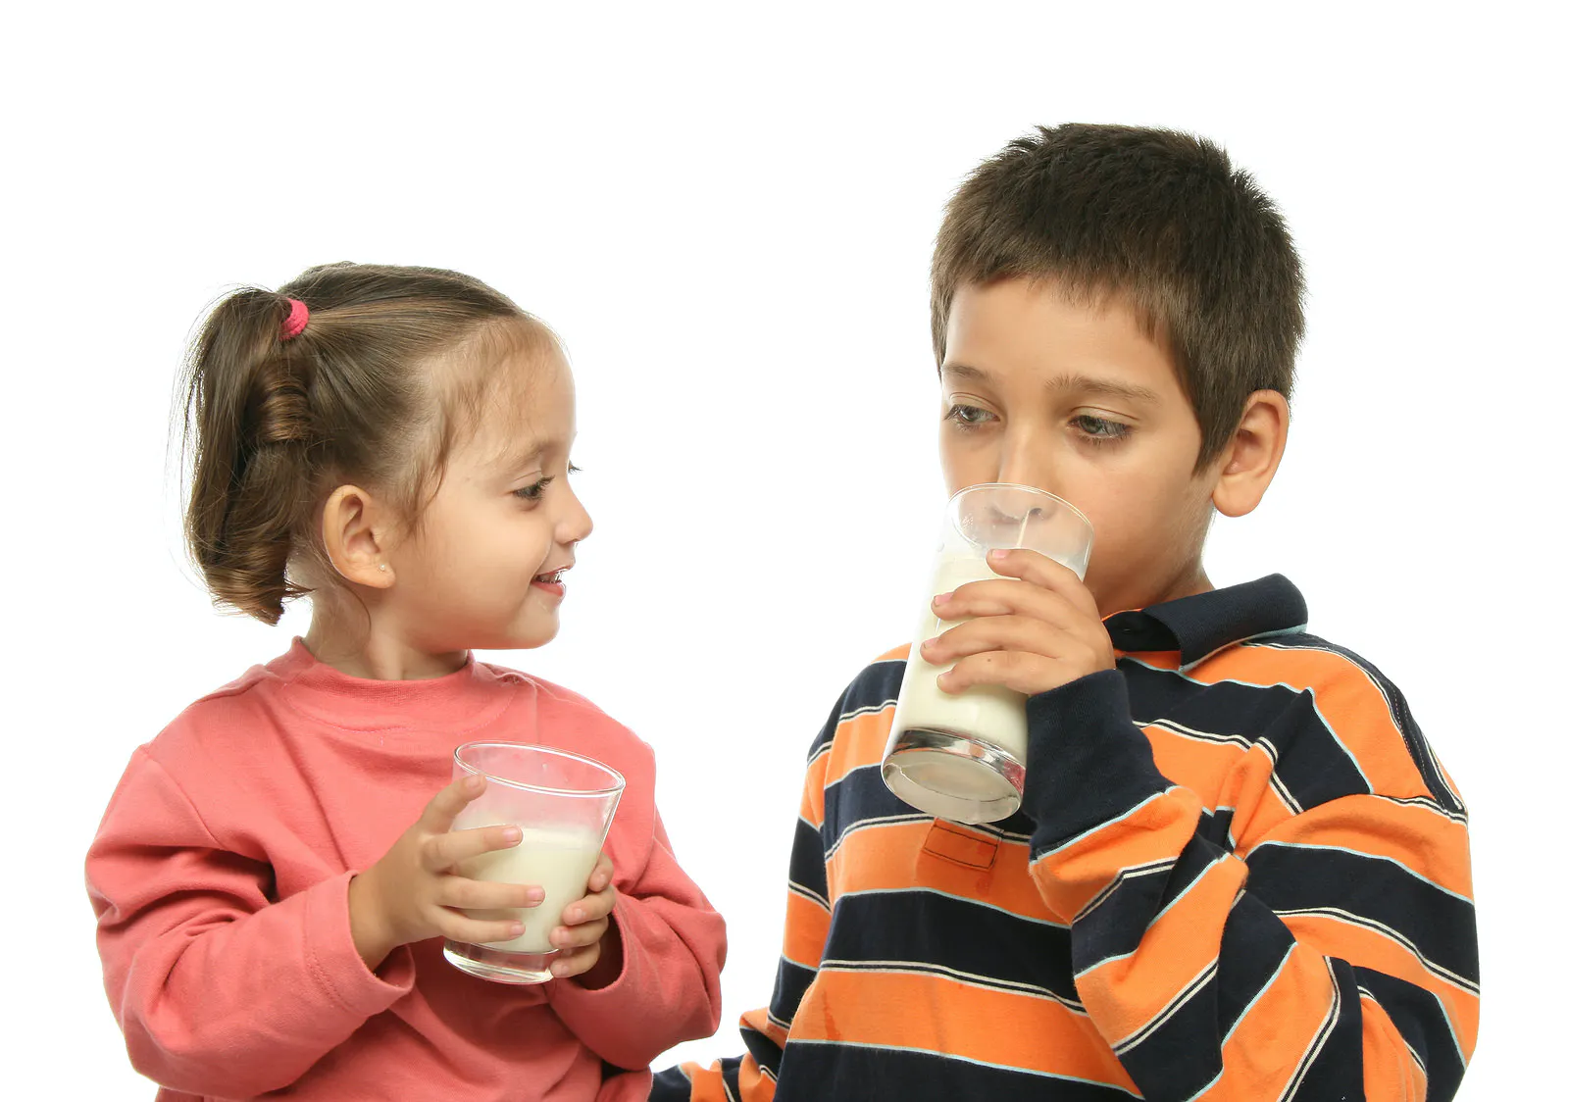
Target Audience
The primary target market for the Farmers Dairy skim milk is:,
Children aged between 5-15 years because;
They actively need calcium for strong bones.
The milk consumption at these ages is higher than the rest
Notes:
The target market for the Farmers Dairy skim milk is children between the ages of 5 15 years old because they require vitamins, nutrients, and calcium for strong development, and all these are found in the Farmers Dairy skim milk. The 5-15 years age bracket is the main target because children in that age group consume milk the most in comparison with the other age groups.

Slide 6
The Farmers Dairy Product
Regular Skim Milk
Flavored Skim Milk
0.58 grams of fat
Polysaturated fats 0.017 grams
Monosaturated fats 0.115 grams
Total carbohydrates 11.88grams
0.60 grams of fat
Polysaturated fats 0.019 grams
Monosaturated fats 0.117 grams
Total carbohydrates 11.92 grams
Notes:
The product is skim milk which comes in two varieties. There is regular bottled skim milk and flavored bottled skim milk. Regular bottled skim milk has 0.058 grams of fat, 0.017 grams of polysaturated fats, 0.115 grams of monosaturated fats, and 11.88 grams of carbohydrates, while the flavored bottled skim milk has 0.60 grams of fat, 0.019 grams are saturated fats, 0.117 grams is monosaturated fats, and there are 11.92 grams of carbohydrates.

Slide 7
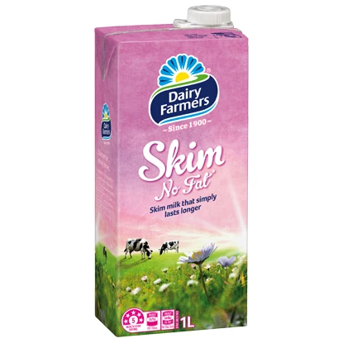
Pricing
The price for regular non-flavored skim milk is $3.559 per gallon
The price for flavored skim milk is $4.07 per gallon
Purchase of more than one gallon comes with free 100-gram butter
Notes:
The pricing policy for regular non-flavored milk is $3. 559 per gallon and $4.07 per gallon for the flavored skim milk. When a customer purchases more than one gallon of either skim milk, they get 100-gram butter as a discount.

Slide 8

Promotion
Television commercials on selected regional networks
Facebook ads on the company page
Newspaper ads
Notes:
The promotion tools will include newspaper ads on local and regional newspapers in the areas of the target market. Facebook ads will also run on the company's Facebook page, and lastly, tv commercials on selected regions will be utilized to promote the skim milk product.

Slide 9
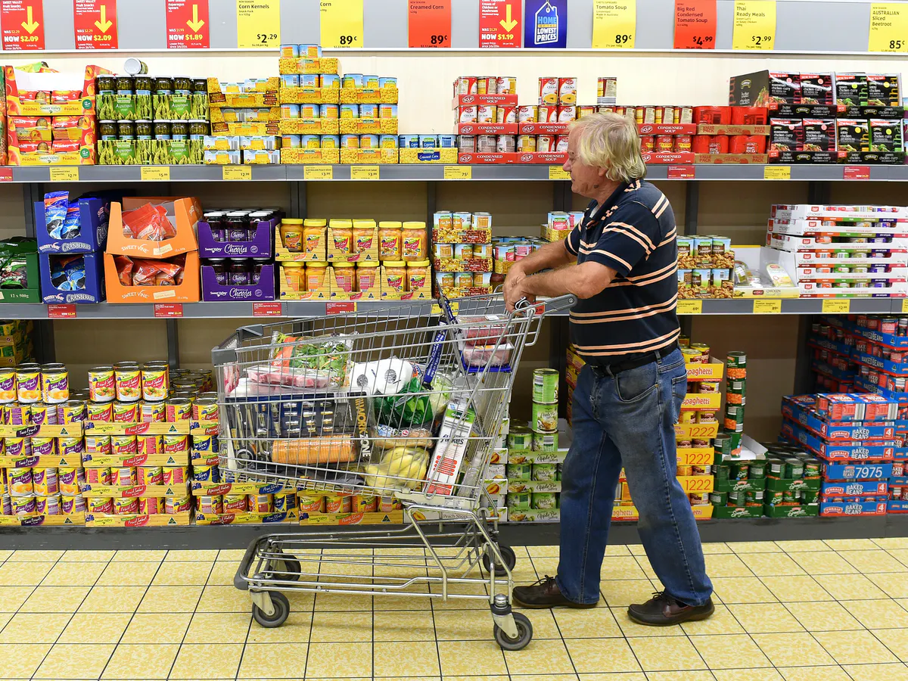
Placement
Sold at specific regional supermarkets
Sold at different convenience stores
Sold directly from the company's online store.
Notes:
The Farmers Dairy skim milk will be distributed for sale in regional and local convenience stores such as kiosks and malls. The product will also be sold through different supermarkets and hypermarkets locally and in the region. Lastly, customers will also be able to purchase the skim milk from the company's online store and get it delivered to a preferred delivery station.

Slide 10
References
Arab, N. (2018). Relationship between dimensions of Brand Equity and 4Ps of Marketing Mix-Place, Product, Promotion, & Price: Coca Cola-Consumer Based Qualitative Survey.
Davari Farid, R., Azizi, J., Allahyari, M. S., Damalas, C. A., & Sadeghpour, H. (2019). Marketing mix for the promotion of biological control among small-scale paddy farmers. International Journal of Pest Management, 65(1), 59-65.
Lee, T. R., Huang, H. L., Huang, B. W., & Chen, S. Y. (2007). Milk supply chain and development strategy. International Journal of Services and Operations Management, 3(2), 227-244.

