Slide 1
Measurement of hormone levels in plasma
INTRODUCTION
Relevance of measuring hormone concentrations
  Diagnosis of endocrine disorders
Notes:
Hormone concentrations in a blood plasma sample reflect the amount of hormones produced by the body. Thus measuring hormone levels helps in the diagnosis of endocrine disorders such Diabetes Mellitus, Grave’s disease, Hirsutism, Adrenal insufficiency, Cushing’s syndrome, Infertility, Mood disorders, Hyperthyroidism to mention a few.

Slide 2
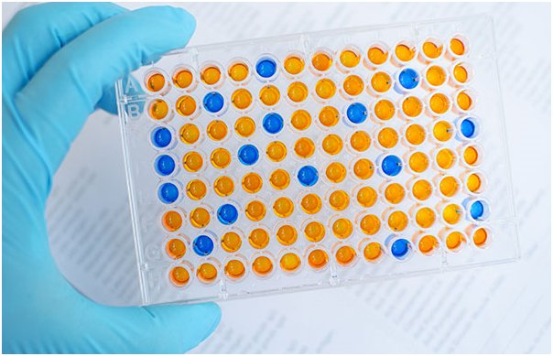
Methods used to measure hormone levels
Radioimmunoassay
Enzyme-Linked Immunosorbent Assay
Liquid chromatography-tandem mass
spectrometry
Molecular Sieving (Gel Filtration)
(Michael Moore 2020)
Notes:
Liquid chromatography-tandem mass spectrometry and Molecular Sieving (Gel Filtration) are also used for qualitative analysis of hormones.

Slide 3
Radioimmunoassay
Invented in 1956 by Rosalyn Yalow and Solomon Berson to measure insulin levels
Principle:
  Use of radiolabeled isotopes to measure hormone concentrations.
Method
  A radiolabeled hormone analog competes with sample hormone molecules for binding sites.
Quantification-Gamma calorimeter
Notes:
Radioimmunoassay was first developed in 1956 by Rosalyn Yalow and Solomon Berson to measure insulin levels (Goldsmith 1975).
Principle- In this technique, radiolabeled isotopes are used as tags to quantify biochemical molecules such as antigens and hormones from the plasma of a subject. The technique is exceptionally sensitive and specific.
Method- A known quantity of antigen (hormone analog) is radiolabeled with radioactive isotopes such as iodine-125. The radiolabeled hormone analog is mixed with antibodies that can interact with the substance being tested hence producing an antibody-antigen complex. Afterward, the sample containing the hormone being quantified is mixed with the antigen-antibody complex. Thus it competes with the radiolabeled antigens for receptors dislodging the radiolabeled antigens as its concentration increases. The antigen-antibody complex (bound) is then separated from the free radiolabeled antigen. The resulting supernatant is then collected and the unbound radiolabeled antigens quantified by a gamma counter (Bang 2018)

Slide 4
Radioimmunoassay
Uses
  Measuring thyroid hormones (T3 and T4), thyroid releasing hormone, insulin, testosterone, estrogen, aldosterone, progesterone, follicle-stimulating hormone, and luteinizing hormone.
Advantages
  Sensitivity, specificity and simplicity
Disadvantages
  Cost,
  Health hazard.
Notes:
Hormones that can be measured with this method include thyroid hormones (T3 and T4), thyroid releasing hormone, insulin, testosterone, estrogen, aldosterone, progesterone, follicle-stimulating hormone, and luteinizing hormone.
Its advantage is that it is specific, sensitive, and relatively simple to perform.
Disadvantages- It is very expensive, time-consuming, and hazardous due to the use of radiation.

Slide 5
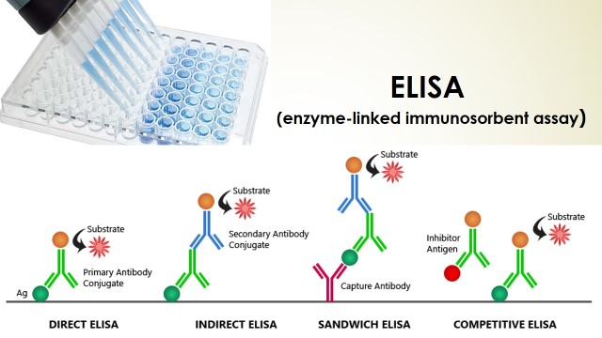
Enzyme-linked immunosorbent assay (ELISA)
Invented in 1971 by Eva Engvall and Peter Perlman
Types:
  Direct ELISA
  Indirect ELISA
  Sandwich ELISA
  Competitive ELISA
(Bioscience notes 2018)
(Bioscience notes 2018)
Notes:
ELISA is a versatile assaying technique with vast applications in medicine, biotechnology and plant pathology. It was invented in 1971 by Eva Engvall and Peter Perlman (Alhajj 2021). It is a modification and improvement of radioimmunoassay.
Types
Direct ELISA –Antigen is fixed to the surface of the multi-well plate. Enzyme linked antibody is poured into the well. A substrate is then added. The substrate enzyme-complex produces color.
Indirect ELISA – Antigen is immobilized to the surface of the multi-well plate. The analyte to be assayed is poured. The anylate binds to the antigen. An enzyme-linked antibody against the anylate is added. The excess is washed off. Then a substrate is added that reacts with the enzyme to produce color.
Sandwich ELISA –The surface of the multi-well plate is coated with a capture antibody, and then an antigen is added to bind it. The complex is the incubated with the enzyme-antibody complex that binds to the antigen. The substrate is poured to produce color after conjugating with the enzyme.
Competitive ELISA- Primary antibody is incubated with the sample antigen. The mixture is poured into micro-wells pre-coated with similar antigens. Unbound antibody is removed by washing. A secondary antibody, specific to the primary antibody, complexed with an enzyme is added. The enzyme reacts with the substrate to produce color. Absence of color means the test is positive (presence of antibodies).

Slide 6
ELISA
Principle- Based on immunologic response.
  Interaction of substrate and enzyme produces pigment of varied optical densities.
Method
  Antigen-antibody interaction, followed by substrate enzyme interaction that produces color
Hormones assayed by the technique- Thyroid hormones, gonadotropic hormones, steroid hormones
Advantages- Affordable cost, Specificity, Safety
Disadvantages- False negative or false positive results are common
Notes:
Principle- An enzyme linked to an antibody interacts with a colorless substrate to produce a colored complex whose optical density can be measured (Sakamoto 2017).
Method- ELISA wells are coated with an antigen that is suitable for the test. The serum containing the antibody (in this case an unknown hormone) to be tested is added and left to bind with the antigen. The excess is washed away. Afterward, the enzyme-linked purified antibody that is against the serum hormone is added. This binds to the initial hormone and the excess is washed off before a substrate is added. The substrate reacts to the enzyme producing a pigment whose intensity is proportional to the hormone hormone being assayed. It is then measured using a calorimeter (Sakamoto 2017)
Hormones that can be assayed by ELISA are; thyroid stimulating hormone, thyroxine, triiodothyronine, free T3 and T4, cortisol, follicle stimulating hormone, luteinizing hormone, prolactin, estrogen, prolactin, progesterone, testosterone, human chorionic gonadotropin.
ELISA is superior to other tests including RIA as it is cost effective, specific, and sensitive and can allow simultaneous analysis without pre-treatment. It does not bear any radiological hazards. However, it the antibody/ anti-hormone can be unstable thus causing false negative and false positive errors. It is also laborious to perform and requires a lot of skill to perform (Sakamoto 2017)
being assayed. It is then measured using a calorimeter (Sakamoto 2017).

Slide 7
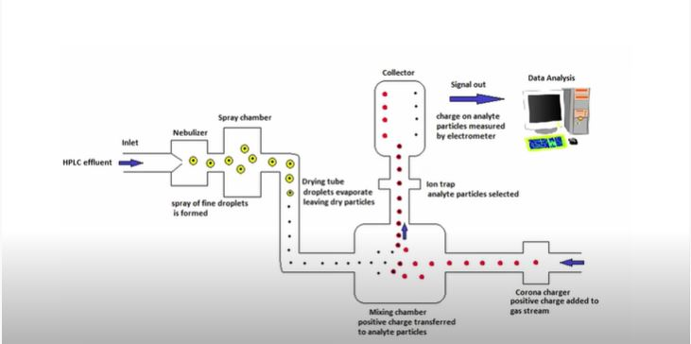
Liquid chromatography tandem mass spectrometry
Novel technique applied in therapeutic drug monitoring, endocrinology toxicology and pediatrics.
Notes:
This is a powerful novel method that has gained recognition in therapeutic drug monitoring, endocrinology toxicology and pediatrics. It can be used for both qualitative and quantitative analysis (Jannetto 2015).
Principle- Its principle is based on integrating many mass spectrometers in a series to analyze mixtures (Jannetto 2015).
Method- Liquid chromatography tandem mass spectrometry involves sophisticated equipment where a serum sample to be analyzed is nebulized then ionized. After ionization it is passed through an analyzer. The ions are then separated based on mass charge ratio and passed through a detector and the information is obtained through a computer through different kind of plots (Jannetto 2015).

Slide 8
Liquid chromatography tandem mass spectrometry
Used in quantitative analysis of steroid hormones.
Advantages
  Enables analysis of different analytes concurrently.
  Time saving
  Can measure hormones at extremely low concentrations
Disadvantages
  Costly equipment
  Sophisticated technique
Notes:
The method is principally used to measure steroid hormones such as androgens and glucocorticoids.
The advantage of the method is that it enables analysis of different analytes concurrently, therefore saving costs of individual analysis. It can also be able to measure hormones at extremely low concentrations. The major drawback of the method is that sophisticated equipment which is costly to acquire.

Slide 9
Molecular sieving
Also known as molecular sieve chromatography.
Principle
  Different molecular weights of molecules allow their separation and quantification
Method
  Application of a gel matrix to separate molecules.
  Fractionation of the target molecule and its analysis.
Used in quantification of androgenic hormones
Advantages-High sensitivity, sample preservation and time-saving
Disadvantages- Limited load capacity.
Notes:
The technique that is also known as molecular sieve chromatography is a separation technique that can also be used to quantify hormones
Principle- Its principle relies on the relative molecular weight and sizes of hormones which allow their separation.
Method- The serum containing the hormone to be measured is poured into a gel matrix. The matrix has the ability to separate molecules based on their molecular weights. The process involves the use of an eluent. Molecules with high molecular weights cannot pass through the pores of the gel. They will also elute early leaving the target molecule to pass through the gel. Once separation has occurred, the target molecule is acquired through fractionation and analyzed (N.S 2020).
Hormones that can be assayed by the method include cortisol, thyroid hormones, estradiol, testosterone and progesterone.
The technique is effective in that no sample is lost during the process. It requires a short analysis time. It also has high sensitivity. However it has relatively poor selectivity and has a limited load capacity.

Slide 10
Other methods used in hormone analysis
Other tests that can be used to assay hormones are:
  Blot Tests (qualitative analysis)
  Autoradiography (qualitative analysis)
  Immunocytochemistry (qualitative analysis)
  In situ hybridization (qualitative analysis)
  Solvent extraction (qualitative and quantitative analysis)

Slide 11
References
Alhajj, M., & Farhana, A. (2021). Enzyme Linked Immunosorbent Assay. Statpearls Publishing. Retrieved from https://www.ncbi.nlm.nih.gov/books/NBK555922/
Goldsmith, S. (1975). Radioimmunoassay: Review of basic principles. Seminars In Nuclear Medicine, 5(2), 125-152. doi: 10.1016/s0001-2998(75)80028-6
Sakamoto, S., Putalun, W., Vimolmangkang, S., Phoolcharoen, W., Shoyama, Y., Tanaka, H., & Morimoto, S. (2017). Enzyme-linked immunosorbent assay for the quantitative/qualitative analysis of plant secondary metabolites. Journal Of Natural Medicines, 72(1), 32-42. doi: 10.1007/s11418-017-1144-z
Jannetto P. (2015). Liquid Chromatography Tandem Mass Spectrometry | AACC.org . (2021). Retrieved 19 September 2021, from https://www.aacc.org/cln/articles/2015/july/liquid-chromatography-tandem-mass-spectrometry

Slide 12
References
N, S. (2020). Gel Filtration Chromatography? Definition, Principle & Procedure - Biology Reader. Retrieved 19 September 2021, from https://biologyreader.com/gel-filtration-chromatography.html#Applications
Davis C.(2021) ELISA. Medicine Net. Retrieved 19 September 2021, from https://www.medicinenet.com/elisa_tests/article.htm
ELISA (enzyme-linked immunosorbent assay) - Bioscience Notes. (2018). Retrieved 20 September 2021, from http://www.biosciencenotes.com/elisa-enzyme-linked-immunosorbent-assay/
Michael Moore (2020). ELISA tests and their Advantages. Retrieved 20 September 2021, from https://www.h-h-c.com/what-is-elisa-and-what-are-its-advantages/

