Slide 1
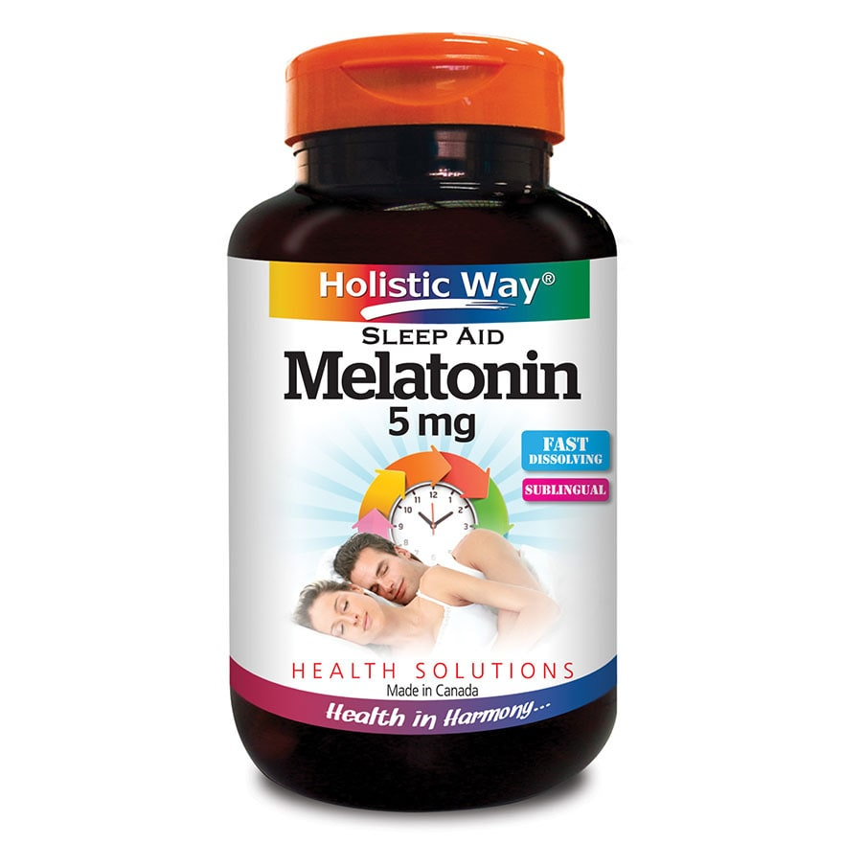
Melatonin
Presented by:

Slide 2
Health Benefits
Melatonin is supplement that is available in pill form.
It assists in regulating one’s sleep cycle.
It tells the body when it’s time to sleep.
It also wakes up the body.
Helps in treating sleep disorders.
Family Doctor. (2018). Melatonin. Retrieved from https://familydoctor.org/melatonin/

Slide 3
Health Risks
It is associated with diverse side effects.
The side effects include:
Drowsiness
Nausea
Depression
Headache
Hangover feelings

Slide 4
Reducing Health Risks
Seek doctor’s advice before taking melatonin.
Always take the recommended amount.
Consuming more of it cannot bring results quicker.
Store it in cool and dry place.
Family Doctor. (2018). Melatonin. Retrieved from https://familydoctor.org/melatonin/

Slide 5
Types of Melatonin
There are two types.
These are:
Natural and
Synthetic
Hopkins Medicine (n.d). Melatonin for Sleep: Does It Work? Retrieved from https://www.hopkinsmedicine.org/health/wellness-and-prevention/melatonin-for-sleep-does-it-work

Slide 6
Natural
It is made from animals’ pineal gland.
Considered to be probably contaminated by a virus.
Therefore it is not recommended.

Slide 7
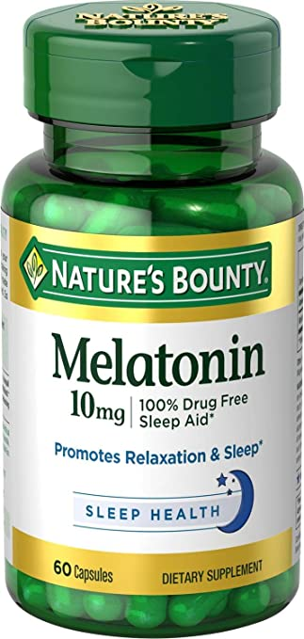
Natural melatonin

Slide 8
Synthetic
Does not contain any components from animals.
Therefore does not have the risk of being contaminated with a virus.
It is the one that is highly recommended.
Family Doctor. (2018). Melatonin. Retrieved from
https://familydoctor.org/melatonin/

Slide 9
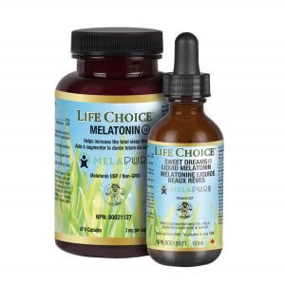
Synthetic melatonin

Slide 10
Overall Recommendations
Always check the pill bottle to know the type.
It should be used wisely and safely.
It should not be taken by pregnant or lactating mothers.
Always seek the doctor’s advice about when you should stop taking melatonin.
Hopkins Medicine (n.d). Melatonin for Sleep: Does It Work? Retrieved from https://www.hopkinsmedicine.org/health/wellness-and-prevention/melatonin-for-sleep-does-it-work

Slide 11
BIBLIOGRAPHY
Family Doctor. (2018). Melatonin. Retrieved from https://familydoctor.org/melatonin/
Hopkins Medicine (n.d). Melatonin for Sleep: Does It Work? Retrieved from https://www.hopkinsmedicine.org/health/wellness-and-prevention/melatonin-for-sleep-does-it-work

