Slide 1
Method: Data Collection and Analytic Techniques

Slide 2
From Theoretical Framework To Empirical Test
“Literature review” section
  Provides theoretical and conceptual ground to your research
    Goal 1: Identify “causal mechanisms” from previous literature
    Goal 2: Develop your “hypotheses”
“Data Collection & Analytic Technique” section (simply “Method” section)
  Provides empirical process to your research
    “How do you test your hypothesis”: Show a research plan (i.e. a narrow concept of research design) to test your hypotheses
      What variables and data will be used?
      What analytic technique will be used?

Slide 3
Case, Variable, and Value

Slide 4
Case, variable, and Value
A case (or observation)
  “The object described by a set of data”
    In statistics, minimum number of observation (called minimum “sample size”) should be 20
  Unit of analysis
  e.g. a person, group, event, university students, city, county, state government, country
A variable **
  “A characteristic of a case”
  A quantified concept (i.e. a measurable concept)
  e.g. gender, race, years of American education, income
A value
  “A particular category of a variable”
  e. g. male, Asian, 6 years, $2,000
4
Notes:
4

Slide 5
Two types of variables in terms of continuity
Continuous (or numeric) variable
  Values of a variable are true numeric values
  Also, there is unlimited true numeric values between two values
    e.g. To measure income: “$100, $100.99, $100.999….”
  Therefore, we can do very complicated and sophisticated statistical analyses
  In terms of level of measurement
    Interval level variable and ratio level variables
    There is no “data entry” issues
5
Notes:
5

Slide 6
Two types of variables in terms of continuity (cont.)
Discrete (or categorical) variables
  Values of a variable are NOT true numeric values even if the values are numbers
  Thus, there is no meaningful true numeric values between two values
    e.g. To measure sex/gender: “Male, female”
  We can do less complicated and less sophisticated statistical analyses
  In terms of level of measurement
    Ordinal level variable, nominal level variable, and dummy variable
    There is “data entry” issues
6
Notes:
6

Slide 7
Four types of variables: Four level of measurement
Interval level variable
  Values of a variable are ordered on a scale of equal units
  Also, size of differences in values is measurable in meaningful units (e.g. Celsius or dollar)
    e.g.
      To measure temperature: “- 10C, 20C, 33C…”
      To measure income: “$100, $100.99, $100.999….”
  High level of variable
    High level of statistical analysis can be conducted
7
Notes:
7

Slide 8
Four types of variables: Four level of measurement
Ratio level variable
  Most of interval level variables are Ratio variables
    Values of a variable are ordered on a scale of equal units
    Size of differences in values is measurable in meaningful units
    Also, the variable has “a true zero point”
      Height (and weight) has an absolute zero
      Temperature does not has an absolute zero, meaning that there is no such thing as “no temperature”
  Highest level of variable
    Highest level of statistical analysis can be conducted
8
Notes:
8

Slide 9
Four types of variables: Four level of measurement (cont.)
Ordinal level variable
  Values of a variable are ordered
  But, size of differences in values are not measurable in meaningful units
  e.g.
    Likert scales (strongly agree, agree, neutral, disagree, strongly disagree)
    To measure income: “Very high income, middle income, low income, very low income,”
    To measure education: “elementary, middle, high, undergraduate”
  Data entry: “3,2,1,0”
    Higher number means more income simply, meaning that the attributes is simply rank-ordered. But, its distance from 0 to 1 is not same as 3 to 4
9
Notes:
9

Slide 10
Four types of variables: Four level of measurement (cont.)
Nominal level variable
  Values have no inherent order
  Also, size of differences in values is not measurable in meaningful units
  e.g.
    To measure political party: “Democrats, Republicans, Independent”
    To measure race: “White, Black, Asian”
  Data entry
    First, make “1− number of categories” dummy variables of a categorical variable
    Second, enter “0 or 1” as values of a dummy variable
10
Notes:
10

Slide 11
Four types of variables: Four level of measurement (cont.)
Dummy (or dichotomous) variable
  A special type of nominal variables
    Values have no inherent order
    Also, size of differences in values is not measurable in meaningful units
  A nominal variable with “only two values”
  Examples:
    To measure gender: “male, female”
    To measure income: “rich, poor”
    To measure promotion: “promoted, not promoted”
  Data entry
    Either “1,0” or “0,1”
11
Notes:
11

Slide 12
Four types of variables: Four level of measurement (cont.)
Summary
PROPERTY | Dummy/ Nominal | Ordinal | Interval/ Ratio
Values are mutually exclusive | ♥ | ♥ | ♥
Values are logically ordered |  | ♥ | ♥
Values are measurable on a scale of equal units |  |  | ♥
12
Notes:
12

Slide 13
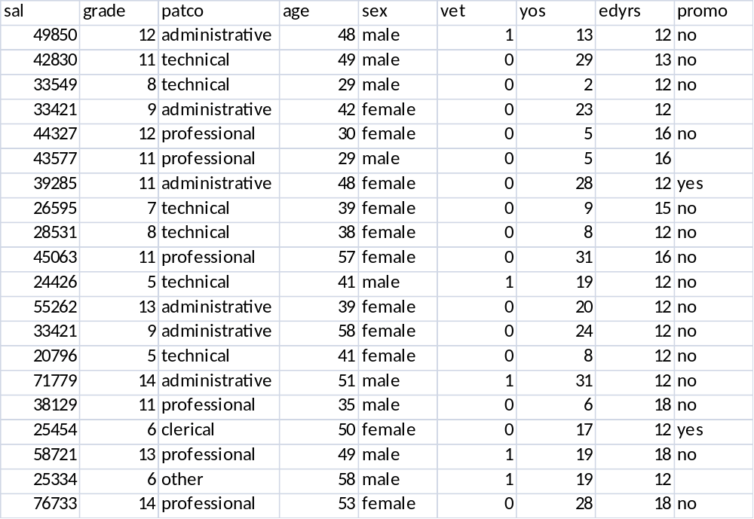
Office of Personnel Management
(Federal’s OPM data)

Slide 14
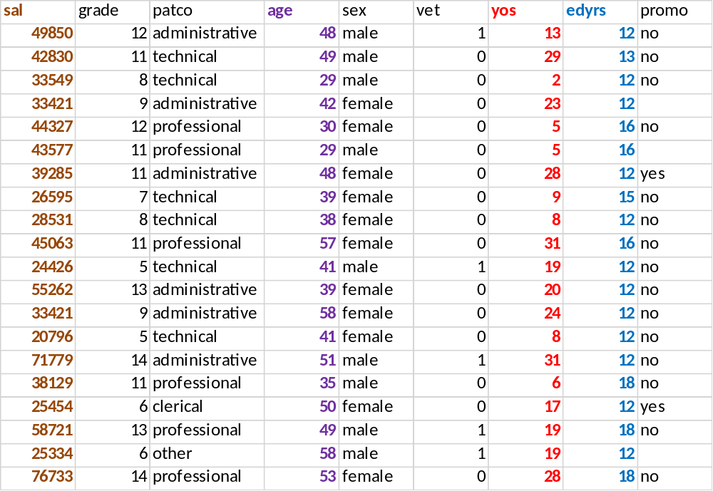
Interval Scales: Examples

Slide 15
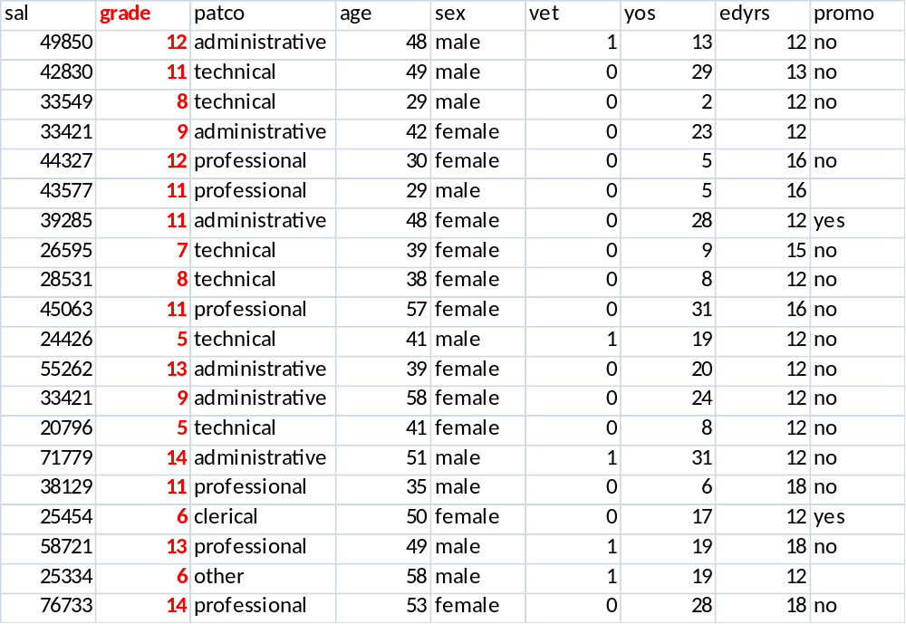
Ordinal Scales: Examples

Slide 16
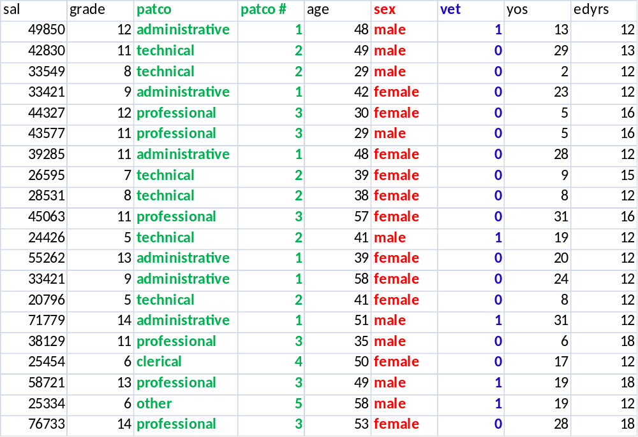
Nominal Scales: Examples

Slide 17
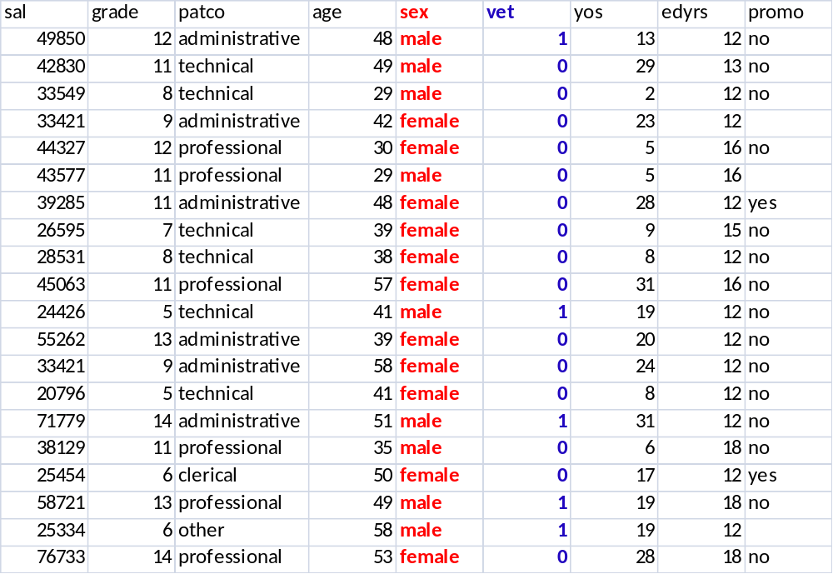
Dummy variables: Examples

Slide 18
Method Section

Slide 19
Method Section (cont.)
Through the “Methodology Section”
  Researcher should write detailed plan about how to test your hypothesis
    Clearly state “how you conduct your research”
  Through the “hypothesis test plan,” the research should identify the following elements:
    1. Writing conceptual hypothesis again (from Lit. Review)
    2. Stating operationalized hypothesis
    3. Selecting cases
    4. Defining key concepts and corresponding variables of cases
    5. Identifying data sources of variables
    6. Stating analytic technique

Slide 20
Elements of Method Section
1. While you have already written a “conceptual” hypothesis in a conclusive paragraph of your literature review section, write the conceptual hypothesis in your Methodology section again
  e.g. “As the level of effort of a student to study increases, the student’s performance is likely to increase”
2. Through the Methodological section, researcher should transform conceptual hypothesis into testable/measurable/quantified hypothesis, called “operationalized hypothesis”
  e.g. “As a student’s study hours increase, the student’s GPA is likely to increase”

Slide 21
Elements of Method Section (cont.)
2. Through the Methodological section, researcher should transform conceptual hypothesis into testable/measurable/quantified hypothesis, called “operationalized hypothesis” (cont.)
  Casual mechanism and hypothesis
    Based on casual mechanism identified through reviewing previous research (i.e. literature review), you need to develop testable hypotheses
    A hypothesis should include a key cause and an effect (or results)
      The key cause become an independent variable
      The effect become a dependent variable
      Other potential/possible causes become control variables
        Identify at least three (3) control variables

Slide 22
Elements of Method Section (cont.)
3. Select cases for study
  Set boundaries in your research
    Define an unit of analysis
      Examples: State governments, not just governments / students, not just people
    Define geographical area
      Examples: Southern state governments, 50 states, students in University of Ohio, patients in Columbus area
    Define time period
      Examples: 2016, 2000-2013,

Slide 23
Elements of Method Section (cont.)
4. Define key concepts and corresponding variables
  Clearly state your key concepts “conceptually” and “operationally”
  Conceptual definition (or abstract definition)
    Example: “In this research, the level of effort of a student to study is defined as …”
  Operationalized definition (or measurable definition)
    How do you measure your key concepts?
    Operationalization: Transform abstract concepts into measurable variables
      Abstract concept became a measurable variable such as independent, dependent, and control variables
    Example: “The level of effort of a student to study is measured as study hours per day”

Slide 24
Elements of Method Section (cont.)
5. Identify data sources
  What data will be used to measure your variables (or operationalized concepts)?
    In other words, what data will be used to test your hypotheses?
  Where will you get the data?
    e.g. “The data on students’ GPA will come from the Annual Report issued by the Ohio Department of Education”

Slide 25
Elements of Method Section (cont.)
5. Identify data sources (cont.)
  Where will you get the data?
    It may be the most difficult part of your capstone project
      You may have to contact your client or related organizations in practice
      Collect secondary data (someone already have) than raw data
      You may want to collect by yourself using a survey. But, it would be easy

Slide 26
Elements of Method Section (cont.)
6. State your analytic technique
  Qualitative analysis
    What qualitative analytic technique will you use?
    Examples: Interview, Meta analysis, Content analysis
  Quantitative analysis **
    What statistical technique will you use?
    Examples: Regression analysis, Chi-square analysis (or Logit analysis)

Slide 27
Elements of Method Section (cont.)
6. State your analytic technique (cont.)
  (1) What statistical technique will you use?
    While you have learned diverse analytic techniques, I want you use regression analysis **
      Therefore, your dependent variable should be a continuous/numerical variable
      If your dependent variable is discontinuous/categorical variable, you should use Chi-square test and/or Logit analysis, which you have not learned
    If you are thinking of another analytic technique, please see me before choosing the technique

Slide 28
Elements of Method Section (cont.)
6. State your analytic technique (cont.)
  (2) What type of data set will be used for your regression analysis? There are three types of statistical analysis depending on types of data set (cont.)
    Cross-sectional analysis: Researchers examine a cross section of social reality, focusing on variation between individual spatial units (or cases)
      e.g. Income tax rates across 50 states in 2015
    Time-series analysis: Researchers examine the variation within one spatial unit (or cases) over time
      e.g. Income tax rate in Ohio in 2005 to 2015
    Panel data analysis: Researcher examine a variation across spatial units over time
      e.g. Income tax rates across 50 states in 2005 to 2015

Slide 29
Elements of Method Section (cont.)
6. State your analytic technique (cont.)
  (3) What is the size of your data set?
    In other words, what is the number of your observations
    For regression analysis (t-test), you should have at least 20 observations

Slide 30
Elements of Method Section (cont.)
6. Data table
Type | Dependent | Key Independent | Control 1 | Control 2 | Control 3
Unit | score | In thousand $ | score | year | person
ID | GPA Score | Funding | IQ | Teacher's Quality | Class size
1
2
3
4
…

Slide 31
For next In-Class session
In class
  Data Collection and Analytic Technique presentation (5:30-6:45 pm)
    Bring hard copies of your literature review assignment and PowerPoint.

