Slide 1
Microsoft Supplier Responsibility
Name:
Institution:

Slide 2
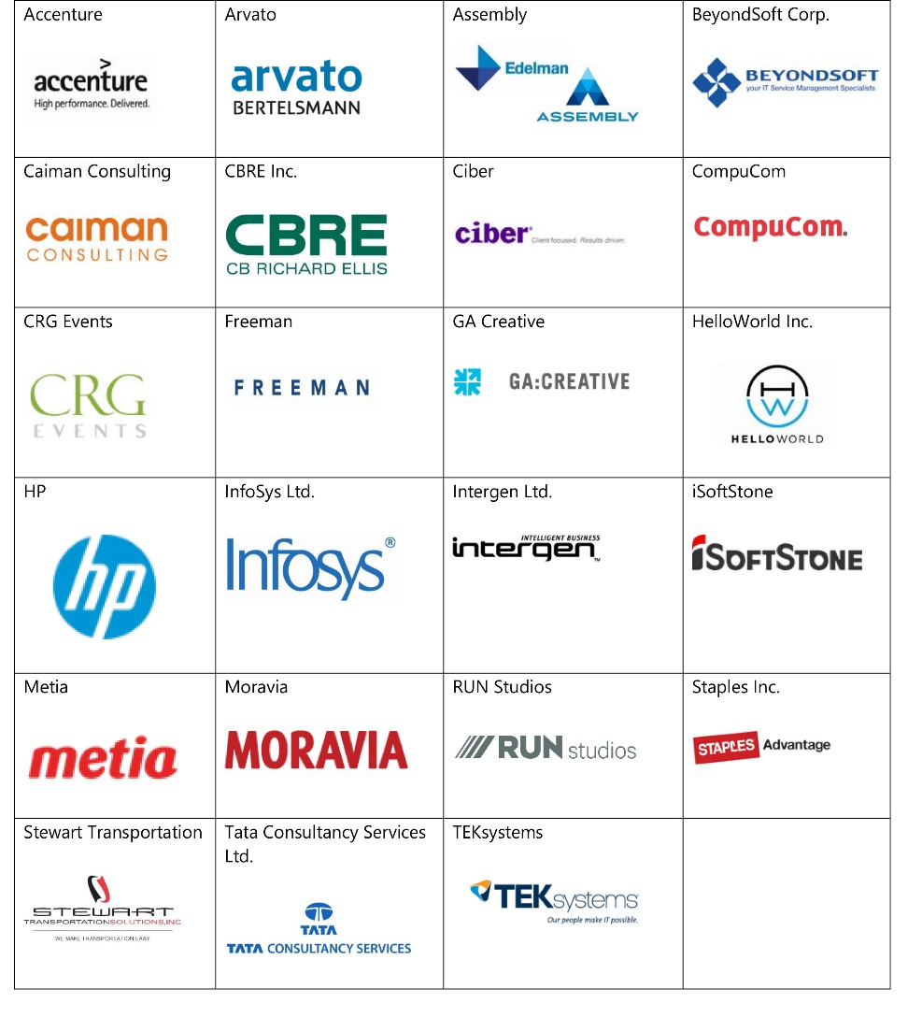
Microsoft’s Supplier Responsibility Summary
The supply chain is monitored to ensure it complies to Microsoft’s code of conduct. (Habboubi, 2019).
Partnerships are built to reduce the amount of waste from Microsoft products.
Microsoft suppliers are at the frontline of environmental conservation.
The raw material suppliers are supposed to minimize workplace risks, to partner with Microsoft.
Notes:
Microsoft takes its supplier responsibility seriously and has been the biggest campaigners of environmental conservation (Lawless, 2018). The company reduces waste products through their recycling programs. It encourages its suppliers to be water conservation campaigners; and it believes that raw products are as important when it comes to scrutiny as the final products.

Slide 3

Commitment to Ethical Business Practices
Microsoft believes that the workplace environment should be safe and respectful.
Suppliers should offer the working hours that correspond with the worker’s pay (Sehgal et al., 2020).
Microsoft provides that suppliers should be in harmony with cultural practices of the community in which they operate.
Notes:
The “Real Impact for Better Tomorrow” logo is Microsoft’s way of indicating that while other companies follow the normal route of taking advantage of the available resources, the company decided whether the exploiting the resources will be harmful to the society (Bonsu, 2019). The suppliers should exploit their workers in a fair manner while working hard in hard with the community they work in. Microsoft focuses on making an impact more than exploiting the available resources.

Slide 4
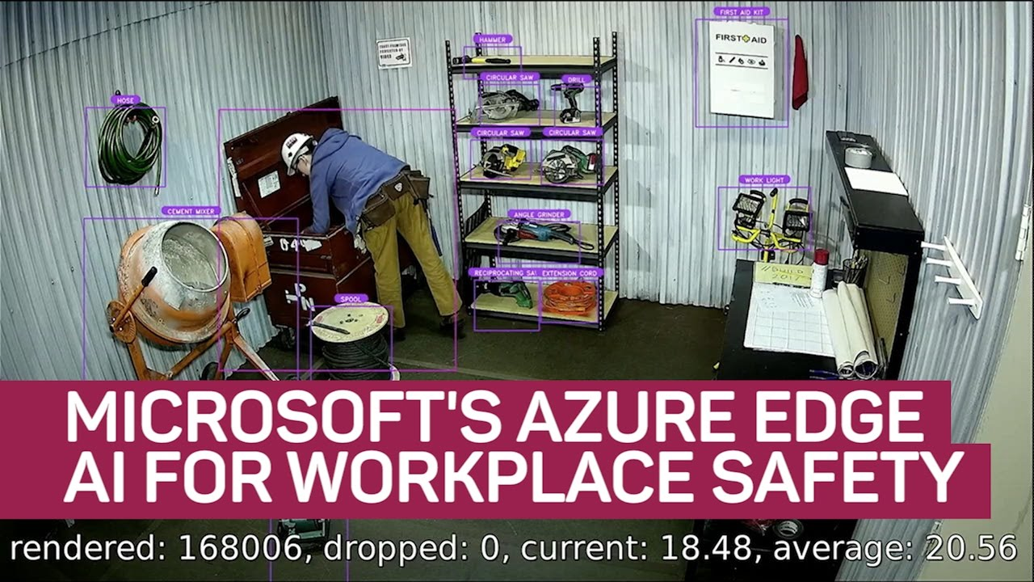
Workers’ Health and Safety
Microsoft insists that suppliers should give their workers safety an utmost priority.
To minimize workplace accidents, suppliers should provide the necessary protective equipment and training (Bonsu, 2019).
Regulations should be clear in instances where workers fall sick while at the workplace.
Notes:
Microsoft’s suppliers are advised to look after their employees or be removed from the supply chain. Workers should be protected from harmful chemicals and other accidents at the workplace. Microsoft strives to revolutionize the safety of workplaces through their AI inventions.

Slide 5

Workers Labor and Human Rights
Suppliers should ensure that their workers are free from intimidation and workplace stress (Bonsu, 2019).
The workers are also trained on their rights before they begin working.
Microsoft does not tolerate any request for recruitment fees.
Notes:
A supplier whose workers keep complaining of denial of their rights at the workplace risks being removed from the supply chain. Microsoft also ensures that workers are well aware of their rights before they start working for the company or any of its partners (Lawless, 2018). Some organizations are so corrupt that workers are requested to pay a fee so they can join them. Microsoft believes that nobody should pay to work. Microsoft believes that workers rights are human rights and should therefore be respected.

Slide 6
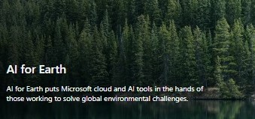

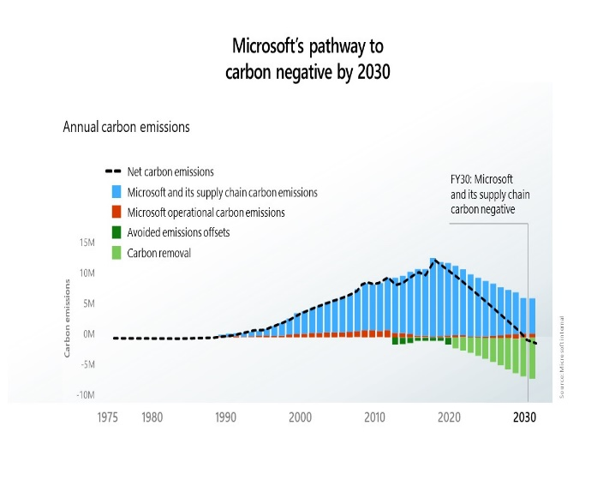
Environmental Accountability
Notes:
The graph shows the environmental effects of various products in relation to emission of carbon while the product is in use. By 2030, Microsoft intends to reduce carbon emissions to the environment to zero. The AI’s goal of making analysis on environmental conservation is illustrated in the photos above (Lawless, 2018). They are all a proof of Microsoft’s environmental accountability.

Slide 7
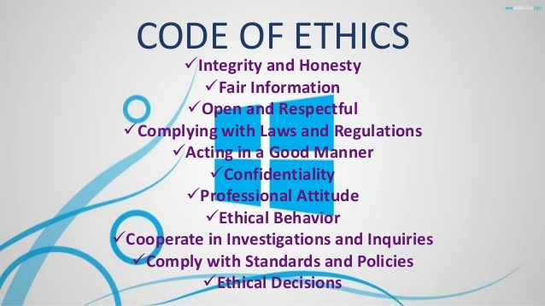
Changes in Code of Conduct
The company has been eliminating all possible shortcuts in its organizational process (Lawless, 2018).
All processes are placed under strict scrutiny and audits are done frequently.
Suppliers have been put on probation or entirely removed where workers rights are ignored.
Microsoft has focused on providing education to its workers.
Notes:
The photo shows a list of code of conducts from one of Microsoft’s offices. Every supplier should be ready to comply with these regulations.

Slide 8
References
Bonsu, S. (2019). Corporate Social Responsibility: Assessing the Alignment of Theory and Practice Utilizing Case Studies. Journal of Marketing & Management, 10(1).
Habboubi, S. (2019). Analytics Models for Corporate Social Responsibility in Global Supply Chains (Doctoral dissertation).
Sehgal, G., Kee, D. M. H., Low, A. R., Chin, Y. S., Woo, E. M. Y., Lee, P. F., & Almutairi, F. (2020). Corporate Social Responsibility: A Case Study of Microsoft Corporation. Asia Pacific Journal of Management and Education, 3(1), 63-71.
Lawless, J. (2018). Global Diversity & Inclusion at Microsoft.

