Slide 1
M9: Motivational Interviewing for Health Behavior Change
Adapted from Paul F. Cook, PhD
University of Colorado, College of Nursing

Slide 2
Health is Connected to Behavior
Behavior-linked conditions (cancer, heart disease and diabetes) account for 75% of US health costs
  American Psychological Association, 2009
50% of medications are abandoned by 12 mos.
  Meichenbaum & Turk, 1987; NCPIE, 1994
Healthy People 2010 Objectives
  Physical Activity – Less injury and violence
  Less Overweight and Obesity – Immunization
  Less Tobacco Use – Less Substance Use
  Responsible Sexual Behavior – Getting Mental Health Care

Slide 3
Example: Treatment Nonadherence
50% of meds abandoned by 12 mos.
Exercise has even lower adherence
Diet changes are hard to sustain
Self-monitoring is often insufficient
Patients find lifestyle change difficult
Continued smoking, alcohol, drug use
Change in one area does not generalize to changes in other areas
Glasgow, McCaul, & Schafer, 1987 ; Meichenbaum & Turk, 1987;
NCPIE, 1994; Polivy & Herman, 2002

Slide 4


We
Talk About Nonadherence…

Slide 5
Why don’t we do something about it? …

Slide 6
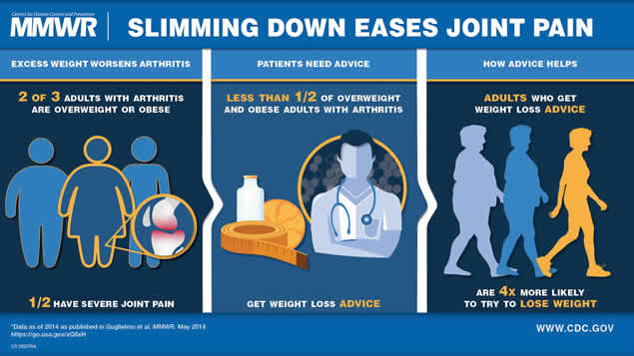

Slide 7
… Why Don’t We Do Something About It?
Brief physician advice improves diet and exercise.
The percent of providers counseling patients about behavioral approaches is disappointing (less than 50%).
Providers don’t ask about behavior because they believe patients can’t or don’t want to change
Kraschnewski, J.L. et al. (2012). Abid, et al., 2005; Goldstein, Whitlock, & DePue, 2004;
Polivy & Herman, 2002;

Slide 8
Can We Make a Difference?
Average Adherence Rate
(for any medical recommendation)
provider behavior
can reduce adherence
patient behavior
can increase adherence
standard medical practice

Slide 9
The Paradox
People behave in ways counter to their own interests
Labels (like “noncompliant”) increase resistance
Confronting denial increases resistance
Appeals to fear increase resistance
Increased knowledge = behavior change
Cook, 2006

Slide 10
Quiz
T or F: People behave in ways counter to their own interests.
T or F: Labels (like “noncompliant”) improve compliance to recommendations.
T or F: Confronting someone about their “bad” behavior increases compliance.
T or F: Appeals to fear generally increase compliance.
T or F: Providing information and increasing knowledge generally translates into health behavior change.
Cook, 2006

Slide 11
Twelve Roadblocks
Ordering
Threatening
Persuading
Lecturing
Moralizing
Criticizing
Shaming
Psychoanalyzing
Sympathizing
Praising
Questioning
Changing the Subject
Try it!
Gordon, 1970

Slide 12
What to do about noncompliant clients?
What is our responsibility to the healthcare team?
What is our responsibility to the client?
What can we do (as providers) to decrease resistance and increase trust in healthcare?
Miller & Rollnick. (2002). Motivational Interviewing, 2nd Ed.

Slide 13
Motivational Interviewing
Developed for substance abuse
Intended to motivate “resistant” clients
Based on social psychology principles
  Social influence/persuasion
  Resistance (“reactance”) to change attempts
  Rogerian psychotherapy techniques
“A method for exploring and resolving ambivalence”
“MI is like dancing”
Miller & Rollnick. (2002). Motivational Interviewing, 2nd Ed.

Slide 14
Motivational Interviewing Aims
Explore and resolve ambivalence
MI is not a cagey way to get the change you, the counselor, want to see.
The counselor’s role is to help clients understand their ambivalence and make educated decisions about what to do
Counselor supports and strengthens clients’ autonomy and desire to change

Slide 15
The Evidence for MI
Meta-analysis of 30 RCTs, total N = 5541, most with 3-12 month data
Dose of treatment: 30 min to 4 hrs
Average effect of d = .5 for ETOH use, drug use, diet & exercise, treatment adherence (similar to effects for longer-term counseling methods)
Weaker but significant effect of d = .2 for smoking cessation (based on 16 RCTs)
Smaller effects for safer sex (2 studies), eating disorders (1 study)
Burke, et al. (2003). J Consult Clin Psych, 71(5), 843-861; Hettema & Hendricks. (2010). J Consult Clin Psych, 78(6), 868-884.

Slide 16
What Works?
What Works?
Acceptance
Attention
Choice
Support
Reminders
Experimentation
Reinforcement
MI Principles
Roll with Resistance
Develop Discrepancy
Express Empathy
Support Self-Efficacy

Slide 17
How MI Works
http://www.youtube.com/watch?v=mDBPxvylXKU

Slide 18
Four General Principles
Roll with resistance
  Avoid arguing
  Provide new perspectives, but don’t impose them
Develop discrepancy
  Client presents the arguments for change
Express empathy
  Skillful reflection, acceptance, ambivalence
Support self-efficacy
  The client chooses and carries out the change
  Facilitate client’s belief that change is possible
Rollnick, Miller, & Butler. (2007). Motivational Interviewing in Health Care.

Slide 19
Everyone is Ambivalent
The nonadherent client (or parent)
  Argues or interrupts
  Denies or ignores problems
  Still has a part of them that values health
  Still has a part of them that wants to change
The adherent client (or parent)
  Is (probably) telling you the truth
  Is doing fine for now
  Still has a part of them that resents/resists change

Slide 20
Basic MI Techniques: OARS
Open-Ended Questions
  Problem recognition
  Concern about the problem / pros and cons
  Optimism about change
  Intention to change
Affirm
Restate
  Reflect content
  Reflect emotion (worry, concern, upset)
  Reflect intention
  Reflect meaning (go one step further)
Summarize (“what else?”)
Miller & Rollnick, 2002

Slide 21
When Can I Educate?
The Medical Model:
Tell — Ask — Tell
The Motivational Interviewing Model:
Elicit — Provide — Elicit
Rollnick, Mason, & Butler. (1999). Health Behavior Change.

Slide 22
Learn More about MI
Rollnick, Miller, & Butler (2007). Motivational Interviewing in Health Care
Rollnick, et al. (1999). Health Behavior Change
MI home page: www.motivationalinterview.org
Prochaska, Norcross, & DiClemente (1995). Changing for Good
Stages of change home page: www.uri.edu/research/cprc/transtheoretical.htm
Bothello (2004). Motivate Healthy Habits
Seminars: professional.development@ucdenver.edu

