Slide 1
Protamine Dose Determination by Dose Response

Slide 2
Outline
Protamine
Need for Accuracy
HDR
Research
Thesis Question
Possible Methods
HMS Plus
Overview
References

Slide 3
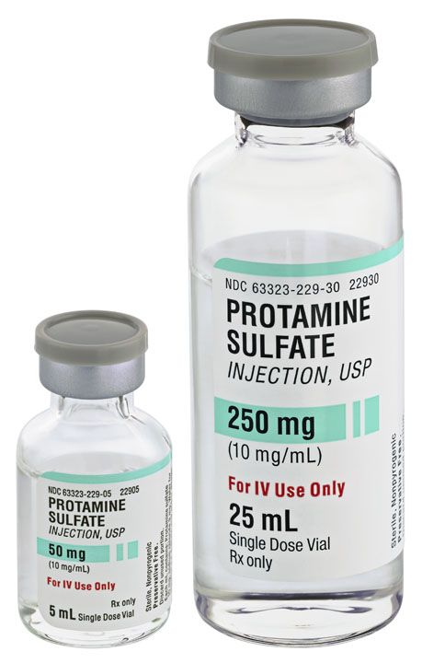
Protamine
FDA Approved
Isolated from salmon fish sperm
Reduces postoperative bleeding
Adverse effects
Various dosages
Notes:
Protamine is an FDA approved drug used to neutralize the effects of unfractionated heparin. It was originally isolated from salmon sperm however, its currently produced using recombinant technology. When dosed appropriately protamine reduces the risk of postop. bleeding. There are various dosages from 0.6 to 1.8mg to every 1mg heparin. With the most common ratio among institutions being 1:1 or 1.3:1.

Slide 4
Need for Accuracy
Underdosing of protamine may increase blood loss post-operatively.
Overdosing has been shown to increase blood loss post-operatively as well.
Complexities in the pharmacology and monitoring
No effective means of identifying an ideal dose.
Notes:
So, why do we need accuracy? As we know underdosing protamine can lead to increased blood loss post-operatively due to the residual heparin in circulation. So if that’s the case why don’t we just shot high to be on the safe side? Well, the reason is since protamine is inherently an anticoagulant, overdosing would not only completely neutralize heparin in the circulation but would lead to the same issues of post-op bleeding because of the excess and lack of heparin to neutralize. This means the administration of this drug needs to be extremely accurate to prevent any issues of post-operative bleeding. Which I why we need to figure out and ideal dose that would completely neutralize heparin without leaving excess protamine.

Slide 5
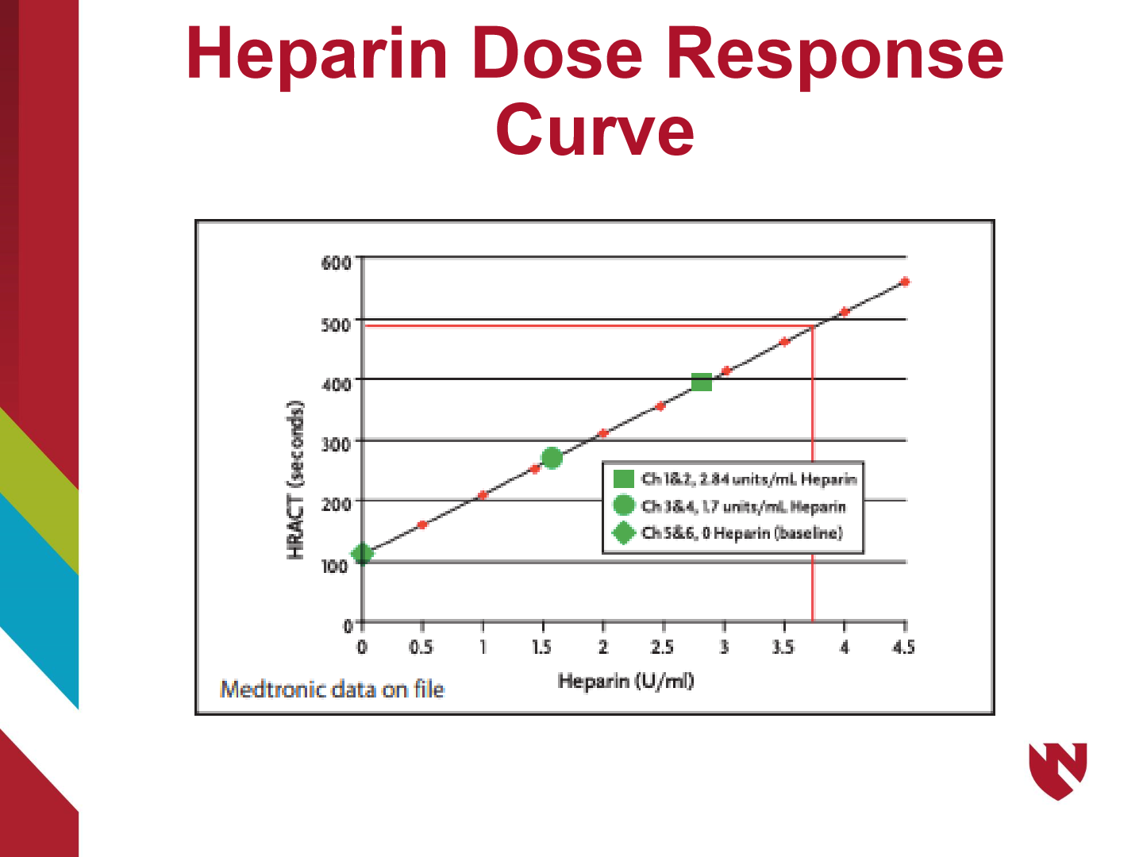
Heparin Dose Response
Used to maintain adequate anticoagulation.
Defined by a target ACT.
May be just as effective in heparin reversal.
In theory, can be used to calculate protamine.
Notes:
The heparin dose response curve is used to determine the amount of heparin needed to maintain adequate anticoagulation throughout a procedure. Its defined by a target ACT which has been proven to effective. A similar technique may be just as effective in heparin reversal with Protamine. In theory, a linear regression equation, generated from the curve, can then be used to calculate the amount of protamine necessary to achieve a target activated clotting time.

Slide 6
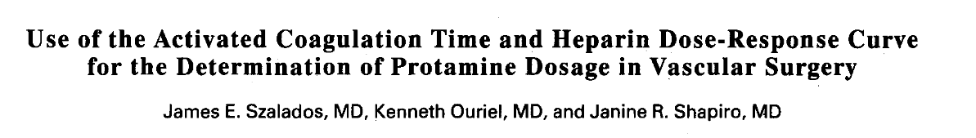
Research
45 randomized patients
3 groups which did not differ significantly with respect to age, weight, sex distribution, or duration of heparinization
ACT’s were measured before heparinization, 5 minutes later, and then every 30 minutes
Protamine dose was significantly less when the Heparin Dose Response Curve was used.
Notes:
In a research article found in Journal of Cardiothoracic and Vascular Anesthesia by Dr. Szalados he eludes that the activated coagulation time can be used to construct a two-point heparin dose-response curve from the ACT values at baseline and 5 minutes after heparin administration. He goes on to say that the ACT value at any subsequent time interval can then be used to estimate the residual heparin activity from the Heparin Dose Response Curve.
45 patients were randomized to one of three groups and ACTs were measured before heparinization, 5 minutes later, and then every 30 minutes until just prior to and after protamine administration. Group 1 received 1mg/kg protamine. Groups II and III the residual heparin activity was extrapolated from the dose response curve and multiplied by 1.3 for group 2 and 1.0 for group 3 to obtain the protamine dosage. The article concluded that for all 3 groups the ACT returned to its normal levels after protamine administration. However, the protamine dose was significantly less when the Heparin Dose Response Curve was used.

Slide 7
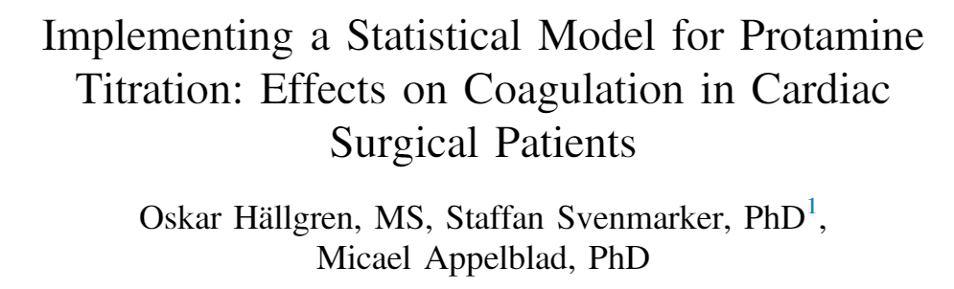
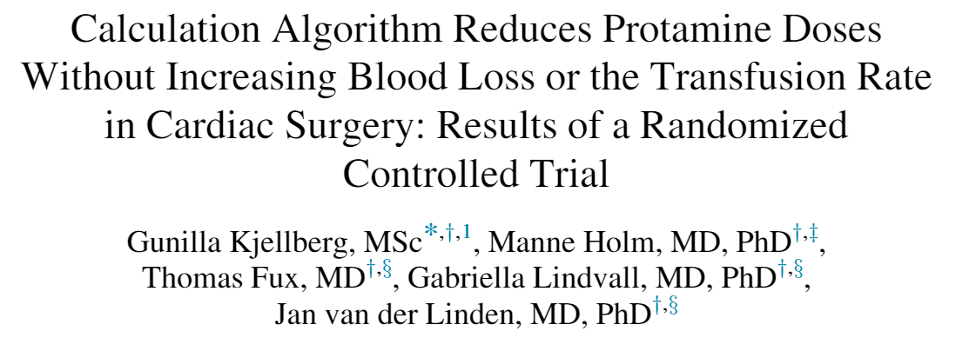
Research
Notes:
This article talks about how the use of a calculated algorithm reduces protamine dosage without increasing post-op bleeding. This study compares conventional dosage based on weight vs. using the algorithm and they came to the conclusion that although there wasn’t any significant difference in postoperative bleeding. However, the groups that was dosed using the algorithm used less protamine.
In this next article it talks about how this same algorithm is used in point-of-care devices in order to determine protamine dosage. The HMS-plus is a well-recognized device that calculates protamine by assessing the concentration of heparin in a device-specific cartridge filled with a small volume of whole blood. The concentration is then measured using the algorithm to finalize the patient’s protamine requirement.

Slide 8
Thesis Question
When compared to the HMS plus, can the heparin dose response curve be used to accurately determine protamine dosage?

Slide 9
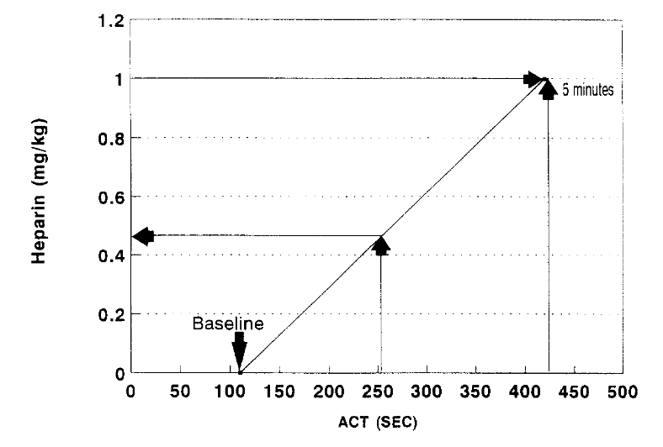
Possible Method
Notes:
So the way we would calculate HDR we would get a baseline ACT prior to administration of heparin, another ACT about 5 min after heparin administration and if need be a third one once we reach an ACT of 480. We would then plot these out on a graph like shown here and use this data to determine an accurate protamine dose to get the patient back to a baseline ACT once off bypass. For example if we come off bypass and we have an ACT of about 252sec according to this chart that would mean we have a heparin concentration of 0.4mg/kg. So we would administer either a 1:1 ratio or and 1.3:1 ratio based of this concentration, so .4mg/kg protamine or 0.52mg/kg protamine respectively.

Slide 10
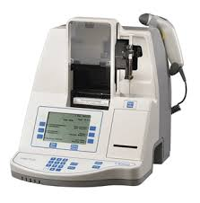
HMS Plus
The HMS Plus Hemostasis Management System is a reliable, versatile and effective platform for accurate heparin and protamine management resulting in lower procedural and operational costs.
After determining the dose of protamine using the heparin dose response curve I would compare it to the HMS-plus for accuracy.
Notes:
So this is the HMS plus is a reliable and effective platform for accurate heparin and protamine management resulting in lower procedural and operational costs. However the cost of this device a expensive and if using the HDR curve is just as effective why not save on the cost of this device and just use the HDR curve to determine protamine dose.

Slide 11
Overview
Protamine
Need for Accuracy
HDR
Research
Thesis Question
Possible Methods
HMS Plus
Overview
References

Slide 12
References
The effect of protamine dosing variation on bleeding and transfusion after heparinization for cardiopulmonary bypass (https://pubmed.ncbi.nlm.nih.gov/29544405/)
Interaction of heparin and protamine in presence of overdosage: in vitro study (https://pubmed.ncbi.nlm.nih.gov/32854516/)
Increased Accuracy in Heparin and Protamine Administration Decreases Bleeding: A Pilot Study (Increased Accuracy in Heparin and Protamine Administration Decreases Bleeding: A Pilot Study (nih.gov))
Hand-held personal digital assistant program for the HEMOCHRON RxDx heparin and protamine dosing system (https://pubmed.ncbi.nlm.nih.gov/14653423/)
COMPARISON OF HEPARIN DOSE RESPONSE TO ACTIVATED CLOTTING TIME IN INFANTS AND CHILDREN FOR CARDIAC SURGERY (COMPARISON OF HEPARIN DOSE RESPONSE TO ACTIVATED CLOTTING TI... : Anesthesia & Analgesia (lww.com))
Heparin therapy during extracorporeal circulation: II. The use of a dose-response curve to individualize heparin and protamine dosage (Heparin therapy during extracorporeal circulation: II. The use of a dose-response curve to individualize heparin and protamine dosage – ScienceDirect)
Anticoagulation monitoring during extracorporeal circulation with the Hepcon/HMS device (Heparin dose response (HDR) curve | Download Scientific Diagram (researchgate.net))
Hepcon HMS Plus® reduced intraoperative protamine dosages following weaning from cardiopulmonary bypass (Hepcon HMS Plus® reduced intraoperative protamine dosages fo... : European Journal of Anaesthesiology | EJA (lww.com))
Method to Calculate the Protamine Dose Necessary for Reversal of Heparin as a Function of Activated Clotting Time in Patients Undergoing Cardiac Surgery (https://www.ncbi.nlm.nih.gov/pmc/articles/PMC4557496/)

Slide 13
References
Are We Able to Dose Protamine Accurately Yet? A Review of the Protamine Conundrum (JECT1900038 63..70 (nih.gov))
Use of the activated coagulation time and heparin dose-response curve for the determination of protamine dosage in vascular surgery (Use of the activated coagulation time and heparin dose-response curve for the determination of protamine dosage in vascular surgery – ScienceDirect)
Real time measurement of heparin concentration during cardiopulmonary bypass (Real time measurement of heparin concentration – ProQuest)
More Effective Suppression of Hemostatic System Activation in Patients Undergoing Cardiac Surgery by Heparin Dosing Based on Heparin Blood Concentrations rather than ACT (Thieme E-Journals - Thrombosis and Haemostasis / Abstract (thieme-connect.com))
Implementing a Statistical Model for Protamine Titration: Effects on Coagulation in Cardiac Surgical Patients (Implementing a Statistical Model for Protamine Titration: Effects on Coagulation in Cardiac Surgical Patients – ScienceDirect)
Calculation Algorithm Reduces Protamine Doses Without Increasing Blood Loss or the Transfusion Rate in Cardiac Surgery: Results of a Randomized Controlled Trial (Calculation Algorithm Reduces Protamine Doses Without Increasing Blood Loss or the Transfusion Rate in Cardiac Surgery: Results of a Randomized Controlled Trial – ScienceDirect)
Medtronic HMS Plus HEMOSTASIS MANAGEMENT SYSTEM (HMS_Plus_Brochure_200501780d_EN_FINAL.pdf (medtronic.com))

