Slide 1
Nutrition management for peptic ulcer
Definition: A peptic ulcer (stomach ulcer) is a sore on the lining of your stomach or duodenum. People who take NSAIDs such as aspirin and ibuprofen long-term or are infected with the bacteria H. pylori are most likely to develop peptic ulcers.

Slide 2
Eating, Diet, & Nutrition
Different foods do not cause or prevent peptic ulcers (stomach ulcers),
drinking alcohol worsen ulcers.

Slide 3
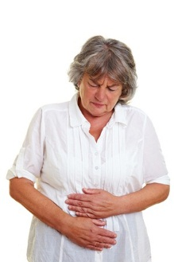
Symptoms & Causes
A dull and burning pain in the stomach is the most common signs of peptic ulcers identified by National institute of diabetes and digestive and kidney disease.
Causes are long-term use of NSAIDs, an infection with H.pylori, or both. Rarely, tumors cause peptic ulcers.
Picture from National institute of diabetes and digestive and kidney disease showing somebody with ulcer symptoms

Slide 4
Clinical Trials
The National Institute of Diabetes and Digestive and Kidney Diseases (NIDDK) and other components of the National Institutes of Health (NIH) conduct and support basic and clinical research into many digestive disorders.

Slide 5
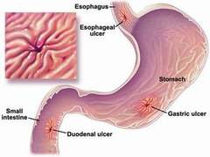
Diagnosis
Peptic Ulcers have several symptoms and causes, but National institute of diabetes and digestive and kidney disease uses endoscopy or an x-ray to examine if you have ulcer.
The picture uploaded from National institute of diabetes and digestive and kidney disease website shows the infected part of the stomach.

Slide 6
Treatment
Your doctor will decide the best treatment based on the cause of your peptic ulcer (stomach ulcer). Most ulcers heal from treatment with Proton Pump Inhibitors (PPIs). If an ulcer is caused by NSAID’s, your doctor may tell you to stop taking them.

Slide 7
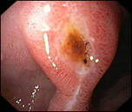
World Health Organization
Peptic ulcer is a lesion of the mucosal lining of the upper gastrointestinal tract characterized by an imbalance between aggressive and protective factors of the mucosa, having H. pylori as the main etiologic factor. Dietotherapy is important in the prevention and treatment of this disease.
The picture showing lesion of the mucosal lining

Slide 8
Treatment
WHO suggest that; A balanced diet is vital in the treatment of peptic ulcer, once food can prevent, treat or even alleviate the symptoms involving this pathology. However, there are few papers that innovate dietotherapy; so additional studies addressing more specifically the dietotherapy for treatment of peptic ulcer are necessary.

Slide 9
Who Nutrition assessment
Malnutrition in this case may occur especially when there is stenosis, which prevents normal ingestion of foods can cause peptic ulcers

Slide 10
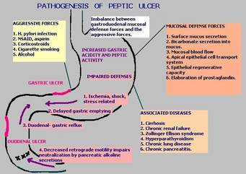
Pathogenesis of Peptic ulcer

Slide 11
According to American gastroenterological association
Ulcers are the most common cause of hospitalization for upper gastrointestinal bleeding (UGIB), and the vast majority of clinical trials of therapy for nonvariceal UGIB focus on ulcer disease.
Good morning, please help me. I have a brief presentation. I want you to reorder the presentation in a simple way

Slide 12
Treatment recommendation by American gastroenterological association
This organization recommends for the management of patients with overt UGIB due to gastric or duodenal ulcers. "Overt" indicates that patients present with symptoms of hematemesis, melena, and/or hematochezia.
They then focus on the endoscopic and medical management of ulcer disease, including endoscopic findings and their prognostic implications, endoscopic hemostatic therapy, post-endoscopic medical therapy and disposition, and prevention of recurrent ulcer bleeding.

