Slide 1
Negligence, Standard of Care, and Causation
Student’s Name
Institutional Affiliation

Slide 2

Standard of Care: Reasonable Person
Duty of care is the responsibility of individuals or entities to prevent acts of negligence and omission that cause harm to others.
Standard of care refers to the reasonable things that ought be done in certain situations.
A “reasonable person” is an ideal fiction persona in legal context that portrays how a typical person should act in particular circumstances (Find Law, 2020).
For example, a defendant can be tasked with the loading of docks and he tosses large cargo on the truck and immediately notices that children are playing in the proximity of the truck. He continues loading and strikes one of them.
The jury is likely to argue that the defendant knew about the presence of the children and probably violated the standard of care.
A reasonable person ought to warned the children to stop playing near the truck to avoid cases of injuries.

Slide 3
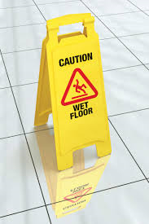
Foreseeability and Application to Minors
Foreseeability the ability of a reasonable person to take precautions in the case of an event likely to cause harm to other people.
In the case of children or minors, the standard of care does not expect them to act as reasonable as their adult counterparts.
The standard of care is limited to their experience, age, and intelligence.
The acts of this demographic is compared with the actions of other children within the same age group.
For example, charging a 3-year child for stealing will be outrageous since they have the same capacities to act as a reasonable adult.

Slide 4

Application to Experts and Professionals
In the case of experts and professional, medical and armed personnel are taken into account.
The standard of care assumes that professionals and experts are trained and educated in a particular field, therefore, must act with regards to ‘reasonable person” and “foreseeability.”
In the case of medical practitioners, the plaintiff is required to prove that he/ she departed the standard of care. There must be an expert testimony showing the departure of the standard of care.
In the case of armed professional, they are required to use force appropriately and the standard of care is used to determine whether excessive force was used.
For example, usage of cause can be appropriate when a law enforcement applies to a person that tries to resist arrest.

Slide 5
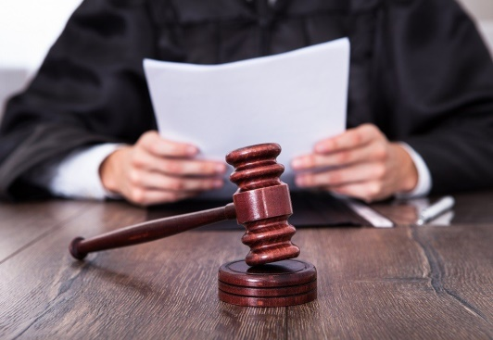
Causation: Breach and Damage
Causation is a Law of Tort principle that assess the damages that result from a breach of contract.
The claimant is required to prove the balance of probabilities that a breach resulted into loss, injury, or harm (damage) (Practical Law, 2020).
Proximate cause is related to damage that a legal systems believe that was the actual cause of a particular event.
Cause-in-fact is determined using the “but for” assessment.
If not the action, the event had zero probability of occurring.

Slide 6
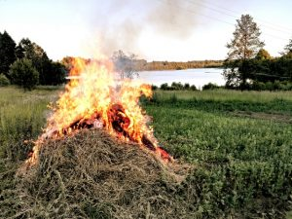
Situations with Multiple Causes
Multiple causes is experienced when an event has more than one causations (The Dilemma, 2020).
In this regard, the “but for” test cannot be applied to these situations.
For example, a defendant poisons the claimant's tea while another defendant shoots him before he drinks the tea. In this case, there are two causes.
The argument will be that the two are but-for causes collectively but individually, none of them was a but-for causation.
The principle of contributory negligence is used in claims where the claimants were responsible for their damages due to their own negligence.
It is applied in car accidents and fires, for example knocking a tree.

Slide 7
References
Find Law (2020). Negligence and the “Reasonable Person.’ Retrieved from
https://injury.findlaw.com/accident-injury- law/standards-of-care-and-the-reasonable- person.html
Practical Law. (2020). Causation. Retrieved from
https://uk.practicallaw.thomsonreuters.com/4-107- 5865?transitionType=Default&contextData=(sc.Default )&firstPage=true&bhcp=1
The Dilemma. (2020). Causation in Tort Law. Retrieved from http://www.myjli.com/dilemma/index.php/2017/02/23 /causation-in-tort-law/

