Slide 1
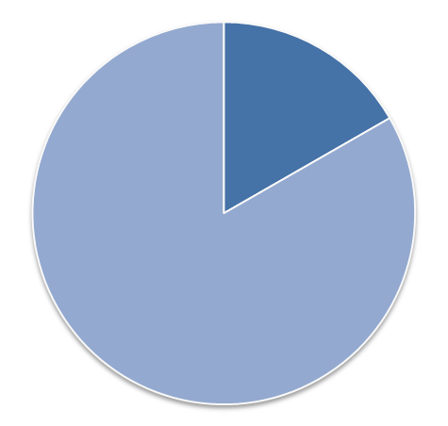
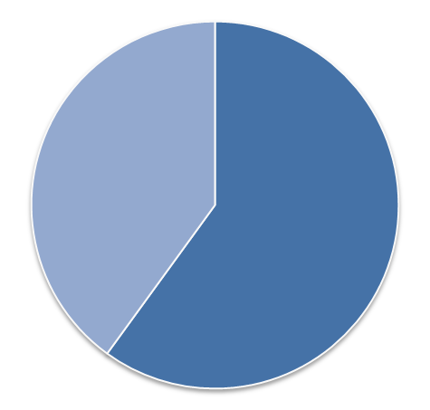
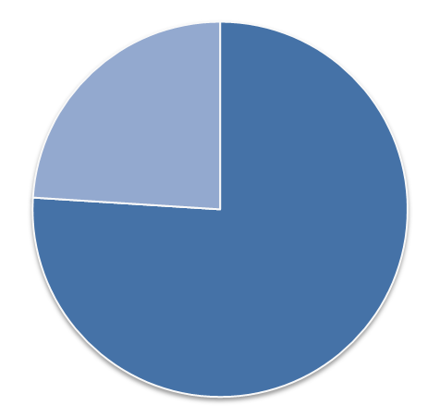

Report
Summary
There is a special trades report that emerged in the economy and shows how products for two years faired. Challenges that prevailed in the economy has contributed by far what is witnessed and what is perceived to portray in the society.
Product Features for year 2014 and 2015
In the quarter report, different cities sold different commodities and different amounts of them with regards to how they created a way into the markets and consumption channels for individuals.
In regards to the outlined products, A misfortune chief is an item sold beneath cost to bring clients into a store where they are probably going to purchase different items.
The business anticipates that the customer should buy different things simultaneously as the misfortune chief and that the benefit made on different items will bring about a general benefit.
A misfortune chief is regularly positioned in the rear of a store, so clients need to stroll past higher overall revenue merchandise
All then products has different prices changing over the years because of the situated and recommend prices and the control they get from all over authorities.
The standards of the products have a critical trend that is enumerated to define the area economy in the different cities to an extent of promoting factors that reduces and increase product prices.
In conclusion , the products in to hire prevalence states has projected differently probably for the two years in a manner promoting distinguished
The trade represents a fluctuating moment for products in the two years endings and in the manner they are operated.
A great regard for the position in place to enhance sell strategies in place and promotion of best price products.
2014
The first time records of the commodities . They include peanut butter, sugar, chocolate chi, Ginger bread.
2015 Projections in the last evaluation year
Year
The first recording that was made
Jan 2014
Email us

