Slide 1

HEALTHCARE
ELECTRONIC HEALTH RECORDS INFORMATICS SYSTEM

Slide 2
Abstract
Most of the patients are aware of the breach of their personal information in Amani Healthcare Centre.
Amani Healthcare Centre has been recording data of patients manually and kept in files.
This has made it difficult for some of the doctors and even patients to access the information at the required time.
The privacy of the patient’s data has also been at risk.
Amann Healthcare Centre should implement Electronic Health records ensuring the security and privacy of patient’s data and making access to be easy.

Slide 3
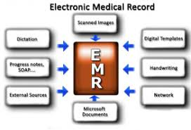
Introduction
Health Informatics is the link between information science, computer science and health care (Aziz, 2017).
Informatics deals with the resources, devices and methods required in optimizing the storage, acquisition and usage of information in health for the quality and safety of the patients.
Electronic health records are replacing filing methods allowing nurses to document care provided to patients and retrieving information for optimizing care.
Electronic Health Records has HIPAA laws ensuring the security and privacy of electronic records.
Electronic Health Records will help registered nurses to identify steps for treating a patient and monitor changes in the health of the patient thus giving immediate information as alerts or reminders.

Slide 4
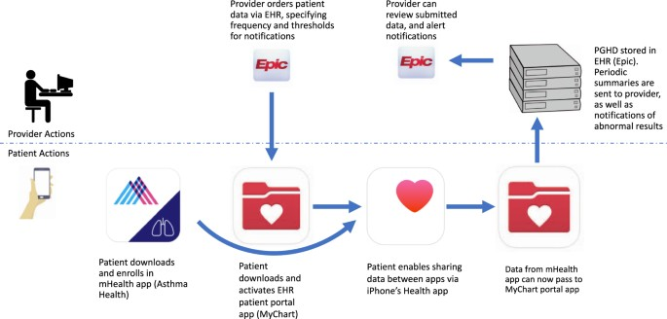
Literature Review
According to Campanella et al., (2016) electronic health record is a systematic electronic collection of information on health about the patients.
The information includes medications procedures, radiology results, vital signs and medical history
The researchers show that Electronic Health Record is important in reducing the costs and medical errors, time inefficiency and ADEs.
Guidelines provided reduce costs and supporting specialists in their clinical choices thus reducing errors, improving patients’ outcomes and providing more cost-effective care.
The study also shows that the technology improves the efficiency of the hospital with advantages exceeding the cost of adoption and increasing the rating of patient satisfaction.

Slide 5
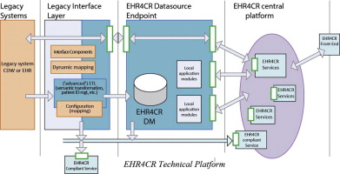
Cont…
Electronic Health Records allows healthcare providers to enhance patient’s care, imbed measures of performance in clinical practice and improve the identification of eligible patients in clinical research (Cowie, et al., 2017)
Electronica Health Records assist in assessing the innovation and treatment in healthcare delivery resulting in improving the outcome of healthcare savings.
EHRs is applied in signal detection since it provides realistic rates of events and informatic on the real world.
Electronic health records are applied in the research process to impair the quality of healthcare to patients.

Slide 6
Cont…
According to Evans (2016), there is the increased use of EHRs in the USA improving the quality of healthcare since 2009.
The information is electronically shared from one facility to another making many medical organizations to impediment EHRs and health information networks.
EHRs are used for educating and vowing different independent entities including primary care physicians and pastimes.
USA medical organizations are using EHRs in the primary care exam rooms to document and access the records of the patients along with decision-making tools and prescribing medications.
The EHRs have changed the dynamics of the interaction between healthcare providers and patients through the use of emails and telemedicine, improving the quality of healthcare.
The fundamental duties and roles of EHRs are projected in the article o to be a data repository based on international values of APIS for retrieving and strong data.
The roles will be coupled with facilities and user-selected applications for reviewing and entering data by the CDS.

Slide 7
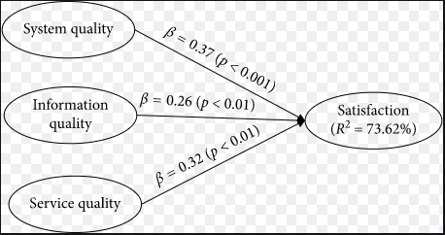
Cont…
The review of the work of Nguyen, Bellucci and Nguyen (2014), shows that EHRs technology helps in the documentation of patient care, improving the quality, efficiency, safety and coordination.
The article has also provided negative impacts such as changes to working flow and disruption but can be monitored through training of the employees
The healthcare providers have been informed of contingent factors affecting the implementation of EHRs in an organization setting.
The review suggests that EHRs implementation is important in enhancing the faster flow of information in the organization and keeping the security of data making the patients free while providing their information.
The satisfaction rate of the patient increases

Slide 8
Cont…
Electronic health record data is expected to provide quality healthcare to patients
Artificial neural networks and deep learning have allowed the implementation of EHRs (Rajkomar et al., 2018).
EHRs are considered to handle a large volume of data reducing the wastage of files and space in the Health Record Department.
A deep learning approach incorporating the entire EHRs has helped healthcare providers to predict clinical problems and outcomes outperforming traditional clinical models.
Accurate predictions made are important in improving the quality of healthcare.

Slide 9
Cost and Implementation of Electronic Health Record System
For the Electronic Health Record System t to be implemented in Amani Healthcare within the Record Department, employees need to be trained
The cost of training the employees is estimated to be $40000
The cost of buying the machines is hesitated to be $300000
The patient should also be trained on how to use the system while providing their health information

Slide 10
Conclusion
The Health Record Department at Amani Healthcare Center has been undergoing challenge's in tracking the patient's data
After a consultation, the department proposed for the implementation of the Electronic Health Records in the organization
Most of the hospital is currently using technology in keeping the documents of the patient but the organization is still making use of the files
To improve the quality of healthcare, the department recommends the implementation of the digitalis recording and storage of patient’s data

Slide 11
Cont…
The EHRs will be important in providing faster information to the healthcare providers
The healthcare providers will be able to monitor the progress of the patients easily
The patients will also feel secure and provide secret information used to improve their care
Thus, the management is requested to implement the system helping in improving the outcome of the patient’s care.

Slide 12
References
Aziz, H. A. (2017). A review of the role of public health informatics in healthcare. Journal of Taibah University Medical Sciences, 12(1), 78-81.
Campanella, P., Lovato, E., Marone, C., Fallacara, L., Mancuso, A., Ricciardi, W., & Specchia, M. L. (2016). The impact of electronic health records on healthcare quality: a systematic review and meta-analysis. The European Journal of Public Health, 26(1), 60-64.
Cowie, M. R., Blomster, J. I., Curtis, L. H., Duclaux, S., Ford, I., Fritz, F., & Michel, A. (2017). Electronic health records to facilitate clinical research. Clinical Research in Cardiology, 106(1), 1-9.
Evans, R. S. (2016). Electronic health records: then, now, and in the future. Yearbook of medical informatics, (Suppl 1), S48.
Nguyen, L., Bellucci, E., & Nguyen, L. T. (2014). Electronic health records implementation: an evaluation of information system impact and contingency factors. International journal of medical informatics, 83(11), 779-796.
Rajkomar, A., Oren, E., Chen, K., Dai, A. M., Hajaj, N., Hardt, M., & Sundberg, P. (2018). Scalable and accurate deep learning with electronic health records. NPJ Digital Medicine, 1(1), 18.

