Slide 1

Topic 4: Diversity Management
www.lisamajpertl.com

Slide 2
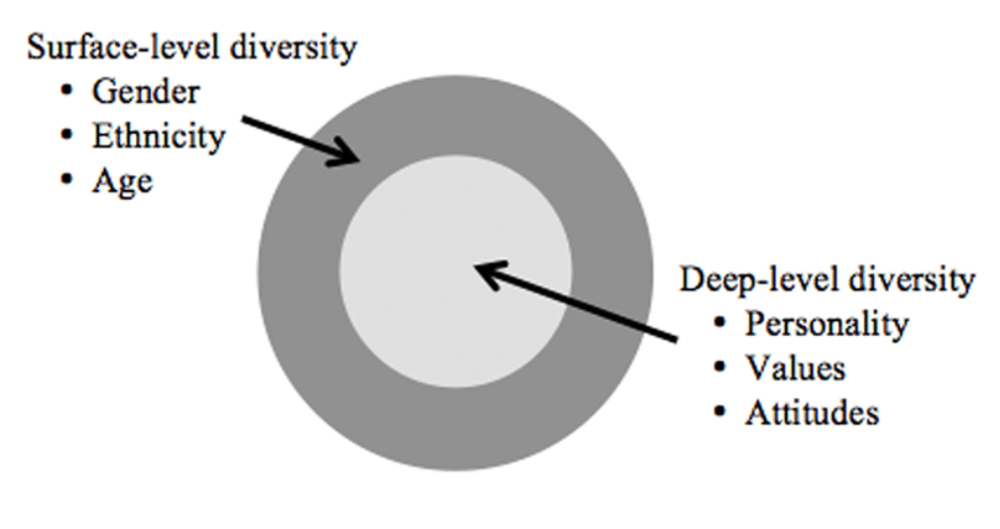
Important Concepts
Diversity is the existence of differences

Slide 3
Important Concepts
stereotype is a generalized belief about a specific group of people.
Stereotypes threat describes the degree to which we agree internally with the generally negative stereotyped perceptions of our groups.

Slide 4
Important Concepts
Social identity refers to the part of an individual's self-concept resulting from perceived membership in a relevant social group
In-group favouritism occurs when we see members of our group as better than other people, and people who are not in our group as all the same.
Social Identity Threat individuals believe they will be personally negatively evaluated due to their association with a devalued group, and they may lose confidence and performance effectiveness.

Slide 5
Important Concepts
Gender roles are social roles including a range of behaviours and attitudes that are normally considered acceptable, appropriate, or desirable for individuals based on their gender.

Slide 6
Important Concepts
Discrimination is to note a difference between things.
Unfair discrimination assumes stereotypes about groups.
  Refusal to recognize individual differences is harmful to organizations and employees.
Notes:
Managing diversity effectively requires working to eliminate unfair discrimination. The act of discrimination means to note differences between things, which isn’t a bad thing. However, when we allow our behaviour to be influenced by stereotypes about groups of people, unfair discrimination can be harmful to organizations and employees. Recognizing people for their abilities rather than assumptions of stereotypes is an important part of OB and its application to the work environment.

Slide 7
The bases of discrimination include…
Biological characteristics are personal characteristics that are objective and easily obtained from personnel records.
  Variations in these can be the basis for discrimination.
Notes:
Biographical characteristics typically include age, gender and race, and represent many of the surface-level aspects of diversity. We can usually find out about these from personnel records. Because biological characteristics can be the basis for discrimination, it’s important to understand how they are related to work outcomes.

Slide 8
The bases of discrimination include…
Age
  Does job performance decline with increasing age?
  Studies show that turnover and absenteeism rates are lower among older workers, and age is not associated with lower productivity.
Notes:
Age is an increasingly relevant characteristic as the workforce is ageing. Older workers bring with them a wealth of knowledge and experience, but the misperception is that productivity often declines with age. Whether this is true or not, it is a perception people act upon and will affect the workplace.

Slide 9
The bases of discrimination include…
Gender
  There are no consistent male–female differences in problem-solving ability, analytical skills, competitive drive, motivation, sociability or learning drive.
  But women earn less than men for the same positions and have fewer professional opportunities.
Notes:
Another biological characteristic is sex. In studying gender in the workplace, it has been found that there are very few differences between men and women that impact job performance. However, women, still earn less money than men for the same positions and working mothers may face additional bias that limits their professional opportunities.

Slide 10
The bases of discrimination include…
Race and ethnicity
  Race is a factor in some employment decisions.
  There is a tendency for individuals to favour colleagues of their own race in performance evaluations and promotion decisions.
  Members of racial and ethnic minorities report higher levels of discrimination in the workplace.
Notes:
Race is a controversial issue and research shows members of racial and ethnic minorities perceive discrimination in the workplace. More specifically, studies indicate that people in the workplace do identify more with people like themselves; so in some cases, opportunities may be given to people based on the fact that they are like their supervisor, rather than their merits. Keep in mind, though, that research has found no significant differences in race or ethnic backgrounds related to absence rates, applied social skills or accident rates, and that discrimination can lead to higher turnover.

Slide 11
The bases of discrimination include…
Disability
  One in six people in the EU has a disability that ranges from mild to severe.
  Workers with disabilities receive higher performance evaluations, but may have lower performance expectations and are less likely to be hired.
    Biases against those with mental impairment may be especially strong.

Slide 12
The bases of discrimination include…
Other Biological Characteristics
  Tenure
  Religion
  Cultural identity
Notes:
Tenure refers to the length of time people have been on the job. Tenure is often seen as a positive, as it signifies that people are happy with their employment because they have remained in their job for a long period of time. Therefore, employees with long tenure tend to be more productive, call in sick less frequently and don’t leave the organization as readily.

Slide 13
The bases of discrimination include…
Ability is an individual’s current capacity to perform various tasks in a job.
Two types
  Intellectual abilities
  Physical abilities
Notes:
Ability is an individual’s capacity to perform job tasks. An individual’s overall abilities are comprised of intellectual abilities and physical abilities.

Slide 14
Ability at work
The importance of ability at work complicates the formulation of workplace policies that recognize disabilities.
  Recognizing that individuals have different abilities that can be taken into account when making hiring decisions is not problematic.
  It is possible to make accommodations for disabilities.
Notes:
When an organization discusses abilities, it can cause difficulty when developing policies that recognize diversity in terms of disabilities. While it is important for the organization to strive for diversity in the hiring process, it is important to be careful to avoid discriminatory practices during hiring by making generalizations about people with disabilities.

Slide 15
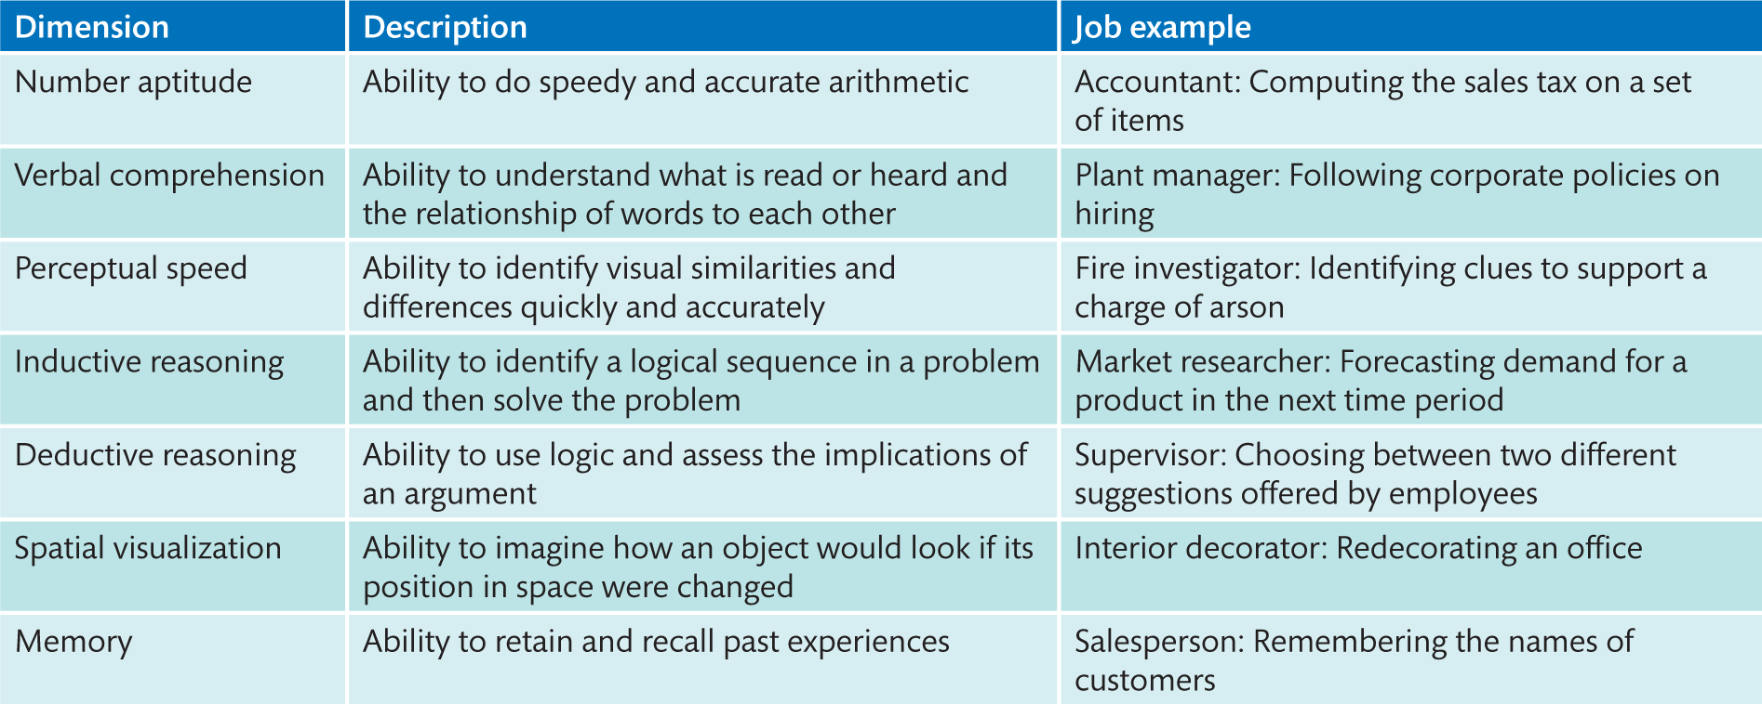
Intellectual Ability
Notes:
Table 2.2 Dimensions of intellectual ability
The seven most frequently cited dimensions making up intellectual abilities are number aptitude, verbal comprehension, perceptual speed, inductive reasoning, deductive reasoning, spatial visualization and memory.
Table 2.2 describes these dimensions. If you score high on verbal comprehension, you’re more likely to also score high on spatial visualization. Evidence strongly supports the idea that the structures and measures of intellectual abilities generalize across cultures.

Slide 16
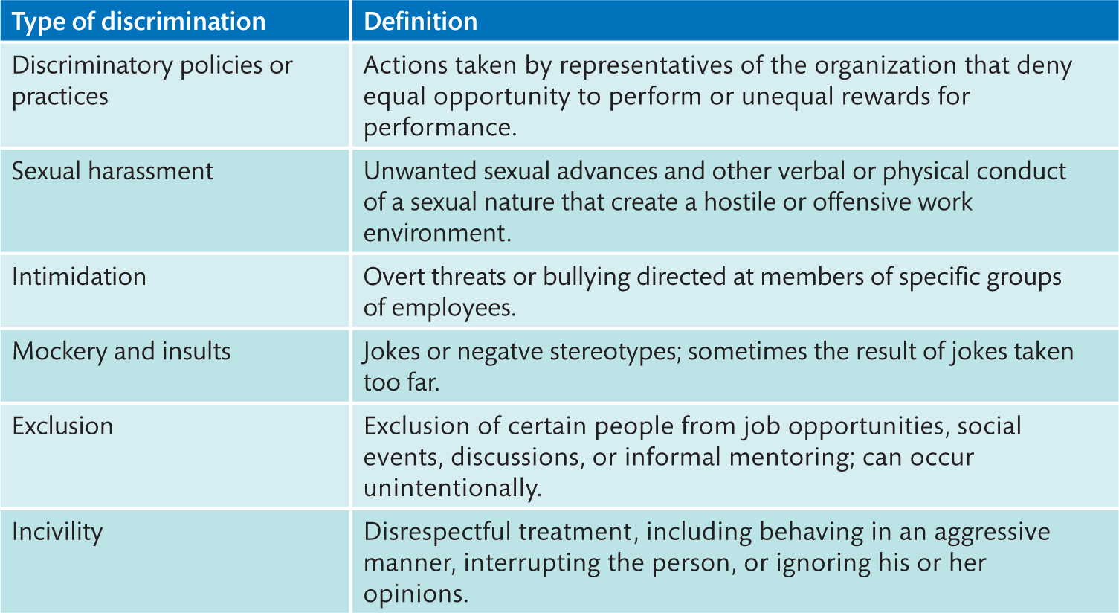
Discrimination Forms in Workplace
Notes:
Table 2.1 Forms of discrimination
This Exhibit lists definitions and examples of different types of discrimination. Increasing legal scrutiny and social disapproval have reduced most overt forms of discrimination, but less obvious discrimination, like incivility or exclusion, continue to exist. This type of discrimination can be difficult to eliminate because it’s less easily observed, and because it’s not always intentional. Even so, it can have serious negative implications for an organization including reduced productivity, increased turnover and increased conflict among employees.

Slide 17
Affirmative Action
The logic behind the Affirmative action
The inclusion of underrepresented group is an ethical practice. Valuing and managing a diverse workforce is ethically and morally correct. Also, companies that fail to do an excellent job of recruiting, retaining, developing and promoting women and minorities simply will be unable to meet their staffing needs. Affirmative action is explained (or justified) by many ethical theories. For example,
Based on compensation theory
Notes:
Diversity management makes everyone more aware of and sensitive to the needs and differences of others. Diversity management programmes are more successful when they are the norm for everyone, rather than just for certain groups of employees.

Slide 18
Affirmative Action
Affirmative Action: A series of policies, programs, and initiatives designed to give preference in the hiring of individuals in protected groups in certain circumstances as an attempt to mitigate past discriminatory practices.
Notes:
Diversity management makes everyone more aware of and sensitive to the needs and differences of others. Diversity management programmes are more successful when they are the norm for everyone, rather than just for certain groups of employees.

Slide 19
Affirmative Action
The logic behind the Affirmative action
The inclusion of underrepresented group is an ethical practice. Valuing and managing a diverse workforce is ethically and morally correct. Also, companies that fail to do an excellent job of recruiting, retaining, developing and promoting women and minorities simply will be unable to meet their staffing needs. Affirmative action is explained (or justified) by many ethical theories. For example,
Based on compensation theory
Notes:
Diversity management makes everyone more aware of and sensitive to the needs and differences of others. Diversity management programmes are more successful when they are the norm for everyone, rather than just for certain groups of employees.

Slide 20
Diversity management
Diversity management is the process and programmes by which managers make everyone more aware of and sensitive to the needs and differences of others.
  Diversity is more successful when it is everyone’s business, not just for certain groups of employees.
Notes:
Diversity management makes everyone more aware of and sensitive to the needs and differences of others. Diversity management programmes are more successful when they are the norm for everyone, rather than just for certain groups of employees.

Slide 21
Topic | Governance | Concept
Affirmative Action | Executive orders, governmental orders, or voluntary | Policies that broadly define situations in which actions should be taken to balance a workforce with its surroundings
Diversity Management | Organizational voluntary policies | No legal requirement; designed to better serve a more diverse customer base
Notes:
Diversity management makes everyone more aware of and sensitive to the needs and differences of others. Diversity management programmes are more successful when they are the norm for everyone, rather than just for certain groups of employees.

Slide 22
  Is affirmative action ethical?
Notes:
Diversity management makes everyone more aware of and sensitive to the needs and differences of others. Diversity management programmes are more successful when they are the norm for everyone, rather than just for certain groups of employees.

Slide 23
Theory | Evaluation of discrimination | Evaluation of affirmative action
Utilitarian Argument: focuses on economic value | discrimination leads to inefficient use of human resources. | affirmative action reduces need by benefiting minorities and women in need, and so increases utility
Equal Justice Argument: focuses on fairness and equal opportunities | Discrimination results in unjust distributions of benefits and burdens. Discrimination violates the formal principle of equality by differentiating between people on the basis of characteristics that are not relevant to job performance. | Affirmative action will secure equal opportunity by a fairer distribution of jobs, by neutralizing the effects of unconscious bias that affects judgments about minorities and women, and by placing women and minorities in less disadvantaged and more competitive positions in competitions with males and whites

