Slide 1
Body-Worn Camera
Shanta Oliver
Northcentral University
April 8, 2021

Slide 2
Introduction
Body-worn cameras are wearable devices with the ability to record videos, audio, and photographs.
The police mainly use them to capture events in which they are involved while in the line of duty.
Notably, the device is worn on the body's torso on the officers' uniform, mainly on the shoulder or the chest (Ariel, 2016).
They are designed to collect high-quality videos as the security officers engage in their daily activities.
Notes:
In policing equipment, body-worn cameras have become one of the most important tools for security officers. Body-worn cameras are wearable devices with the ability to record videos, audio, and photographs. Notably, they are mainly used by the police to capture events in which they are involved while in the line of duty. Besides, the device is worn on the torso of the body on the officers' uniform, mainly on the shoulder or the chest (Ariel, 2016). The body-worn cameras used for policing are similar to those used by the military, firefighters, or even civilians. However, those used by the police are designed to address particular associated with law enforcement. Besides, they are designed in a way that they collect high-quality videos as the security officers engage in their daily activities. As a result, this helps them gather video evidence while at a crime scene. Besides, with the technological innovations, the modern body-worn cameras have specific features such as night vision, H.D. quality, varying degrees of view, infrared, and fisheye lenses (Ariel, 2016). There are also those designed to automatically start receding when the police officers start a particular procedure, for instance, when the car door opens or when the siren is activated.

Slide 3
History
Body-worn cameras were first introduced in the United Kingdom in 2005 (Fan, 2018).
However, it was not until 2012 when the United States National Institute of Justice issued a primer in relation to policies, laws, practices, and technology for the states' department to consider.
As a result, the Law Enforcement Officer-Worn Body Camera Act (eff. 1-1-16) was enacted.
Illinois became the first state in the U.S. to have laws regarding the use of body cams.
However, the issue of body cams has come under criticism in the United States about legality.
Notes:
Body-worn cameras were first introduced in the United Kingdom in 2005 (Fan, 2018). Notably, the test began on a small scale by Cornwall and Devon Police. However, the first significant deployment of body-worn cameras at the national level was done in 2006 undertaken by the Police Standard Unit as well as the Domestic Violence Enforcement Campaign by 2010, the use of body-worn cameras had been rolled out in more than 40 U.K. police areas (Fan, 2018). It was not until 2012 when the United States National Institute of justice within the Department of Justice issued a primer in relation to policies, laws, practices, and technology for the states' department to consider. Therefore, after The Law Enforcement Officer-Worn Body Camera Act (eff. 1-1-16) was enacted, Illinois became the first state in the U.S. to have laws regarding the use of body cams (Fan, 2018). Hence, the different police departments in the United States have also adopted body-worn cameras for police officers. However, body cams have come under criticism in the United States on the legality of using body-worn cameras. For instance, New York has had formulated rigid rules that guide the use of body-worn cameras by law enforcement officers.

Slide 4
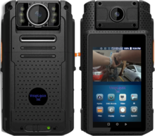
Issues associated with body-worn cameras
Expensive and unreliable for the majority of the police departments.
Despite being very expensive gadgets, they have very insufficient battery length, making them unreliable (Malm, 2019).
They negatively affect the law enforcement officers' physical and mental health.
The constant surveillance was subjecting the law enforcement officers to distress, anxiety, and fatigue.
Notes:
Notably, the body-worn camera program has been associated with numerous issues. The first issue is that they tend to be expensive and unreliable for the majority of the police departments. Despite being very expensive gadgets, they have very insufficient battery length, especially ding the cold seasons, making them unreliable in capturing the necessary information during policing (Malm, 2019). Besides, the short battery life makes it difficult for body-worn cameras to store information accurately. Studies have shown that the majority of the police in the United States have stopped using body-worn cameras due to the on-off buttons' unreliability. This means that the maintenance cost for these devices is very high. The second issue is associated with the body-worn cameras program is that it negatively affects the law enforcement officers' physical and mental health. Notably, the constant surveillance that the majority of the police are exposed to during their daily duties makes them vulnerable to developing psychological problems. In a study conducted in most of the United States departments, approximately 60% of the law enforcement officers oppose constant surveillance (Malm, 2019). This is because the police officers complained of increased performance impairment and mental health. Besides, the constant surveillance was subjecting the law enforcement officers to distress, anxiety, and fatigue.

Slide 5
Issues associated with body-worn cameras
In addition, sharing of the gadgets was prone to the transmission of transmissible infections.
In most police departments, the cameras are limited; hence to officers on duty have to share (Nowacki & Willits, 2018).
This then exposes the law enforcement officers to health and safety issues.
The body-worn cameras invade the privacy of citizens as well as that of the officers.
Notes:
In addition, sharing of the gadgets was prone to the transmission of transmissible infections. In most police departments, the cameras are limited; hence to officers on duty have to share. This then exposes the law enforcement officers to health and safety issues. Lastly, body-worn cameras invade the privacy of citizens (Nowacki & Willits, 2018). Notably, most states have no laws which limit when the police officers should stop recording, hence at times, they end up infringing on people's privacy, exposing private affairs such as people's medical conditions. Besides, the recording, at times, exposes the people to trauma. One police officer in Washington argued that the body cameras should be withdrawn after realizing that they consistently exposed people with a disability such as mental illness and autism on a daily basis. Notably, he stated that such behavior would have a long-lasting effect on this group of people. In addition, these body-worn cameras also invade the privacy of the police (Nowacki & Willits, 2018). Besides, despite being at work, there are times when the law enforcement officers require their personal time, hence carrying recording gadgets everywhere and every time denies the opportunity to have personal moments and times. Therefore, these cameras create a bad working environment for the officers.

Slide 6
The positive impacts of body-worn cameras
Significant reduction in complaint allegations.
Increased support for the use of body-worn cameras by the public.
The police who are equipped with body-worn cameras have fewer complaints from the public.
It has reduced the use of force by the police by about 59% (Wolfe et al., 2020).
Lastly, the use of body-worn cameras had increased early guilty pleas by 39%.
Notes:
The police and the law enforcement agencies were among the first organizations to evaluate, test and deploy body-worn cameras in large volumes. Notably, the police's growing use of body-worn cameras has had some positive impact on modern policing. The first impact is the significant reduction in complaint allegations (Wolfe et al., 2020). Besides, since the introduction of the body-worn camera programs, the number of allegations and complaints made by the public against the police has significantly decreased. This resulted in the second impact, which is increased support for the use of body-worn cameras by the public. There has been growing support from the public supporting implementing the body-worn camera programs in the recent past. The third impact is the police who are equipped with body-worn cameras have fewer complaints from the public. The fourth impact is that it has reduced the use of force by the police by about 59% (Wolfe et al., 2020). This had made the police have better work ethics than before when they were not equipped. Lastly, the use of body-worn cameras had increased early guilty pleas by 39% (Wolfe et al., 2020). This is because the cameras provide video-based evidence, making it hard for the offenders to plead not guilty.

Slide 7
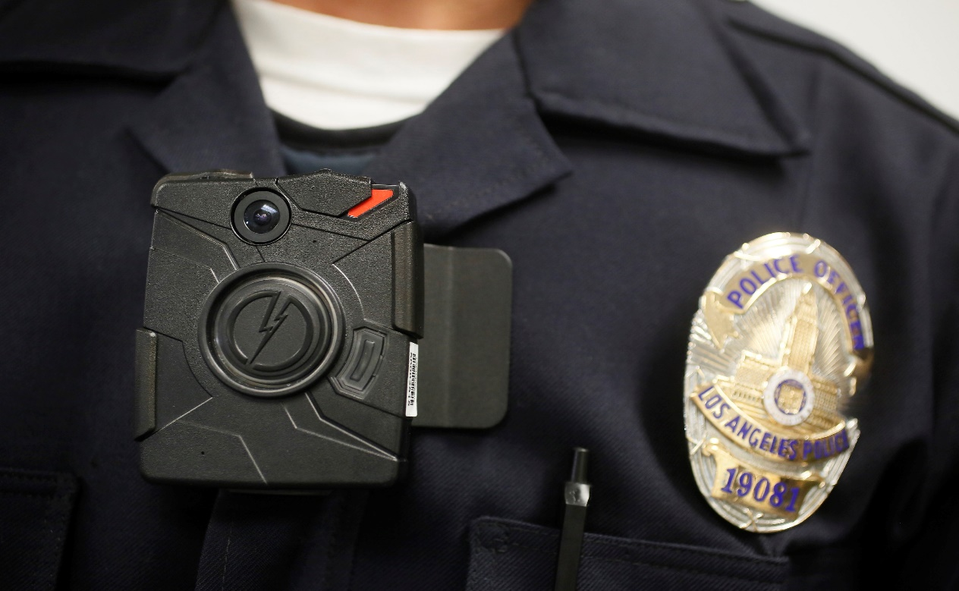
The negative impacts of body-worn cameras
Misinformation.
Retrieval induced forgetting (Adams & Mastracci, 2019).
Cognitive offloading.
Notes:
Despite the fact that body-worn cameras have significant positive impacts, studies have also associated body-worn cameras with some negative impacts. The first is misinformation, where results, when information that was not captured in the actual event is intentionally or unintentionally, including in an officer's memory (Adams & Mastracci, 2019). Notably, this new information might be true or false, but in either way, it was not captured during the original event. Therefore, this can later be used to capture the credibility of the video due to such aspects. The second impact is retrieval-induced forgetting. This is where an act of remembering a section of an actual event prompts another aspect of the event to be forgotten. This means that if a law enforcement officer is viewing a video of an incident, then they are at the risk of forgetting some details of the actual event when they were not captured in the video. Lastly is cognitive offloading, where the police officers tend to trust the cameras more than themselves (Adams & Mastracci, 2019). That is, they trust the cameras to stand in for their awareness in some moments. This offloading then steals away the officers' ability to use their cognitive processes such as decision making, problem-solving, de-escalation, and communication.

Slide 8
Solutions to the issue surrounding body-worn cameras
Formulation of policies that ensure that the body-worn cameras preserve the citizens' right to privacy.
Previous studies have shown that unregulated use of body-worn cameras leads to the invention of people's privacy (Yokum et al., 2017).
Besides, body-worn cameras should strictly be for the police officers on duty.
This is to avoid interference with the law enforcement officer's privacy.
However, considering that it's hard to control what to be captured and what not to be captured, this might be a challenge.
Notes:
Having learned that numerous issues surround the use of body-worn cameras, several solutions can be implemented to curb these issues. First, citizens' privacy is a fundamental issue; therefore, while implementing this program, the states should formulate policies that ensure that the body-worn cameras preserve the citizens' right to privacy (Yokum et al., 2017). Notably, previous studies have shown that unregulated use of body-worn cameras leads to the invention of people's privacy. Therefore, the benefit of formulating this governing policy is that it will help in dealing with the issue of privacy invention. However, one of the major challenges associated with this is that the invention might be inevitable at the time, considering that some body-worn cameras might be hard to control what to be captured and what not to be captured. Besides, body-worn cameras should strictly be for the police officers on duty to avoid interference with the law enforcement officer's privacy (Yokum et al., 2017). This is because every person is entitled to the right to privacy; therefore, the policies should uphold everyone's privacy right equally.

Slide 9
Solutions to the issue surrounding body-worn cameras
Policymakers should educate law enforcement officers on precautionary and safety measures.
For instance, they should provide counseling services for the police (Ariel, 2016).
States should allocate resources for purchasing more body-worn cameras to deal with the issue of transmitting infectious diseases.
The only challenge associated with these solutions is the body-worn cameras are at times too expensive.
Notes:
In relation to the health issue, be considerate when implementing the body-worn camera. The policymakers should educate the law enforcement officers on precautionary and safety measures that they should uphold to preserve their mental health and their physical health. For instance, if an officer encountered a traumatic event, they should be given counseling to help the police cope with the situation (Ariel, 2016). Additionally, the government should implement ways that lower the risk of physical injury while using body-worn cameras. At times, the police carry very heavy cameras on their neck resulting in neck aches, and this opens them to a potential risk of being electrocuted. Therefore, the police departments should purchase light body-worn cameras when on duty for their safety. In addition, in some stations, the cameras are limited, meaning that the police have them there, which puts them at risk of contracting transmissible diseases. Therefore, states should allocate resources for purchasing more body-worn cameras to deal with the issue of transmitting infectious diseases (Ariel, 2016). However, the only challenge associated with these solutions is that body-worn cameras are too expensive, becoming a challenge to the police departments to purchase adequate cameras.

Slide 10
Solutions to the issue surrounding body-worn cameras
The police should be provided with adequate training on how to use body-worn cameras effectively.
The officers should be trained on the departmental body-worn cameras policy and any state law or tribal/local ordinances (Fan, 2018).
The police should be trained on how the conduct pre-shift inspection of the body-worn cameras to ensure that it is working well.
The officers should be trained on how and where to wear the body-worn cameras.
They should be trained on how to document the recorded events correctly.
Notes:
Lastly, the police should be provided with adequate training on how to use body-worn cameras effectively. Notably, proper training is the determining factor for the success of the body-worn camera program. Besides, as with any other police department initiative, the agency's various roles might need unique content, delivery, and approach methods. Moreover, the training should include the following. First, the officers should be trained on the departmental body-worn cameras policy and any state law or tribal/local ordinances (Fan, 2018). Second, the police should be trained on how the conduct pre-shift inspection of the body-worn cameras to ensure that it is working well. Third, the officers should be trained on how and where to wear the body-worn cameras. Lastly, they should be trained on how to correctly document the recorded events as well as how to download the information for storage. This is beneficial to improve the effectiveness of the police, whereas some police are adamant about the implementation of the program; hence this might become a challenge. Besides, engaging with the public in a positive way regarding the body-worn camera deployment demonstrates transparency to the society (Fan, 2018). It also makes them supportive in a way that helps the police be effective in their duties.

Slide 11
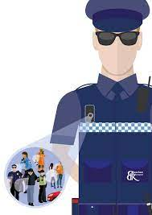
Targeted outcome
Increase the productivity and effectiveness of the police departments.
Motivate the police towards doing their job effectively.
Enhancing the relationship between the police departments and the public.
Promote the security of the country (Nowacki & Willits, 2018).
Notes:
Notably, the application of the above solution can help in different ways. First, these solutions can help in increasing the productivity and effectiveness of the police departments. Besides, one of the most overlooked but fundamental factors is training the parties outside the law enforcement agency, such as the defense bar, prosecutors, technical support, and any other relevant party that might have access to the video recording (Nowacki & Willits, 2018). In addition, as part of the holistic training, the agency should also train the media and public on the policies, technology as well as operational aspects of the proposed body-worn cameras program. This is because things like safety and health measures will motivate the police towards doing their job effectively. The solution will also help enhance the relationship between the police departments and the public. For instance, if the police are in a position to uphold the citizens' right to privacy, then coordinating the security operations will not be any issues. Besides, such measures will help promote the security of the country (Nowacki & Willits, 2018). In addition, funding the police departments well to enable them to purchase enough cameras will mean that their geographical areas will be well covered because the police operations will have been made easier.

Slide 12
Reasons for funding the body-worn cameras programs
The cameras help with evidence collection hence saving money that could otherwise be used for investigation.
Besides, body-worn cameras capture first-hand information (Wolfe et al., 2020).
Body-worn camera programs enhance transparency in police operations.
Body-worn cameras help in holding the officers accountable for their actions.
Notes:
Notably, the government should allocate enough resources to facilitate the implementation of body-worn camera programs. This is because the cameras help with evidence collection, saving money that could otherwise be used for investigation. Besides, the body-worn cameras capture first-hand information, that is, while the offender is doing the actual offense. As a result, evidence speed up court processes since the prosecutor and the court at large can clearly see how, where, and when the crime occurred (Wolfe et al., 2020). In addition, the government should fund body-worn camera programs to enhance transparency in police operations. Besides, in the United States, there has been a widespread call for police reforms due to several negative issues associated with the police departments, such as corruption, racism, and police brutality. Arguably, these issues are prevalent because the police know that they are not accountable for anything, considering that there is no evidence that can incriminate them (Wolfe et al., 2020). However, the body-worn cameras will help hold the officers accountable for their actions, hence boosting the police department's transparency. Besides, they will make the police conscious about what they do hence improving their work ethics. In return, this will help in rebuilding public trust for the police.

Slide 13
Conclusion
Body-worn cameras are wearable devices with the ability to record videos, audio, and photographs.
However, it was not until 2012 when the United States National Institute of Justice issued a primer in relation to policies, laws, practices, and technology for the states' department to consider.
One of the issues linked with body-worn cameras is that they tend to be expensive and unreliable for the majority of the police departments.
However, the positive impact is that the number of allegations and complaints made by the public against the police has significantly decreased.
On the other hand, the negative impact associated with body-worn cameras is misinformation.
Therefore, to deal with this negative issue, the police departments can train their officers.
Notes:
Body-worn cameras are wearable devices with the ability to record videos, audio, and photographs. Notably, they are mainly used by the police to capture events in which they are involved while in the line of duty. Body-worn cameras were first introduced in the United Kingdom in 2005. However, it was not until 2012 when the United States National Institute of justice within the Department of Justice issued a primer in relation to policies, laws, practices, and technology for the states' department to consider. Therefore, after The Law Enforcement Officer-Worn Body Camera Act (eff. 1-1-16) was enacted, Illinois became the first state in the U.S. to have laws regarding the use of body cams. However, the body-worn camera program has been associated with numerous issues. One of these issues is that they tend to be expensive and unreliable for the majority of the police departments. Nevertheless, the body-worn camera program has both positive and negative impacts. One of the positive impacts is that the number of allegations and complaints made by the public against the police has significantly decreased since their introduction. On the other hand, one of the negative impacts is misinformation. It results when information that was not captured in the actual event is intentionally or unintentionally included in an officer's memory. Misinformation is when information that was not captured in the actual event is intentionally or unintentionally included in an officer's memory. Therefore, to deal with this negative issue, the police departments can train their officers on how to use body-worn cameras effectively.

Slide 14
References
Adams, I., & Mastracci, S. (2019). Police body-worn cameras: Effects on officers’ burnout and perceived organizational support. Police Quarterly, 22(1), 5-30.
Ariel, B. (2016). Increasing cooperation with the police using body-worn cameras. Police Quarterly, 19(3), 326-362.
Fan, M. D. (2018). Body cameras, big data, and police accountability. Law & social inquiry, 43(4), 1236-1256.
Malm, A. (2019). The promise of police body-worn cameras. Criminology & Public Policy, 18(1), 119-130.
Nowacki, J. S., & Willits, D. (2018). Adoption of body cameras by United States police agencies: an organisational analysis. Policing and Society, 28(7), 841-853.
Wolfe, S., Rojek, J., McLean, K., & Alpert, G. (2020). Social interaction training to reduce police use of force. The ANNALS of the American Academy of Political and Social Science, 687(1), 124-145.
Yokum, D., Ravishankar, A., & Coppock, A. (2017). Evaluating the effects of police body-worn cameras. Washington, DC: The Lab@ DC, 20.

