Slide 1
OSM 419 – Operations Strategy
Value Creation and Operations

Slide 2
Quantifying Value Creation from Operations
ROIC – return on invested capital
EVA – economic value added
WACC – weighted average cost of capital
NOPAT – net operating profit after taxes
EBITDA – earnings before interest, taxes, depreciation and amortization

Slide 3
Quantifying Value Creation from Operations
ROIC = Operating profit per period / Invested capital in the operation
= (Operating Profit/Sales) x (Sales/Capital)
= Profit margin x Capital turns
DuPont analysis – ROIC decomposed into profit margin and capital turns
 | Profit margin | Capital turns/year | ROIC/year
Apple | 29% | 5.5 | 159%
HP | 8% | 2.0 | 17%
Microsoft | 52% | 0.7 | 39%

Slide 4
ROIC Tree
Operating Revenue
Operating Income
(EBIT)
Return
(NOPAT)
Operating Expense OPEX
1- tax rate
Current assets
ROIC
Operating net WC
Current liabilities
Invested Capital
Operating Assets
PPE
Operating Fixed Assets
Goodwill,
other

Slide 5
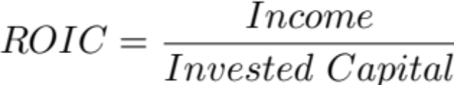
How to build a ROIC tree
Start with the objective (ROIC) on one side
Decompose a variable into components
Decide which branches have impact
  What are the main cost drivers
  What are the strategic levers
  Which inputs are most likely to change
Expand important branches
End with measures that can be tied to operations strategy
Populate the tree with actual numbers
Reflect: Benchmark performance and perform sensitivity analysis

Slide 7
ROA and ROE
ROA = Net income per period / Total assets
(Return on assets)
ROE = Net income per period/ Shareholder equity
(Return on equity)

Slide 8
Key Performance Indicators
Accounting metrics report past performance
A performance indicator is “key” if it is a leading indicator of overall firm performance
  A current improvement in an operational KPI is likely to improve future financial performance
Sensitivity analysis
  Value sensitivity to a KPI = % change in value / % change in the KPI
  Rank the variables by their sensitivities, the variable with highest sensitivity is the most important performance indicator.

Slide 9
Linking Profit and Value to Process Flows
Z Car Rental
1) Draw the process flows
2) Populate the data and analyze process flows
3) Link financial and operational flows
4) Sensitivity and operational KPIs
5) Value improvement and aid decision-making

Slide 10
Tools to Tailor Operations
1) Strategic operational audit
2) A balanced scorecard map
3) The product/process matrix

Slide 11
Strategic Operational Audit
Deliverable
Value
Propositions
Strategy Gap?
Value
Proposition
Resource
view
Market
view
Capabilities
Competency Gap?
Needed
Capabilities
Assets
&
Processes
Assets & Process Gap?
Needed
Assets &
Processes

Slide 12
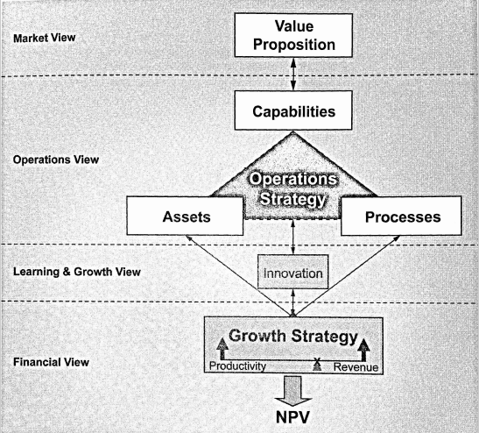
A Balanced Scorecard Map

Slide 13
Balanced Scorecard
Financial
How do we manage our resources?
Internal Processes
What must we excel at to achieve our goals?
Mission, Vision, Strategy
Learning and Growth
How do we enhance our capacity for continuous improvement?
Customer
How do we support our customers?

Slide 14
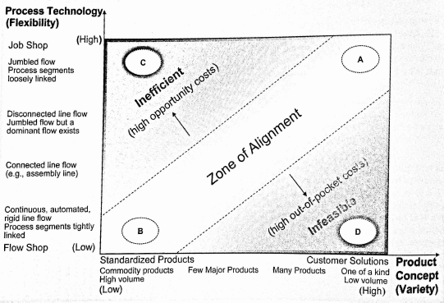
Product/Process Matrix

Slide 15
Product-Process Matrix: Types of Processes
Project
Job Shop
Batch
Repetitive or continuous flow
Mass customization

Slide 16
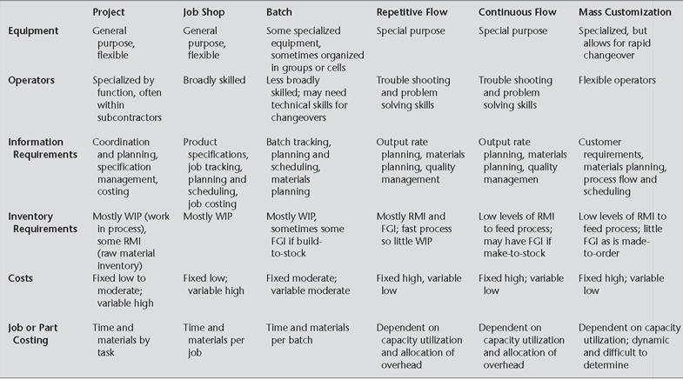
Product-Process Matrix: Requirements by Type of Process

Slide 17
Product-Process Matrix
Less customization and higher volume
(1) (2) (3) (4)
Low-volume Multiple products with low Few major High volume, high
products, made to moderate volume products, standardization,
to customer higher commodity
order volume products
Process
Characteristics
(1)
Customized process, with flexible and unique sequence of tasks
(2)
Disconnected line flows, moderately complex work
(3)
Connected line, highly repetitive work
(4)
Continuous flows
Job
process
Small batch
process
Batch processes
Less complexity, less divergence, and more line flows
Large batch
process
Line
process
Continuous
process
Product-Process Matrix for Processes

Slide 18
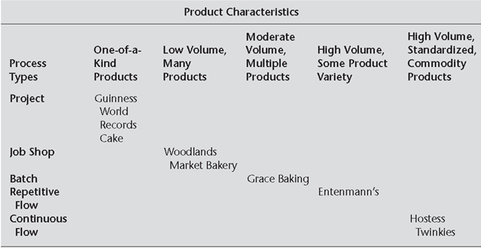
Product-Process Matrix: Matching Processes to Product Needs

Slide 19
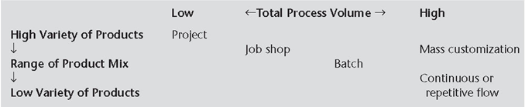
Product-Process Matrix: Off-Diagonal Positions

Slide 20
Decision Patterns for Manufacturing
Low-Volume,
make-to-order process
More process divergence and more flexible flows
More customer involvement
More resource flexibility
Less capital intensity
Job
process
Small batch
process
Batch processes
Major process decisions
Large batch
process
Line
process
High-Volume,
make-to-stock process
Less process divergence and more line flows
Less customer involvement
Less resource flexibility
More capital intensity
Continuous
process
Low
High
Volume
Decision Patterns for Manufacturing Processes

Slide 21
Service-Process Matrix: Types of Service Processes
Demand-sensitive services
  e.g., banks, restaurants, retail stores
Delivered services
  e.g., fire and police protection
Quasi-manufacturing
  e.g., banks’ back offices, call centers

Slide 22
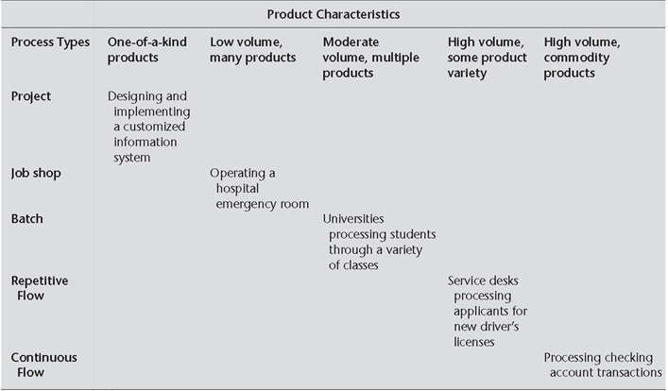
Service-Process Matrix: Adaptation of Product-Process Matrix

Slide 23
Service Process Structuring
Less customer contact and customization
(1) (2) (3)
High interaction with Some interaction with Low interaction with
customers, highly customers, standard customers, standardized
customized service services with some options services
Process
Characteristics
(1)
Flexible flows with
Individual processes
Front office
(2)
Flexible flows with
some dominant
paths, with
some exceptions to how work performed
Less processes divergence and more line flows
Hybrid office
(3)
Line flows, routine
work same with all customers
Back office
Customer-Contact Matrix for Service Processes

Slide 24
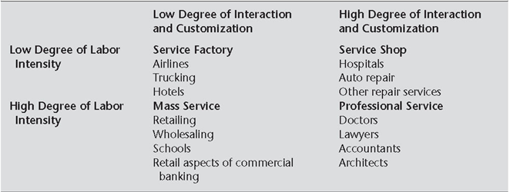
Service-Process Matrix: Labor Intensity, Interaction and Customization

Slide 25
Decision Patterns for Services
High customer-contact
process
More complexity, more divergence, more flexible flows
More customer involvement
More resource flexibility
Capital intensity varies with volume
Front office
Hybrid office
Major process decisions
Low customer-contact
process
Less complexity, less divergence, more line flows
Less customer involvement
Less resource flexibility
Capital intensity varies with volume
Back office
High
Low
Customer contact and customization
Decision Patterns for Service Processes

Slide 26
In-class Exercise
Process-choice in a bakery
https://www.youtube.com/watch?v=3ZLj-NvjHR8

