Slide 1

ERP
Open source Management solution
By : Students Name – Registration Number

Slide 2
Software OVERVIEW
Open ERP is an open source Enterprise Resource Planning software.
The software is published under the AGPL license.
Open ERP is localized in 22 languages.
It covers all the major business applications such as: Sales Management, Customer Relationship Management, Accounting & Financial Management, Human Resource Management, etc.
Open ERP has more than 500 modules.

Slide 3

KEY CHARACTERITICS
Modularity- Open ERP modular approach allows users to commence with a single application and add other later.
Flexibility- The user interface is customizable and business processes can be managed with clicks.
Affordability- The software is very affordable due to absence of license fees.

Slide 4
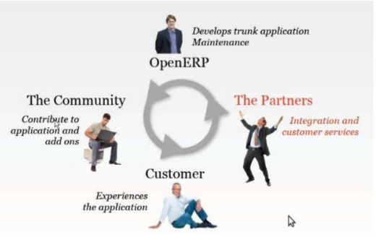
The stakeholders

Slide 5

Linkage & Role in management information SyStems (MIS)
Open ERS "enterprise resource planning," provides a set of applications that integrate inventory management, financial data, manufacturing and purchasing into a single system.
These are the software systems that aid in making business decisions that are critical.

Slide 6
Role & Linkage in MIS COnT…
Businesses Benefit from open ERP software as it provides the managers with a platform to view information about inventory, sales then evaluate and analyze the information targeted to support various management decisions.
Open ERP leads to good and effective management of an enterprise through CRM (Customer Relationship Management), Accounting, POS (Point of Sale), Project Management, Human Resources, Procurement, Production, Marketing, Invoices amid others.

Slide 7
Role & Linkage in MIS COnT…
Open ERP leads to good and effective management of a business through CRM (Customer Relationship Management), Accounting, POS (Point of Sale), Project Management, Human Resources, Procurement, Production, Marketing, Invoices amid others.
This way managers can have the modules modified to fit the specific business models and become more competitive.

Slide 8

Applications of open erp in mis
  Example 1: Customer Relationship Management
  Utilized to manage marketing campaigns that automate emails.
  Get accurate forecasts from analyzing sales trends using the CRM business intelligence engine.
  Manage and keep a track of the best leads and opportunities.
  Assist in planning meetings using a shared calendar.

Slide 9
Applications of open erp in mis
  Example 2: Human Resource Management
  Utilized to manage the recruitment process from selections, training and appraisals.
  Personal staff information is also managed effectively.
  Manage employee leaves and the associated allowances.
  Managing the attendance of employees and obtaining reports.
  Manage the employees’ expenses by keeping and validating records.

Slide 10
References
Chan, J., Husted, K., Dual Allegiance and Knowledge Sharing in Open Source Software Firms. Creativity and innovation management, Blackwell Publishing, 2010
Pinckaers, F., Gardiner, G., & Van Vossel, E. (2011). Open ERP, a modern approach to integrated business management. Open Source management Solution.
Johansson, B., & Sudzina, F. (2008). ERP systems and open source: an initial review and some implications for SMEs. Journal of Enterprise Information Management, 21(6), 649-658.

Slide 11

THE END

