Slide 1
Chapter 3: The Manager’s Environment

Slide 2
Learning Objectives
After reading and studying this chapter, you should be able to:
Discuss why organizations are considered to be open systems
Identify the elements in an organization’s internal environment
Describe the directly interactive forces in an organization’s external environment
Determine the indirectly interactive forces in an organization’s external environment
© 2013 Cengage Learning. All Rights Reserved. May not be copied, scanned, or duplicated in whole or in part, except for use as permitted in a license distributed with a certain product or service or otherwise on a password–protected website for classroom.

Slide 3
Learning Objectives (Continued)
After reading and studying this chapter, you should be able to:
Discuss the means available to managers for boundary spanning
Explain how managers can influence their external environments
Describe the obligations of organizations to their stakeholders
© 2013 Cengage Learning. All Rights Reserved. May not be copied, scanned, or duplicated in whole or in part, except for use as permitted in a license distributed with a certain product or service or otherwise on a password–protected website for classroom.

Slide 4
The Organization as a System
Learning Organization
A process whereby groups and individuals within the organization challenge existing models of behavior and learn to rapidly and creatively adapt to a changing environment
Systems Perspective
Provides a useful framework for examining the relationship between an organization and its environment
Environmental Scanning
The process of collecting information about the external environment to identify and analyze trends
Benefits of Scanning
Identifies and analyzes trends
Allows managers to determine the best response to an environmental change
Identifies signals of change and monitoring follows these signals
© 2013 Cengage Learning. All Rights Reserved. May not be copied, scanned, or duplicated in whole or in part, except for use as permitted in a license distributed with a certain product or service or otherwise on a password–protected website for classroom.

Slide 5
The Organization as a System (cont’d)
Open System
A system that regularly affects and is affected by various and constantly changing forces (elements
and components) outside itself
Internal Environment
Composed of elements within an organization’s borders that managers create, acquire, and utilize, including the organization’s mission, vision, core values, core competencies, leadership, culture, climate, structure, and available resources
External Environment
Includes all the forces outside an organization’s borders that interact directly or indirectly with it
© 2013 Cengage Learning. All Rights Reserved. May not be copied, scanned, or duplicated in whole or in part, except for use as permitted in a license distributed with a certain product or service or otherwise on a password–protected website for classroom.

Slide 6
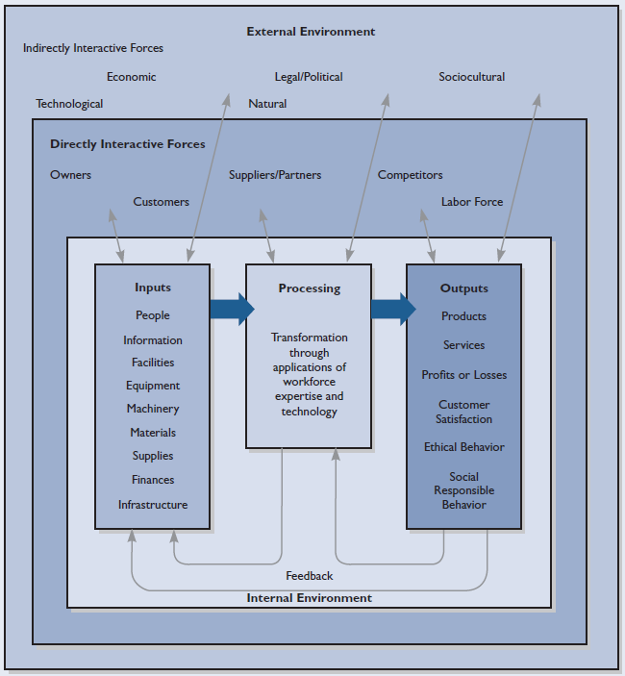
Figure 3.1 The organization as an open system
© 2013 Cengage Learning. All Rights Reserved. May not be copied, scanned, or duplicated in whole or in part, except for use as permitted in a license distributed with a certain product or service or otherwise on a password–protected website for classroom.

Slide 7
Internal Environment
Core Competencies
What an organization knows and does best—most significant cause for an organization’s success is a continuing focus on its core competencies
Intellectual Capital
Collective experiences
Wisdom
Knowledge
Expertise
Organizational Culture
Dynamic system of shared values, beliefs, philosophies, experiences, customs, and norms of behavior that give an organization its distinctive character
2
© 2013 Cengage Learning. All Rights Reserved. May not be copied, scanned, or duplicated in whole or in part, except for use as permitted in a license distributed with a certain product or service or otherwise on a password–protected website for classroom.

Slide 8
Internal Environment (cont’d)
Organizational Climate
An outgrowth of a corporation’s culture showing how employees feel about working there
Leadership
Influencing others to set and achieve goals
Encouraging and enabling followers
“Walking the talk”
Setting an example
Creating a generative shared vision
Providing the catalyst for perpetual learning
© 2013 Cengage Learning. All Rights Reserved. May not be copied, scanned, or duplicated in whole or in part, except for use as permitted in a license distributed with a certain product or service or otherwise on a password–protected website for classroom.

Slide 9

Internal Environment (cont’d)
Organizational Structure
Determines how activities are conducted
Determines authority and communication flows
Boundaryless Organization
An organization not defined or limited by horizontal, vertical, or external boundaries imposed by a predetermined structure
Required by learning organizations
Task
Requirements
Government
Regulations
Structural Determinants
Task
Performance
Competitors’
Strategies
Customer Demands
© 2013 Cengage Learning. All Rights Reserved. May not be copied, scanned, or duplicated in whole or in part, except for use as permitted in a license distributed with a certain product or service or otherwise on a password–protected website for classroom.

Slide 10
Internal Environment (cont’d)
Resources
Inputs to the system—the elements processed, transformed, or used—that influence the internal environment
Information
Finances
Facilities and Infrastructure
Resources
Materials and Supplies
Machinery and Equipment
© 2013 Cengage Learning. All Rights Reserved. May not be copied, scanned, or duplicated in whole or in part, except for use as permitted in a license distributed with a certain product or service or otherwise on a password–protected website for classroom.

Slide 11
External Environment
Owners
External Labor Pool
Customers
Directly Interactive Forces
Competitors
Suppliers and Partners
3
© 2013 Cengage Learning. All Rights Reserved. May not be copied, scanned, or duplicated in whole or in part, except for use as permitted in a license distributed with a certain product or service or otherwise on a password–protected website for classroom.

Slide 12
External Environment (cont’d)
Trends in Supplier Practices
Increasing use of outsourcing to improve quality and reduce costs
Formation of close alliances with outside suppliers
Development of “deep” alliances with a select few suppliers
Active seeking of foreign sources for needed supplies
© 2013 Cengage Learning. All Rights Reserved. May not be copied, scanned, or duplicated in whole or in part, except for use as permitted in a license distributed with a certain product or service or otherwise on a password–protected website for classroom.

Slide 13
External Environment (cont’d)
Competitive Bases
Price
Product Features
Quality
Performance
Selection
Customer Services
Convenience
© 2013 Cengage Learning. All Rights Reserved. May not be copied, scanned, or duplicated in whole or in part, except for use as permitted in a license distributed with a certain product or service or otherwise on a password–protected website for classroom.

Slide 14
External Environment (cont’d)
Economic
Natural
Legal and Political
Indirectly Interactive Forces
Technological
Sociocultural
4
© 2013 Cengage Learning. All Rights Reserved. May not be copied, scanned, or duplicated in whole or in part, except for use as permitted in a license distributed with a certain product or service or otherwise on a password–protected website for classroom.

Slide 15
External Environment (cont’d)
Economic Forces
Conditions in an economy that influence management decisions and the costs and availability of resources
Taxes
Inflation
Wages
Prices
Personal
Spending
Business
Spending
Interest
Rates
State of
Economy
© 2013 Cengage Learning. All Rights Reserved. May not be copied, scanned, or duplicated in whole or in part, except for use as permitted in a license distributed with a certain product or service or otherwise on a password–protected website for classroom.

Slide 16
External Environment (cont’d)
Legislative Statutes
Agreements Governments/ Companies
Legal/Political Forces
Court Decision Precedents
Regulations and Rulings
© 2013 Cengage Learning. All Rights Reserved. May not be copied, scanned, or duplicated in whole or in part, except for use as permitted in a license distributed with a certain product or service or otherwise on a password–protected website for classroom.

Slide 17
External Environment (cont’d)
Sociocultural Forces
The influences and contributions from diverse groups outside an organization
Technological Forces
The combined effects of processes, materials, knowledge, and other discoveries resulting from research and development activities
Natural
Forces
Forces such as climate, weather, geography, and
geology that affect how businesses operate and locate their operations
© 2013 Cengage Learning. All Rights Reserved. May not be copied, scanned, or duplicated in whole or in part, except for use as permitted in a license distributed with a certain product or service or otherwise on a password–protected website for classroom.

Slide 18
Environments and Management
Managing External Environmental Forces
Sensing and Adapting to Environments
Boundary Spanning
The surveillance of outside areas and factors that can influence plans, forecasts, decisions, and organizations. Sometimes called environmental scanning.
Influencing
Environments
Exercising the right of organizations to lobby to influence legislation and using the power of the media to influence public opinion and public policy.
5
6
© 2013 Cengage Learning. All Rights Reserved. May not be copied, scanned, or duplicated in whole or in part, except for use as permitted in a license distributed with a certain product or service or otherwise on a password–protected website for classroom.

Slide 19
Environments and Management (cont’d)
Meeting Responsibilities to Stakeholders
Owners
Honest effort to earn a fair return on investment
Employees
Fair treatment and safe and psychologically rewarding work environment
Customers
A source of reliable and safe goods and services
Suppliers
Open and honest communication; prompt payment for services
Society
Support for community and societal needs
Proactive compliance with environmental laws
Ethical behavior by the firm
7
© 2013 Cengage Learning. All Rights Reserved. May not be copied, scanned, or duplicated in whole or in part, except for use as permitted in a license distributed with a certain product or service or otherwise on a password–protected website for classroom.

Slide 20
Key Terms
boundary spanning
boundaryless organizations
core competencies
directly interactive forces
economic forces
environmental scanning
external environment
indirectly interactive forces
intellectual capital
internal environment
legal/political forces
natural forces
open system
organizational climate
organizational culture
sociocultural forces
stakeholders
technological forces
© 2013 Cengage Learning. All Rights Reserved. May not be copied, scanned, or duplicated in whole or in part, except for use as permitted in a license distributed with a certain product or service or otherwise on a password–protected website for classroom.

