Slide 1
Chapter 8: Organizational Design, Culture, and Change

Slide 2
Learning Objectives
After reading and studying this chapter, you should be able to:
Define organizational design and describe its four objectives
Distinguish between mechanistic and organic organizational structures
Discuss the influence that contingency factors—organizational strategy, environment, size, age, and technology—have on organizational design
Describe the characteristics, advantages, and disadvantages of functional, divisional, matrix, team, and network structural designs
Define organizational culture and describe the ways that culture is manifested

Slide 3
Learning Objectives (Cont.)
After reading and studying this chapter, you should be able to:
Explain the role of managers and employees in creating culture and making a culture effective
Define change and identify the kinds of change that can occur in an organization
Explain the steps managers can follow to implement planned change
Identify the organizational qualities that promote change
Explain why people resist change and what managers can do to overcome that resistance
Explain why change efforts fail
Explain the purpose of an organizational development program

Slide 4
Designing Organizational Structures
Organizational Design
The creation of or change to an organization’s structure
Creating or changing organizational structure by:
Developing the overall layout of positions and departments
Developing the interrelationships of the departments
Create the means to implement plans, achieve goals, and ultimately satisfy the customer
1

Slide 5

Objectives of Organizational Design
Respond
to Change
Encourage
Flexibility
Organizational Design
Integrate New Elements
Coordinate Components

Slide 6
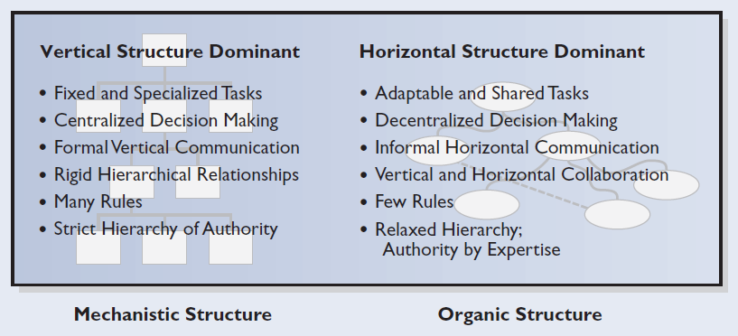
Figure 8.1 Mechanistic structures versus organic structures
A tight organizational structure characterized by rigidly defined tasks, formalization, many rules and regulations, and centralized decision making
A flexible, free-flowing organizational structure that has few rules and regulations and decentralizes decision making right down to the employees performing the job
2

Slide 7
Contingency Factors Affecting Organizational Design
Strategy
Technology
Environment
Organizational Design
Age
Size
3

Slide 8
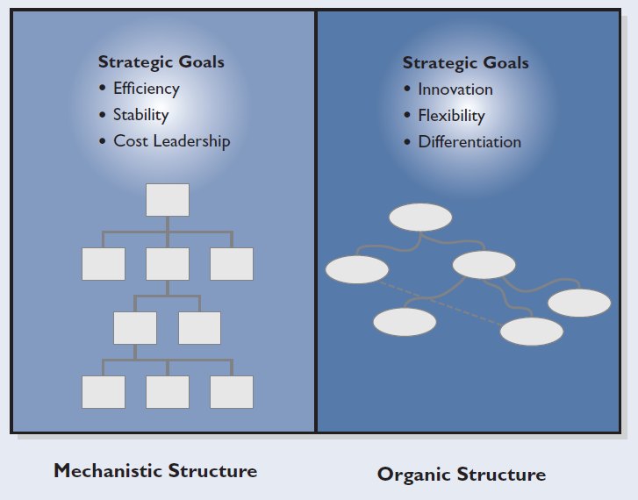
Figure 8.2 Influence of strategy on structure

Slide 9
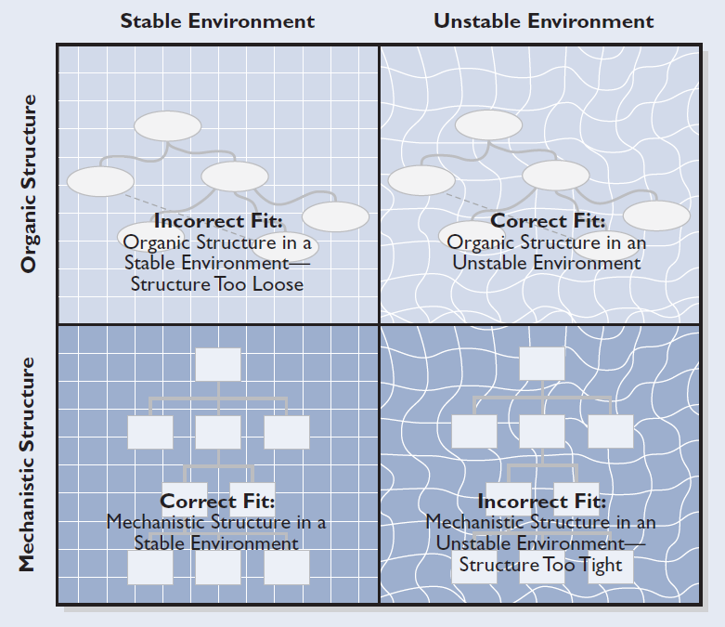
Figure 8.3 Relationship between environment and structure
Organizational requirements for an unstable environment:
The ability to adapt to change
Greater coordination between departments

Slide 10
Size of the Organization
Small Organization Characteristics
  Organic structure
  Little division of labor
  Few rules and regulations
  Informal procedures
Large Organization Characteristics
  Mechanistic structure
  Greater division of labor
  More rules and regulations
  More elaborate internal systems to control

Slide 11
Figure 8.4 Relationship between organizational life cycle and structural characteristics
STRUCTURAL CHARACTERISTICS | BIRTH STAGE | YOUTH STAGE | MIDLIFE STAGE | MATURITY STAGE
Division of labor | Overlapping tasks | Some departments | Many departments, well-defined tasks, organization chart | Extensive—small jobs, written job descriptions
Centralization | One-person rule | Top leaders rule | Decentralization to department heads | Enforced decentralization (top management overloaded)
Degree of formal control | No written rules | Few rules | Policy and procedures | Extensive—most activities covered by written manuals
Administrative staff | Secretary, no professional staff | Increasing clerical and maintenance, few professional staff members | Increasing size of professional support staff | Large—multiple professional and clerical staff departments
Internal systems (information, budget, planning, performance) | Nonexistent | Crude budget and information system | Control systems in place—budget, performance, operational reports | Extensive—planning, financial, and personnel systems added
Source: Based on Robert E. Quinn and Kim Cameron, “Organizational Life Cycles and Shifting Criteria of Effectiveness: Some Preliminary Evidence,” Management Science 29 (1983), 33–51. Copyright 1983, The Institute of Management Sciences, now the Institute for Operations Research and the Management Sciences (INFORMS), 901 Elkridge Landing Road, Suite 400, Linthicum, MD 21090.

Slide 12
Technology
Technology
The knowledge, machinery, work procedures, and materials that transform the inputs into outputs
Small Batch
or Unit production
Producing goods in small quantities designed to customer specifications
Large Batch or
Mass Production
Producing a large volume of standardized products
Continuous-Process
Production
Completing the entire conversion process through a series of mechanical or chemical processes
Flexible Manufacturing
System (FMS)
The automating and integrating of manufacturing elements such as product design, production, equipment, robotics, and performance analysis

Slide 13
Figure 8.5 Relationship between production technology and organizational structure
ELEMENTS OF STRUCTURE | PRODUCTION TECHNOLOGY
 | SMALL BATCH | MASS PRODUCTION | CONTINUOUS PROCESS
Complexity of technology | Low | Medium | High
Organizational structure:
Degree of formal control | Low | High | Low
Centralization | Low | High | Low
Typical span of control | 23 | 48 | 15
Overall structure | Organic | Mechanistic | Organic
Source: Based on Joan Woodward, Industrial Organization: Theory and Practice (London: Oxford University Press, 1965). Reprinted by permission of Oxford University Press.

Slide 14
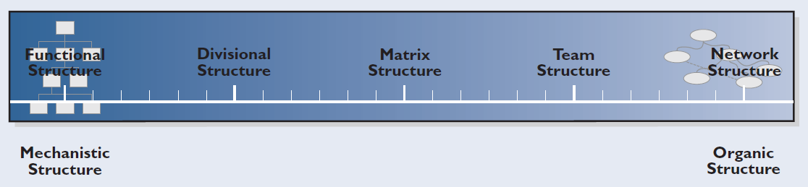
Figure 8.6 Structural options on the mechanistic-organic continuum

Slide 15
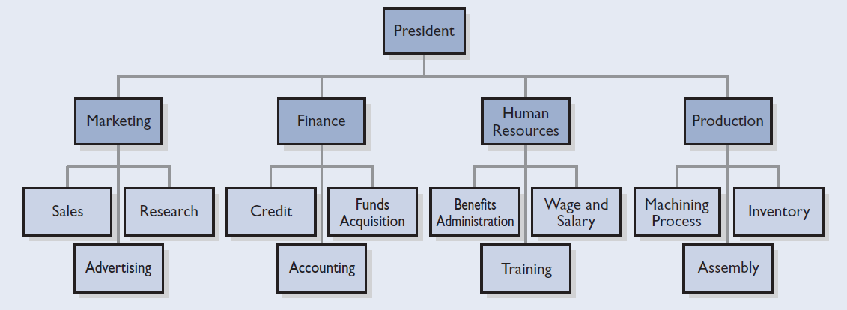
Figure 8.7 Functional organizational structure
Functional Structure
An organizational design that groups positions into departments based on similar skills, expertise, and resources
4

Slide 16
Functional Structure
Advantages
Disadvantages
Economies of scale
Minimizes duplication
Comfortable environment for employees
Simplifies training
Employees have little understanding of or concern for areas outside their own area
Barriers in communication, cooperation, and coordination
Slow response time to changes in the environment
4

Slide 17
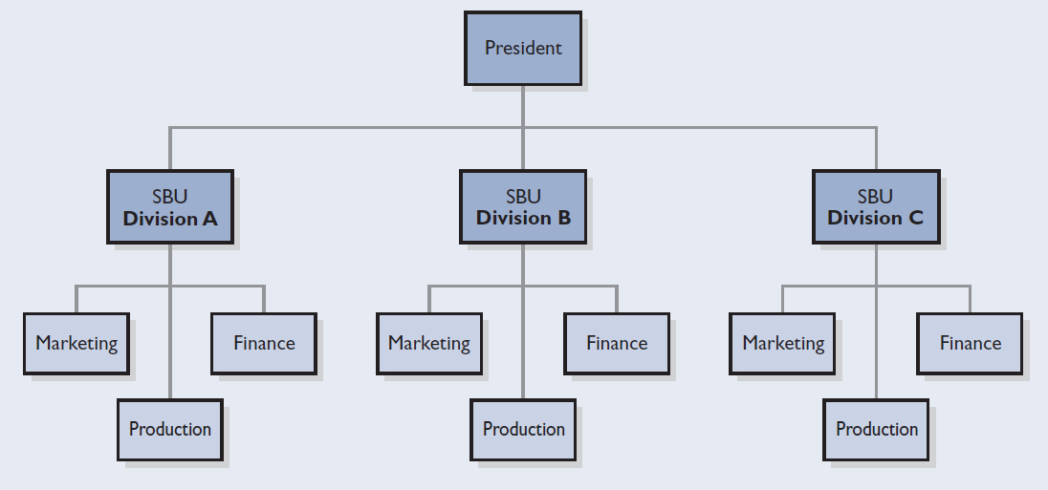
Figure 8.8 Divisional organizational structure
Divisional
Structure
An organizational design that groups departments based on organizational outputs; these divisions are self-contained strategic business units that produce a single product
4

Slide 18
Divisional Structure
Advantages
Disadvantages
Focuses the attention on results
Flexible and responsive to change
Responsibility and accountability are easier to target
Excellent vehicle for developing senior executives
Duplication of activities and resources
Loss of efficiency and economies of scale
Lack of technical specialization, expertise, and training
Different divisions may feel they are competing with one another
4

Slide 19
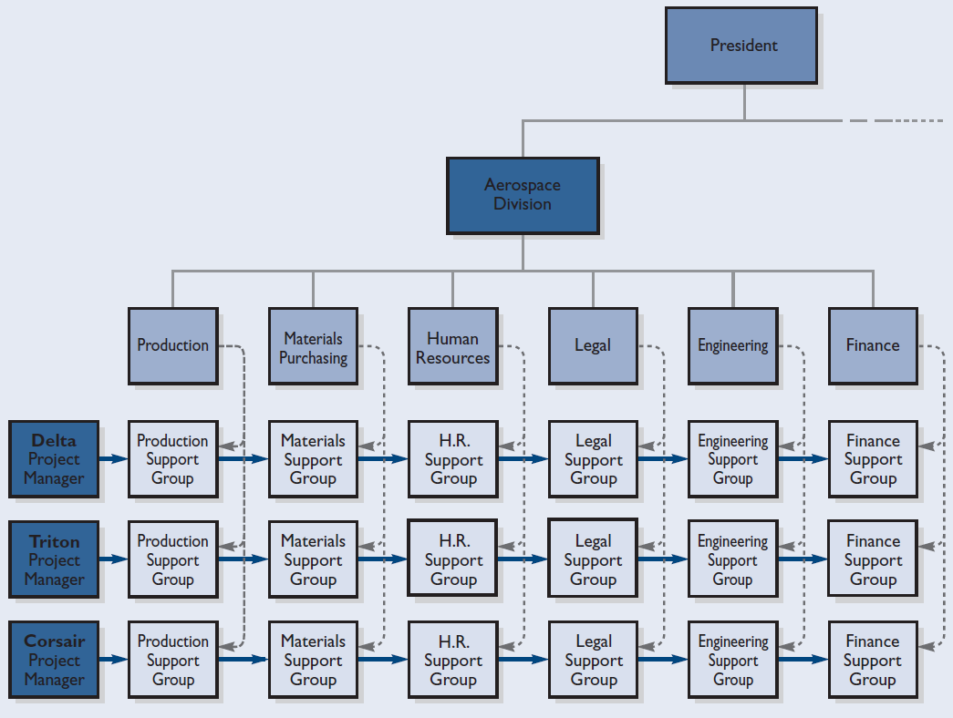

Figure 8.9 Matrix organizational structure
4

Slide 20
Matrix Structure
Advantages
Disadvantages
Flexible
Increase in communication and coordination
Increase in employee motivation
Sense of commitment and satisfaction
Training in functional and management skills
General perspective
Dual chain of command
Pits divisional objectives against functional objectives
Time loss to meetings
Balance of power between functional and divisional sides
4

Slide 21
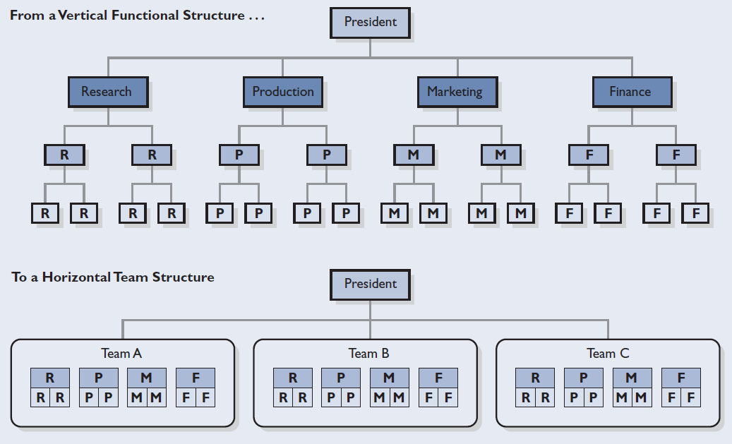
Figure 8.10 Development of a team structure
4

Slide 22
Team Structure
Advantages
Disadvantages
Breaks down departmental barriers
Speeds up decision making
Motivates employees
Lower administrative costs
Does not involve the problem of double reporting
Team membership
Performance suffers if training is not provided
Time required for team meetings
4

Slide 23
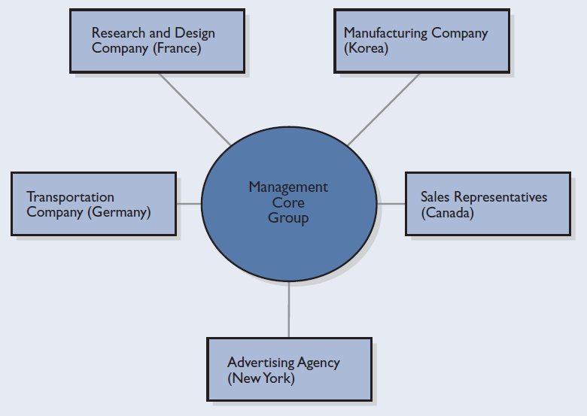
Figure 8.11 Network organizational structure
4

Slide 24
Network Structure
Advantages
Disadvantages
Flexibility
Low administrative overhead
Communication by
e-mail
Lack of control
Reliance on contractors
Supply unreliability
Lack of technical expertise
4

Slide 25
Organizational Culture
Organizational Culture
A dynamic system of shared values, beliefs, philosophies, experiences, habits, expectations, norms, and behaviors that give an organization its distinctive character.
Defines
  What is important to the organization
  The way decisions are made
  Methods of communication
  The degree of structure
  The freedom to function independently
  How people should behave
  How they should interact with each other
  For what they should be striving
5

Slide 26
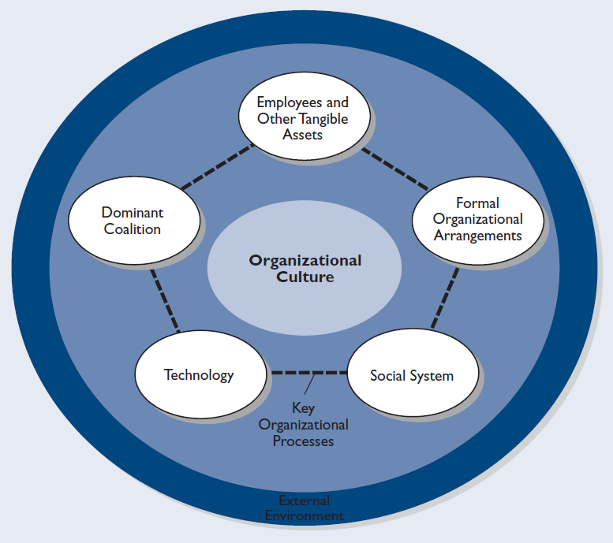
Figure 8.12 Factors that shape organizational culture

Slide 27
Factors Shaping Culture
Key Organizational Processes
Dominant Coalition of Managers
How managers communicate to employees
How they share decision making
How they structure the flow of work
Objectives
Strategies
Personal characteristics
Interrelationships

Slide 28
Factors Shaping Culture (cont’d)
Employees and Other Tangible Assets
Formal Organizational Arrangements
Employee population
Plant and offices
Equipment
Tools
Land
Inventory
Money
Structure of the organization
Procedures and rules
Specific mandated behaviors

Slide 29
Factors Shaping Culture (cont’d)
Social System
External Environment
Contributes norms and values to organizational culture
Includes the set of employee relationships that relate to power, affiliation, and trust
Includes the grapevine and the informal organization
Suppliers
Markets
Competitors
The economy
Regulators
Other factors
Technology
Technological processes
Equipment and its use

Slide 30
Manifestations of Culture
Statements of Principle
Physical Environment
Stories
Culture
Climate
Slogans
Symbols
Heroes
Ceremonies
5

Slide 31
Figure 8.13 Nordstrom’s handbook symbolizes its core values
WELCOME TO NORDSTROM
We’re glad to have you with our Company.
Our number one goal is to provide
outstanding customer service.
Set both your personal and professional goals high.
We have great confidence in your ability to achieve them.
So our employee handbook is very simple.
We have only one rule. . .
Our only rule: Use good judgment in all situations.
Please feel free to ask your department Manager,
store manager or Human Resource Office
any questions at any time.
Source: Used with permission of Nordstrom, Inc.

Slide 32
Manifestations of Culture: Climate
Healthy Climate
Unhealthy Climate
Encouragement to tap into the other person’s expertise
Empowers people
Rewards people for taking risks
Provides celebrations where peers cheer peers
Management has different values
Management is in conflict
Management has widely divergent goals

Slide 33
Creation of Culture: The Role of Managers
Management helps create culture by…
Clearly defining the company’s mission and goals
Identifying the core values
Determining the amount to individual autonomy and the degree to which people work separately or in groups
Structuring the work in accordance with the corporation’s values to achieve its goals
Developing reward systems that reinforce the values of goals
Creating methods of socialization
6

Slide 34
Creation of Culture: The Role of Managers (cont’d)
Translate their core values into tangible mechanisms
Create a sense
of belonging to something special
Visionary Managers and Companies
Indoctrinate
people
Impose tightness
of fit
6

Slide 35
Figure 8.14 Practical ways to build a culture
Create orientation and ongoing training programs that have ideological as well as practical content, teaching such things as values, norms, and traditions.
Promote on-the-job socialization by peers and immediate supervisors.
Initiate rigorous up-through-the-ranks policies—hiring young, promoting from within, and shaping the employee’s mind-set from a young age.
Ensure exposure to pervasive methodology of “heroic deeds” and corporate exemplars (e.g., customer heroic letters, marble statues).
Create unique language and terminology (such as cast members, Motorolans) that reinforce a frame of reference and sense of belonging to an elite group.
Develop corporate songs, cheers, affirmations, or pledges that reinforce psychological commitment.
Initiate tight screening processes, either during hiring or within the first few years of employment.
Provide incentive and advancement criteria explicitly linked to fit with the corporate ideology.
Furnish awards, contests, and public recognition that reward those who display great effort consistent with the
ideology; assure tangible and physical penalties for those who break ideological boundaries.
Have tolerance for honest mistakes that do not breach the company’s ideology (“nonsins”); provide severe penalties or termination for breaching the ideology (“sins”).
Create buy-in mechanisms (financial, time, investment).
Design plant and office layouts that reinforce norms and values.
Place constant verbal and written emphasis on corporate values, heritage, and the sense of something special.
Source: James C. Collins and Jerry I. Porras, Built to Last (New York: HarperBusiness, 1993), p. 136. Copyright © 1994 by James C. Collins and Jerry I. Porras. Reprinted by permission of HarperCollins Publishers, Inc.

Slide 36

Creation of Culture: The Role of Employees
Contribute to the extent that they accept and adopt the culture
Contribute by helping to shape the values it embodies
Employees
and Culture
Influence organizational culture by forming subcultures
6

Slide 37
The Effectiveness of Culture
Coherence of the culture
Persuasiveness and depth of the culture
Factors Making Culture Effective
Adaptability to the External Environment
6

Slide 38
Nature of Change
Change
Any alteration in the current work environment
External Sources of Change
Internal Sources of Change
Political
Social
Technological
Economic
Managerial policies or styles
Systems and procedures
Technology
Employee attitudes
7

Slide 39
Types of Change
Strategic
Change
Change in the strategy or mission of the organization
Structural
Change
Change through team building and downsizing
Process-Oriented
Change
Change through new technology, shift to mechanical labor, adopting new procedures
People-Centered
Change
Changes directed at the attitudes, behaviors, skills, or performance of employees
7

Slide 40
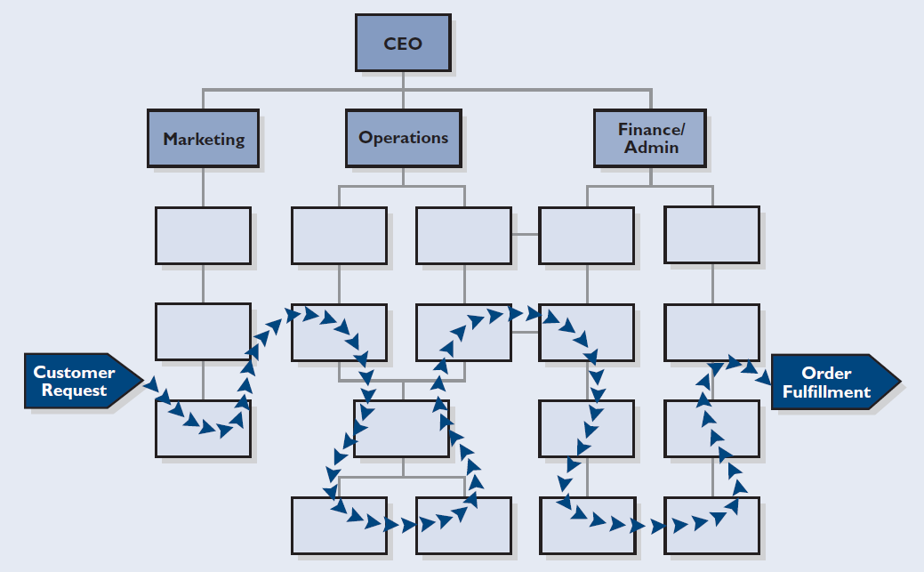
Figure 8.15 Processes wind throughout the organization

Slide 41
Rates of Change
Evolutionary Change
  The incremental steps taken to bring about progress and change
Revolutionary Change
  Bold, discontinuous advances that bring about dramatic transformations in organizational strategies and structure
7

Slide 42
Figure 8.16 Examples of evolutionary and revolutionary change
FACTORS | EVOLUTIONARY CHANGE | REVOLUTIONARY CHANGE
Time Period | Longer | Shorter
Strategy | Strategy refocused on core business Noncore businesses sold | Strategy focused on downsizing Older plants closed Jobs eliminated
Structure | New unit created Reorganize several units into one unit Experienced manager hired to lead new unit | Large percentage of headquarters staff eliminated Large percentage of management eliminated Many nonmanagerial employees eliminated
Culture | Core values identified Culture reshaped to stress accountability, quality, and cycle time | Organization focused on cost cutting Cultural change bypassed
People | Morale positive Future bright Communication open | Morale negative Future uncertain Communication sporadic
Finance | Debt reduced by sale of noncore businesses | Debt eliminated by the stream-lining of operations and the selling of assets

Slide 43
Management and Change
Top Managers
Sensitive to the external environment
Need to stay tuned to the environment
Middle Managers
Likely will face structural, process-oriented,
or people-centered changes
First-Line Managers
Participate in discussions about strategic or
structural changes.
Institute process-oriented and people-centered change

Slide 44
Management and Change
Planned
Change
Trying to anticipate what changes will occur in the external and internal environment and then developing a response that will maximize the organization’s success
Management
by Reaction
A management method that does not anticipate change but merely reacts to it
Change Agent
Implements planned change
Could be the manager who conceived the need to change
Could be another manager within the organization
Could be an outsider
8

Slide 45
Need for Change: Diagnosing and Predicting It
Five Phases of Growth
1
Creativity
2
Direction
3
Delegation
4
Coordination
5
Collaboration

Slide 46
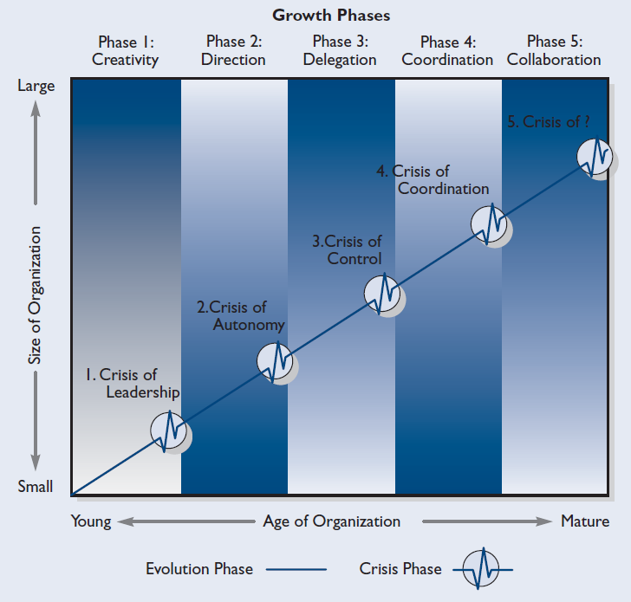
Figure 8.17 Model of organizational growth and change
Source: Reprinted and adapted by permission of Harvard Business Review from “Evolution and Revolution as Organizations Grow,” by Larry E. Greiner, Harvard Business Review (July–August 1972): 55–64. Copyright © 1972 by the Harvard Business School Publishing Corporation. All rights reserved.

Slide 47
Phases of Growth
Phase 1: Creativity
Concerns for product and market
Informal social system
Entrepreneurial style of management
Phase 2: Direction
Implementation of rules, regulations, and procedures
Introduction of a functional organizational structure
Creation of an accounting system
Establishment of incentives, budgets, and work standards
Formal, impersonal communications

Slide 48
Phases of Growth (cont’d)
Phase 3: Delegation
Decentralization
Creation of profit centers
Less frequent communication from the top
Phase 4: Coordination
Managers emphasize coordination
Merger of decentralized work units
Introduction of formal organizationwide planning
Restriction of capital expenditures
Staff personnel begin to wield greater power

Slide 49
Phases of Growth (cont’d)
Phase 5: Collaboration
Introduction of a new people-oriented and flexible system
Problem solving by teams
Reductions in headquarters staff
Simplification of formal systems
Encouragement of an attitude of risk taking and innovation

Slide 50
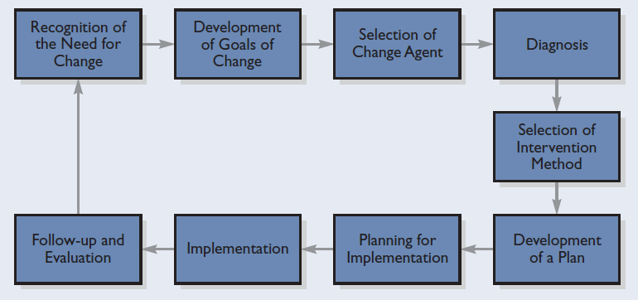
Figure 8.18 Nine steps for implementing planned change

Slide 51
Qualities Promoting Change
Mutual Trust
Organizational Learning
Change
Adaptability
9

Slide 52
Implementation of Change
Resistance to Change
Sources of Resistance
Managers must be aware of…
  Why people resist change
  Why efforts fail
  What techniques can be used to
  modify behavior
Loss of security
Fear of economic loss
Loss of power and control
Reluctance to change old habits
Selective perception
Awareness of weakness in the proposed change
10

Slide 53
Resistance to Change
Techniques for Overcoming Resistance to Change
1
Participation
2
Open communication
3
Advance warning
4
Sensitivity
5
Security

Slide 54
Why Change Efforts Fail
Faulty Thinking
A Resistant Culture
Inadequate Process
Causes of Change Effort Failures
Lack of Time and Poor Timing
Lack of Resources
Lack of Acceptance and Commitment
11

Slide 55
Methods of Affecting Change
Three-Step Approach
A technique of behavior modification to change attitudes in lasting ways
Step 1
Unfreezing
Managers who spot deficiencies in a subordinate’s behavior must identify the causes of that behavior
Step 2
Change
The individual’s discomfort level rises causing the individual to question his or her motives for the current behavior
Step 3
Refreezing
Manager recognizes and rewards new and improved attitudes and behaviors

Slide 56
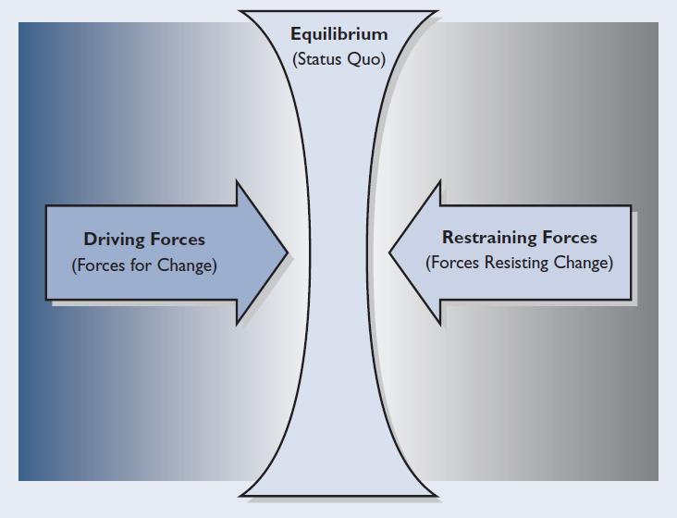
Figure 8.19 Forces that contribute to a force field
Force-Field Analysis
A technique to implement change by determining which forces drive change and which forces resist it

Slide 57
Organizational Development
Organizational
Development
A process of conducting a thorough analysis of an organization’s problems and then implementing long-term solutions to solve them
Diagnostic Strategies
Change Strategies
Consultants
Surveys
Group discussions
Training programs
Meetings and seminars
Grid OD
  laboratory training
  team development
  intergroup development
  organizational goal setting
  goal attainment
  stabilization
12

Slide 58
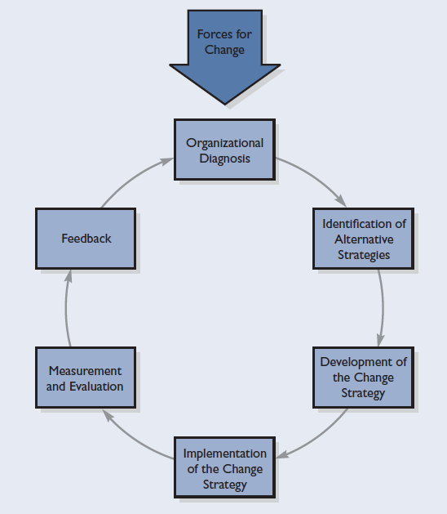
Figure 8.20 Model of the organizational development process
Source: Gene E. Burton, “Organizational Development—A Systematic Process,” Management World, March 1976. Reprinted with permission from the Administrative Management Society, Willow Grove, PA. Copyright 1976 AMS.

Slide 59
Figure 8.21 Tools and methods for applying organizational development strategies
DIAGNOSTIC STRATEGIES
Consultants |  | This strategy consists of bringing in objective outsiders (consultants) to analyze and conduct audits of existing policies, procedures, and problems. Consultants can be individuals or groups and may act as change agents as well.
Surveys |  | Surveys consist of interviews or questionnaires used to assess the attitudes, complaints, problems, and unmet needs of employees. Surveys are usually conducted by outsiders and guarantee anonymity to participants.
Group discussions |  | Group discussions are periodic meetings conducted by managers to uncover problems and sources of their subordinates’ discomfort and dissatisfaction.
CHANGE STRATEGIES
Training programs | Training programs are ongoing or special efforts to improve or increase skill levels, change or instill attitudes, or increase the knowledge needed to perform jobs more effectively and efficiently.
Meetings and seminars | As change strategies, meetings or seminars are gatherings held to explore mutual problems and seek mutually agreeable solutions. Such group sessions may be chaired by insiders or outsiders and may be used to prepare people for changes in advance of implementation.
Grid OD | Grid OD is a six-phase program based on the Leadership Grid. Its purpose is management and organizational development. The first two phases focus on management development. The last four phases are devoted to organizational development. The six phases are laboratory training, team development, intergroup development, organizational goal setting, goal attainment, and stabilization.

Slide 60
Key Terms
change
change agent
continuous-process production
divisional structure
evolutionary change
flexible manufacturing systems (FMS)
force-field analysis
functional structure
large batch technology
Lean
organizational life cycle
planned change
revolutionary change
small batch technology
social media
subculture
team structure
technology
three-step approach
unit production technology
management by reaction
mass production technology
matrix structure
mechanistic structure
mutual trust
network structure
organic structure
organizational design
organizational development (OD)
organizational learning

