Slide 1
Chapter 9: Management Ethics and Social Responsibility

Slide 2
Learning Objectives
After reading and studying this chapter, you should be able to:
Describe the two broad categories of ethical theories
Explain what individuals need in order to act ethically
Describe the organizational influences on ethical conduct
Discuss three primary ways in which business can promote ethical conduct
Describe the relationship between law and ethics
Explain the concept of an ethical dilemma

Slide 3
Learning Objectives Cont.
After reading and studying this chapter, you should be able to:
Discuss the guidelines for acting ethically
Explain the three approaches by businesses to social responsibility
Explain the responsibilities businesses have to stakeholders
Describe government’s role in promoting socially responsible conduct by businesses
Discuss the ways in which businesses can promote socially responsible conduct

Slide 4
Managing Ethically
Ethics
  Is the branch of philosophy concerned with human values and conduct, moral duty, and obligation.
  Is concerned with what constitutes right and wrong human conduct, values, beliefs, and attitudes in light of a specific set of circumstances.
Business Ethics
  Are the rules or standards governing the conduct of persons or members of organizations in the field of commerce.

Slide 5

Categories of Ethical Theories
Ethical Theories
Consequential Principles
Judge the ethics of a particular situation by the consequences of that action. Determines the “rightness” or “wrongness” of any action by determining the ratio of good to evil that the action will produce.
Nonconsequential Principles
A person acts ethically if that person is faithful regardless of the consequences that follow from being faithful to that duty.
1

Slide 6
Balancing Demands
Conflicting demands on those who manage institutions and hold power
Consequences of management decisions that affect more people and environments than ever before

Slide 7
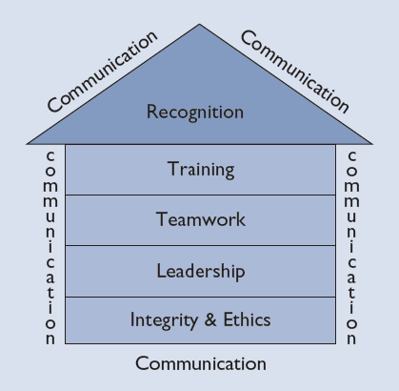
TQM Foundation
The foundation of Total Quality Management is ethics, integrity and trust.
Source: Padhi, Nayantara, SixSigma, “The Eight Elements of TQM,” http://www.isixsigma.com/index.php?options-com_k2&view-item&id-1333:the-eight-elements-of-tqm&Itemid-179.

Slide 8
Individuals and Ethical Conduct
Morality
  The core values and beliefs that act as a guide (i.e., conscience) when individuals formulate courses of action
Religious Beliefs and Training
Work
Experience
Educational Background
Personal Code of Ethics
Family and
Peer Group
Political and Economic Philosophy
2

Slide 9
Leaders’ Ethics
Treatment of employees
High standard of personal ethics and responsibility
Understanding of personal motivation
Caring for the public interest
“Walk the talk”

Slide 10
Organizational Influences on Ethical Conduct
Offers of Unusually High Rewards
Threats of Unusually Severe Punishments
Encouraging Unethical Behavior
Undue Emphasis
on Results
3

Slide 11
Importance of Organizational Controls
Commitment of Top Management
Codes of
Ethics
Promoting Ethical Conduct
Compliance
Programs
4

Slide 12

Commitment of Top Management
Establishing a code
of ethics
Training, oversight, and rewarding ethical behavior
Discouraging Unethical Behavior
Punish wrongdoers

Slide 13
Figure 9.1 Checklist for determining if a corporate culture supports ethical behavior and social responsibility
IS THE COMPANY: YES NO
Concerned about quality in its services, products, and operations? ❑ ❑
Concerned about its employees’ quality of life? ❑ ❑
Proud of its reputation in the industry? ❑ ❑
Proud of its reputation in the community? ❑ ❑
Focused on the needs of its customers? ❑ ❑
Honest in its dealings with you? ❑ ❑
Honest in its dealings with customers? ❑ ❑
Honest in its dealings with others? ❑ ❑
Fair and equitable in the ways in which it decides on promotions? ❑ ❑
Fair and equitable in the ways in which it compensates employees? ❑ ❑
Open in its communications? ❑ ❑
Trusting in its relationships with employees? ❑ ❑
Concerned with developing and keeping its employees? ❑ ❑
Actively promoting ethical conduct in all its operations and employees? ❑ ❑
Actively searching for ways to better serve its stakeholders? ❑ ❑
Carefully monitoring how decisions are made and checking them for ❑ ❑
their concern for ethical behavior?

Slide 14
Codes of Ethics
Characteristics of effective codes of ethics
They are visible guidelines for ethical behavior at all organization levels.
They are an unchallengeable basis for firing an unethical employee.
They protect all personnel from the pressures of the market, which tend to incite desperation and unethical behavior.
They remind employees to look beyond the bottom line, and they provide a touchstone for appeals through the hierarchy.

Slide 15
Compliance Programs
Ethics Training
Compliance Training
Alerts people to policies, regulations, and laws that establish acceptable behavior within a company
Cognitive Thinking
Develops skills to allow people to think through various “moral mazes”
with which they may be confronted in the workplace

Slide 16
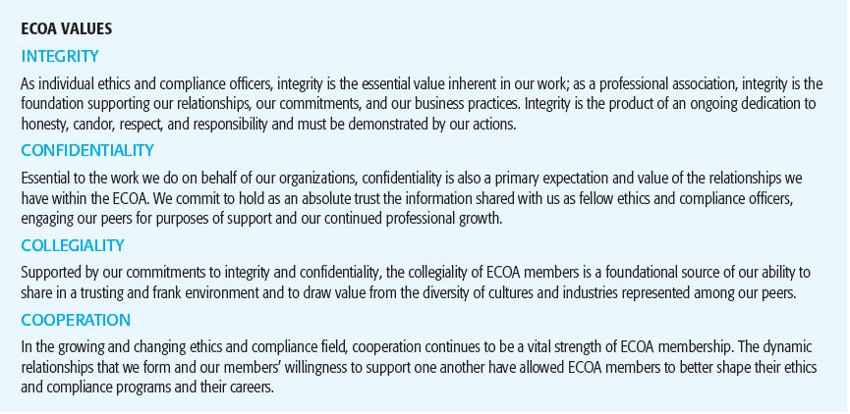
Figure 9.2 The ECOA standards of conduct for business ethics and compliance professionals
Sources: ECOA http://www.theecoa.org

Slide 17
Relationship of Law to Ethics
According to Dr. Peter Madsen, “Laws and policies form an ethical foundation. But the law is a moral minimum……The best ethics training goes beyond legal compliance.” Source: Human Resources Management:I deas & Trends in Personnel 273. “The best ethics training goes beyond legal compliance by giving people skills needed to make value-based decision,” an interview with Dr. Peter Madsen. Chicago: Commerce Clearing House, (April 15, 1992), 60.
Author Vincent Barry says, “Although useful in alerting us to moral issues and informing us of our rights and responsibilities, law cannot be taken as an adequate standard of moral conduct.” Source: Barry, Vincent. Moral Issues in Business, 3d ed. Belmont, Calif.: Wadsworth, 1986,5, 9-10, 156.
5

Slide 18
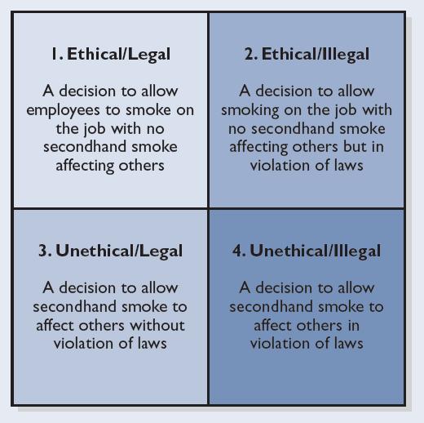
Figure 9.3 Legal/ethical behavior model applied to the issue of smoking in the workplace
5

Slide 19
Ethical Dilemmas
Ethical Dilemma
  A situation that arises when all courses of action open to a decision maker are judged to be unethical
Suggestions for Handling Dilemmas
When in doubt, don’t.
Don’t try to find out “how far is too far.”
Superiors who push you to do things better, faster, cheaper will turn on you when you cross the line between right and wrong.
6

Slide 20
Guidelines for Acting Ethically
Consider other people’s well-being, including the well-being of nonparticipants.
Think as a member of the business community and not as an isolated individual.
Obey, but do not depend solely on, the law.
Think of yourself—and your company—as part of society.
Obey moral rules.
Think objectively.
Ask the question, “What sort of person would
do such a thing?”
Respect the customs of others, but not at the
expense of your own ethics.
7

Slide 21
Guidelines for Ethical Actions
Is it legal?
Is it balanced?
Tests for Ethical Implications of Intended Actions
How will it make me feel about myself?

Slide 22
Nature of Social Responsibility
Social Responsibility
  The notion that, in addition to their business interests, individuals and organizations have certain obligations to protect and benefit other individuals and society and to avoid actions that could harm them
  Being socially responsible does not mean making everyone happy

Slide 23
Nature of Social Responsibility (cont’d)
Resistance Approach
Businesses actively fight to eliminate, delay, or fend off demands being made on them
Reactive Approach
Businesses wait for demands to be made and then react to them, choosing a response by evaluating alternatives
Proactive Approach
Businesses continually look to the needs of constituents and try to find ways to meet those needs
8

Slide 24
Figure 9.4 Dimensions of reputation
Emotional Appeal
Has a good feeling about the company
Admires and respects the company
Trusts the company a great deal
Products & Services
Stands behind its products and services
Develops innovative products and services
Offers high-quality products and services
Offers products and services that are a good value for the money
Financial Performance
Has a strong record of profitability
Looks like a low-risk investment
Looks like a company with strong prospects for future growth
Tends to outperform its competitors
Vision & Leadership
Has excellent leadership
Has a clear vision for its future
Recognizes and takes advantage of market opportunities
Workplace Environment
Is well-managed
Looks like a good company to work for
Looks like a company that would have good employees
Social Responsibility
Supports good causes
Is an environmentally responsible company
Maintains high standards in the way it treats people
Source: Harris Interactive Inc. “Harris–Fombrun Reputation Quotient (RQ)”

Slide 25
Responsibilities to Stakeholders
Owners and Stockholders
Society
Employees
Stakeholder
Interests
Communities
Customers
Suppliers
9

Slide 26
Government Regulation: Pros and Cons
Laws and Regulations
  Were brought about to compel corporations to stop environmentally abusive acts
  Protect whistleblowers who report wrongdoing
  Cannot prevent all acts, rely on individuals to know, obey, and assist in enforcement
  Are increasingly costly to business and compliance makes businesses less competitive
Sustainable Communities – Healthy, livable communities effectively using resources to meet today’s community needs while ensuring that these resources are available to meet the community’s future needs.
10

Slide 27
Managing for Social Responsibility
Top-level commitment and support
Establishment of responsibility for environmental problems
Corporate policies that integrate environmental issues
Making an Organization Proactive
Strong auditing programs
Effective interfaces between corporate and business-unit staff
High degree of employee awareness and training
11

Slide 28
Figure 9.5 Components and elements for generic EMS
COMPONENT ELEMENT
Policy Develop, document, and communicate policy
Planning Identify and track requirements
Identify vulnerable assets and business and management practices that
may impact them
Identify pollution prevention (P2) opportunities
Identify, document, and rank environmental impacts
Develop objectives and targets based on environmental impacts
Establish programs to meet objectives and targets
Implementation Provide resources (funding, manpower, technical, material)
Identify training needs and provide training
Develop and control EMS documentation
Develop and document standard operating procedures (SOPs) for practices
associated with impacts
Develop and test emergency procedures
Evaluation Identify, characterize, and document problems (compliance and
management system)
Develop corrective/preventive actions (solutions)
Secure management approval for solutions
Implement solutions
Review EMS
Improvement Aim for continual improvement
Source: U.S. Navy Environmental Quality Assessment Guide, Au gust 31, 1999, http://www-nehc.med.navy.mil/downloads/ep/eqaguide.pdf.

Slide 29
Key Terms
business ethics
ethical dilemma
green products
morality
proactive approach
reactive approach
resistance approach
Sarbanes–Oxley Act of 2002 (SOX)
social audit
social responsibility
sustainable communities
whistle-blower

