Slide 1
Information Needed to Complete the Exercise Plan and Presentation Parts 1 and Parts 2
Dr. Todd Alan Rygh

Slide 2

FITT Formula
F
Frequency
Intensity
Time
Type
I
2 other key terms
T
V
Volume
T
P
Progression
Copyright © 2016 McGraw-Hill Education. All rights reserved. No reproduction or distribution without the prior written consent of McGraw-Hill Education.
Notes:
11
The FIT formula is used to describe the amounts of exercise needed to improve fitness or health.
They are similar to a doctor's prescription in that if you follow the guidelines you will receive the best results. When prescribing medication doctors typically tell you how much to take (dose or intensity), how often to take it (frequency), and how long you should continue (time). These are the same parameters that are used to prescribe exercise.
The parameters (Frequency, Intensity, and Time) relate to the overload principle. As you get more fit, it is important to change these values if you want to keep improving. If maintenance is your goal it may only be necessary to follow what you have been doing.
Some health professionals add a second T to create the acronym FITT. This is done to illustrate the fact that there is a FIT formula for each different Type, or mode, of physical activity. In this book, the acronym FIT formula will be used to describe the amount of activity necessary to produce benefits for each type of activity from the physical activity pyramid described later in this concept.
The ACSM recently added new terms of Volume (V) and Progression (P) to reinforce these other key training principle. Volume refers to the total amount of physical activity that you perform each day. It is a combination of the frequency and intensity. Progression, in this context, refers to the application of the principle of progression as part of training.

Slide 3
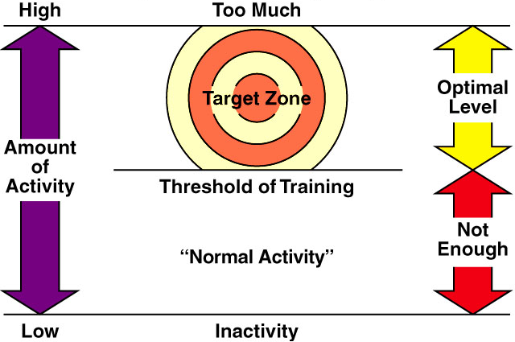
Physical Activity Target Zone
Copyright © 2016 McGraw-Hill Education. All rights reserved. No reproduction or distribution without the prior written consent of McGraw-Hill Education.
Notes:
13
Physical Activity Target Zone: The optimal amount and intensity of exercise is known as the "target zone.” For fitness, you have to reach the threshold amount of exercise to make some gains in fitness, but doing a lot more than the optimal level does not guarantee extra health.
It is important to point out that too much exercise can also be unhealthy.

Slide 4
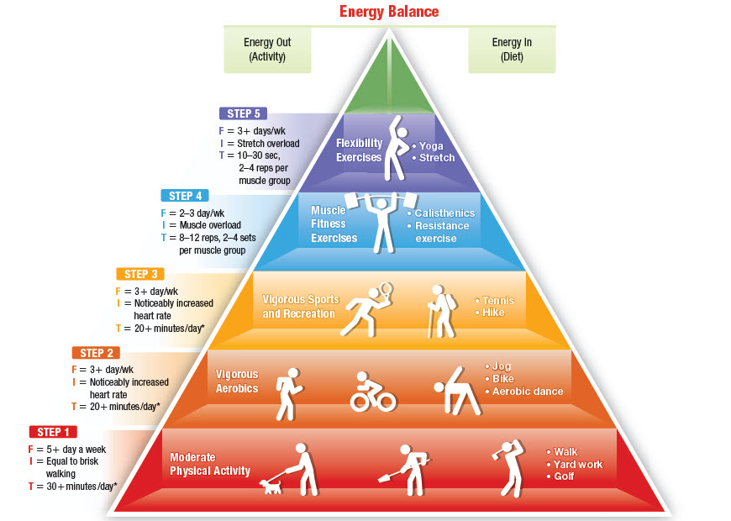
Physical Activity Pyramid
Copyright © 2016 McGraw-Hill Education. All rights reserved. No reproduction or distribution without the prior written consent of McGraw-Hill Education.
Photo Credit: C. B. Corbin
Notes:
7
The activity pyramid provides a conceptual diagram of how to incorporate physical activity into your life. The most important factor for health is just to do some form of physical activity. This is the reason why moderate intensity physical activity is at the base of the pyramid. The other activities move up the pyramid in their order of importance. Note that rest is also an important consideration for optimal health and fitness. Excessive periods of inactivity, however should be minimized.
Additional coverage of each layer of the pyramid will occur in the subsequent concepts.

Slide 5
STEP 1 Moderate Activities
Base of pyramid
Equal in intensity to brisk walking
When done as part of normal daily routine = lifestyle physical activities
Photo Credit: C. B. Corbin
Copyright © 2016 McGraw-Hill Education. All rights reserved. No reproduction or distribution without the prior written consent of McGraw-Hill Education.
Notes:
Moderate activities are at the base of the pyramid because they provide many benefits for modest amounts of effort. Moderate aerobic activity equal in intensity to brisk walking results in significant health benefits. Moderate activities, such as walking to and from work, climbing the stairs rather than taking an elevator, or doing brisk housework, when done as part of the normal daily routine are often referred to as lifestyle physical activities.
Moderate activities that are not part of the normal daily routine, such as taking a walk or a bike ride, can also be planned specifically to increase activity levels.

Slide 6
STEP 2 Vigorous Aerobic Activity
Greater intensity
3 days/week
Builds cardiovascular fitness
Helps control body fatness
Instead of, or in combination with, STEP 1 moderate activities
Photo Credit: C. B. Corbin
Copyright © 2016 McGraw-Hill Education. All rights reserved. No reproduction or distribution without the prior written consent of McGraw-Hill Education.
Notes:
Vigorous aerobic activity is at the second step of the pyramid. They are of greater intensity than moderate activities. The greater intensity results in significantly higher heart rates and higher oxygen consumption. Because of its greater intensity, vigorous aerobics can be performed as few as 3 days/week and are especially good for building cardiovascular fitness and helping control body fatness.
Examples: Active aerobics, jogging, biking, and aerobic dance.

Slide 7
STEP 3
Vigorous sports & recreation activities
Similar in intensity to vigorous aerobics
Instead of, or in combination with, vigorous aerobic or moderate activities
Photo Credit: C. B. Corbin
Copyright © 2016 McGraw-Hill Education. All rights reserved. No reproduction or distribution without the prior written consent of McGraw-Hill Education.
Notes:
Vigorous sports and recreation activities are at the third step of the pyramid. They are similar in intensity to vigorous aerobics. They can be performed instead of, or in combination with, vigorous aerobic activities or moderate activities, to meet national activity guidelines.

Slide 8
STEP 4
Muscle Fitness Exercises
Planned activities to build strength and muscular endurance
(e.g., resistance training and calisthenics)
Photo Credit: C. B. Corbin
Copyright © 2016 McGraw-Hill Education. All rights reserved. No reproduction or distribution without the prior written consent of McGraw-Hill Education.
Notes:
There are muscle fitness benefits from many different activities, including vocational activities that require lifting, active sports such as gymnastics and wrestling, and recreational activities such as rock climbing. The muscle fitness activities included in STEP 4 of the pyramid are those that are planned specifically to build strength and muscular endurance, such as resistance training and calisthenics. The many health and performance benefits of muscle fitness exercises are described in a future concept.

Slide 9
STEP 5
Flexibility Exercises
Promotes full range of motion in joints and decreases risk of injuries and back pain
Photo Credit: C. B. Corbin
Copyright © 2016 McGraw-Hill Education. All rights reserved. No reproduction or distribution without the prior written consent of McGraw-Hill Education.
Notes:
There are flexibility benefits from many different activities, including sports such as gymnastics and diving. The flexibility activities included at STEP 5 are those that are planned specifically to build flexibility, such as stretching and yoga. The many benefits of flexibility exercises are described in a future concept.

Slide 10
Principles from the
Physical Activity Pyramid
No single activity provides all the benefits
Something is better than nothing
These amounts may not be enough for weight management or weight loss
  Longer duration may be needed to burn more calories
Specific activity recommendations for youth and older adults
Copyright © 2016 McGraw-Hill Education. All rights reserved. No reproduction or distribution without the prior written consent of McGraw-Hill Education.
Notes:
The points on the slide reflect the key principles from the activity pyramid. The FIT formula boxes in the physical activity pyramid provide general information about the amounts of activity (energy expenditure) necessary for general health and fitness benefits. But these amounts many not be enough for weight management (or weight loss). New physical activity guidelines suggest that 45-60 minutes of daily moderate activity may be necessary (as opposed to 30 minutes).
Separate activity recommendations have been proposed for children. Children are different from adults and they have different needs for activity. The National Association for Sports and Physical Education (NASPE) and the CDC have developed activity recommendations that are specific to children. According to these guidelines, children should accumulate at least 60 minutes, and up to several hours, of age-appropriate physical activity on all, if not most, days of the week. This daily accumulation should include participation in a variety of age-appropriate activities (both moderate and vigorous) with the majority of the time being spent in activity that is intermittent. The guidelines also recommend minimizing periods of inactivity (periods of 2 or more hours). Adults play a major role in shaping children’s activity patterns. Helping children meet these guidelines may help reduce the prevalence of inactive and overweight adults in future years.
Older adult physical activity recommendations are similar to those for younger adults, but differ in flexibility, balance, and intensity of aerobic activity. These will be described later in the book.

Slide 11
Physical Activity Patterns
Prevalence of adults meeting recommendations varies based on:
  Gender
  Age
  Ethnicity
  Income
  Education
  Disability status
For children, age is a critical factor in the variations among those meeting recommendations
Copyright © 2016 McGraw-Hill Education. All rights reserved. No reproduction or distribution without the prior written consent of McGraw-Hill Education.
Notes:
Table 1 in the textbook shows the percentage of adults meetings guidelines by the different factors. It is important to consider why there might be variations based on these factors. Discuss what some of these reasons might be with your students. Consider environments, opportunities, knowledge of the importance of PA, etc.

Slide 12
Physical Fitness Standards
Lab 6b Info
Health-based criterion-referenced standards are recommended for rating your fitness
Good fitness zone
High performance zone
Copyright © 2016 McGraw-Hill Education. All rights reserved. No reproduction or distribution without the prior written consent of McGraw-Hill Education.
Notes:
Most experts recommend health-based criterion-referenced standards to rate your current fitness. These standards are based on how much fitness is needed for good health. Other standards use norms or percentiles that compare a person’s fitness against a reference population. Knowing how you compare with other people is not that important. In fact, such comparisons have been shown to be discouraging to many people. Determining your fitness is adequate to enhance your health and wellness is more relevant.
In this book, the health-related standard is referred to as the good fitness zone. With reasonable amounts of physical activity, most people should be able to improve their fitness enough to make it into this range. For personal reasons, some may wish to aim for a higher level, referred to as the high performance zone. Attaining this level does not provide many additional health benefits but may be important for those interested in performance. The low fit zone and the marginal zone are levels of fitness that are not sufficient for optimal health benefits.

Slide 13
How Much is Enough?: Summary
Some activity is better than none
More activity is not necessarily better
Use the recommendations that best apply to your specific needs and goals
Copyright © 2016 McGraw-Hill Education. All rights reserved. No reproduction or distribution without the prior written consent of McGraw-Hill Education.
End of presentation
Notes:
15
The summary about physical activity is that some is better than none but more is not necessarily better. It is important for everyone to get some activity as part of their normal life. If you want more significant benefits, then aiming for a fitness target zone is a good goal. Too much activity, however, can be hard on the body so this is the reason for the caution about excessive activity.

