Slide 1
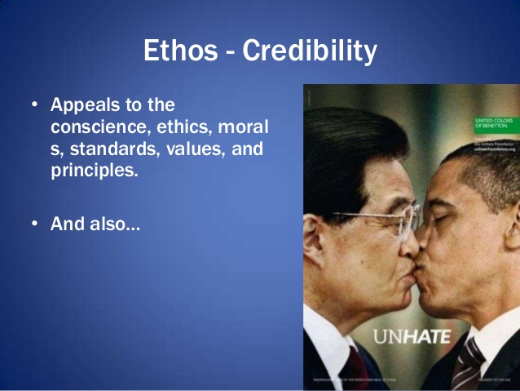
PERSUASION
There are three main modes of persuasion.
Persuasion is a process whereby one is able to influence an individual or a group’s attitude or behavior regarding an issue
ethos
This means the personality of the persuading personnel. Their credibility or ability to appeal means a lot a far as achieving the objectives of the process is to be achieved.
The issue is that it appeals to the way the appealing is being done. The person who is persuading must do that in an ethical way and with high level of professionalism.( Lin, W. A. N. G. 106)

Slide 2

Pathos
This mode of persuading appeals to the emotions of the audience. The main purpose is to show that target group the feelings that you are intending to pass across. This means that persuasion depends on how much the issue is emotional. The more emotional it is the better the results.
Happiness in many cases attracts in many cases more than sorrowful emotions although it depends on the issue at hand.

Slide 3

Logos.
This kind of persuasion appeals to the needs of the consumers or the audience being targeted. The main aim is to show the consumer on reasons why they need the product that is being advertised.

Slide 4
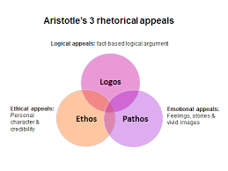
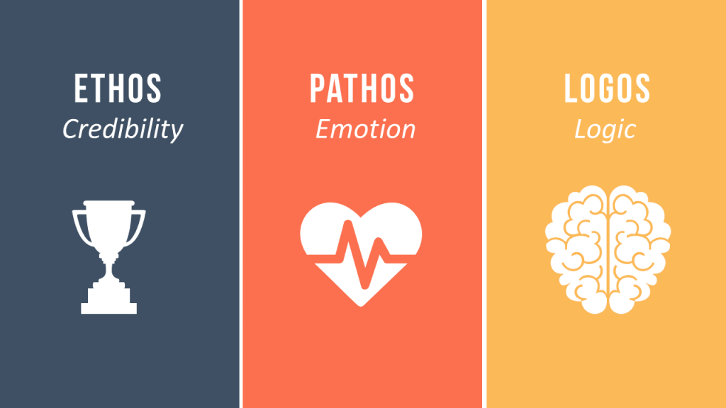
summary

Slide 5
REFERENCES.
Lin, W. A. N. G. "Three Modes of Rhetorical Persuasion." Sino-US English Teaching 16.3 (2019): 106-112.
Bardhi, Arjada, and Yingni Guo. "Modes of persuasion toward unanimous consent." Theoretical Economics 13.3 (2018): 1111-1149.

