Slide 1
PHILOSOPHY
Presented by:

Slide 2
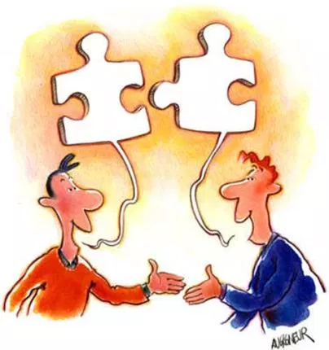
What is dialogism ?
Dialogism claims of diversity in viewpoints and expressions where mismatched components or parties are pooled within different viewpoints of equivalent worth, in the presence of an observer. The truth from such a scenario is determined through engagement and commitment.
Bakhtin insists the non-centeredness of the parties themselves requires the center constituted by an observer.

Slide 3

The self as a sign
  Basically the thoughts on “self as a sign” defines the meaning of whatever is observed by an individual being shaped by the place from which it is perceived.
The self and the other observer don’t necessarily exist as separate entities. It is more of the two synchronizing in viewing the other differently.

Slide 4
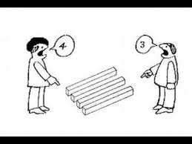
The Time and Space of Self and Other
According to Michael Holquist, two individuals could be doing essentially the same thing, but from different places. Although we are in the same event, that event is different for each of us.
We as humans observe situations according to what we feel is appropriate or right, in making the most sense.

Slide 5
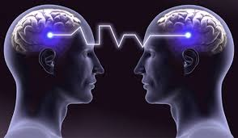
Outsideness and Values
Bakhtin's view summarizes the impossibility of one being completely transgredience to another living subject, i.e. having the ability to see the Outsideness of an individual, like he/she never existed.
Outsideness is the only perspective from which values of specificity and completeness may be brought to bear. Ultimately one should be in the same exact position of the observer in time and space to understand others’ perceptive of yourself.

Slide 6
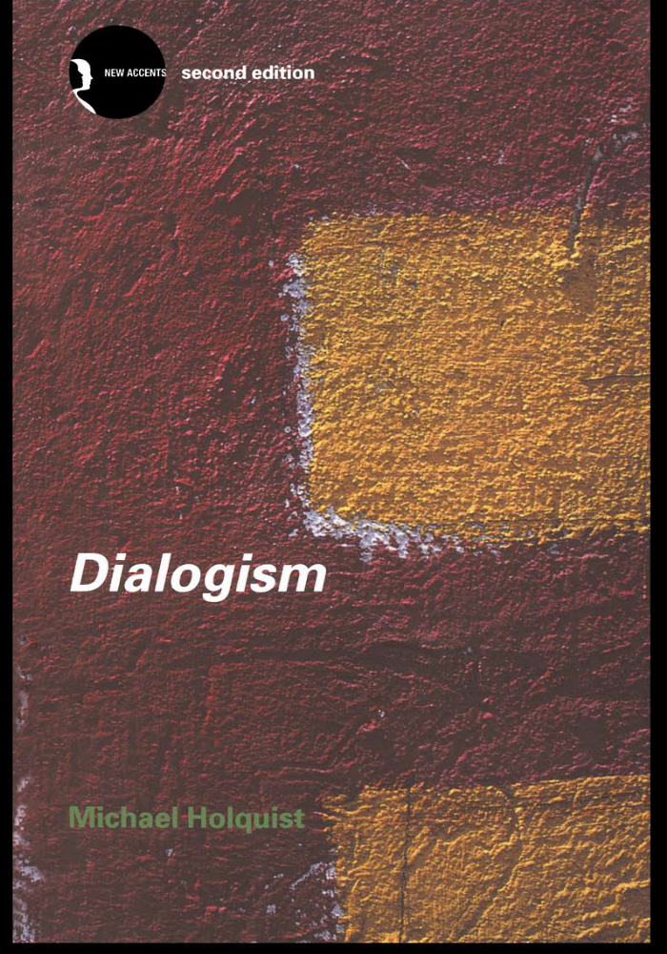
Bakhtin and his world
In a brief summary, the world of Bakhtin was focused on developing his philosophical work at a time where his motherland Russia was involved in wars , famines, revolutions and exiles. Observation on humanity was on record.
His view of the world was “dialogue” potentially being an endless process. The thoughts seemed valid since they were shaped and inspired from the works of Kagan, Kant, and Cohen.
His analogy has now been bridged collectively with other intellectuals of dialogue like Frankenstein, distinct schools that support his work, among others, thanks to Michael Holquist.

Slide 7
THE END

