Slide 1
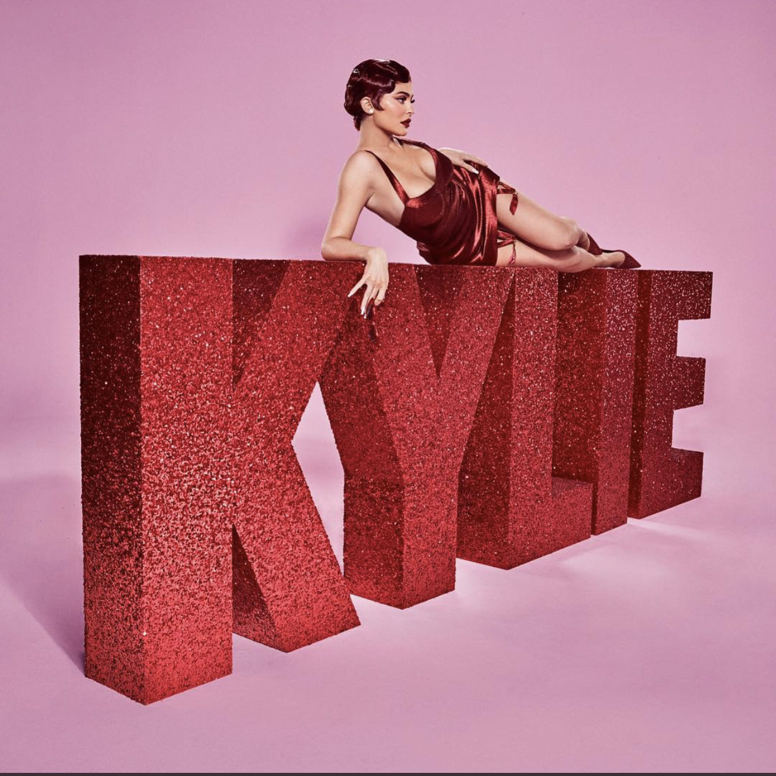
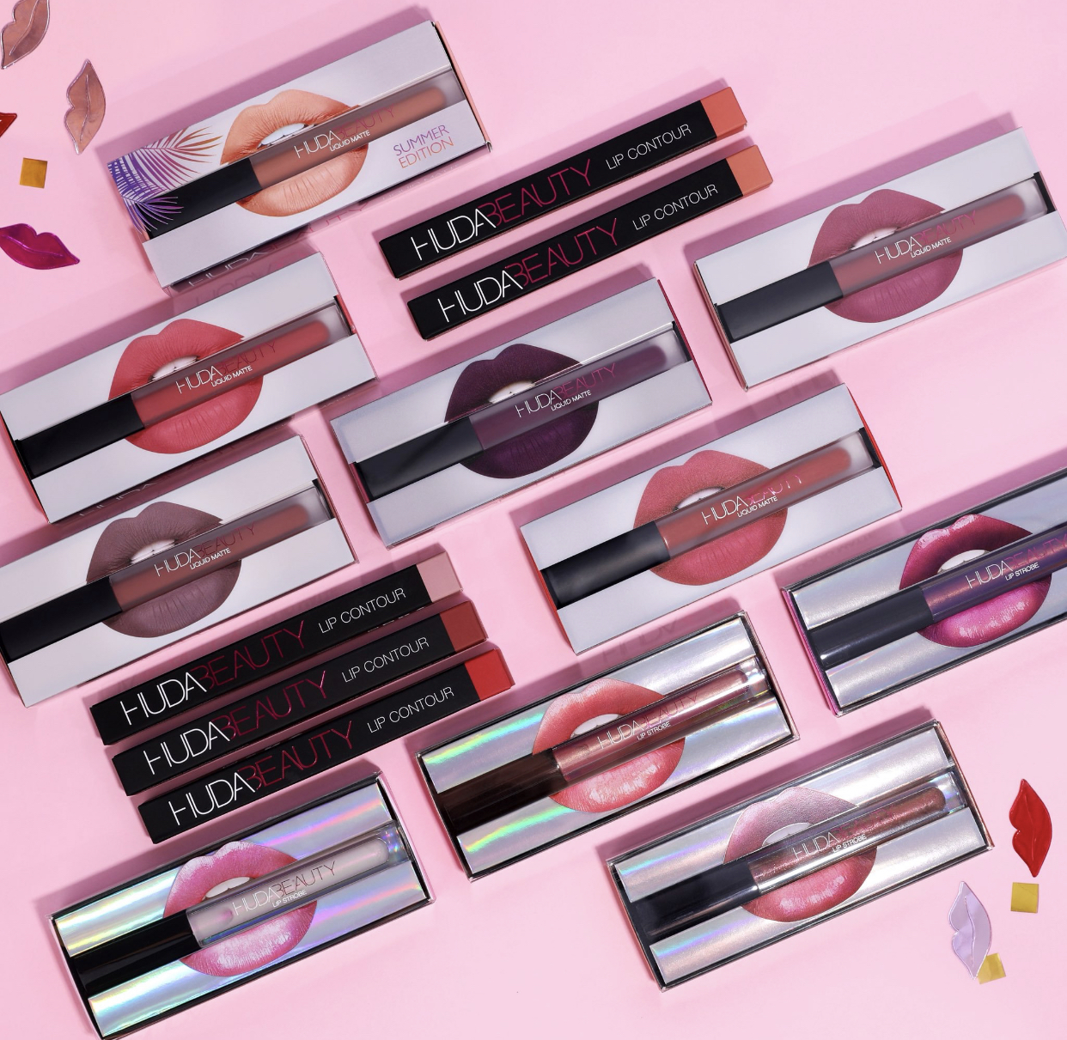
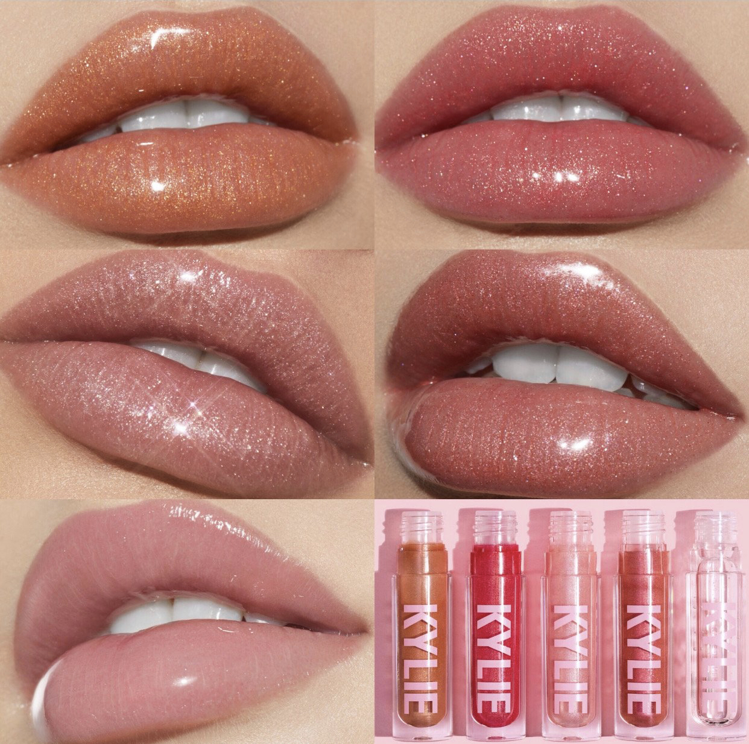
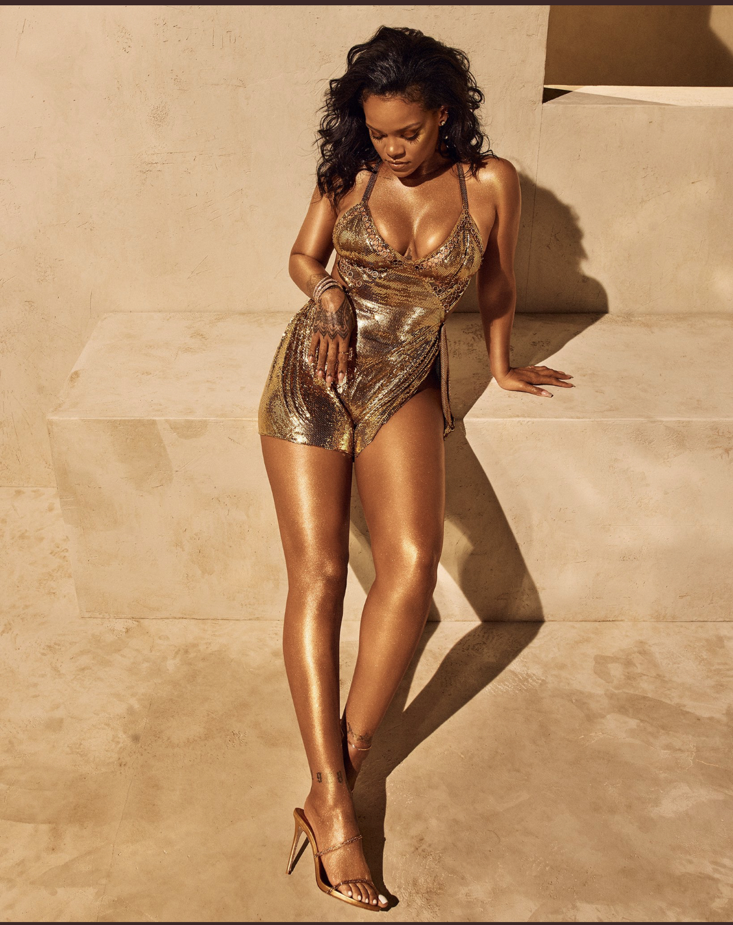
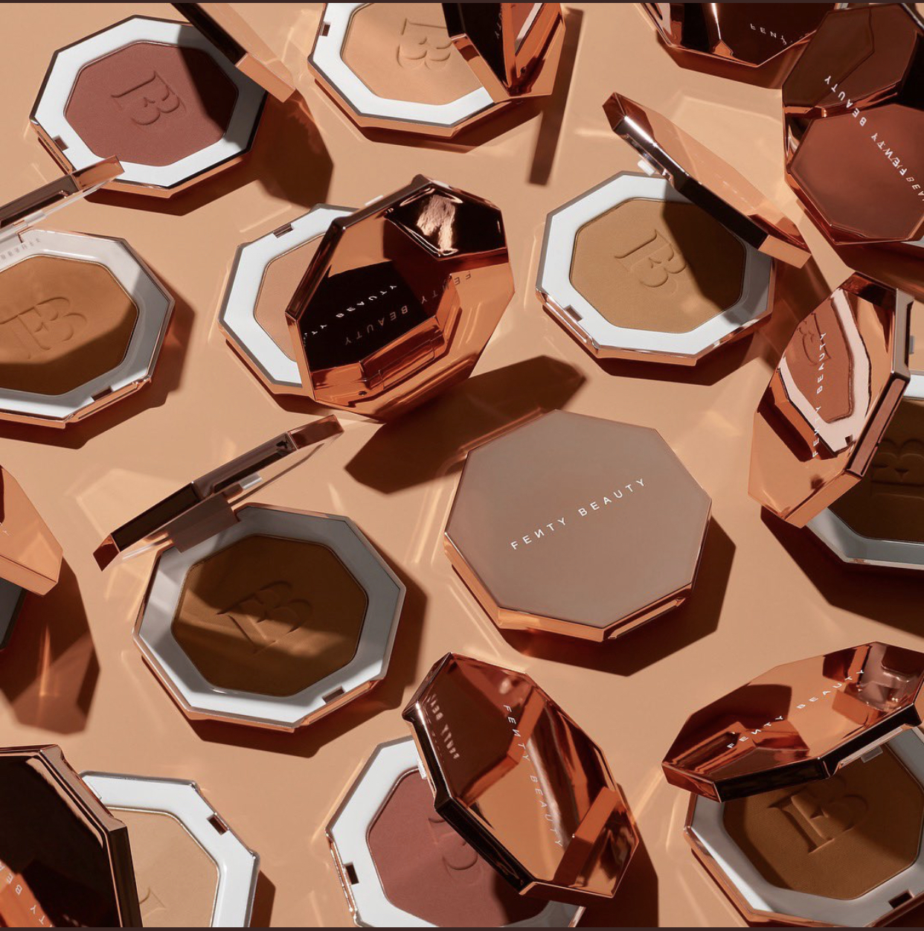
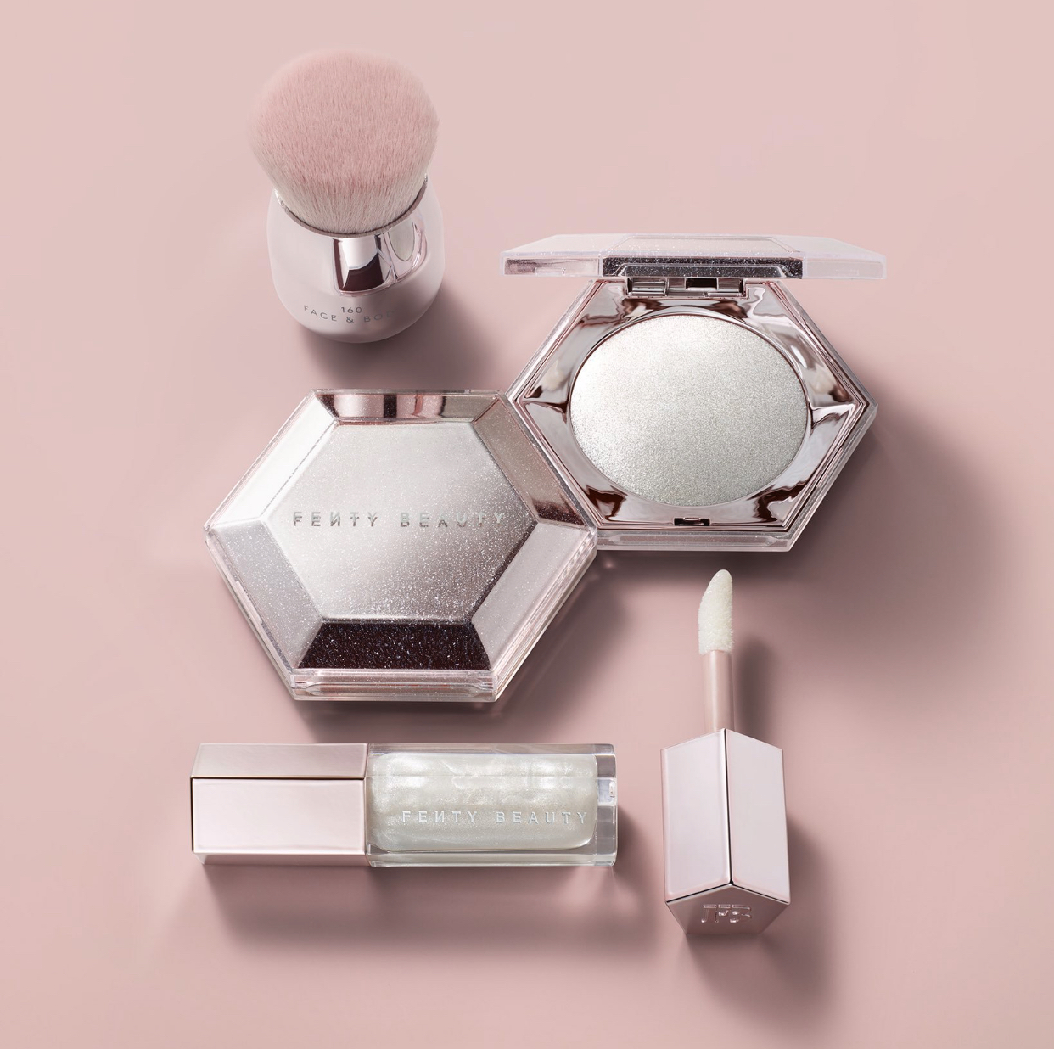
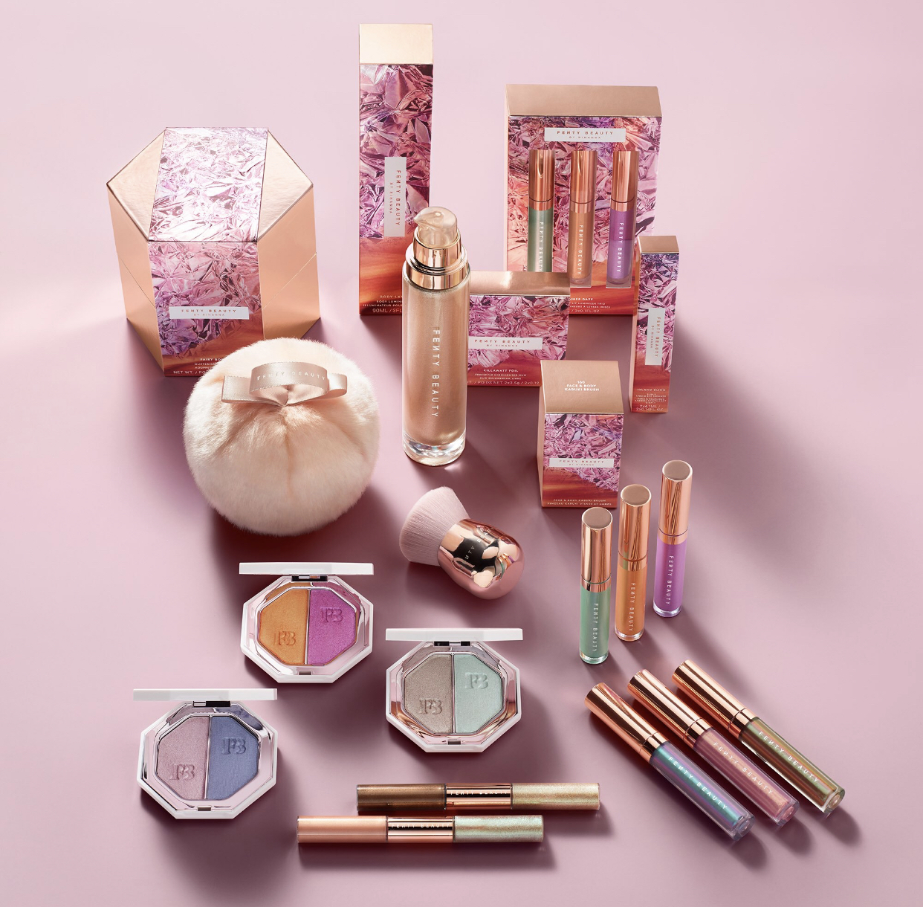
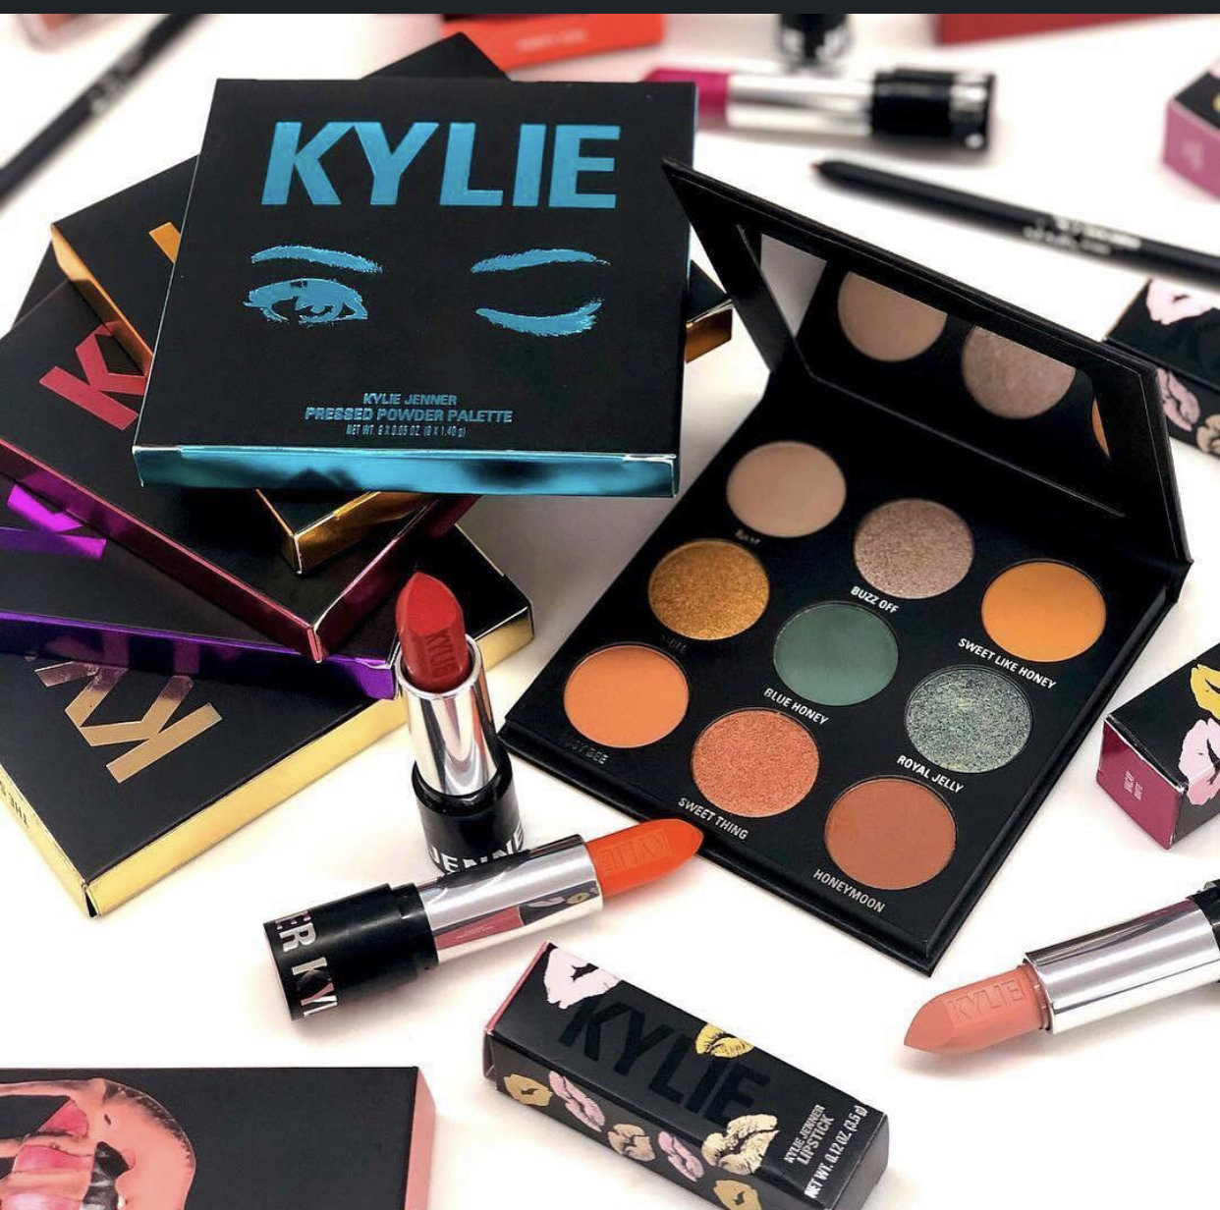
Social Media Marketing
Kylie cosmetics & Flenty Beauty

Slide 2
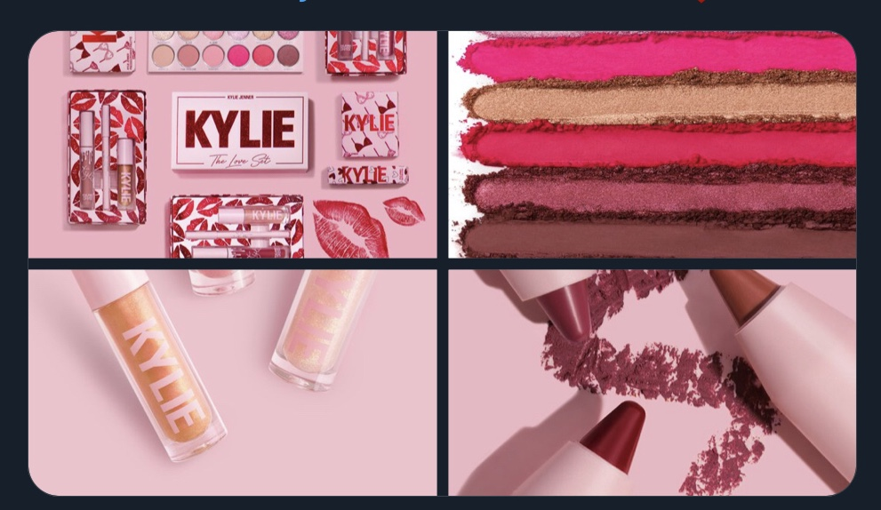
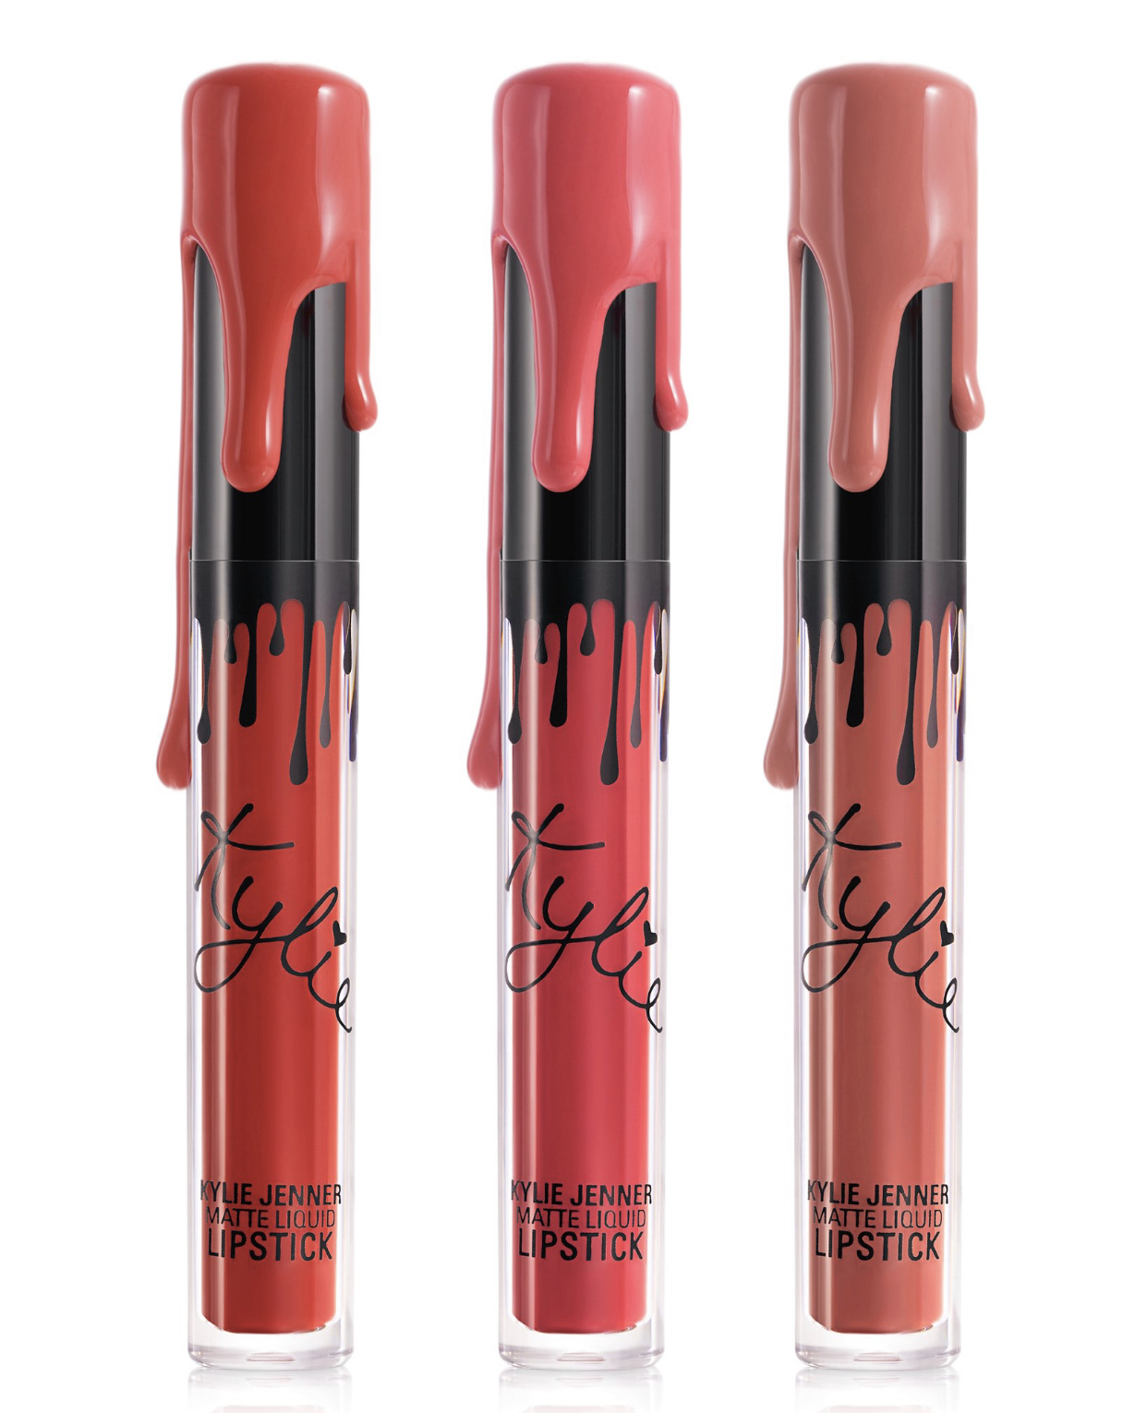
Kylie….
•Kylie cosmetics is one of the American companies of cosmetics founded by Kylie Jenner who is the owner.
The company was known as Kylie Lip Kits but it was renamed and called Kylie cosmetics
In 2016 after it released a set of lip liner and a liquid lipstick .
In 2014, Kylie signed with a company known as Seed Beauty to start producing debut products.
In 2018, the company had a Snapchat account that was followed most and it registered a total of 118 million followers on Instagram .
The company has a reputation of a company that is run and funded individually. The company depends majorly on social media for its marketing.

Slide 3
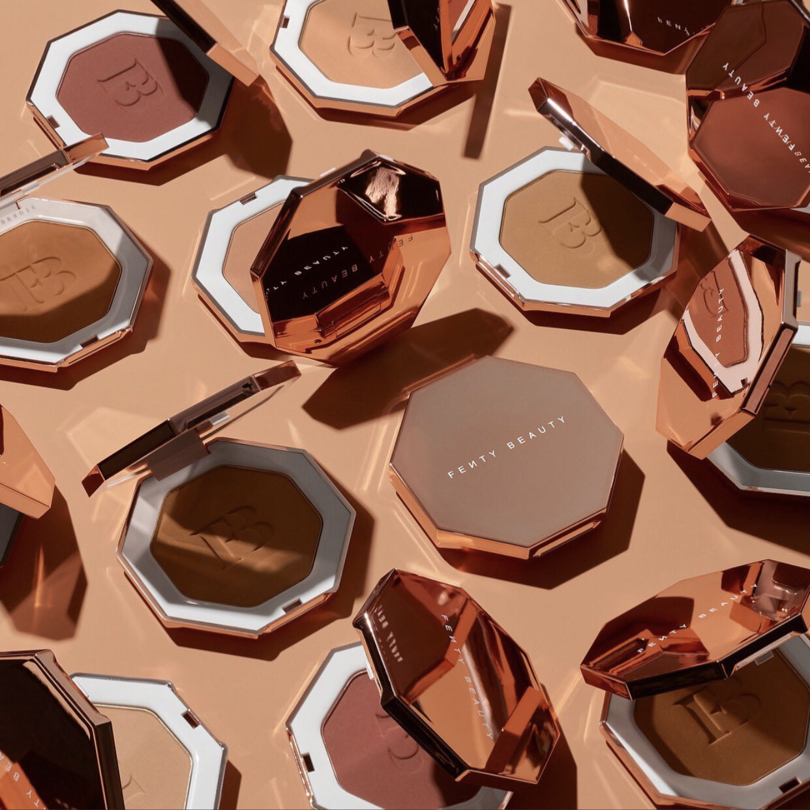
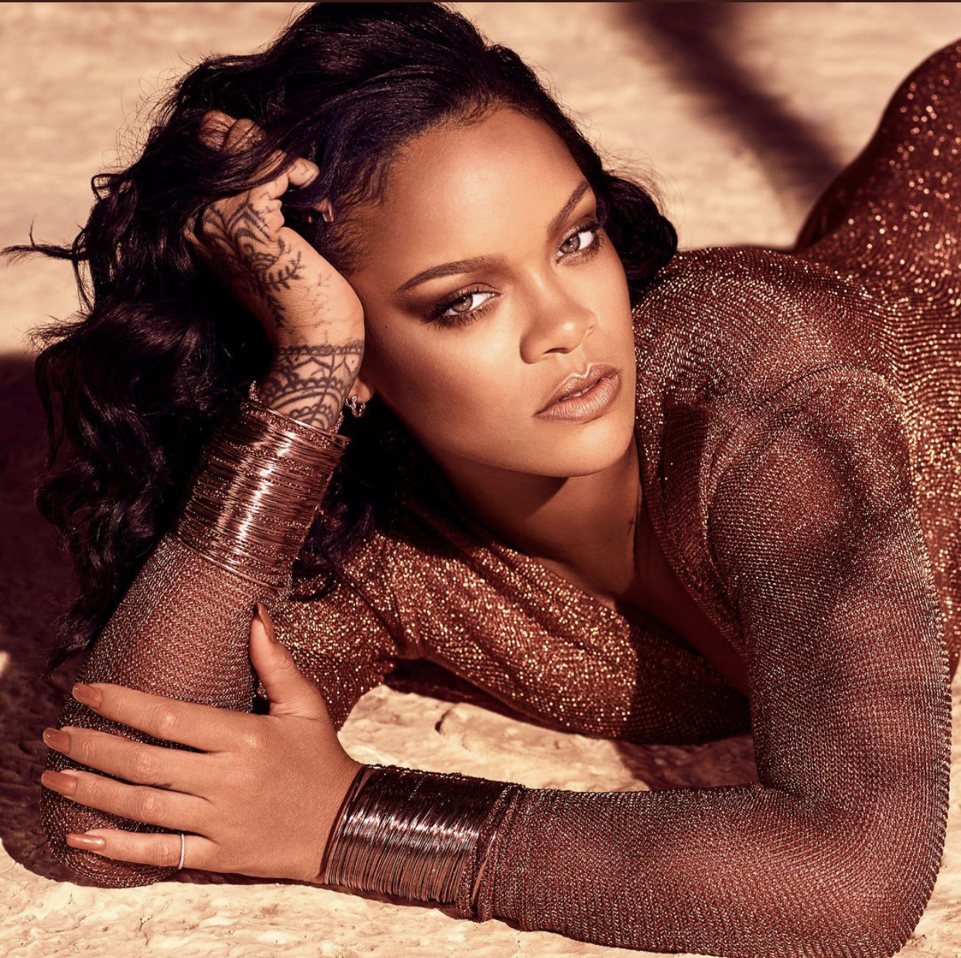
Fenty beauty…
Fenty beauty is a cosmetics brand that was launched by the famous singer Rihanna in 2017, September when she was 29 years old Fenty beauty was her first single brand of cosmetics because she had previously collaborated with MAC cosmetics.
She worked together with Louis Vuitton Moet Hennessey(LVMH)
by signing a deal in 2016 to start producing Fenty Beauty.
Rihanna coming up with shades offerings that are extensive for the users who have skin tones that are deeper The first products of Fenty beauty

Slide 4
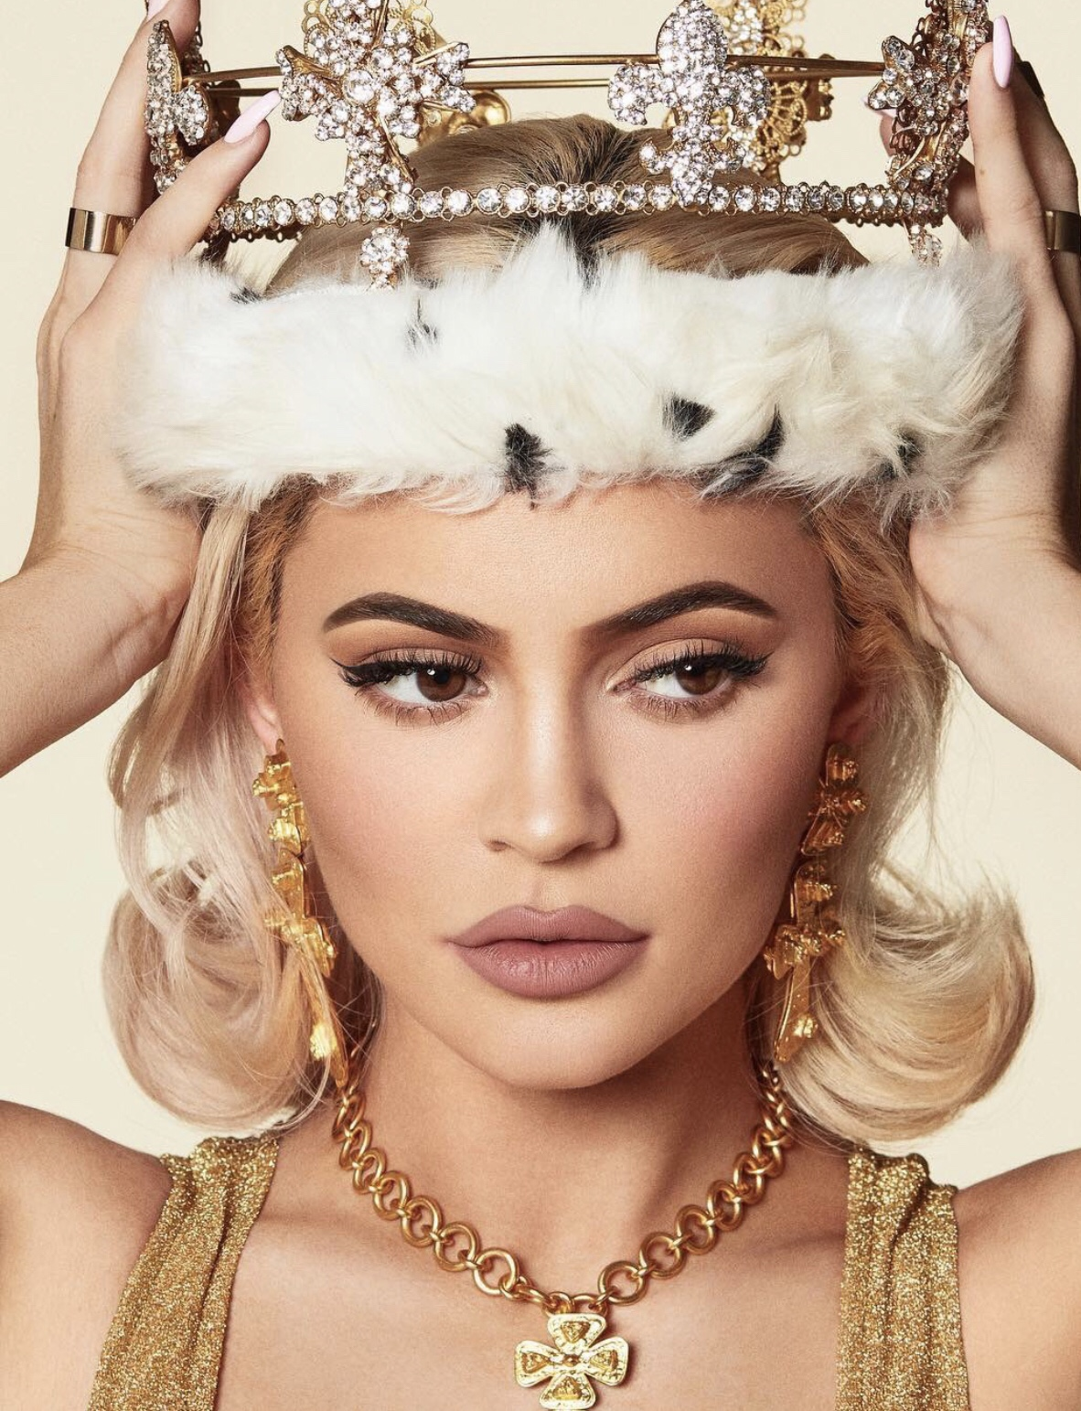
Kylie cosmetic,,
The company was concerned with the issues raised by customers..
changed its packaging style ..
And also customers complained that Kylie was copying Rihanna works on Fenty Beauty
Customers complained about the usage of provocative names on products of the company such as the blush collection that was named as Virginity and others Barely legal..A comparison of the Fenty Beauty company and Kylie cosmetics company is given on the different marketing strategies, the operations and products offered.

Slide 5
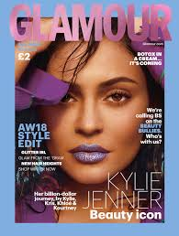
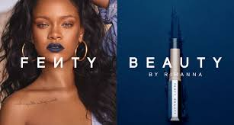
Comparison
Rihanna’s Fenty Beauty company is several steps ahead of Kyle cosmetics company in terms of sales though the Fenty company started a couple of years after Kylie’s.
sales of the year 2018:
Rihanna amounting 500million euros.
And Kyle amounting to 420 million dollars.

Slide 6
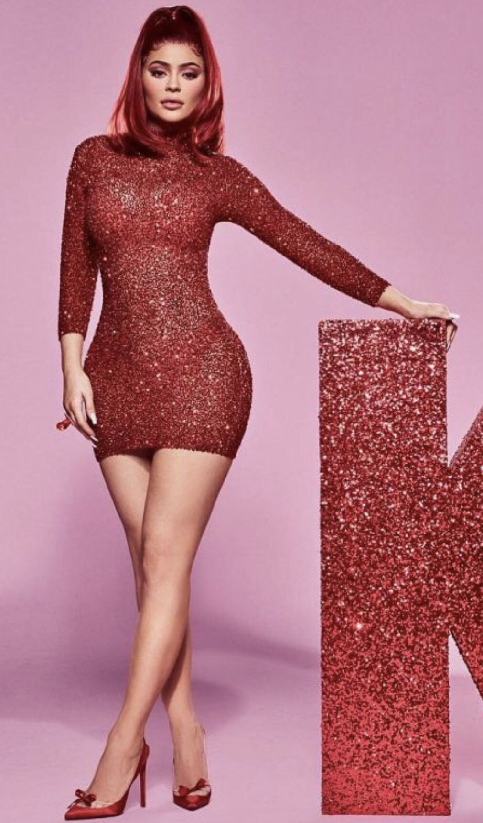
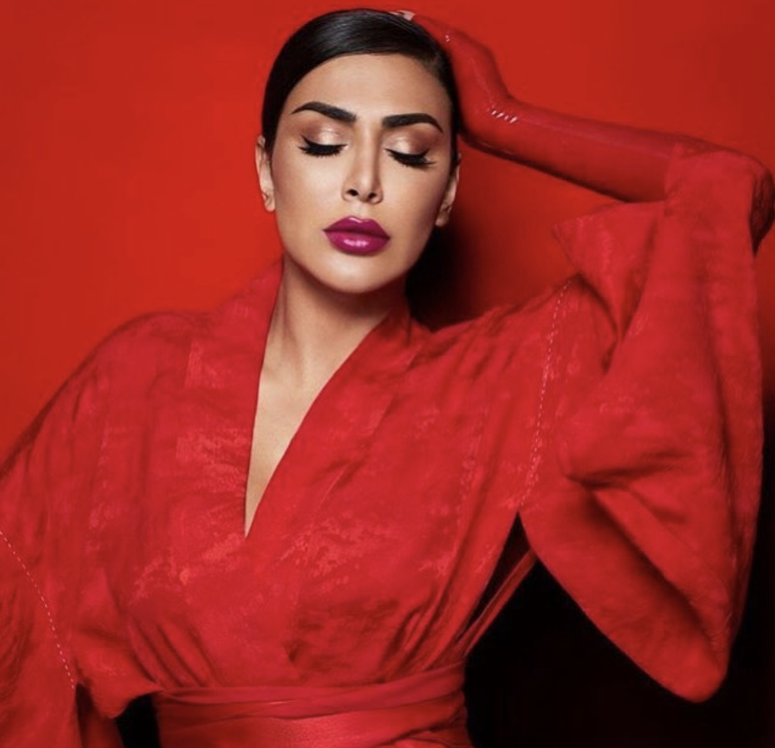
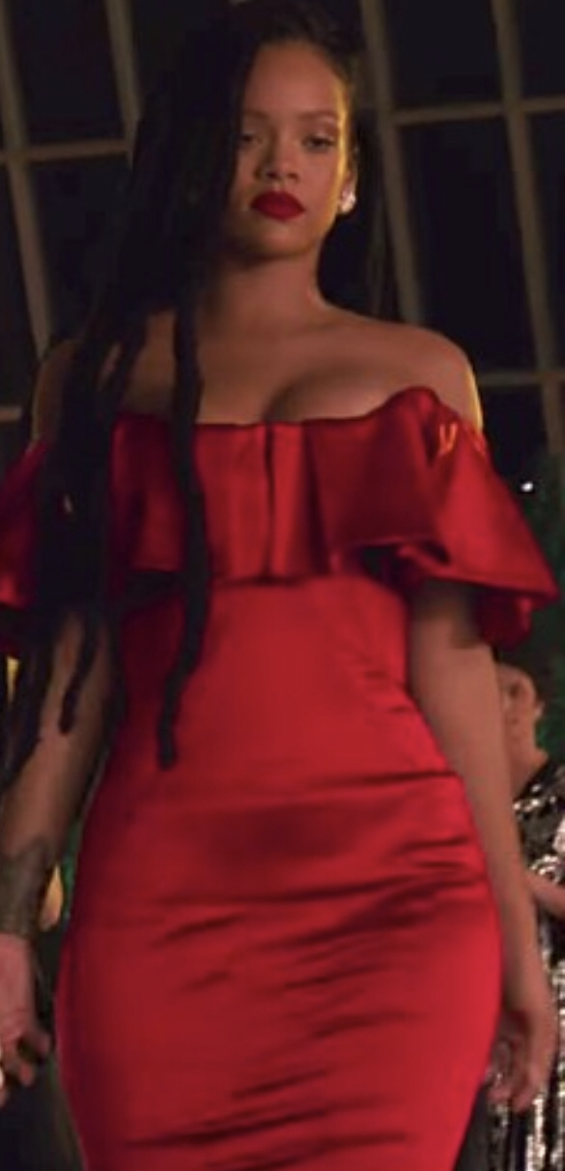
Comparison
It was dominant in the chatter in January 2019 . planning to buy Kendo brands with Kylie by companies such as Benefit Cosmetics and Huda Beauty.•
However, Kylie was dominant in cheek brands as 9.29% of social media users were planning to buy Kylie’s new blushes and bronzers.•
The two companies had no power in sales on social media such as
Instagram and Snapchat .

Slide 7

Solution….
Marketing strategies
Huda Kattan companies
The social platforms
Effectiveness Of social media
advertising’s social media
Benefits and limitations of using social media marketing.

Slide 8
Reference
Ismail, A. (2018). International Marketing Strategies in the Celebrity Cosmetics Industry: A Dual Case Study: Huda Beauty and Fenty Beauty.
DeBelen, B. (2016). Marketing Makeup: How Advertising Cosmetics Affects Consumers.
Hafiz, K. A., & Ali, K. M. (2018). Testing the Black Box’s model on cosmetic products: A psychological perspective. Journal of Fundamental and Applied Sciences, 10, 995-1007.
Walters, J. (2018). “FINALLY SOME DIVERSITY”: An exploration into the publics’ perceptions of the ‘Fenty Beauty’campaign in relation to how it challenges the lack of diversity in the mainstream Westernized beauty industry.
Ward, B., Ward, M., & Paskhover, B. (2018). Google trends as a resource for informing plastic surgery marketing decisions. Aesthetic plastic surgery, 42(2), 598-602.

