Slide 1
Emotional Intelligence and Leadership
WELCOME TO THE PRESENTATION

Slide 2
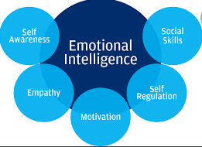
What is emotional intelligence leadership ?
Emotional intelligence in leadership is a leadership style with empathy, self awareness, social skills self regulation and motivation.
Emotional intelligence leadership helps build a better team
A leader using this style is more effective
This style involves the ability of a leader to identify and manage their emotions.
An emotionally intelligent leader has character, wisdom and spiritual and social intelligence.
I prefer to have emotional intelligence in my leadership so as to take care of the feelings of the others and create a situation where I will lead and others will follow.
Leadership style of choice?
.
My leadership style of choice is coaching

Slide 3

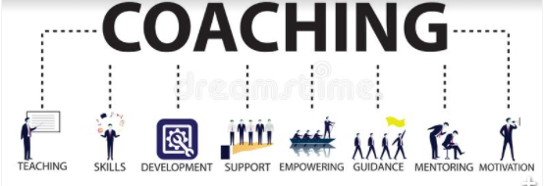
Coaching; My leadership style
Coaching is my preferred leadership style
Coaching involves collaboration, support, and guidance.
Coaching leaders are focused on bringing out the best in their teams by guiding them through goals and obstacles.
Coaching involves engaging with the employees to help them become better through self initiatives.
It is characterized by teaching, skills development, support, empowering, guidance, mentoring and motivation.

Slide 4
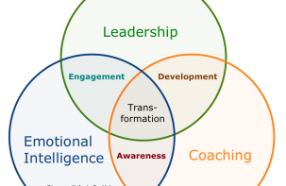
EMOTIONAL INTELLIGENCE
Coaching and emotional intelligence have many benefits on employees. Combining the two in my leadership of the med surg unit will yield benefits Highlighted below
Engagement- With emotional intelligence, I will give the employees an opportunity for engagement. This will help us understand each other better in the unit.
Development- Engagement and Motivation that comes with coaching and emotional intelligence will foster development of the employees knowledge and skills.
.
Awareness- Coaching involves challenging the employee to identify their strengths and weaknesses and make the best out of them and this increases their self awareness.
Transformation- Better engagement, staff development and increased self awareness helps achieve overall organizational transformation

Slide 5


Staffing and effective teamwork
EFFECTIVE TEAMWORK
Coaching as a leadership method will help achieve cohesive teamwork
Coaching involves one-on-one engagement sections where the employees are given an opportunity to identify their strengths and weaknesses.
With these engagements, bonding is created between the employees rather than imposing authoritative leadership which may demotivate the employee.
Coaching enables Working together as a team in the unit and this is an opportunity to bond more.

Slide 6
STAFFING
.
My staffing Model
Impact of Coaching as a leadership style
The staffing model I love best is The patient acuity model
I chose this model because it will help us to set appropriate staffing levels in acute care, long-term care and other treatment and rehabilitation setting
With this model., patients receive the care their health status demands.
Coaching as a leadership style will impact the unit through the following
Employee evolution
Employee Development
Self awareness
Motivation
Effective communication within the unit.

Slide 7
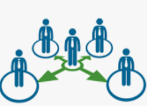
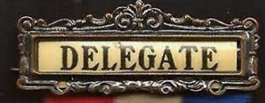
Delegation
My Coaching and delegation
Five rights of delegation
Coaching style of leadership enables good development of employees. This develops people who are competent to take over roles in acting capacity. It helps to develop leaders and therefore is appropriate.
I will utilize my coaching style to develop competent staff to delegate tasks to from time to time and to exercise the five rights of delegation.
Below are the 5 rights of delegation.
Right Task-Only appropriate activities should be delegated. Not all
Right Circumstances- Tasks should be delegated only under correct circumstances.
Right person- The right person should be identified before delegating tasks
Right communication/direction- it helps the person to whom tasks have been delegated to understand their role and scope.
Right supervision- After delegating, it is important to ensure proper supervision and guidance

Slide 8
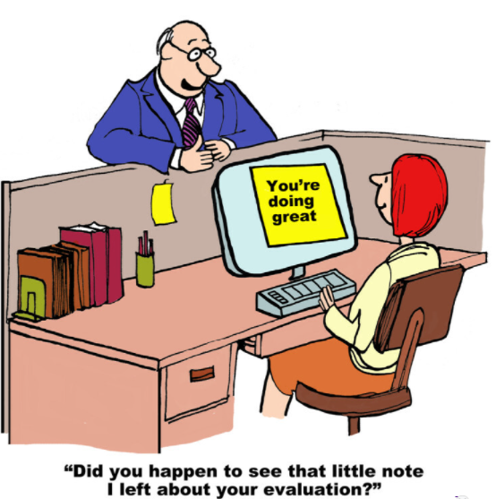
Evaluation of staff
Coaching will be fundamental im my evaluation of staff in the following ways
Increases employee and staff engagement and therefore I will know my staff better
Coaching helps get feedback from employees important in evaluation
Teamwork will keep my close to the team and in a position to understand them better.
Continuous assessment helps in evaluation.
Effective communication- which helps in faster access of employee information.

Slide 9

THANK YOU!
PRESENTER NAME

