Slide 1

A Comparative Presentation on Nelson Mandela & Martin Luther King Jr.
BY Taylor Davis

Slide 2
BIASES
What biases do I have as an African American female political science major from the deep south?

Slide 3


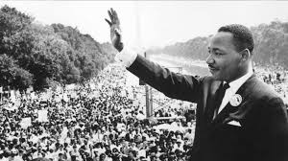
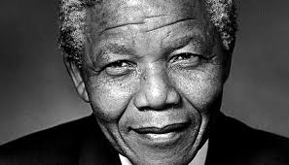
POLITICAL LEADERS
Martin Luther King JR.
Nelson Mandela

Slide 4
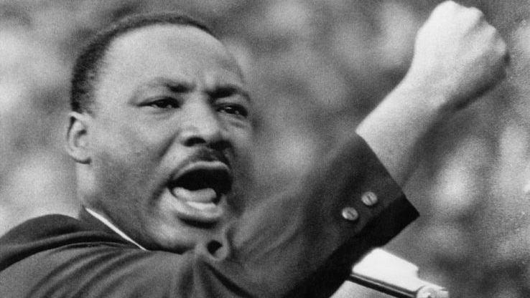
MARTIN LUTHER KING JR.
Early Beginnings & Family Life
-Born January 15, 1929 in Atlanta GA
-Family very involved in church
-Martin Sr. saw as racism ungodly & instilled racial equality in the King children
Education/Occupation
-Booker T. Washington High School
-Sociology Degree Morehouse College Atlanta GA (1948)
-Crozer Theological Seminary Chester PA (1951)
-Boston University Ph. D. (1955)
-Minister

Slide 5
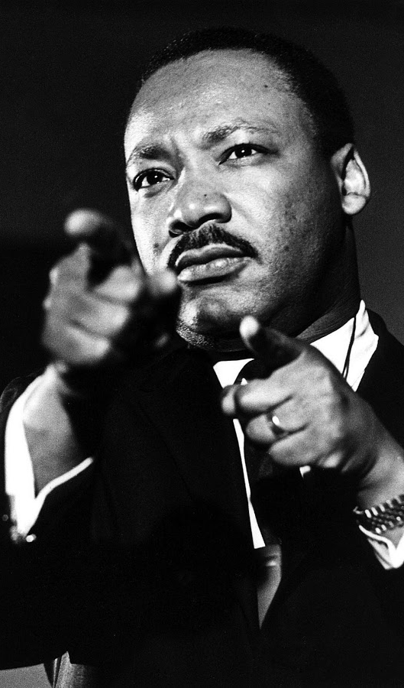
Martin Luther King Jr. Continued
Inspiration
Mahatma Gandhi –Non-Violent Activism
Thomas Aquinas-Natural Law Theory
Significant Contributions to Movement
“I Have a Dream Speech” (1963)
Letter from Birmingham Jail (1963)
Nobel Peace Prize Speech (1964)
Death
Assassinated April 4, 1968 in Memphis TN at the age of 39
Dr. Martin Luther King Jr. Day – National Holiday (1983)

Slide 6
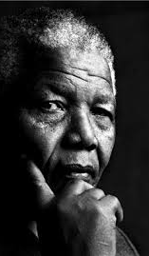
NELSON MANDELA
Early Beginnings
-Born July 18, 1918 in Transkei South Africa
-Rolihlahla means “troublemaker” in Xhosa but was renamed by his British school teacher
-Father was a chief but was stripped of title by British magistrate
-groomed to be a counselor for high office by his adoptive father
Education/Occupation
-British elementary school
-Clarkebury Boarding Institute/ Wesleyan College
-University College of Fort Hare
-Bachelor of Law Degree –University of London
-Lawyer

Slide 7
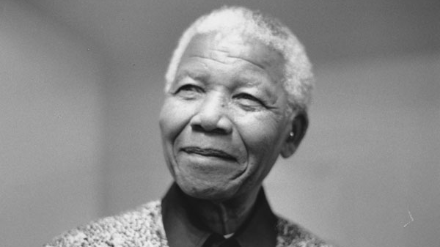
NELSON MANDELA Continued
Inspiration
The history of the African people
ANC Mentor Walter Sisulu
Significant Contribution to Movement
Unflinching resistance with over 27 years in prison
20 years of nonviolent activism
Law firm Mandela & Tambo
Nobel Peace Prize (1993)
Death
died December 5, 2013 at the age of 95
Internationally televised funeral

Slide 8

UNITED STATES OF AMERICA
-“Democracy”
-inequality and oppression
-Judicial system
-STATES Rights
-de facto laws

Slide 9
“Democracy”
-Built as a republic for white land-owning men
-Previously a colony of British government
-Known as the Land of Free, Home of the Brave

Slide 10
Inequality & oppression
lynchings
Discrimination in every part of life
Poll tax at voting booth
Leftover feelings from slavery & civil war
Kkk presence in the deep south
segregation of facilities
No upward mobility for minorities especially blacks
Plessy v Ferguson- separate but unequal doctrine

Slide 11
Judicial system
Dred Scott v Sanford – BLACK PEOPLE WERE NOT CITIZENS & COULDN’T SUE
Judicial system favored the white population
For a long time blacks were seen as citizen so there words in court were not valid
Slavery by another name- prisons turned into places for free labor
Black life was insignificant in the eyes of the court
Emmet till (1955)

Slide 12
Nation-state
The united states is a nation-state or a sovereign state whose citizens or subjects are relatively homogeneous in factors such as language, common descent or shared identity.
This was very important to the success of the civil rights movement

Slide 13
De facto laws
Segregation was synonymous to state rights to many on both sides of the issue
Even though these laws were enforced in the states they were unconstitutional
Little rock 9 (1957) – Dwight Eisenhower federalized the national guard to integrate little rock high school

Slide 14
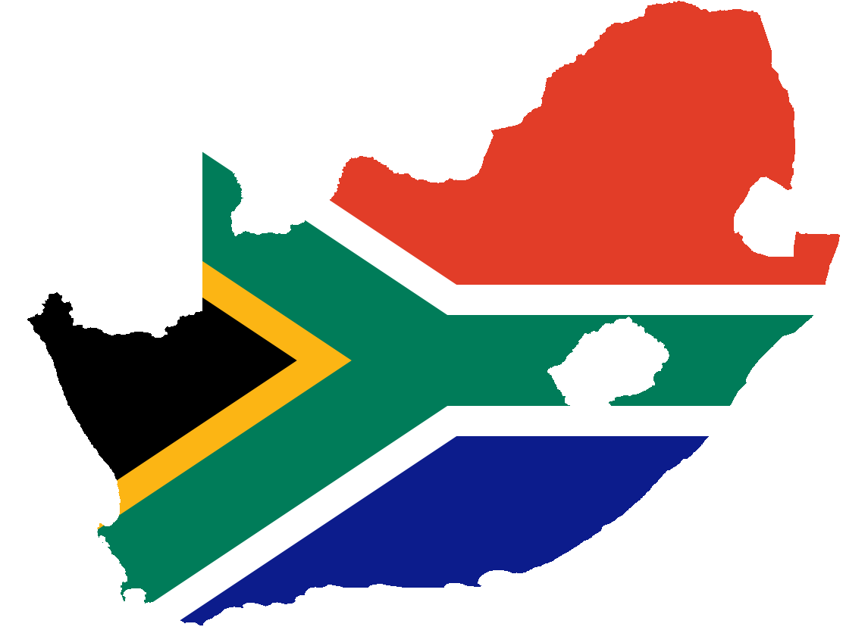
SOUTH AFRICA
-oligarchy
-Apartheid
-“NEOCOLONALISM”
-inequality and oppression
-judicial system

Slide 15
oligarchy
Oligarchy based on a minority ethnic group becoming the ruling class
Elitist approach to governance
The AFRICAN TRIBES WERE THE MASSES IN THE ELITIST MODEL
Unitary system- the power of the government was in the elite class

Slide 16
Apartheid
means apartness in the Afrikaans language
rising with white elites or “Afrikaans” coming to power
A system of institutionalized racism and discrimination from 1948-1991 in south Africa

Slide 17
“neocolonialism”
Previously a colony of Britain
Known for abundance of resources like diamonds & platinum
Marginalized the native people of South Africa and confined them to their tribes
Allowed the non-native Afrikaans to take control

Slide 18
Inequality & oppression
Jail time for activists
Discrimination in every part of life
Africans were mandated to carry “pass” books
Uprooted from home and forced to live in slums
No upward mobility for AFRICANS
separate development system to break ties between Africans and make revolt less likely

Slide 19
De jure laws
Discrimination & marginalization of the Africans were ingrained in the foundation of the country’s laws
Integration of the races was illegal or to be avoided at all costs
Segregation of public facilities
Nothing was “unconstitutional”

Slide 20
State made up of nations
SOUTH AFRICA HAD MANY TRIBES BUT NO REAL NATIONAL IDENTITY DURING APARTHIED
This made the resistance and political mobilization considerably harder for activists

Slide 21
Judicial system
the judicial system was skewed in the favor of whites or Afrikaans.
YOU COULD BE ACCUSED & FOUND GUILTY WITHOUT BEING PROPERLY REPRESENTED—NO DUE PROCESS
No political rights outside of tribe or Bantustan

Slide 22
CIVIL RIGHTS MOVEMENT of the 1960s
Beginnings
Political mobilization
Socialization agents
Demographics of the followers
Theories surrounding the movement

Slide 23
BEGINNINGS of the Civil Rights Movement in the united states
Harlem Renaissance
W. E. B. Dubois
Booker t. Washington
The great migration of the 1940s & 1950s
The growth of educated blacks
NEED FOR CIVIL RIGHTS & LIBERTIES AS AMERICANS

Slide 24
Agents of Socialization AS TACTICS FOR POLITICAL MOBILIZATION
THE BLACK CHURCH & RELIGION
THE MEDIA
SECRET SOCIETIES
FAMILY
CULTURE
NON-VIOLIENCE
CIVIL DISOBEIDIENCE
JAIL CROWDING
SELF-SACRIFICE
Militant groups

Slide 25
Demographics of followers
YOUNG COLLEGE STUDENTS
Those with higher levels education
WOMEN
FOLKS FOR GAY RIGHTS
BLACK CHURCH LEADERS
INTERNATIONAL FOLLOWERS FROM AROUND THE WORLD

Slide 26
Theories surrounding the movement
GHANDI’S IDEAS ON NON-VIOLENT PROTEST
AQUINAS’ IDEA ON An the natural law
THE IMPORTANCE OF ESSENTIALISM FOR MLK’s ARGUMENT
QUESTION OF MORALITY RATHER THAN PREFERENCE
HYPOCRITICAL NOTION OF “LAND OF THE FREE”

Slide 27
Anti-Apartheid movement 1951-1991
Beginnings
Political mobilization
Socialization agents
Demographics of the followers
Theories surrounding movement

Slide 28
Beginnings of the movement
The African national congress
The congress of the people’s charter (1952)- all Africans should be free
The influence of the civil rights movement of USA
NEED FOR CIVIL RIGHTS & LIBERTIES AS Africans

Slide 29
Agents of socialization as tactics for political mobilization
Coalitions of tribes or Bantustans
Consensus on civil rights/liberties
Media
Jail crowding
Non-violent protests
Secret societies
Militant groups

Slide 30
Demographics of followers
African people
White sympathizers
International followers
Lawyers & members of the african national congress

Slide 31
Theories surrounding the movement
Nonviolent protests
Civil disobedience
International embarrassment
Many v few
Essentialism as a victim of apartheid

Slide 32
LASTING EFFECTS of BOTH movements
Martin Luther king jr. day January 15
Face of civil rights movement
Helped to lift up not just blacks but other minorities like women, disabled or groups who don’t confirm to heteronormative standards
Mandela day July 18
Face of south african excellence
Became an international symbol of hope and influenced many political leaders during his lifetime

Slide 33
Interesting facts
In the civil rights movement religion was a very important agent of socialization for and against the movement
  In his letter from the Birmingham jail king criticizes the white religious leaders for being reluctant in endorsing his campaign for civil rights. To king their adherence to the bible and teachings of Christianity meant they must be for equality and anything else is against their own teachings.
  Many black people used their faith in times of strife and turmoil; the black church was a place to excel and uplift

Slide 34
Interesting facts continued
Although nelson Mandela first begin with non-violent protests he did threaten armed struggle between the Afrikaans government and the African national congressional army after his release in 1990.
Nelson Mandela was outspoken with his disagreement of the invasion of iraq in 2003.

Slide 35
Other topics
USA & South Africa RELATIONS DURING THESE TIMES
MANDELA’S APPROACH TO USA as president of south Africa
Un assembly denouement of apartheid
Nelson Mandela & Obama's relationship

Slide 36
REFERENCES
https://www.biography.com/people/martin-luther-king-jr-9365086
http://www.history.com/topics/apartheid
https://www.biography.com/people/nelson-mandela-9397017
https://www.geteverwise.com/mentoring/meet-the-mentor-who-inspired-mandela-to-inspire-millions/
http://www-cs-students.stanford.edu/~cale/cs201/apartheid.hist.html
https://web.cn.edu/kwheeler/documents/Letter_Birmingham_Jail.pdf

