Slide 1
Dakota &
Cameroon-Chad Pipeline Projects
Chase Pope

Slide 2
Research objectives
Detail and compare the Dakota Access Pipeline with the Chad-Cameroon Petroleum Development and Pipeline Project, highlighting three separate political science concepts relevant to the events of the projects.
  Elite Public Policy Approach
  Political Action
  NGOs & IGOs

Slide 3
Chad-Cameroon Petroleum Development and Pipeline Project
Exploration of oil wells in Chad began in 1975, but were stalled due to a civil war in 1981.
In 1988, the framework of the oil pipeline began to take place.
Major partners in the project included Shell, Elf, and ExxonMobil with the Chad government signing on.
The corporate parties spent the next 12 years slowly building the oil fields in Doba, Chad, with companies Shell, Petronas, and Chevron eventually leaving by 2000 due to controversy and issues with the speed of progression.

Slide 4
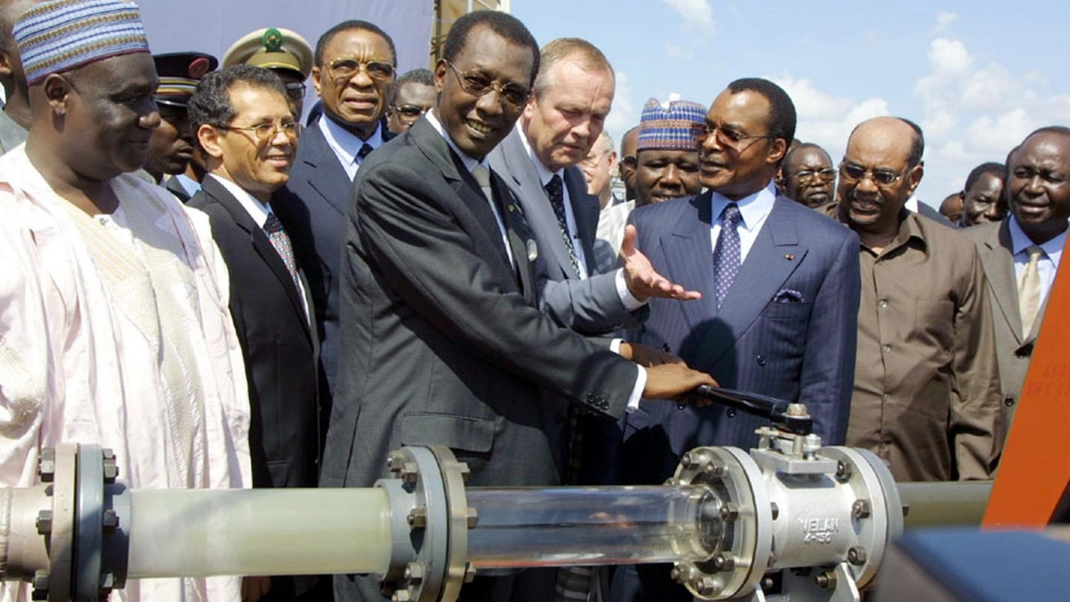
Cameroon’s Involvement
Chad being a landlocked country, they sought out the partnership of neighboring coastal state, Cameroon.
Cameroon is among the poorest, and less developed nations in the world. With oil discovered in Chad, the governments of both saw an opportunity to increase the economic growth of each nation.
Without Chad having the geographical advantage Cameroon does, the pipeline project’s goal was to transport oil from the Doba oil fields to an offshore storing facility off the coast of Cameroon called the FSO (floating storage and offloading).

Slide 5
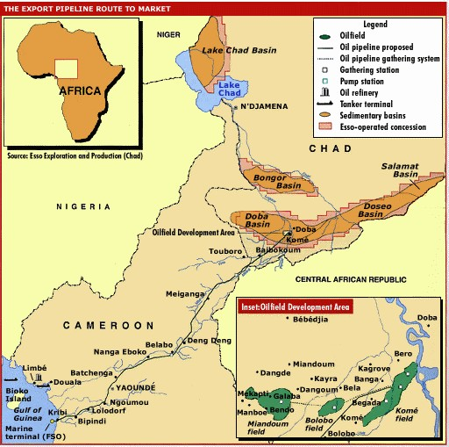
The Layout
The pipeline stretches from the oil fields in southern Chad, to the seaport of Kiribi, Cameroon.
Costing $3.7 billion, the total length of the transnational pipeline is approximately 650 miles.
The project sough out to produce 225,000 barrels of oil a day, and the construction of marine pipeline from the port of Kiribi, Cameroon to an offshore, floating storage vessel.
The pipeline was officially operational since 2003.

Slide 6
Dakota Access Pipeline (DAPL)
In 2014, a Dallas based natural gas and propane company applies to the United States government to build a pipeline.
Other partners include oil and gas companies like Phillips 66, Sunoco, Enbridge, and Marathon.
The construction of the build is will incorporate a $3.78 billion, 1,168 mile long pipeline from shale oil producing facilities in western North Dakota, to storage farms in Patoka, Illinois.
The pipeline can transport as much as 450,000 barrels of oil a day, with future expansion capable of possibly up to 570,000 barrels.
Can supposedly provide a safer way to transport crude oil than rail or public roadway.

Slide 7
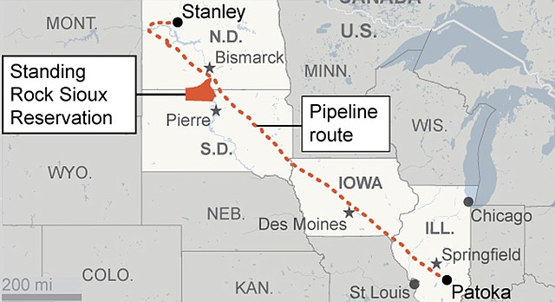
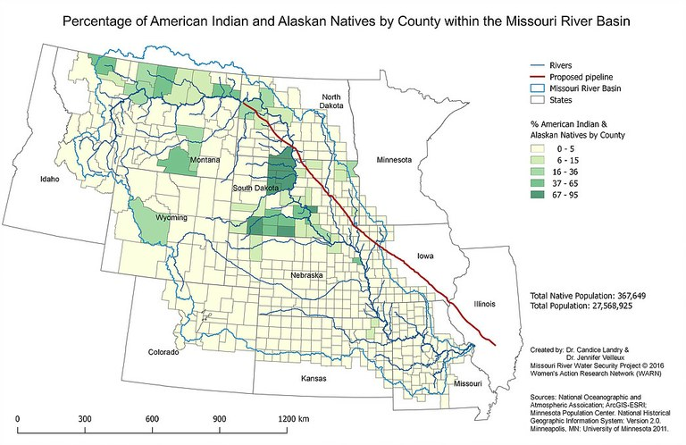
DAPL Geography
Beginning at pumping facilities around Stanley, North Dakota crude oil is pumped along almost 1,200 miles of pipeline to be stored in Patoka, Illinois.
Along with government concerns, large Native American populations are present around the northern parts of the pipeline’s development.
Predominately Sioux tribal communities in north Dakota are leading the protests and resistance to the pipeline’s operation.
These communities cite intrusion to burial and sacred sites, as well as the borders of their reservations.
Issues of eminent domain taken by the federal government for the use of the corporations, have also complicated the construction of the pipeline.

Slide 8
The Pipelines and the Elite Approach
The elite approach separates populations into “strata” that are based upon each groups level of power in society.
This approach separates them into the ruling elite, the understructure, and the mass of the general population.
C. Wright Mills defines three distinct elite backgrounds that comprise the elite class:
  The “military warlords”
  The “corporate chieftains”
  The “political directorate”

Slide 9
Elite Approach - DAPL
The government involvement in the development of the DAPL began to soften with the Trump administration taking office.
In order for the Elite to successfully achieve their goals, they must find way to influence public policy.
In the case of the DAPL and Chad-Cameroon, the elite take the form of Mill’s “Corporate Chieftain”, with understructures being
The understructure would be the American government and political system.
In order for the elite to profit from the DAPL, policy needs to favor their construction and development of the pipeline.

Slide 10
Elite Approach - DAPL
The goal of the understructure is to remain in power, and to do so requires some measure of support.
Kelcy Warren, CEO of Energy Trading Partners, has at least a recorded amount of $100,000 in donations to then Presidential candidate Donald Trump between July and October of 2016.
In order for the DAPL to built, administrators need to be supported.
This also in turn creates a relationship by which the understructure feels obligated to assist the supporting elite for the survival of their political career.

Slide 11
Elite Approach - DAPL
ETP/Kelcy Warren
“Corporate Chieftains”
Campaign donations and support.
President Donald Trump Candidacy/Administration
Political promises given to the public.
Public Approval
Civilian Voting Population

Slide 12
Chad-Cameroon Pipeline – Elite Approach
Both Chad and Cameroon have poor infrastructures, and do not really have the capabilities to direct funds to the needs of the impoverished.
The ability for citizens to change their government in both countries is also largely nonexistent.
As the elite approach would suggest, the masses have very little influence over the actual governance of their country.

Slide 13
Chad-Cameroon Pipeline – Elite Approach
Instead of using the power of the elite class to push back obstacles of policy, they instead seek to bolster the security of the elite class. Pushing the masses out of the way for their own profit.
Chad’s President, Idriss Deby, supposedly spent around $4.5 million of the “signing bonus” granted by the oil companies, towards weapons for security forces.
Cameroon has also been considered one of the most corrupt nations in the world. Transparency International ranked it as the most corrupt in 1999.
Furthermore, Cameroon has neglectfully internally displaced native peoples, and historic sites, along the path of the pipeline.

Slide 14
Chad-Cameroon Pipeline – Elite Approach
Money for development of land.
Oil & Gas Companies
Profit from oil production and trade.
Continue to allow access to land for development.
Corrupt Officials and Military Officers
Money withheld from public.
Poverty continues.
Weapons funded by elites used against political opposition
Oppressed & Displaced Citizens

Slide 15
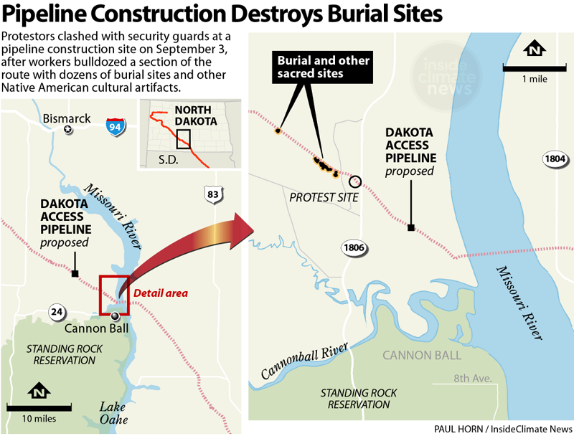
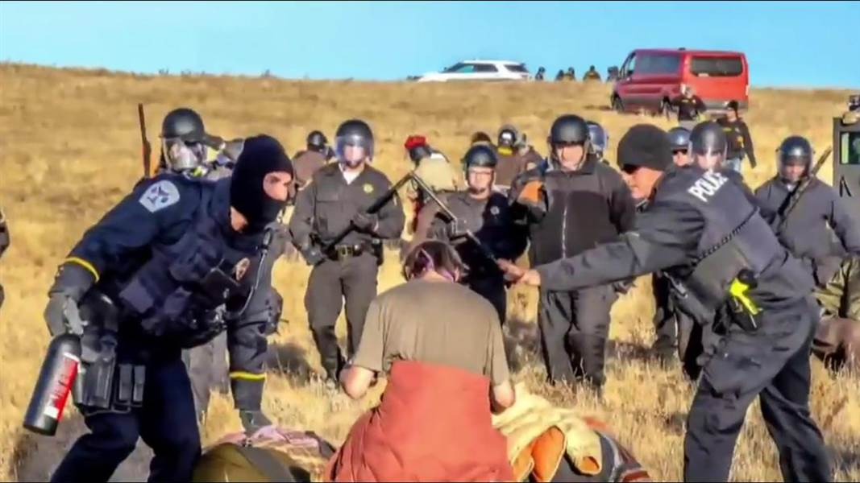
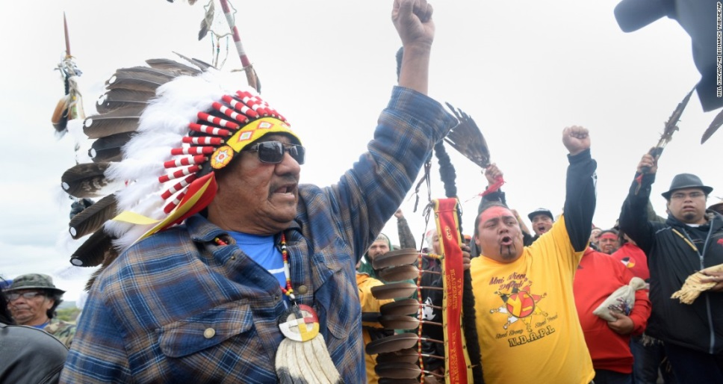
Political action- DAPL
The Dakota Pipeline Project caused a very public controversial debate among Americans.
Particularly the concerns of Native American infringement, environmental threat, and concerns of eminent domain taking farmland away from locals for the use of the pipeline.
The protests of which sparked many human rights complaints and issues.
Most forms of public activity took the form of unconventional political action such as protesting at sites of contention, However, online campaigns and activity in political groups also were examples of more conventional methods.

Slide 16
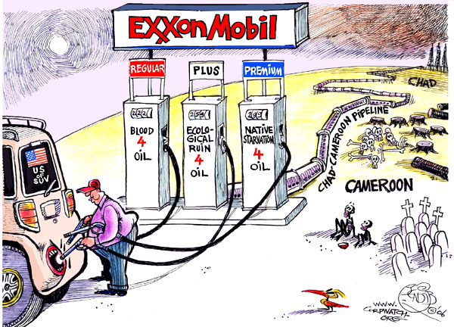
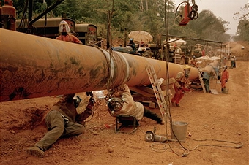
Political action– Chad-Cameroon
Similar to the DAPL, native populations such as the Bagueli people were internally displaced.
Much of their home territory is in the jungles of Cameroon, cut through by the construction of the pipeline.
Many important environmental areas would be touch by the pipelines construction. One of which is the Sanaga River, an important water supply in Africa.
The coastal town of Kiribi, in which the oil pipeline unloads to a marine terminal, is reliant on a small fishing industry. But, it threatened by the pollution and ecological disruption of the pipeline.
With a supposedly low 0.002% chance of leakage, at 225,000 barrels of oil today that leaves the chance of 2,000 barrels being leaked unnoticed.

Slide 17
Political action– Chad-Cameroon
With much of the population being suppressed by the elite, very few options were available for the public to political participate.
Instead, many single issue-activists like environmentalists and other political foot soldiers came to aid through international campaigns and monitorization.

Slide 18

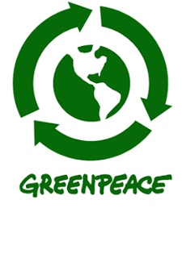

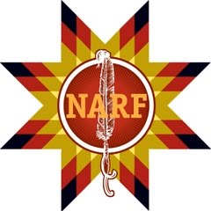

NGOs & IGOs
Many different kinds of international groups are involved in both pipeline projects.
Both Intergovernmental organizations (IGOs) and Non-governmental organizations (NGOs), as well as act as major brokers of planning, funding, and criticism.
IGOs were more common in Africa, as more financial assistance and economic planning was need for the underdeveloped nations than in the US.

Slide 19
NGOs & IGOs
These groups participated in numerous types of support for each situation, especially since the relationship between the corporate entities and state administrations may focus on different concerns than that of their civilian populations.
In Africa, groups such as the Catholic Relief Services served as watch dog warning against environmental degradation and addressing human rights concerns with the Chad-Cameroon Pipeline.
In the US, NARF (Native American Rights Fund), provided assistance to the Sioux communities seeking legal recourse for the conflict of the DAPL.

