Slide 1
Effects of Parasocial Relationships on Adolescents Emotional Interpersonal Abilities
Student’s Name
Institutional Affiliations
Date

Slide 2

Justification
Advancement in technology has resulted in significant parasocial interaction among high school students
The interactions influence adolescent’s growth behaviors when dealing with the changing situations
Typical American adolescent uses over one hour in social media every day (Bond, 2016)
The study aims to explore the consequences of parasocial relationship development and impacts on adolescents’ emotional interpersonal abilities
The topic is important because social media has added another level of interaction among celebrities and adolescents
Social cognitive theory is used because it explains the influence of individuals experiences
Notes:
The world continues to advance technologically and this results in another level of interaction among the audience and the media figures. This relationship is referred to as a parasocial relationship and is always one-sided because hence can easily influence an adolescent’s development, function and maintenance. High school students are always involved in social media because as stated by Bond (2016), American adolescents spend more than one hour on social media every day. This can interfere with their behavior and interpersonal abilities. The qualitative study will aim in exploring the effects of PSR on adolescents’ emotional interpersonal abilities. The topic is essential because social media has added another level of interaction between celebrities and adolescents and needs to be examined on how it affects their interpersonal capabilities. Therefore, the social cognitive theory will help in explaining the topic.

Slide 3
Literature Review
Parasocial interactions are particularly predominant in the social network landscape (Yuan et al., 2019)
Organizations have realized the effects of PSI on adolescents hence using it in marketing procedures
Fictional social interactions are improbable in intervening physical relationship which is important in social growth (Gleason et al., 2017)
When an individual is involved in the PSI context it intends to developed imagination (Dibble et al., 2016)
Bond (2020) argued that PSI is the foundation of prejudice decrease because of the experience it creates on arbitrated outgroups
Cohen et al. (2021) found that likeability and PSI go are bound together because people may dislike their media figure
Parasocial experiences are created by ego since it develops a connection with media figures (Riles & Adams, 2020)
Notes:
Parasocial interaction indicates how the audience relates with their media figures. Therefore, as stated by Yuan et al. (2019), PSI is prevalent in the social network landscape such as Twitter, Instagram and Facebook. Most adolescents are on these social media sites. Considering that companies have recognized the impacts of PSI on adolescents they have used it in promoting their products especially fashion designs. Similarly, another research by Gleason et al. (2017), claimed that fictional social interactions are developed by PSI which is unconvincing in intervening physical associations that are essential in social development. however, Dibble et al. (2016) suggested that PSI is intended to bring an imagination to the individuals when they are involved in the context making them feel as if they are in a real relationship. Also (Bond, 2020) added that PSI creates a ground for reducing prejudices as it develops a critical experience for the other group. Although people can dislike that celebrity they are attached to and detach from those they love, likeability and PSI are always together (Cohen et al., 2021). Similarly, it is found that Parasocial experiences are developed by ego because it creates an association with media figures (Riles & Adams, 2020).

Slide 4
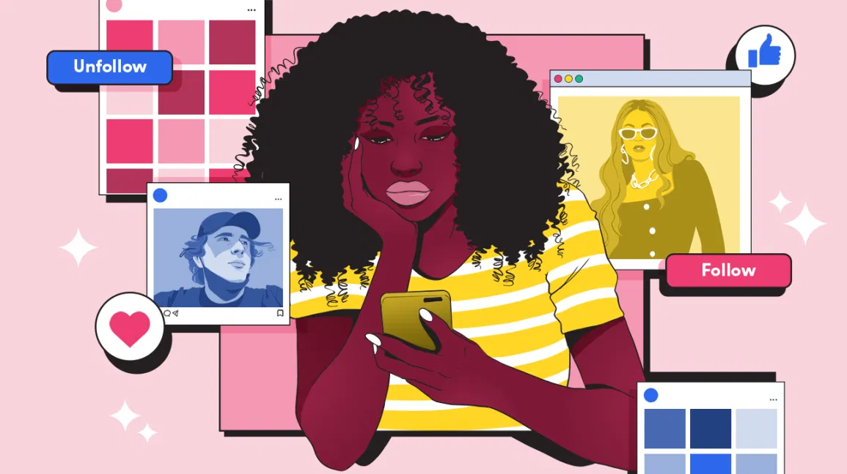
Literature Review Cont.
YouTube has formed a critical platform for adolescents to present their emotional abilities by opening their channels and create videos (Kurtin et al., 2018)
The research is supported by Rihl & Wegener (2019), that individuals can upload videos in Youtube comment and interact the same way they do physically
Stehr et al. (2015) claimed that PSI influences individuals political view because they tend to follow the viewpoint of their parasocial leader
Political PSR has effects on adolescents because it provides them with partisan acquittance in supporting certain policies (Cohen& Holbert, 2018)
Erickson et al. (2018), stated that interactions with celebrity offer a platform for adolescents to discover and express their romantic and stimulating characters
Strong PSR among adolescents results in a robust breakup when the celebrity is involved in a scandal (Hu, 2016)
Ellithorpe & Brookes (2018) found that experiencing spoilers and confidence increases pleasure and decreases parasocial breakup
Notes:
Social media plays an essential role in PSI development. Kurtin et al. (2018), used YouTube as an example indicating that it creates a stand for teenagers to express their emotional abilities and attitudes towards life. However, Rihl & Wegener (2019) emphasized that teenagers will have to first create a YouTube channel and to allow them to upload videos and interact through comments. Also, Stehr et al. (2015) argued that PSI affects people’s political perception since they tend to agree with their celeb leaders. This argument was supported by Cohen& Holbert (2018) that political PSR influences teenagers as they offer them artisan knowledge. romantic attachments are also part of the effects of PSI as stated by Erickson et al. (2018) because teenagers can realize and express their romance. However, strong PSR has direct effects on teenager’s breakup when the celebrity is involved in a scandal (Hu, 2016). Similarly, Ellithorpe & Brookes (2018) added that experiencing spoilers and confidence increases pleasure and reduces parasocial breakup especially when the movie film has ended.

Slide 5
Methodology
The qualitative research method will be used in this study because data collected will be based on participants views
Qualitative surveys will be used to collect data by developing a google form and present to participants to fill
316 students from Dorman High School will answer the google forms to ensure diversity and enough sample population
The google form questionnaire had three parts namely first part; general questions, second focused on measuring emotional aspect and the third on the interaction aspect
Research Question: How does interaction in a personal relationship with media celebrities impact adolescents’ emotional, interpersonal abilities?
Notes:
The study used a qualitative research method and data was collected online through the use of google forms. Online collection of data was essential to allow as many participants as possible to participate in the study. Similarly, Dorman High School was selected because of its diversity in population and geographic location because it is the situation in the middle-income region where participants involved would yield the best results. The sample population was 316 students of varying gender. Almost all races were included in the study. The qualitative survey questions comprised of three parts, one focused on the general life of a teenager with the use of different media sources and the second part focused on the interaction abilities with their favorite media celebrities and finally the emotional abilities. The research question to be answered is: How does interaction in a personal relationship with media celebrities impact adolescents’ emotional, interpersonal abilities?

Slide 6
Data Analysis and Conclusion (Findings)
75% of students spend more than two hours on social media and other streaming sites in a day
20% spend between 1-5 minutes on television and 50% uses an average of 30 minutes
10 media celebrities were frequently reported to be favourite among the participants
All participants reported to be on at least one social media site and followed their favourite celebrity in at least one media site
75% reported viewing their favorite celebrities to be similar to themselves and 62.5% feel connected with their media figures
A small fraction is used on my phone/ computer | 2%
I spend most of my time on phone/computer | 58%
All of my time is used on phone/computer | 23%
Almost half of the time is used on computer/phone | 17%
Notes:
The findings of the study answered the research questions in different ways. Therefore, 75 per cent of the teenagers reported using more than two hours in media channels such as social media and other streaming sites. Moreover, the study also found that twenty per cent of the participants used between one to five minutes on traditional media channels such as television while the other fifty per cent spend at least thirty minutes. Favourite celebrities were many but ten were reported frequently including Remi Badder and Kevin Gates. While students followed their celebrities on social media and liked to watch them on television 90% followed the celebrity on Twitter. Also, the interaction occurs when the majority of the students viewed their celebrities as themselves and felt connected with the media figure.

Slide 7
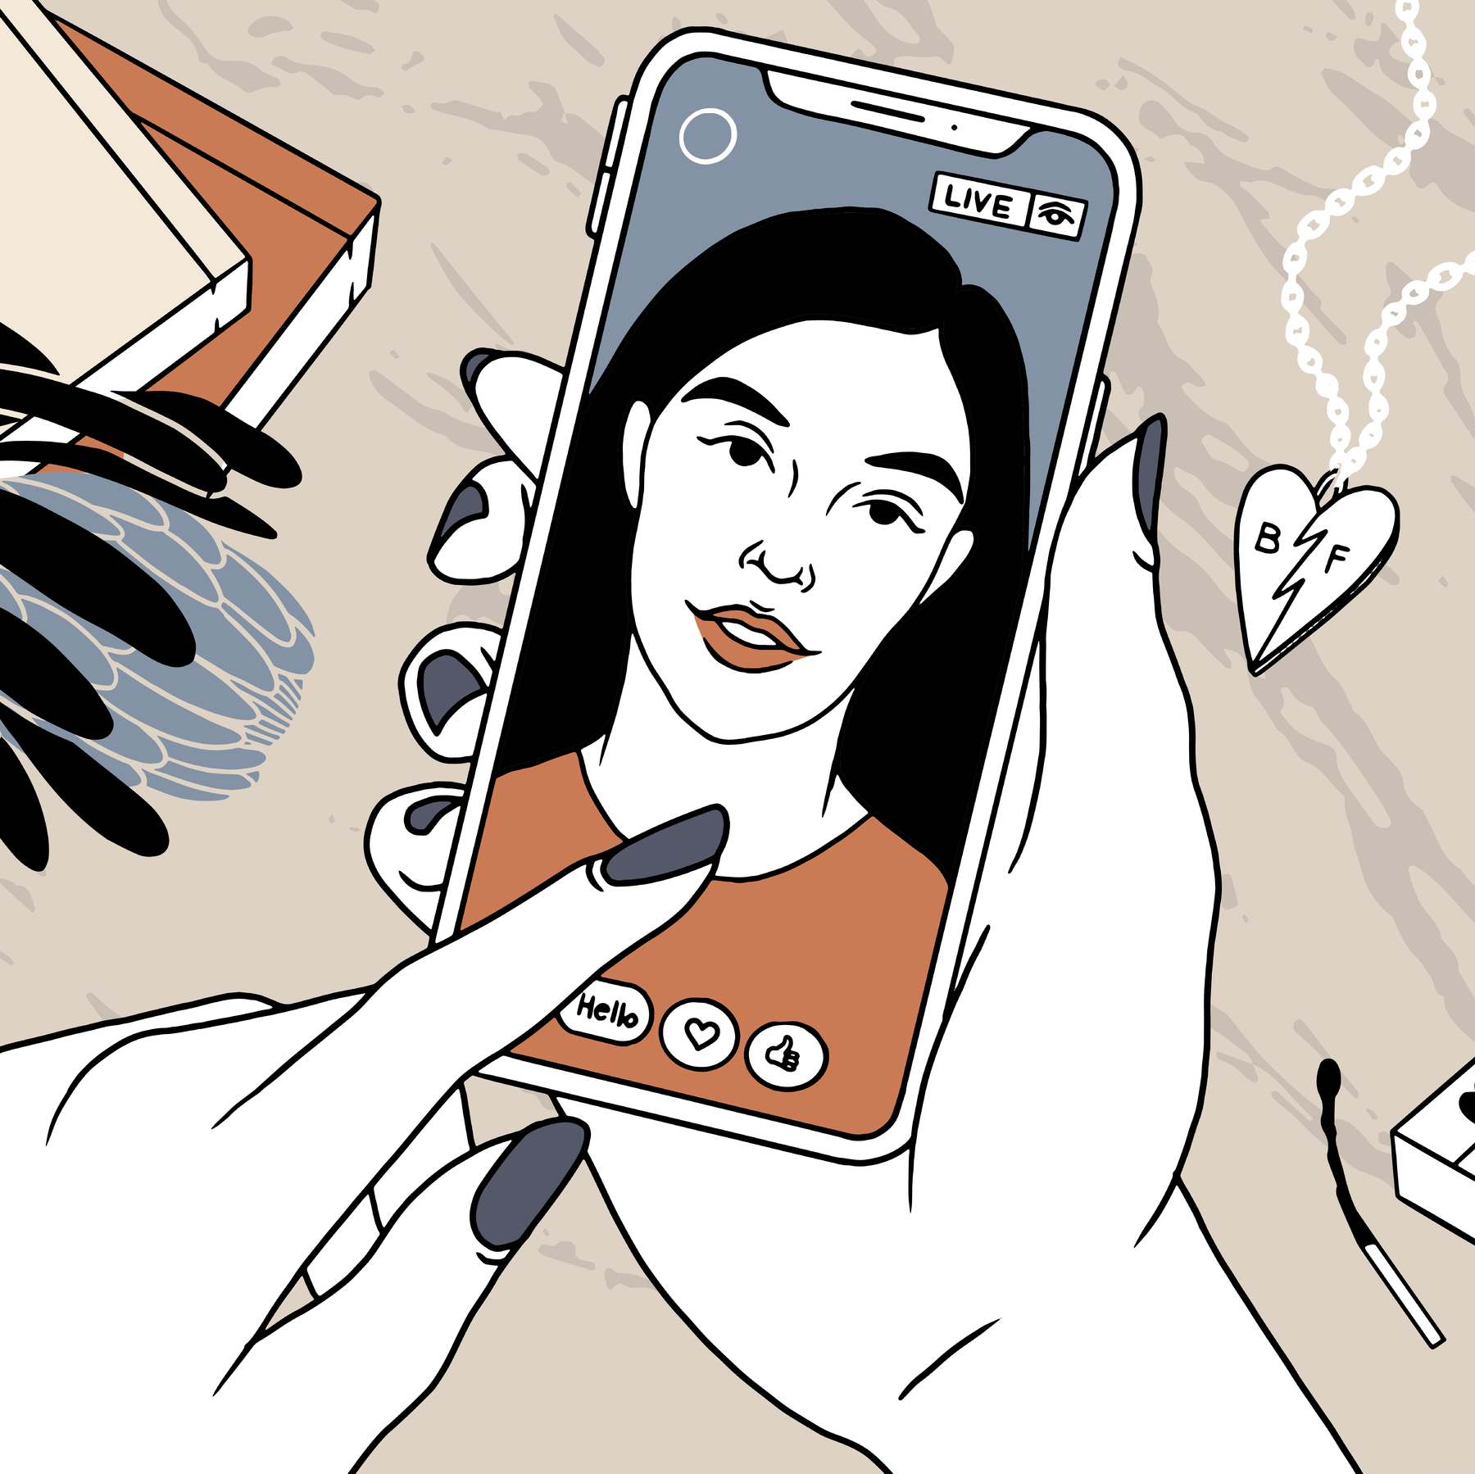
Discussion
Social cognitive theory indicates that social setting, reasoning and behavior are always in a continuous interaction
The theory is explained as the stimulus of people experiences, the activities of other individuals and the ecological conditions on people health behaviors. (Lim et al., 2020)
social interaction and parasocial interaction indicate to be following a social cognitive method in explaining people reasoning events
viewing celebrities as themselves result to increased attachment
media figure is viewed as a friend, what they do can aggravate emotional reactions from the adolescents making them suffer from undesirable feelings
PSR has implications for individuals because it cannot satisfy their emotional interpersonal abilities
Notes:
The social cognitive theory fits in the study because adolescents are in their active part of the development and thus can easily change their behaviors. Therefore, it indicates that social environment, reasoning and behavior are in continuous association. Lim et al. (2020) stated that the theory is explained as the stimulus of people experiences, the activities of other individuals and the ecological conditions on people health behaviors. Therefore, social association and PSI designates to be following a social cognitive approach in addressing individuals reasoning activities thus since teenagers perceive media figures as themselves it leads to more attachment. Celebrities are also considered as friends and this can result in aggravating emotional interpersonal capabilities. The study implies that adolescents cannot be satisfied resulting in a decrease in interpersonal capability such as growth in personal associations.

Slide 8
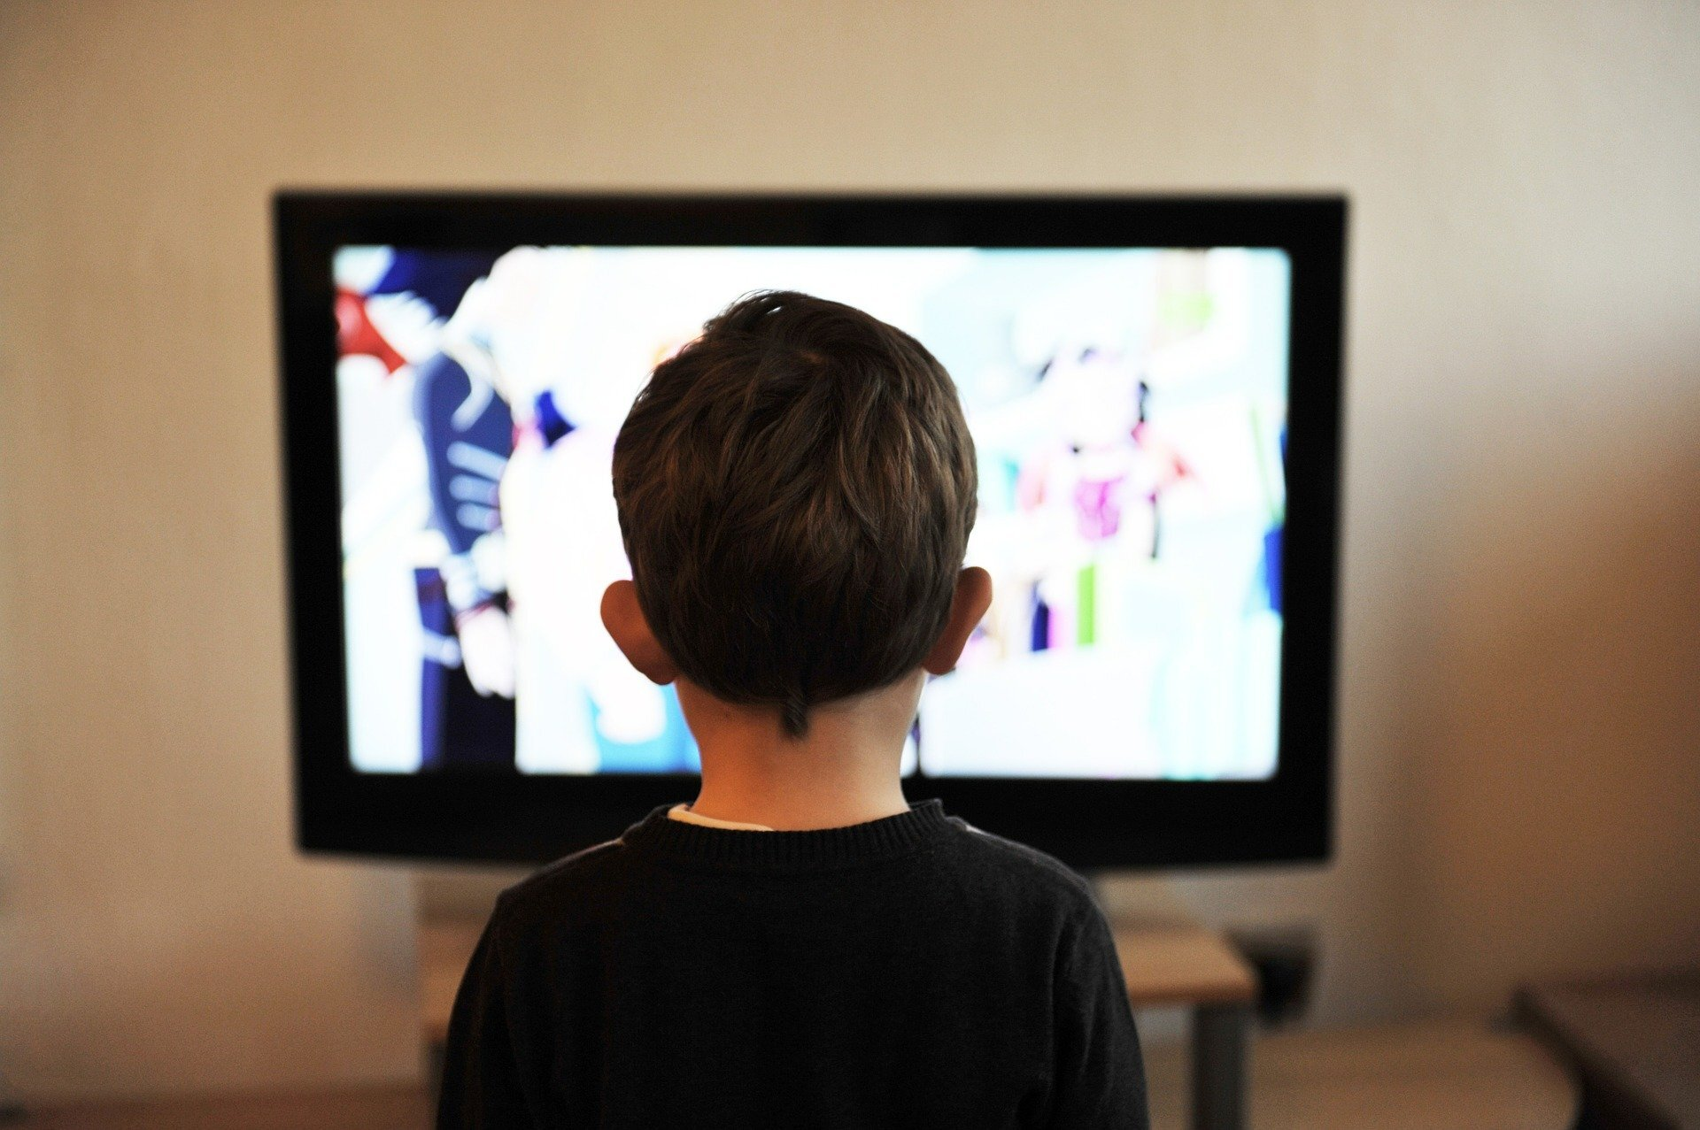
Conclusion
Emotional interpersonal abilities are affected by parasocial interaction
Although PSI results in teenagers evading in-person relations, the behaviors are regarded as a way of handling growth variations
Advancement in social media increases the occurrence of PSR as people can interact easily with celebrities
Identifying PSR can aid adolescents in understanding the effects of PSI Aand PSR
The study had limitation because only one school was used this can have geographic and environmental effects
Notes:
The study approves those emotional interpersonal abilities is affected by PSI because, despite its leading to adolescents evading in-person association, the behaviors are considered as a method of dealing with growth variations and thus not entirely harmful because of their prescriptive nature. Also, with the increased development of social networking sites, being part of the PSR is becoming easier because many individuals are connected with media celebrities. Similarly, recognizing PSR will help individuals in viewing the effects and reassess the methods they can interact with media figure. The study had a limitation of using participants from one school hence resulting in environmental and geographical effects on results.

Slide 9
References
Bond, B. J. (2016). Following your “friend”: Social media and the strength of adolescents' parasocial relationships with media personae. Cyberpsychology, Behavior, and Social Networking, 19(11), 656-660.
Bond, B. J. (2020). The development and influence of parasocial relationships with television characters: A longitudinal experimental test of prejudice reduction through parasocial contact. Communication Research, 0093650219900632. https://doi.org/10.1177/0093650219900632
Cohen, J., & Holbert, R. L. (2018). Assessing the predictive value of parasocial relationship intensity in a political context. Communication Research, 0093650218759446. https://doi.org/10.1177/0093650218759446

Slide 10
References Cont.
Cohen, E. L., Myrick, J. G., & Hoffner, C. A. (2021). The effects of celebrity silence breakers: Liking and parasocial relationship strength interact to predict the social influence of celebrities’ sexual harassment allegations. Mass Communication and Society, 24(2), 288-313. https://doi.org/10.1080/15205436.2020.1839102
Dibble, J. L., Hartmann, T., & Rosaen, S. F. (2016). Parasocial interaction and parasocial relationship: Conceptual clarification and a critical assessment of measures. Human Communication Research, 42(1), 21-44. https://doi.org/10.1111/hcre.12063
Ellithorpe, M. E., & Brookes, S. E. (2018). I didn’t see that coming: Spoilers, fan theories, and their influence on enjoyment and parasocial breakup distress during a series finale. Psychology of Popular Media Culture, 7(3), 250–263. https://doi.org/10.1037/ppm0000134

Slide 11
References Cont.
Erickson, S. E., Harrison, K., & Dal Cin, S. (2018). Toward a multi-dimensional model of adolescent romantic parasocial attachment. Communication Theory, 28(3), 376-399. https://doi.org/10.1093/ct/qtx006
Gleason, T. R., Theran, S. A., & Newberg, E. M. (2017). Parasocial interactions and relationships in early adolescence. Frontiers in Psychology, 8, 255. https://doi.org/10.3389/fpsyg.2017.00255
Hu, M. (2016). The influence of a scandal on parasocial relationship, parasocial interaction, and parasocial breakup. Psychology of Popular Media Culture, 5(3), 217. https://doi.org/10.1037/ppm0000068
Kurtin, K. S., O'Brien, N., Roy, D., & Dam, L. (2018). The development of parasocial interaction relationships on YouTube. The Journal of Social Media in Society, 7(1), 233-252. https://www.thejsms.org/index.php/TSMRI/article/viewFile/304/160

Slide 12
References Cont.
Lim, J. S., Choe, M. J., Zhang, J., & Noh, G. Y. (2020). The role of wishful identification, emotional engagement, and parasocial relationships in repeated viewing of live-streaming games: A social cognitive theory perspective. Computers in Human Behavior, 108, 106327.
Riles, J. M., & Adams, K. (2020). Me, myself, and my mediated ties: Parasocial experiences as an ego-driven process. Media Psychology, 1-22. https://doi.org/10.1080/15213269.2020.1811124
Rihl, A., & Wegener, C. (2019). YouTube celebrities and parasocial interaction: Using feedback channels in mediatized relationships. Convergence, 25(3), 554-566. https://doi.org/10.1177/1354856517736976

Slide 13
References Cont.
Stehr, P., Roessler, P., Leissner, L., & Schoenhardt, F. (2015). Parasocial Opinion Leadership Media Personalities' Influence within Parasocial Relations: Theoretical Conceptualization and Preliminary Results. International Journal of Communication (19328036), 9.
Yuan, C. L., Moon, H., Kim, K. H., & Wang, S. (2019). The influence of parasocial relationship in fashion web on customer equity. Journal of Business Research.

