Slide 1
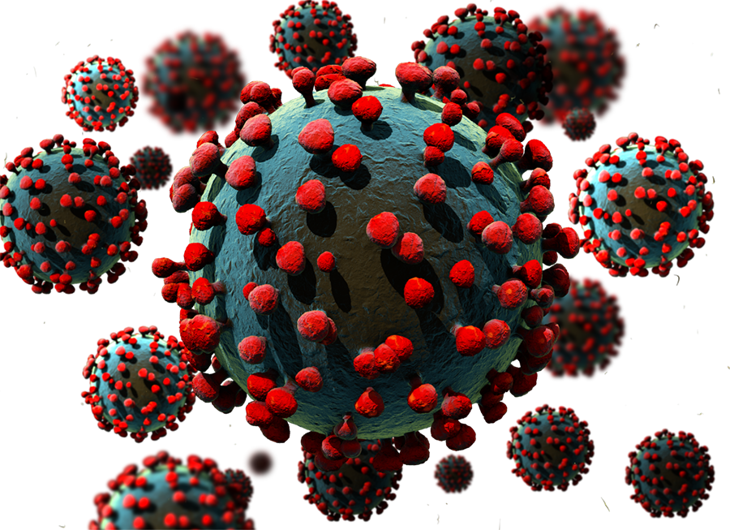
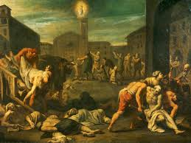
Pandemics
Name
Institution

Slide 2
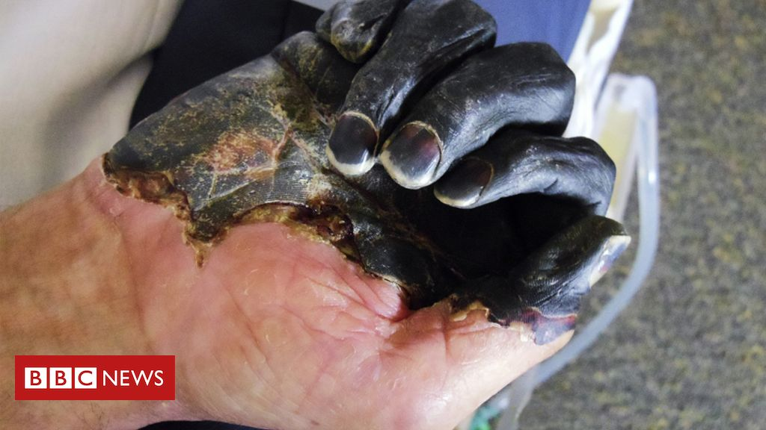
The bubonic plague
The bubonic plague was also known as the black death was caused by the yersinia pestis bacteria that lived among rodents. The plague was spread by fleas which had bitten infected animals (Echenberg, 2010).
The plague seemed to follow huge masses of people thus it quickly spread along trade routes. The limited historical records made it difficult to determine the exact human cost caused by the plague.
According to historians, the plague killed between 30 and 60% of Europe’s population between 1347 and 1351 (Echenberg, 2010).

Slide 3
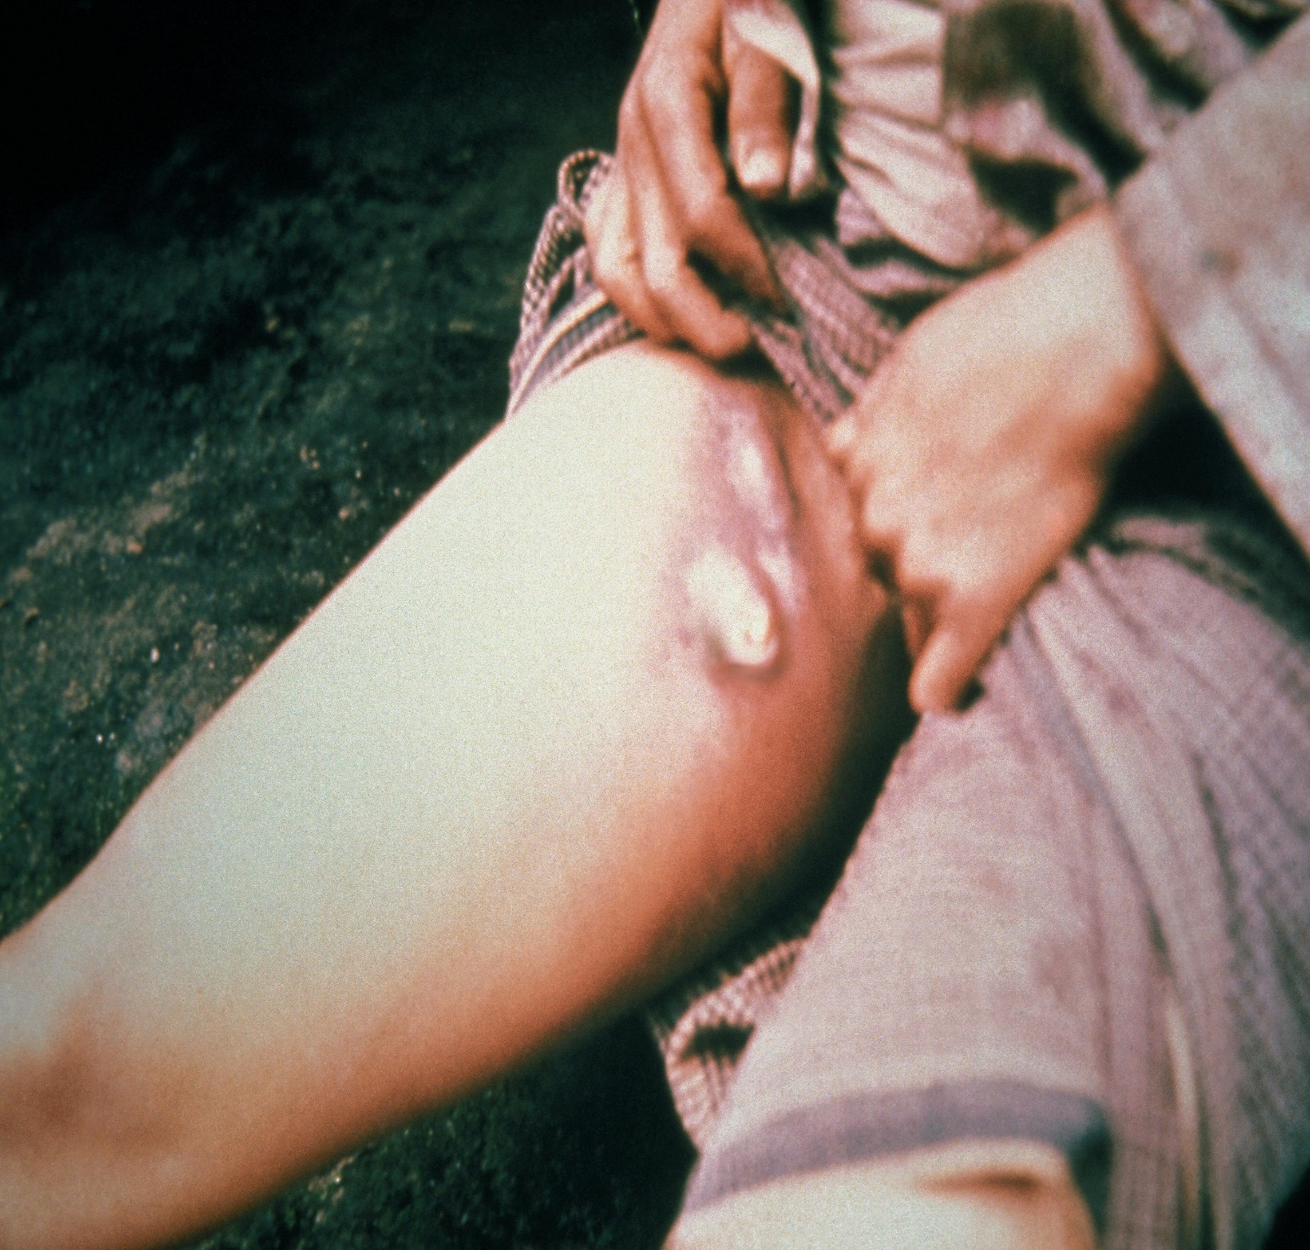
Political, economic and environmental structures causing the bubonic plague
Armies
Prisoners of war captured from the enemies camp kept in unhygienic prison cells.
Congested and unhygienic markets facilitating the growth or rats.
The sewage system beneath the city that was rat infected. Lack of pest control measures.
Social gatherings such as churches and entertainment joints.
Merchant ships that harboured infected rats due to poor hygiene.
Survivors of war seeking better life in other towns.

Slide 4
Corona virus pandemic (COVID-19)
SARS-CoV-2 (Corona virus 2019), is a new strain of virus found in the corona virus family and commonly referred to as COVID-19. the virus is one of several that cause the conditions like middle east respiratory syndrome (MERS) (Ciotti et al., 2019).
The virus triggers a respiratory tract infection that affects the sinuses, nose, throat, windpipe or the lungs. Symptoms of the virus includes fever, coughing, sore throat, nausea, loss of smell among others (Ciotti et al., 2019).
The COVID-19 pandemic was first identified in Wuhan, China from where it spread to different parts of the world.

Slide 5
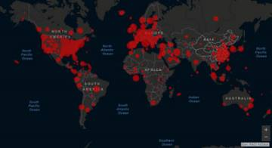
Political, economic and environmental structures causing Corona virus pandemic
Poor international coordination between countries making it difficult for joint efforts to stop the pandemic.
The China USA trade war and their allies.
Congestion in social places such churches, markets, clubs, restaurants and learning institutions
Porous borders between countries which allowed the movement of infected people.
Globalization allowing movement of people to different countries
Late action by governments to increase public awareness and institute social distancing measures.
Cold climate giving the virus a longer lifespan outside a host.

Slide 6
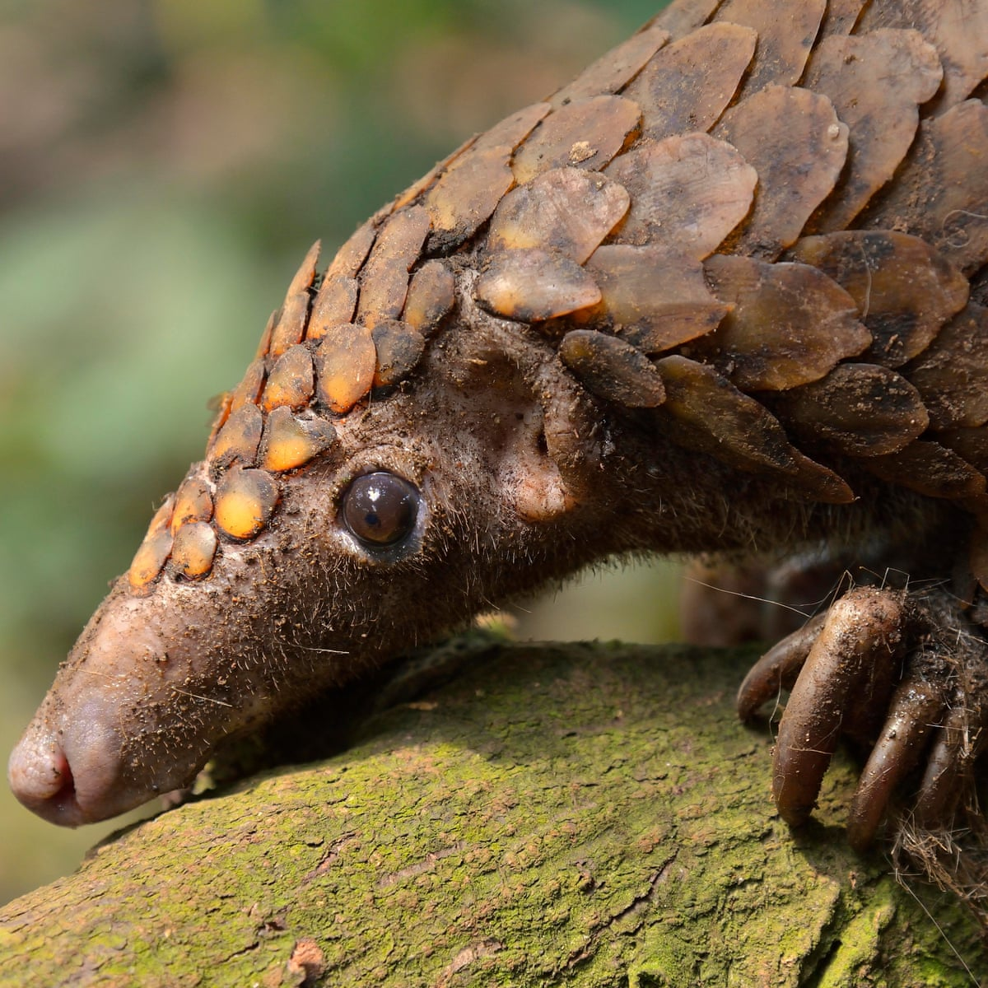
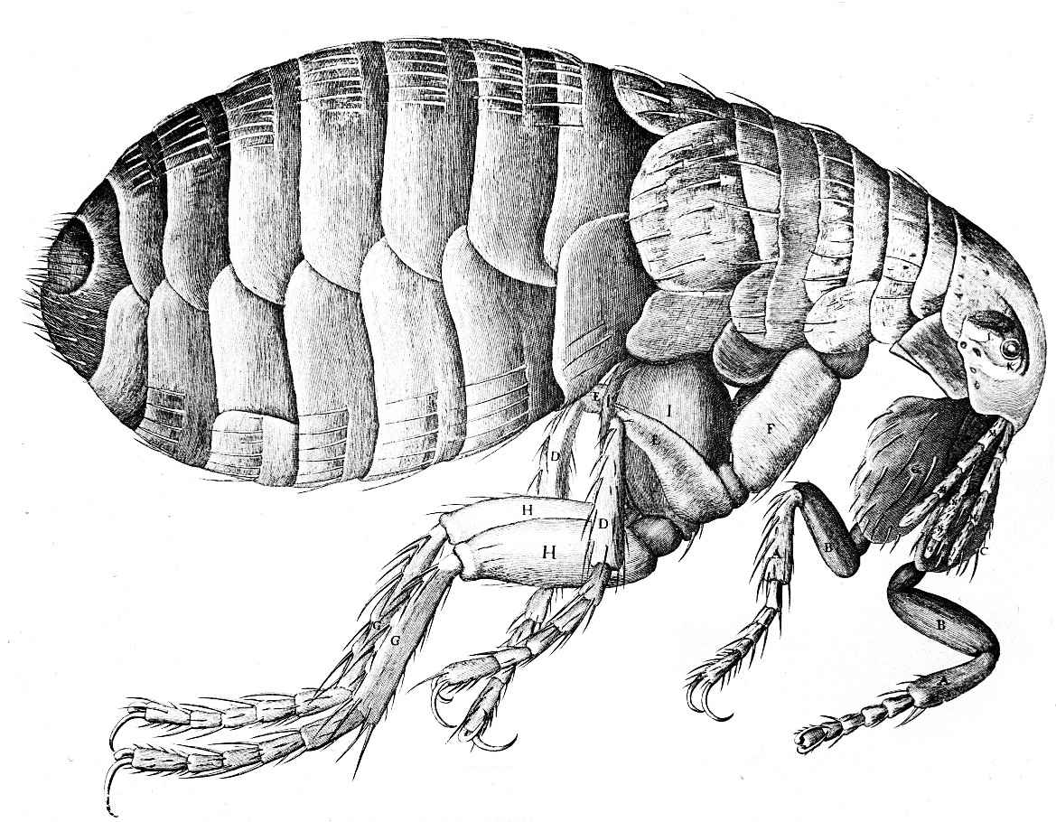
Sources of pandemic
Most pandemic are created when a pathogen such as a bacteria or a virus living within an animal is spread to an human being from where it spreads rapidly to other humans leaving mass death in its wake such as COVID-19 and influenza (Dennis & Staples, 2009).
The bubonic plague emerged from rodents such as rats and squirrels. Rodents were living with the yersinia pestis bacteria which caused the bubonic plague once it infected humans. Fleas bit infected animals and acquired the bacteria and once they spread to humans, they transmitted the bacteria causing infection (Echenberg, 2010).

Slide 7

Sustainability of our capitalist way
The current capitalist way of life is not biologically sustainable. In the capitalist way of life, everyone is out to cater for their self interests without considering those of others. As such, earth is continuously losing biodiversity to create room for personal businesses (Dennis & Staples, 2009).
The human and animal contact is significantly increasing which is increasing the rate of spreading viruses and bacteria between animals and humans and this is further increasing the chances of a pandemic outbreak. Therefore, the capitalist way of life is not sustainable (Echenberg, 2010).

Slide 8
Conclusion
Pandemic are diseases that infect a huge portion of the global population and are caused when bacteria and viruses living in animals are transmitted to humans. Humans and animals interactions should be minimized as much as possible as a way of reducing the possibility of a pandemic (Gough, 2017).
The capitalist system seeks to promote self interest at the expense of others which is significantly dangerous. Capitalism can be used to spread a pandemic with the sole aim of benefiting from selling of the vaccine or treatment medication.

Slide 9
Reference
Echenberg, M. (2010). Plague ports: the global urban impact of bubonic plague, 1894-1901. NYU Press.
Ciotti, M., Angeletti, S., Minieri, M., Giovannetti, M., Benvenuto, D., Pascarella, S., ... & Ciccozzi, M. (2019). COVID-19 outbreak: an overview. Chemotherapy, 64(5-6), 215-223.
Dennis, D. T., & Staples, J. E. (2009). Plague. In Bacterial Infections of Humans (pp. 597-611). Springer, Boston, MA.
Gough, I. (2017). Heat, greed and human need: Climate change, capitalism and sustainable wellbeing. Edward Elgar Publishing.

