Slide 1
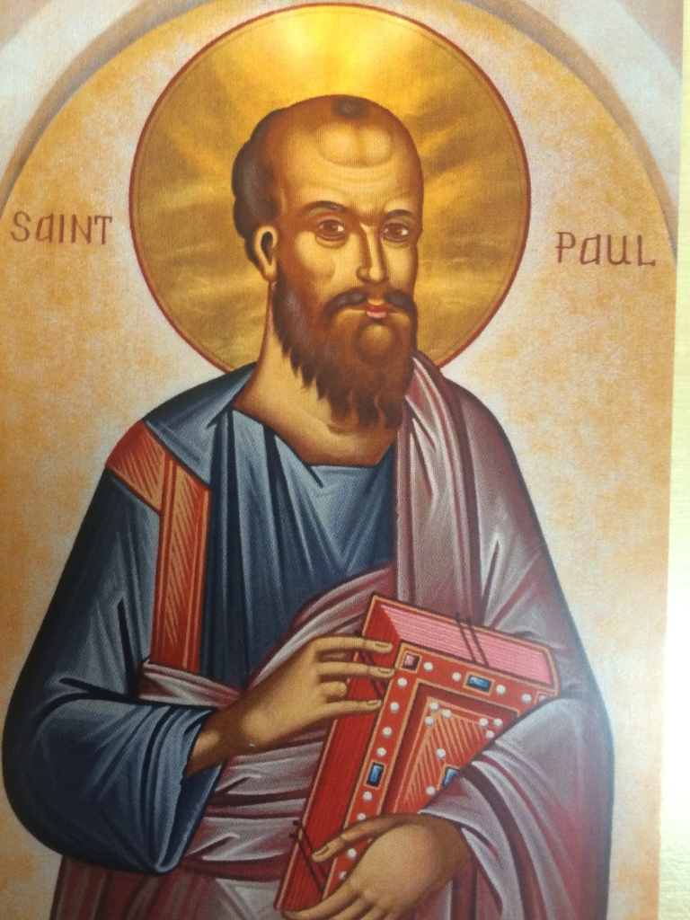
Paul
Week 9 Day 3
Rev. Bruce Gowe, OSL
Sources from: Mark Powell and Raymond E. Brown

Slide 2
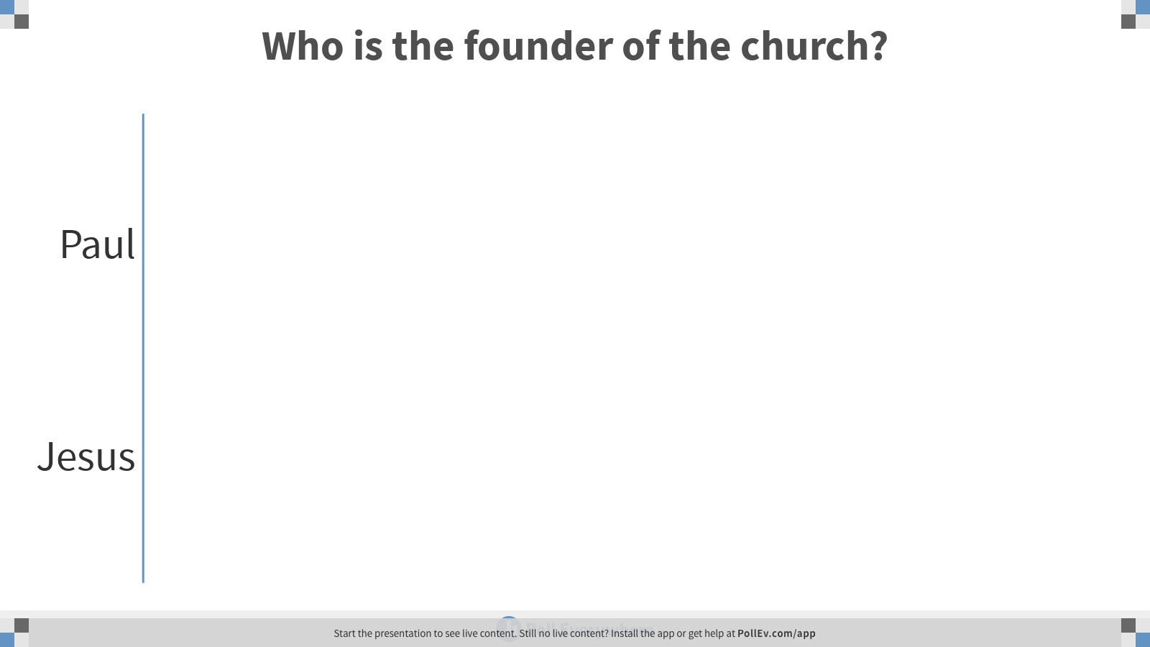
Notes:
Poll Title: Who is the founder of the church?
https://www.polleverywhere.com/multiple_choice_polls/5TY04TDQMWOoy23MlqeMA

Slide 3
Who is Paul?
Notes:
First it is true that a majority of the N.T. letters are likely authored by Paul. And it is true that Paul travelled a lot spread in the Gospel. But he is not the solo founder of the Jesus movement the church.
There were other disciples and apostles who were working hard to advance the news of Jesus and organizing the faithful.
Paul however is recognized as the primary Apostle (although not one of the 12 ) who is reaching to the gentiles.
Paul is writing early in the Christian communities that are still loosely in relations with the Jewish faith.

Slide 4
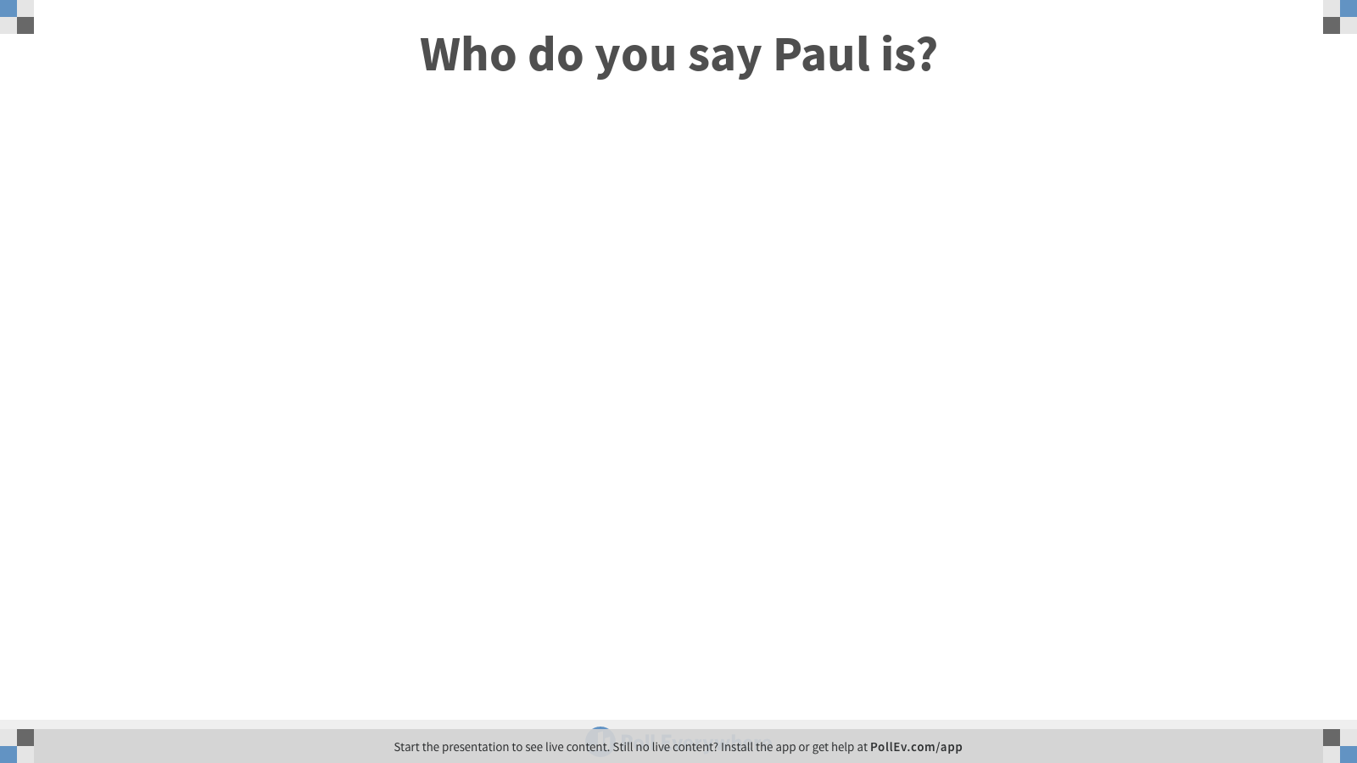
Notes:
Poll Title: Who do you say Paul is?
https://www.polleverywhere.com/free_text_polls/XeRMxJ6iI5ZvJRowW2alL

Slide 5
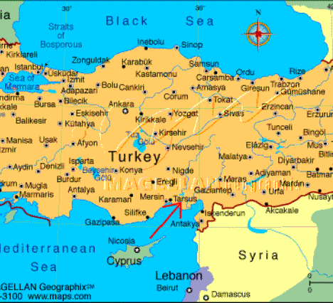
The Life of Paul
Birth and Upbringing
  Born in 5-10 CE
  His Name
  Place of Birth
  Citizenship
  Education
  Trade
Notes:
Paul was probably born around 5-10 CE during the reign of Emperor Augustus.
Evidence for this date: In Acts 7:58 Paul is described as a being a young man at the stoning of Stephen accorded first martyr
and in Philemon 9 (written in 55 CE) as an old man
Paul or Saul
Jews in this time especially in the diaspora (outside Palestine) often had two names, one Greek or roman and the other Semitic.
Paulus was a well-known Roman family name
And in Roman 11:1, Philippians 3:5 the apostle describes himself as of the tribe of Benjamin and his Jewish name is Saul after the first king of Israel, a Benjaminite
Place of birth- Unknown
Citizenship- Citizen of Tarsus the capital of Cilicia
citizenship may have come from his family rather than through the status of Jews in Tarsus
Many scholars hold that Paul was most likely raised and educated here in Tarsus.
Evidence:
He wrote good Greek, had basic Hellenistic rhetorical skills, quoted from scriptures in Greek and knew deuterocanonical books in Greek
Trade:
Tentmaker Acts 18:3
supporting himself – which would be important aspects of his mission trip that folks never paid him for his work in the Gospel which frees him from demands

Slide 6
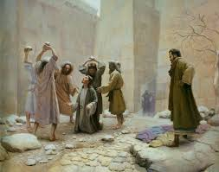
Life Before Christ
Notes:
According to Galatians: 1:13, 1 Corinthians 15;9, Philippians: 3:6 Paul persecuted the church of God and tried to destroy it.
Why?
E.P. Sanders and according to Phil. 3: 5-6 according to the law a pharisee, according to zeal a persecutor of the church, according to righteousness based on the law blameless
Paul saw followers of the way proclaiming a message contrary to their message, and these Jews now still claiming that this condemned man as the God chosen messiah

Slide 7
Did Paul Know Jesus?
Yes and No!
Notes:
The letters do not suggest that Paul knew Jesus during his public ministry and death.
However he also describes himself a Pharisees and a Hebrew. According to Paul and in some of his letters he had great zeal for the traditions, the Law. It was not common for pharisees to be outside of Jerusalem and so with all this evidence it is likely that Paul in his early 20’s prior to Stephen’s death may have come to Jerusalem to study law. At least according to tradition.
But Paul became “a servant/slave of Christ Jesus in a life changing event.
Read Acts 9: 1-22 – Saul’s conversion
Paul knows to Risen Christ

Slide 8
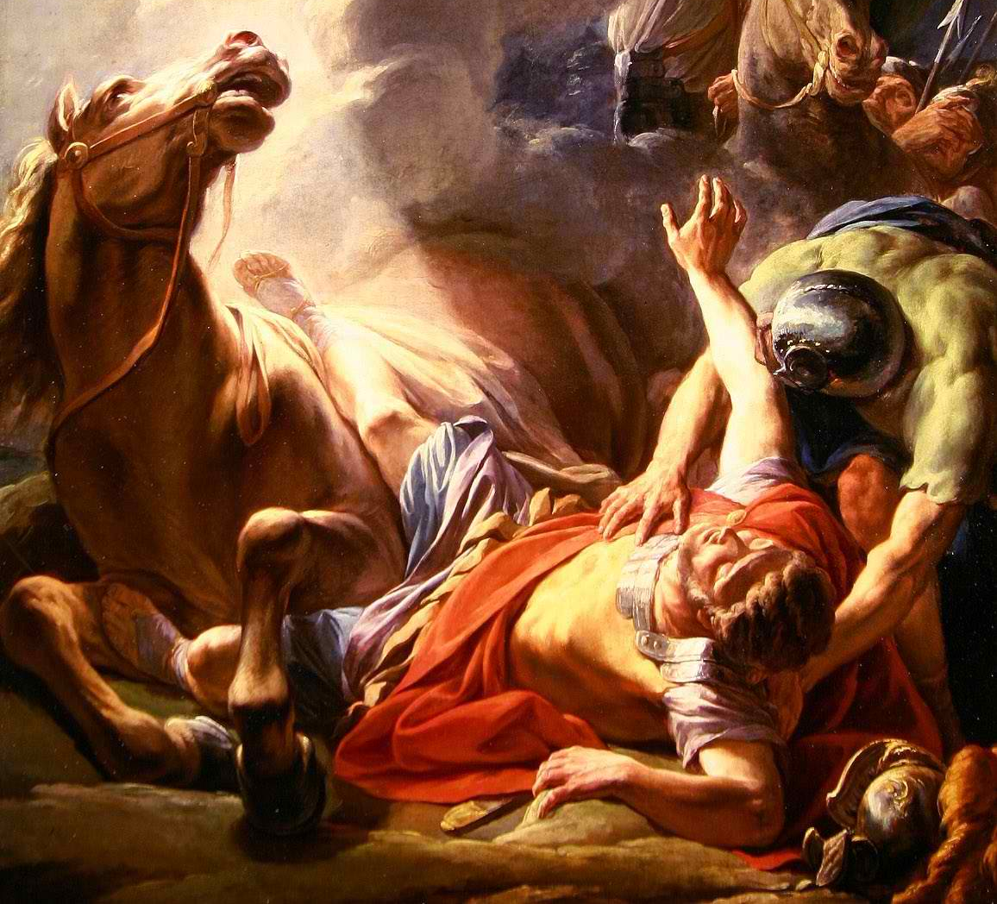
Paul’s life Changes forever
Notes:
Christian’s call this event a Conversion experience
However scholars stay away from that term as it implies a change of religion and it better to use Jewish Christian or Christian Jew
Some say he was given a prophetic call or a moment of enlightenment
Anyway what God has done is taken his misguided zeal and gave him a new purpose of his life. One that would not be easy.
Let's look back, Paul prior to Jesus had a trade for income if needed, but also was a Pharisee, a student of the Law and looks like even the mighty hand of the Sanhedrin to persecutor the church.
Now Paul at first was blinded for three days need healing, then he begins a ministry of hard work using his trade. And traveling foot and boat all over, not safe, no flowing income, sometime almost killed, imprisoned, and so.
Why?
The same reason many who are called to the vocation the gospel. Because for Paul a person becomes a servant freed in Christ Jesus to live in the spirit.

Slide 9
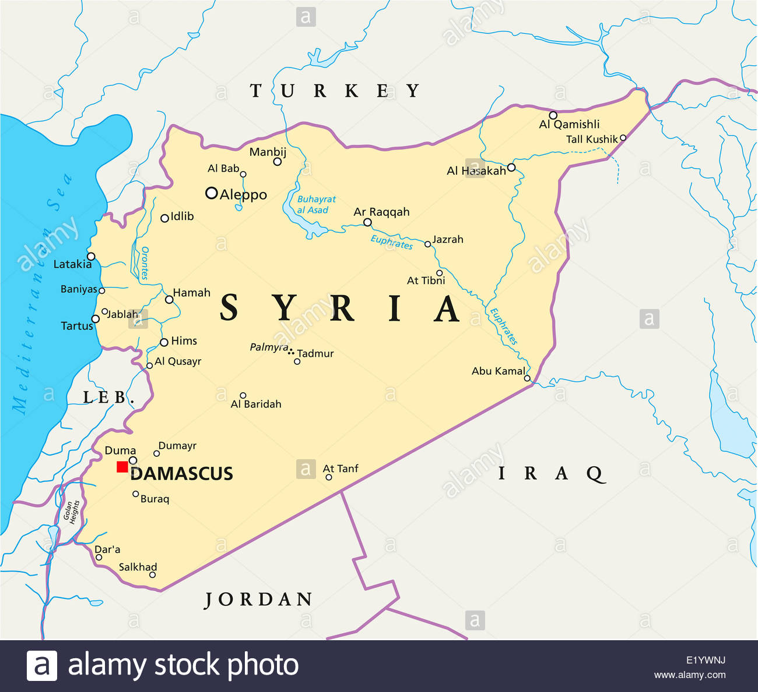
In Between years
Notes:
After his experience he doesn’t go right in to work
For at least three he goes to Arabia in Damascus and southern Syria
There it is thought that he is taking time to learn the faith more
He then return for a brief time to Jerusalem where he has zeal now to learn the tradition from Peter and James the brother of Jesus, leaders of the church in Jerusalem
Yet in these formation years he developed a passion to reach the gentiles Powell mentions that this is what would bring him back to Jerusalem 14 years later over the extent of the Gospel.
What gentiles should or should not observe of the Law when they are in Christ.

Slide 10
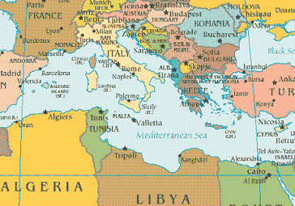
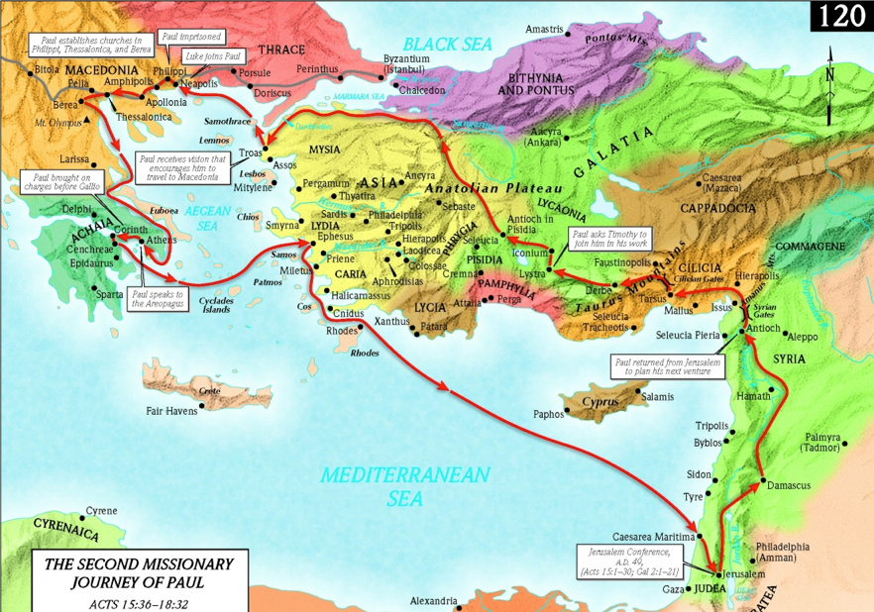
Paul’s World Then and Now

Slide 11

Notes:
LiveSlide
https://www.youtube.com/watch?v=XSmt0WzBcQ0

Slide 12
Although Paul continued to regard himself as a loyal Jew and Pharisee after his encounter with the risen Christ, he does seem to have changed his thinking about some matters.
Jesus
new age
The cross
Paul’s “Conversion”: A Change of Heart and Mind
Notes:
Paul’s “Conversion”: A Change of Heart and Mind (Box 12.2)
Although Paul continued to regard himself as a loyal Jew and Pharisee after his encounter with the risen Christ, he does seem to have changed his thinking about some matters. He may regard himself still a Jew and a student of the Law, yet his encounter of Jesus sets a fire in his heart to spread the gospel the good news of this new enlightenment
Jesus. Paul had considered Jesus to be a false messiah; after his encounter he viewed Jesus as the true Messiah and, indeed, the Son of God (2 Cor. 1:19; Gal. 2:20).
The last days. Paul had believed that God’s Messiah would put an end to the old age of evil and initiate a new age of righteousness; after, he decided that this would occur in stages: the new age (ripe with possibility) had begun with the resurrection of Jesus, but the old age (with all its attendant problems) would continue until Jesus returned (Rom. 16:25; 1 Cor. 10:11; Gal. 1:4).
The cross. Paul had considered death by crucifixion to be a shameful sign that one was cursed by God (Gal. 3:13); after, he understood the crucifixion of Jesus as a voluntary sacrifice that reconciled sinners with God (Rom. 5:6–10; Phil. 2:8).

Slide 13
Paul’s continues to Change his mind
Notes:
The law.
Paul had believed that the law (Jewish Torah) kept people in a right standing with God (Gal. 2:16; 3:12); after, he decided that the law only revealed the extent of people’s enslavement to the power of sin—a power that must be broken by Christ (Rom. 3:20b; 7:7–12).
Gentiles.
Paul had believed that gentiles were outside the covenant that God had made with Israel; after, he believed that gentiles and Jews were united as the people of God in Christ Jesus (Gal. 3:28).
Circumcision.
Paul had believed that circumcision was the rite through which people became part of Israel, an exclusive community of God’s chosen people (Phil. 3:3–5); after, he believed that baptism was the rite through which people became part of the church, an inclusive community of Jews and gentiles put right with God through faith (Rom. 6:4).
Persecution. Paul had considered his violent persecution of the church to be an indication of zeal for his religion (Phil. 3:6); after, he viewed Jewish hostility toward the church as sinful opposition that would incur God’s wrath (1 Thess. 2:14–16).

Slide 14

Who is Paul?

Slide 15

Notes:
Poll Title: Recap: Who is Paul?
https://www.polleverywhere.com/free_text_polls/W1vgegmkm41OEM7LkS1fp

